Slide 1
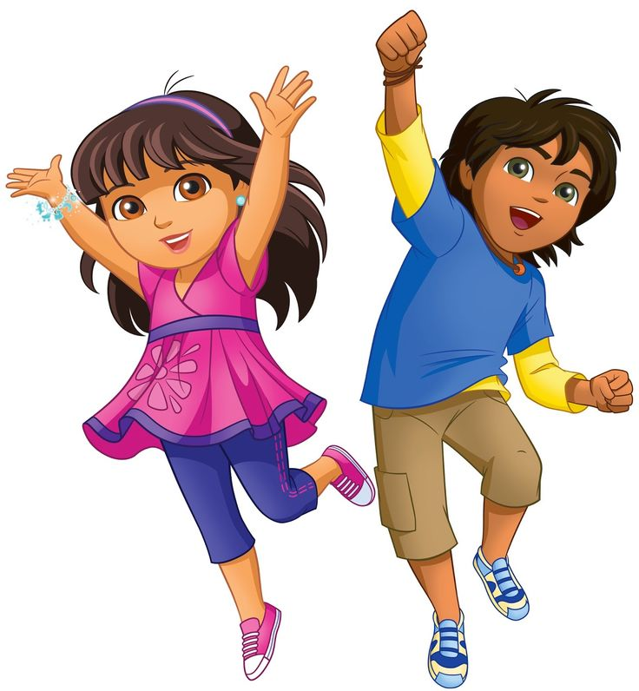
Health is wealth

Slide 2
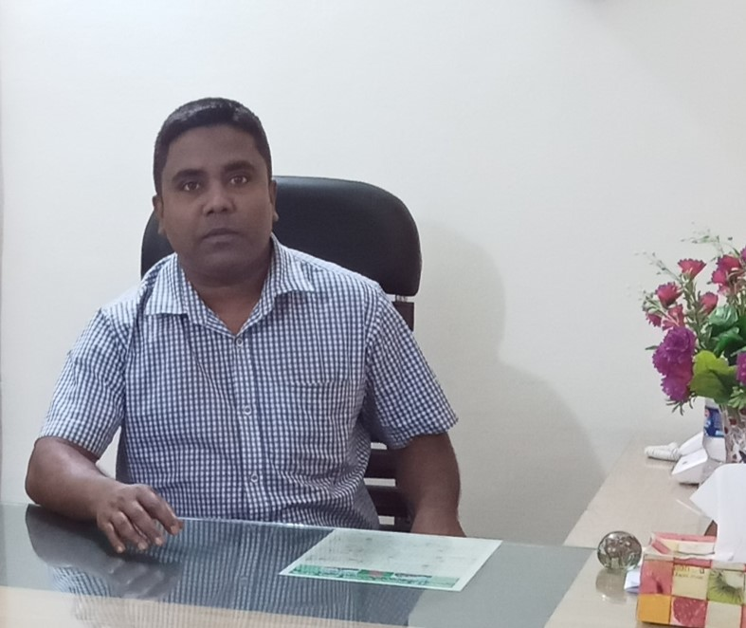
Health is wealth
Sub: English
Class: Two
Lesson : Numbers-14,15,16
Parts of the lesson: Activity-C
Page No-20
Md. Mushfikur Rahman
ASISSTANT TEACHER
PARGOBINDOPUR GOVT. PRIMARY SCHOOL
BIRAMPUR,DINAJPUR.

Slide 3
Safety environment by greetings song.
Health
is
wealth
WE SHALL OVERCOME
WE SHALL OVERCOME
WE SHALL OVERCOME, SOME DAYS.
OH, DEEP IN MY HEART
I DO BELIVE THAT
WE SHALL OVERCOME, SOME DAYS.

Slide 4
Our today’s lesson is too-
Activity-C
Numbers-14,15,16

Slide 5
LEARNING OUTCOMES
By end of the lesson students will be able to-------
Listening: 1.1.1 become familiar with English sounds by listening to
common English words
Speaking: 1.1.1 repeat after the teacher simple words and phrases with
proper sounds and stress.
1.1.2 say simple words and phrases with proper sounds and stress.
Reading: 2.1.1 recognize and read cardinal numbers up to 30.

Slide 6
How many X are there?
How many circles are there?
X
X
X
How many A are there?
How many circles are there?
A
A
A
A
A
A

Slide 7
How many circles are there?
How many circles in the box?
Now we will practice on the board.

Slide 8
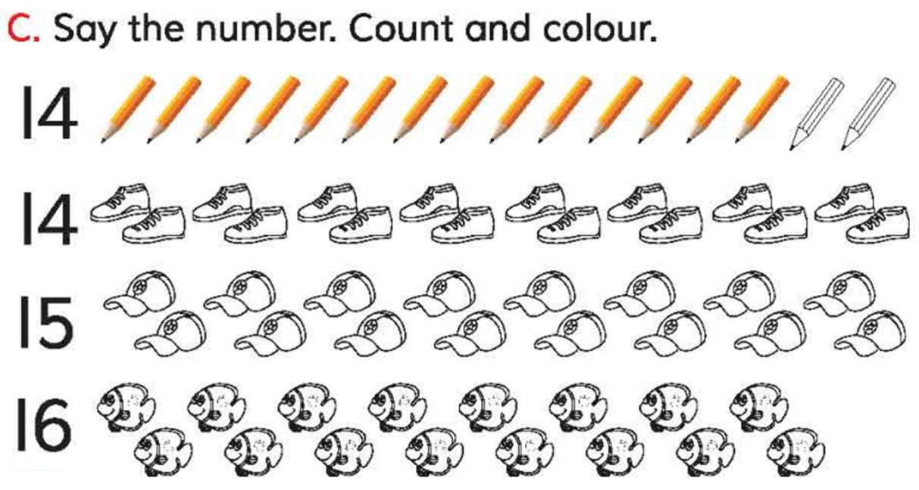

Slide 9
Read and say.
18
12
16
6
2
4
9
17
22
15
21
7
14
5
8
11
20
3
13
1
10
19

Slide 10
One day one word
Do you understand the picture?
fat
মোটা

Slide 11
Say the missing letter.
fa-
f-t
-at
Write the word to your notebook.
Date-
/ /20
fat
ফ্যাট
মোটা

Slide 12
Home work
Page 2 will be well read and written.

Slide 13
That’s all for today. Goodbye. See you tomorrow.

