Slide 1
Notes:
This is just a welcome slide.

Slide 2
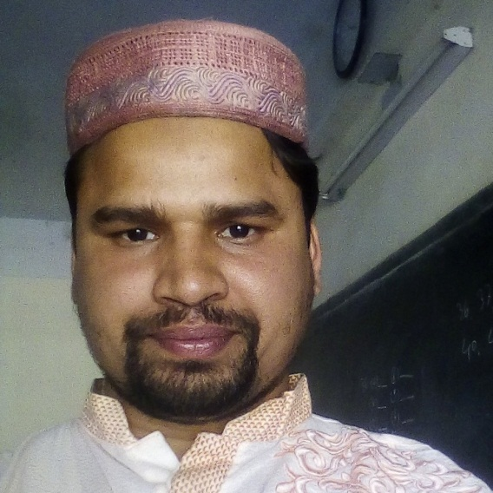
Introduction
Teacher
Class & Subject
Md. Farid Uddin
Assistant Teacher
Dupchanchia D.S Fazil Madrasah
Dupchanchia, Bogura.
English 2nd paper
Class IX & X
Notes:
Identity of the teacher & class as well as subject

Slide 3
What kind of change have you followed?
It is a very amazing ride.
It is a ride which is very amazing.
Simple to Complex
Notes:
Advance to lesson declaration.

Slide 4
Our today’s lesson is-
Simple to Complex
(Transformation)
Notes:
Lesson declaration.

Slide 5
Learning outcomes
At the end of the lesson, the students will be able to—
define a simple sentence
define a complex sentence
transfer from simple to complex

Slide 6
It is a very wonderful sight.
Only one subject
It
Only one verb
is
The sentence that bears only one subject and only one
finite verb with a complete sense is a simple sentence.
Notes:
Identity and definition of a simple sentence

Slide 7
It is a sight which is very wonderful.
Principal clause
Sub-ordinate clause
It & which
Two subjects
is & is
Two verbs
The sentence that bears two or more than two subjects and verbs and
added with a relative or sub - ordinating word is a complex sentence.
Notes:
Identity and definition of a complex sentence

Slide 8
Follow
Principal clause
+
Sub-ordinate clause
স্বাধীন বাক্যাংশ
নির্ভরশীল বাক্যাংশ
Complex Sentence
Notes:
Introducing two parts of a complex sentence.

Slide 9
We may convert simple sentences into complex with the
words below according to the sequence of the sentences.
‘Wh’/relative
words
Who, whom, whose, which, that, what,
where, when, while, why, how,
Though, Although, Since, As, If, so,
so that, not only–-- but also, because, etc
are normally used to mention condition.
Sub - ordinating
words

Slide 10
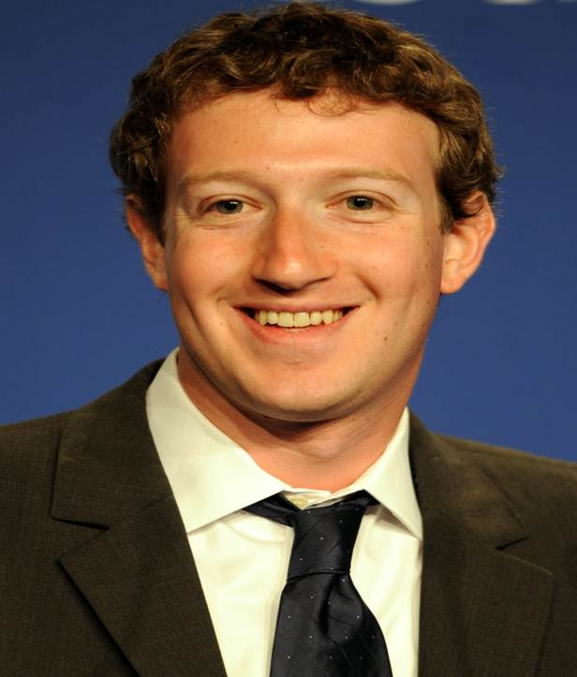
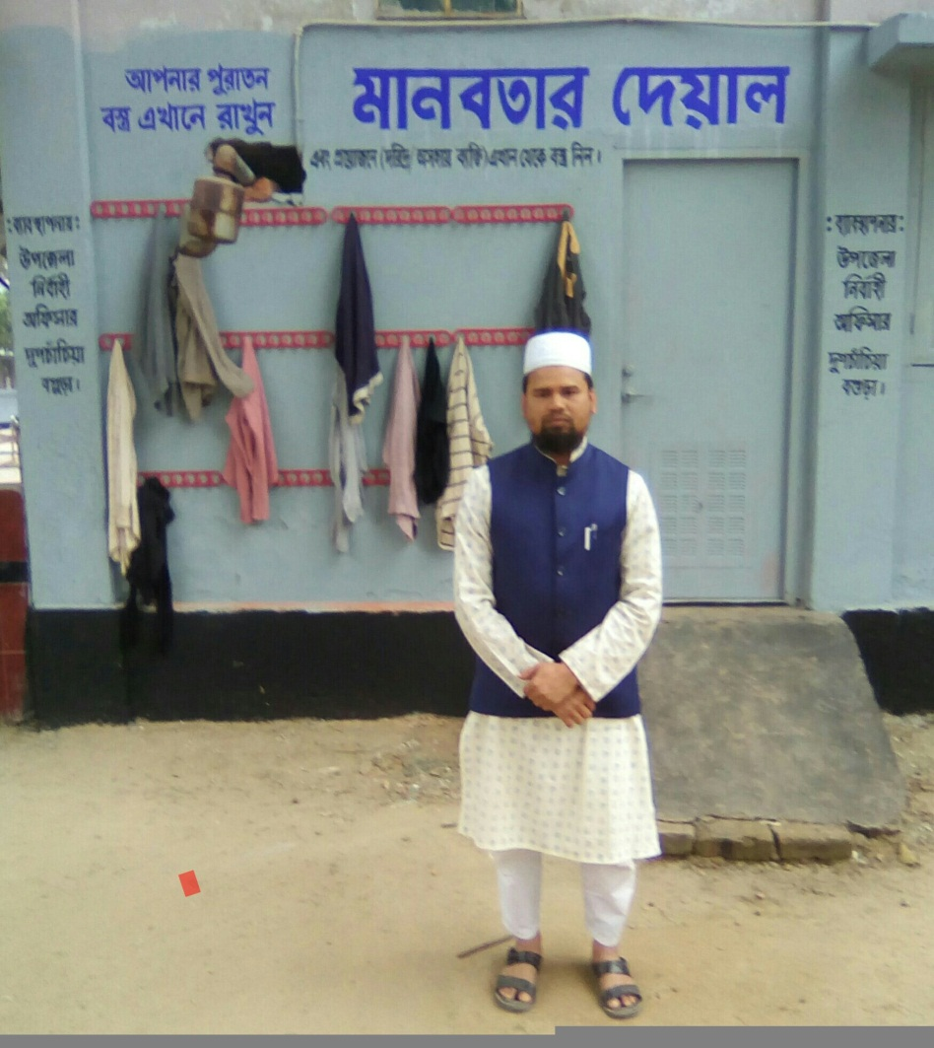
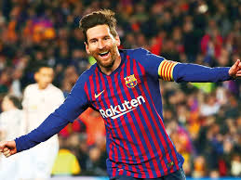
Who, whom, whose are used to mean person/persons
Notes:
How is to convert to mean person.

Slide 11
Simple to complex with Who(1)
We may transform a simple sentence into
complex with ‘who’ in different ways
My mother is a teacher (Complex)
My mother is she who is a teacher.
She is my mother who is a teacher.
The woman who is my mother is a teacher.
She who is my mother is a teacher.
It is my mother who is a teacher .
Notes:
Subject teacher is requested to explain different way to convert a simple sentence into a complex sentence as above.

Slide 12
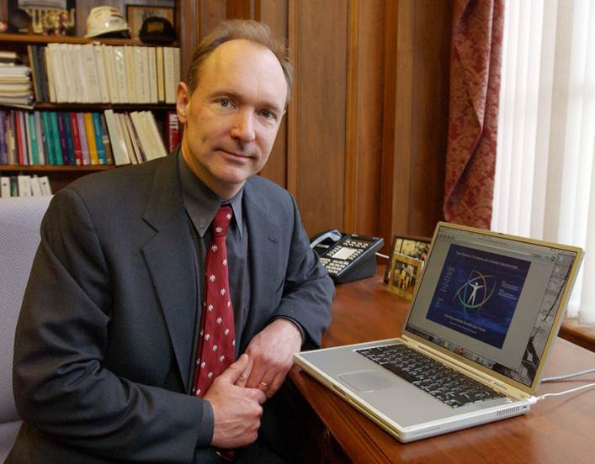
Simple to complex with Who(2)
We may transform a simple sentence into complex
with ‘who’ if there is a sentence with adjective + noun
I work with an educated person (Complex)
Adjective +Noun
Portion before adjective+portion after adjective+who+verb+adjective
I work with a person who is educated.
Notes:
Explanation if there is noun + adjective together.

Slide 13
Simple to complex with Who(3)
Adjective +Noun
A brilliant scholar is respected by all. (Complex)
A/The scholar who is brilliant is respected by all.
Notes:
Explanation if there is noun + adjective together.

Slide 14
Activities
Change the following simple sentences
into complex with ‘who’.
(a) He is a good student.
(b) He is always attentive to his studies.
(c) He is punctual also.
(d) He respects his teachers very much.
(e) He will shine in life.
Notes:
Class work.

Slide 15
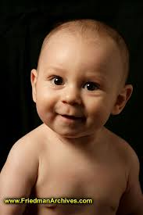
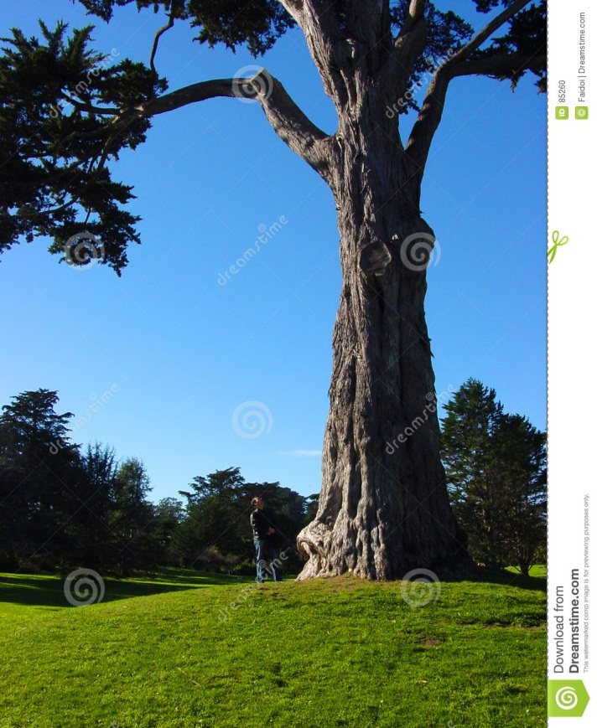
Which, that, what are normally used to mean objects, animals, babies etc.

Slide 16
Simple to complex with which/that
I like the book most (Complex)
This is the book which I like most .
This is the best book to me (Complex).
The book which is the best to me is this.
The book represents Islam at a glance (Complex) .
It is the book that represents Islam at a glance.

Slide 17
Simple to complex with ‘what/that’
I know your choice (Complex).
I know what you choice.
I lost my pen yesterday (Complex).
The pen that I lost yesterday was mine .
You told me an educative story last night. (Complex)
The story what you told me last night was educative.
Notes:
Teacher will discuss it elaborately.

Slide 18
Activities
Change the following simple sentences
into complex with ‘which/that/what’.
(a) I know him well.
(b) I gave him a beautiful gift.
(c) Your speech is doubtful.
(d) The pen writes well.
(e) You may express your desire.
Notes:
Class work.

Slide 19
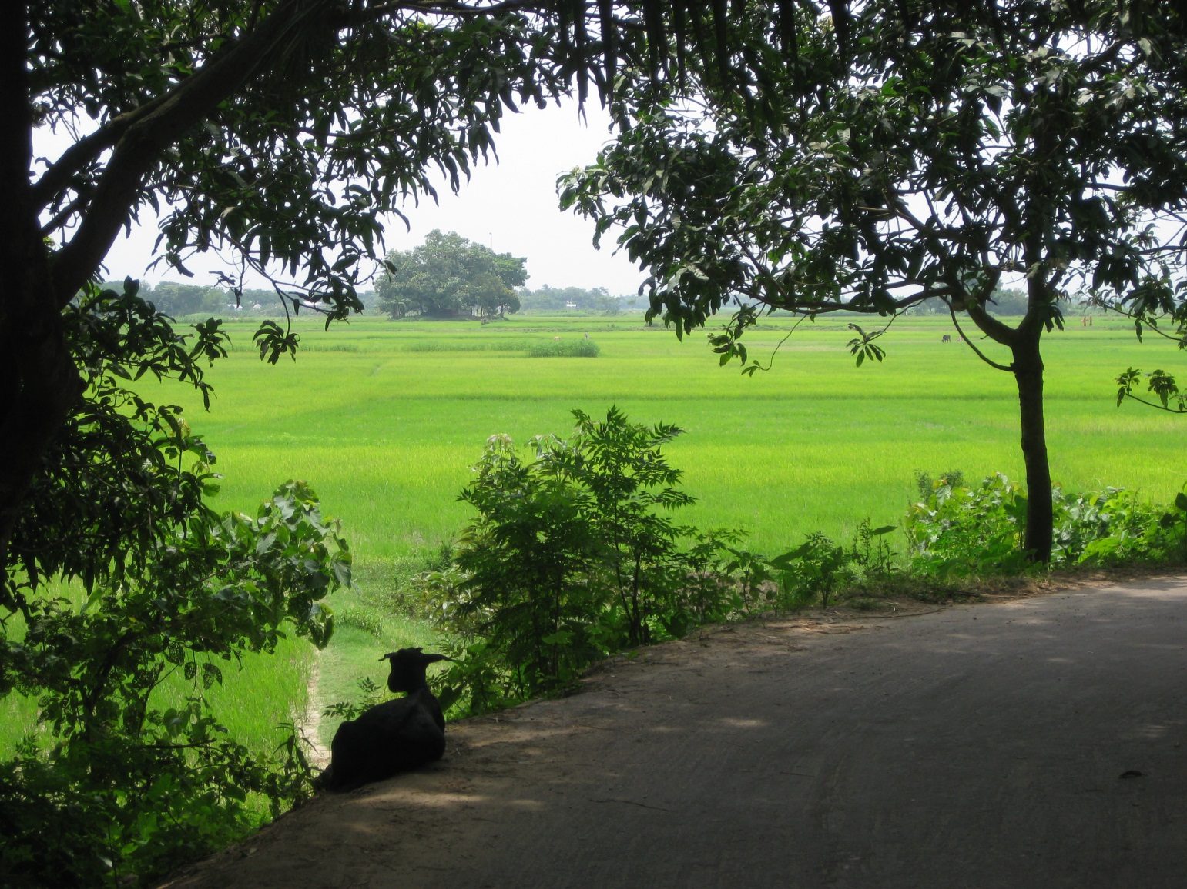
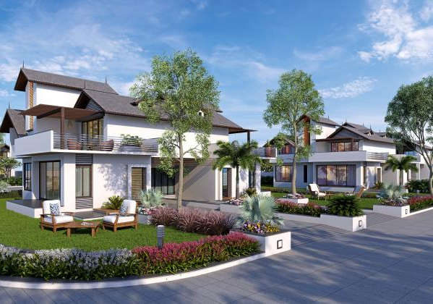
‘Where’ is used to mention a place like
village, town, Dhaka, London, school etc.
Notes:
Use of ‘where’ shown here.

Slide 20
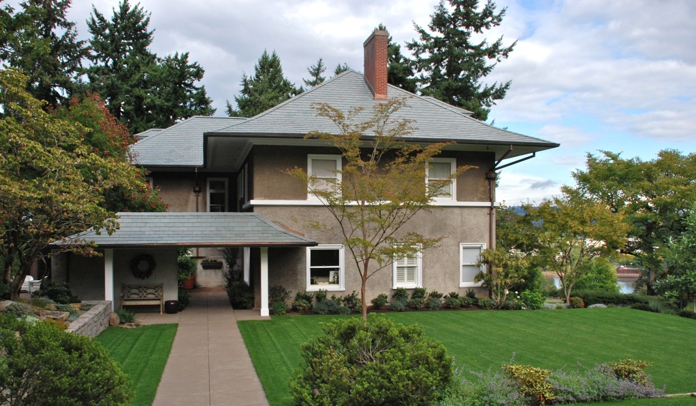
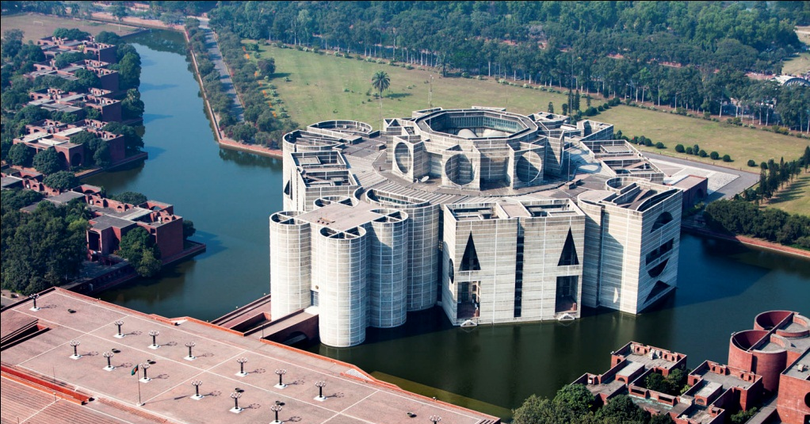
Simple to complex with ‘where’
I know his residence(Complex).
I know where his residence is.
He lives in Dhaka(Complex).
Dhaka is the place where he lives in.
Birds fly in the sky(Complex)
Sky is the place where birds fly.
Notes:
How sentences change with where.

Slide 21
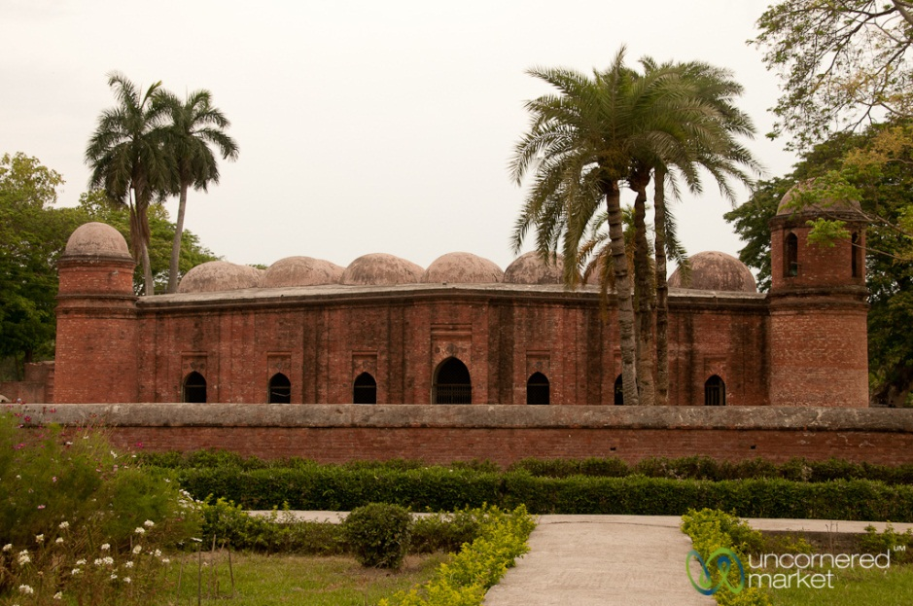
Activities
Change the following simple sentences
into complex with ‘Where’.
(a) Boats ply in the river.
(b) Farmers grow crops in the field.
(c) Dhaka is the capital of Bangladesh.
(d) I was born in Bagerhat.
(e) We enjoy walking in the park.
Notes:
Class work.

Slide 22
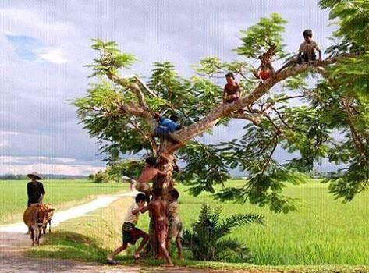
Morning
Boyhood
‘When & while’ is used to mention time
like morning, at 5pm, boyhood, in 1971, etc.
Notes:
Position of when & while.

Slide 23
Note
Simple to complex with ‘when/while’
1. If you start the sentence with when/while, you have to put a comma (,) after the first part of the sentence. If you write when/while at the middle of the sentence you need not put any comma (,). Just a full stop (.) at the end of the sentence.
I say my prayer in the morning.
I say my morning prayer.
2. When is used to mention nearby past or present but while is used to mention long past.
I say my prayer when it is morning.
I visited London at 6 years old.
At 6 years old I visited London.
While I was 6 years old, I visited London.
Notes:
Uses and special notes to use when & while.

Slide 24
Activities
Change the following simple sentences into complex with ‘When/while’.
(a) Our school starts at 10 am.
(b) I was a child in 1971.
(c) The train arrived at the station at 11 at night
(d) I saw you in my childhood.
(e) I always respond my mother’s call.
Notes:
Class work.

Slide 25
Thank You
Notes:
Ending slide.

