Slide 1
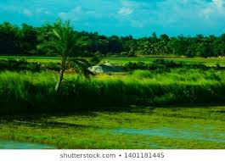
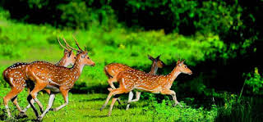

Slide 2
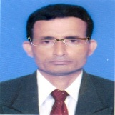

Identity
Manik Chandra Majumder
Senior Teacher (English)
Gazirhat High School
Senbag, Noakhali
Mobile No: 01717155169
Email:manikmajumder01@gmail.com
Class : Nine-Ten
Subject : English 1st paper
Time : 50 Minutes
Date : 00/00/2017

Slide 3
Let’s watch a video
What have you watched in the video?
Have you heard anything in the video?
How was the river?

Slide 4
Can you guess about our today’s lesson ?
But, ….What ?
About river erosion.

Slide 5
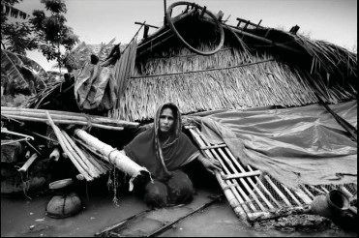
So, dear our today’s topic is….
The greed of the
roaring rivers
Unit : Five
Lesson : One
Page : 66

Slide 6
Learning outcomes
After we have studied this unit, we will be
able to -----
a) ask and answer questions,
b) read, comprehend and summarize texts,
c) make dialogue,
d) take part in debates on given topics,
e) write paragraph.

Slide 7
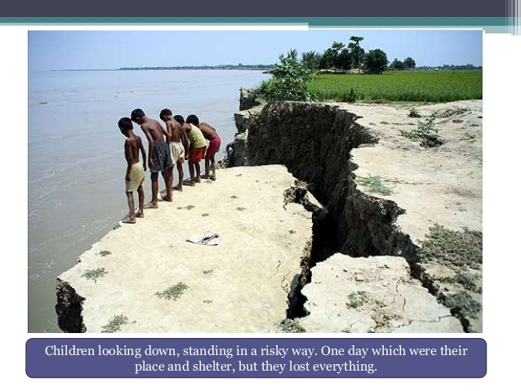
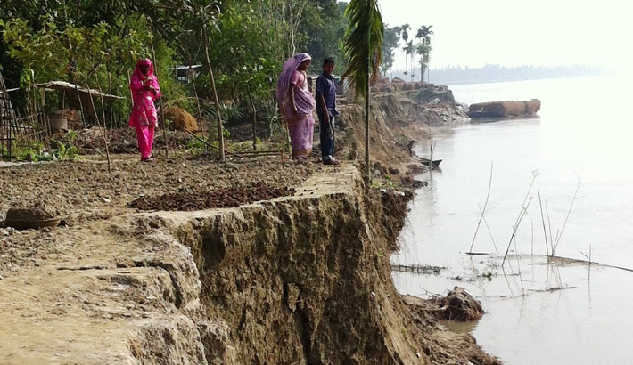
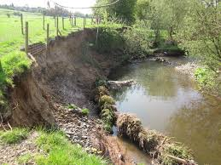
Look and talk about the pictures.

Slide 8
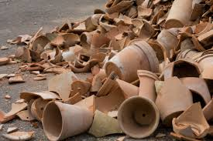
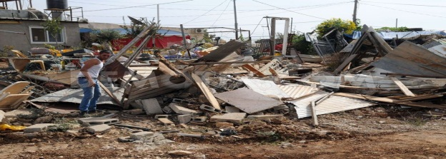
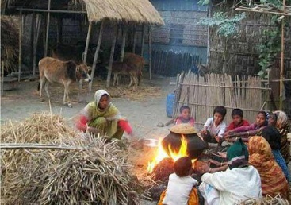
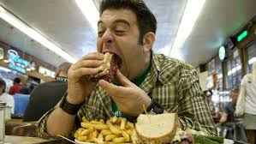
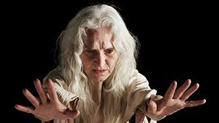
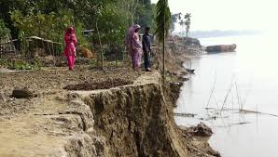
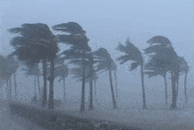
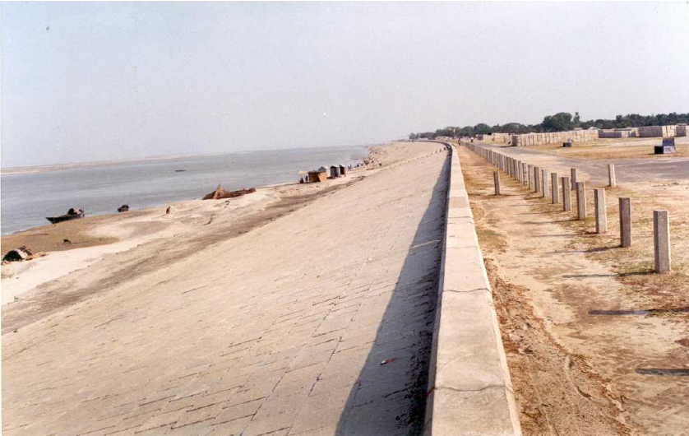
Click box
Word meaning and making sentence
Meaning :Broken into pieces
Meaning : Destroy, Shatter
Meaning: Barrier, Dam
Meaning: Decay , Degradation
Meaning : Shake, Quake. vibrate
Meaning : Unsteady fire
Meaning : Devour, Swallow, Gulp
Embankment (N)
Meaning : Murmur, Hissing sound
Erosion (V)
Dancing flame
Demolish (V)
Whisper (V)
Consume (V)
Shatter (V)
Tremble (V)
Sentence: Whispering wind makes trees unsteady.
Sentence: Dancing flame reminded Meherjan turmoil of her life.
Sentence: Cyclone has demolished the village totally.
Sentence: The man is consuming a huge amount of food.
Sentence: The old man is trembling in cold.
Sentence: Greedy jamuna had shattered Maherjan dream .
Sentence : River erosion makes people rootless.
Sentence :Our government is making embankment to protect river erosion.

Slide 9
Read the following text and answer the questions.
Meherjan lives in a slum on the Sirajgonj Town Protection Embankment. Her polythene roofed shelter looks like a cage. She is nearly 45 but looks more than her age. In front of her shelter, she is trying to make a fire to cook the day’s only meal. Her weak hands tremble as she adds some fallen leaves and straw to the fire. The whispering wind from the river Jamuna makes the fire unsteady. The dancing of the flames reminds Meherjan of the turmoil in her life. Not long ago Meherjan had everything- a family, cultivable land and cattle. The erosion of the Jamuna consumed gradually all her landed property. It finally claimed her last shelter during the last monsoon. It took the river only a day to demolish Meher’s house, trees, vegetable garden and the bamboo bush.

Slide 10
She had a happy family once. Over the years, she lost her husband and her family to diseases that cruel hunger and poverty brought to the family. Now, she is the only one left to live on with the loss and the pain. The greedy Jamuna has shattered her dreams and happiness. There are thousand others waiting to share the same fate with Meherjan. Bangladesh is a land of rivers that affect its people. Erosion is a harsh reality for the people living along the river banks. During each monsoon many more villages are threatened by the roaring of rivers like the Jamuna, the Padma and the Meghna. It is estimated that river erosion makes at least 100,000 people homeless every year in Bangladesh. In fact, river erosion is one of the main dangers caused by climate change. If we can’t take prompt actions to adapt to climate change, there will be thousands of more Meherjans in our towns and villages every year.

Slide 11
Meherjan’s past days………….

Slide 12
Due to river erosion Meherjan lost her……. and victim of…….
husband
family
land
home
happiness
Became
rootless
Victim of
diseases
hunger
poverty

Slide 13
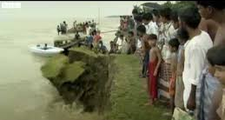
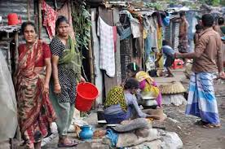
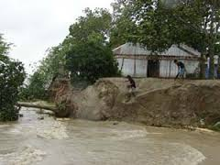
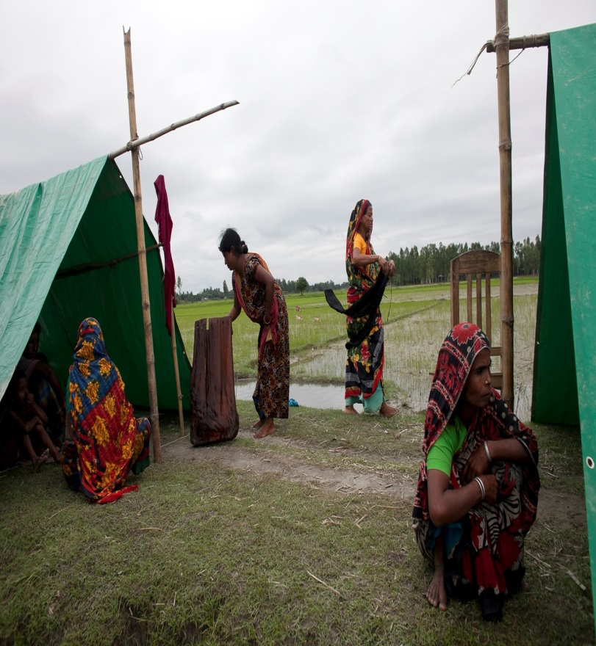
Let’s see some text related pictures on bad effect of river erosion.
Increasing slum dwellers
Waiting to consume shelter.
There are thousand others waiting to share the same fate.
River erosion makes people homeless

Slide 14
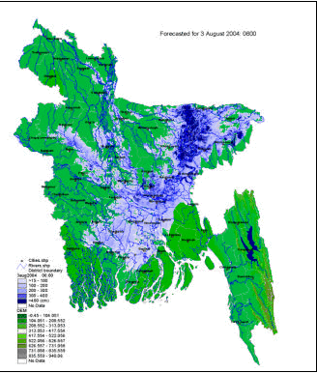
River eroding area of Bangladesh
Click river’s name
Jhamuna
Padma
Meghna

Slide 15
Let’s watch another video.
Individual work
Now, write the effects of river erosion in our country.

Slide 16
Individual work-2
Select the closest meaning of the phrase from your text .
Ans :
Ans :
1. Roaring river
a) rivers that flows strongly making wild sounds
a) rivers that flows strongly making wild sounds
b) rivers having many rowing boats in them
c) rivers that make people cry out
d) rivers that have noisy fishes

Slide 17
2. Landed property
a) Rented piece of land
b) A piece of land on the bank of a river
Ans :
Ans :
c) Property in the form a source of income to its owner
c) Property in the form a source of income to its owner
d) Property used only as an agricultural farm

Slide 18
3. Whispering wind
a) wind that blows from across the river
b) wind that blows with hissing sound
b) wind that blows with hissing sound
Ans :
Ans :
c) wind that helps someone make fire
d) wind that blows in summer

Slide 19
4. Dancing of the flame
a) a traditional form of folk dance
Ans :
Ans :
b) a flame that makes people dance around it
c) a flame that is made unstable by the blast of air
c) a flame that is made unstable by the blast of air
d) a flame made by people to remember their pasts

Slide 20
Pair work
From your reading ask the answer of the questions to your partner and alternate.
Where did Meherjan use to live before?
She would………….
What properties did she lose due to river erosion ?
She lost her house,……………..

Slide 21
Would you please tell me about her family ?
It’s very tragic. Once she had…….her husband, happiness, solvency. Now……
In which season does river erosion most likely occur ?
It’s most likely occurs in ………….
Why is the phrase ‘Greedy Jamuna’ is used to describe the river ? Explain reason.
I think it grabbed ……and waiting to…..

Slide 22
Group work
Make five arguments for debating on the point :
‘Human can’t do anything to control the course of nature’
Supporting Team
Opposition Team

Slide 23
Evaluation
slum dweller
Meherjan is a typical (1) ……………… woman who lives in a slum. She lost her shelter and properties (2) …………… the erosion of river Jamuna. She also lost her family. Her husband had died of diseases caused by poverty and (3) ……………… . Now, she is only a (4)…… . Like Meherjan there are many people who have become the (5) …………… of river erosion. River erosion is still posing (6) ………… to the lives and properties of thousands of people. People living (7) ………… the rivers are the most likely victims of river erosion. Each year about (8) ………… people become homeless due to river erosion in Bangladesh. Meherjan’s life is just one (9) ……………… of how climate change (10) …………… the lives of thousands of people
victims
affects
close to
homeless
hunger
one lakh
threats
example
Due to
Notes:
Group work

Slide 24

Home work
Write a paragraph on ‘River Erosion’.

Slide 25



