Slide 1
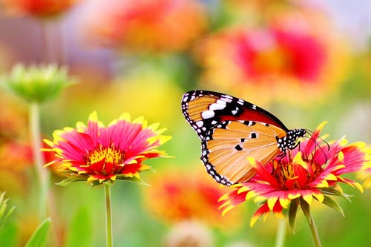
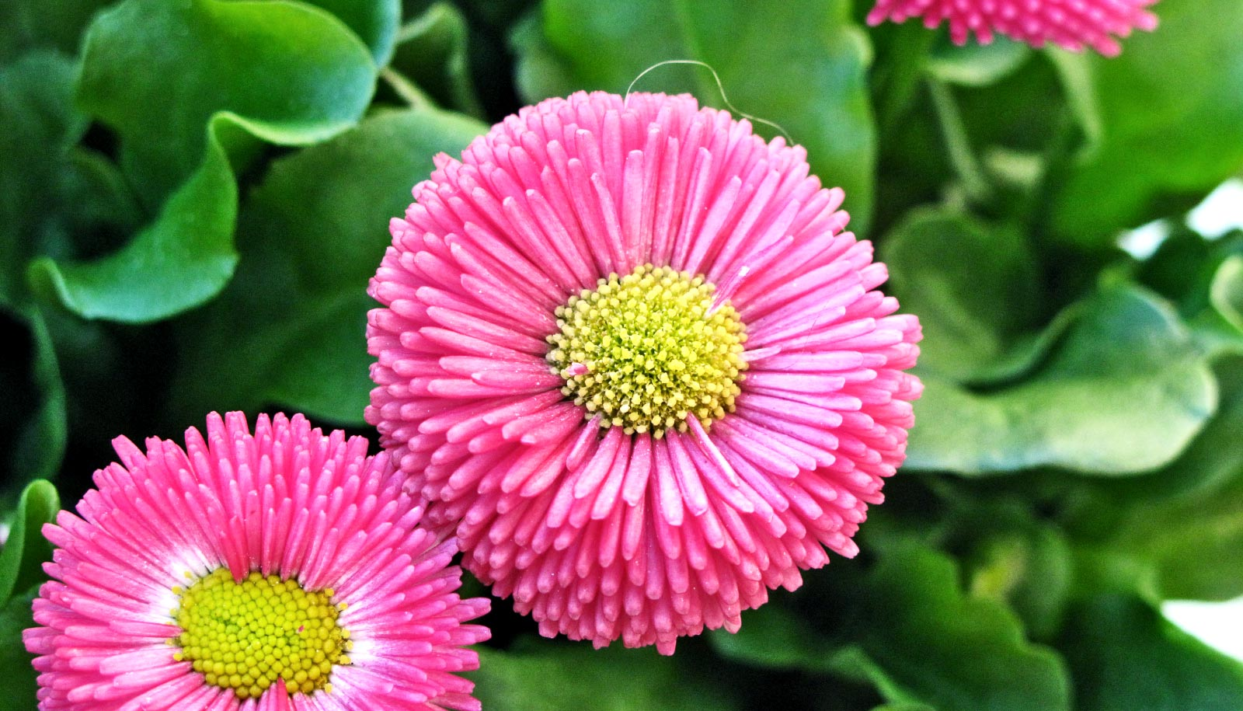

Slide 2

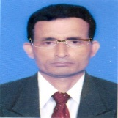

Manik Chandra Majumder
Asst. Teacher
Gazirhat High School
Senbag, Noakhali.
Contact No: 01717155169
Email: manikmajumder01@ gmail.com
Class : Nine-Ten
Subject : English 1st paper
Time : 50 Minutes
Date : 00/00/2018

Slide 3
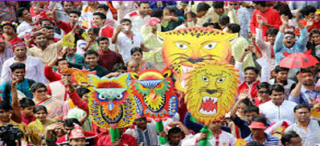
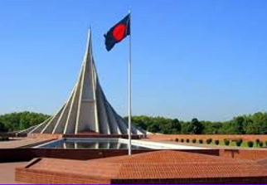
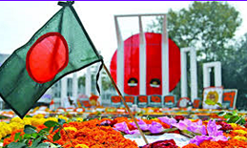
What about are the pictures?
International Mother Language Day
Independence Day
Pahela Baishakh

Slide 4

But !
What does the picture symbolize?
Can you relate any historical event to this picture?
What happened on that day ?

Slide 5


Our today’s lesson is….
Unit : Three
Lesson : Two
page No : 35

Slide 6
Learning Outcomes
After we have studied this lesson ,we will be able to:
# talk about events,
# ask and answer questions and give
opinions in logical sequence,
# infer meanings from the context,
# write paragraph.

Slide 7
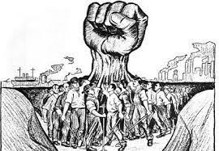
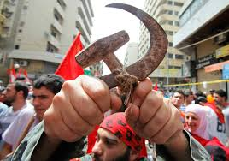
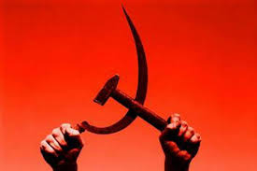
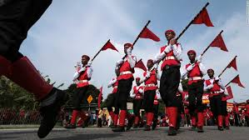
Look at the pictures and talk about them.
What do the pictures symbolize ?
Which class of people are related to the pictures ?

Slide 8

Let’s observe the video attentively
Individual Work
Write the history of May Day in short .

Slide 9


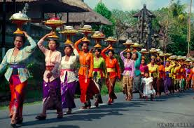
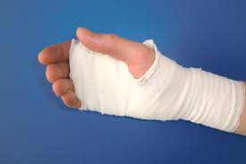
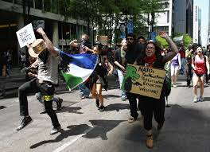
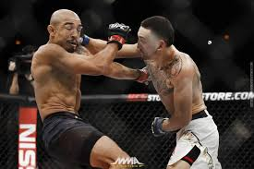
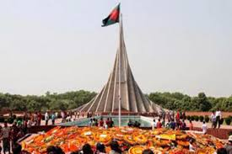
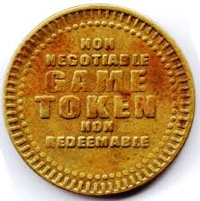
Click word
Vocabulary
Meaning : Wound , Hurt
Meaning : Blower , Protestor
Meaning : Struggle,War, Strike, Rotation
Meaning :Procession, Demonstration,
Meaning :Token, Relic, Sign. Mark
Meaning : Memorialize, Remind
Commemorate (V)
Revolution (N)
Reminder (N)
Rally (N)
Striker (N)
Injury (N)
Sentence: Many workers were injured in May 1 in 1886 by the police.
Sentence: May Day is a reminder for the working class people.
Sentence: Strikers went down to street to bring back the workers.
Sentence: Workers arranged a rally to celebrate May Day.
Sentence: Since the industrial revolution workers had to work for long shift.
Sentence: May 1 commemorate the historical struggle of the working people.

Slide 10
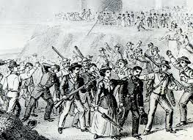
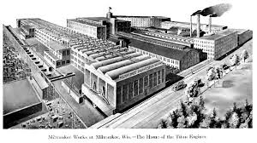
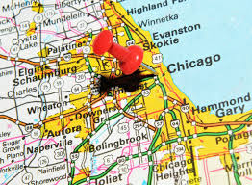
Some text related pictures
Police attack on Workers
McCormic Harvester Company, Chicago
Chicago city, America

Slide 11

May day or International Workers Day is…………

Slide 12
Group work
Group-1
Group-2
What does May Day refer to ?
What do you learn from the events of May 1, 1886 ?

Slide 13
Pair Work
Fill in the blanks with the verbs given in the box and write note book then exchange your notebook with your partner.

Slide 14
add
arrived
began
doing
heard
lives
sends
support
trodden
works
Tania is a poor garment worker. She a) ……. in a big garment factory in Gazipur. She b)……. in a slum with few fellow workers. She works eight hours a day on a monthly salary of TK. 3000/-. She does overtimes to c)…….some more money to her income. If she can save something, she d)………it to her father to e)………..the family. One day Tania was busy f)……….her work in the factory. Suddenly she g)……… Someone shouting “Fire! Fire!”. The workers were panic-stricken and everyone h)………to rush to the stairs. There were no enough staircases in the factory building. So some workers were i)...………under the foot and some other were injured in some other ways. However the fire brigade j) ……….there in minutes and nothing untoward happened.

Slide 15
Work in pair with your partner
1. Do you think Tania’s monthly salary is enough
for her work?
2. Is factory safe enough for workers to work in?
Why do you think so?
3. Do you have any suggestions for safety of
workers? If so what?

Slide 16
Evaluation
Choose the best answer from the alternatives.
a) The word ‘commemorate’ stands for-----------.
i. a unity among people.
Ans :
Ans :
ii. honour the memory of an event.
ii. honour the memory of an event.
iii . the struggle for movement.
iv. a loyalty towards authority.
b) A new movement calling for eight-hour work day started in the…
Ans :
i. 1880s
Ans :
i. 1880s
ii.1890s
iii.1980s
iv.1990s

Slide 17
c) May Day is a ---------- that the workers themselves have to fight for rights.
i. declaration
ii. demand
Ans :
Ans :
iii. reminder
iii. reminder
vi. memory
d) ---------was one of the most important demands of the workers.
Ans :
i. Residential facilities
ii. High salaries
Ans :
iii. Pay scale
iv. Eight hour workday
iv. Eight hour workday

Slide 18
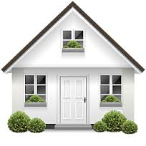
Homework
Write a paragraph on May Day or International Workers Day

Slide 19


Good wishes for the working class people

