Slide 1
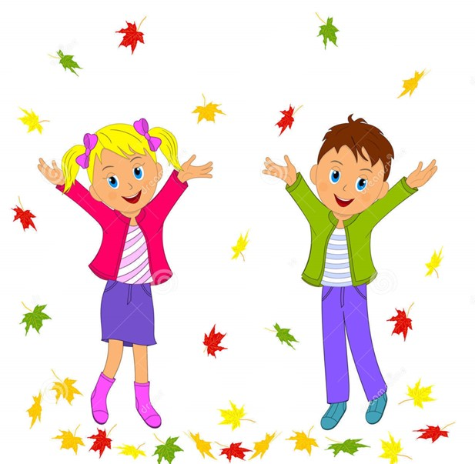
Health is wealth

Slide 2
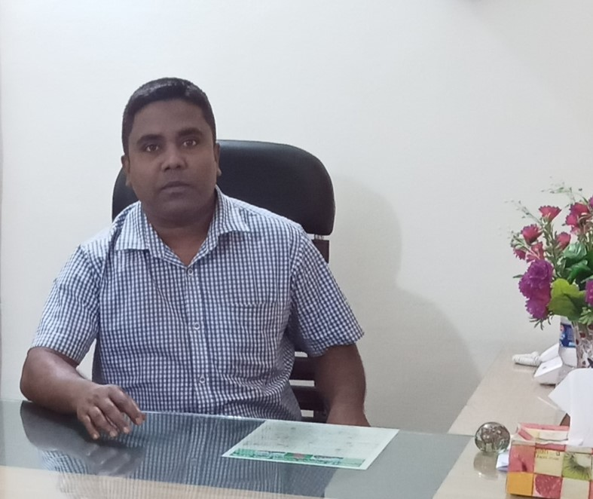
Health is wealth
Sub: English
Class: Two
Lesson : I’m-------------------.
Parts of the lesson: Activity-C
Page No-21
Md. Mushfikur Rahman
ASISSTANT TEACHER
PARGOBINDOPUR GOVT. PRIMARY SCHOOL
BIRAMPUR,DINAJPUR.

Slide 3
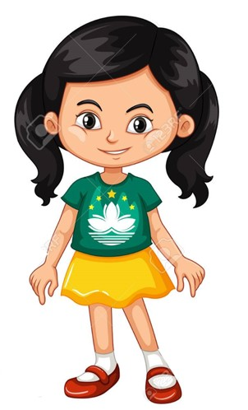
Safety environment by greetings song.
Health
is
wealth
WE SHALL OVERCOME
WE SHALL OVERCOME
WE SHALL OVERCOME, SOME DAYS.
OH, DEEP IN MY HEART
I DO BELIVE THAT
WE SHALL OVERCOME, SOME DAYS.

Slide 4
Our today’s
I’m--
lesson is too-
Activity-C

Slide 5
LEARNING OUTCOMES
By end of the lesson students will be able to-------
Reading: 1.4.1 read words and phrases with the help of visual clues
(about 30 new words) and simple sentences

Slide 6
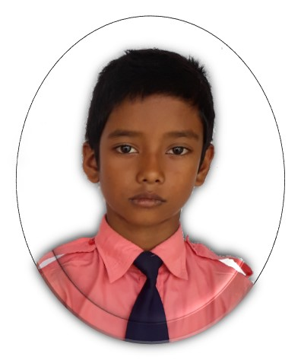
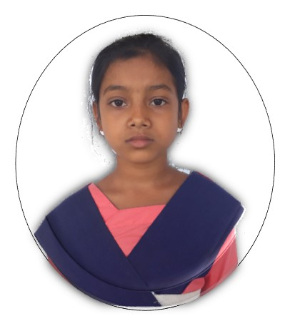
Look listen and say.
He
She

Slide 7
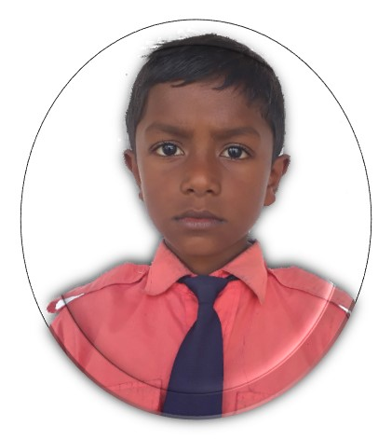
Look and read.
She’s Sumya.
She’s 7 years old.
She’s in class 2.
He’s Mehedi.
He’s 7 years old.
He’s in class 2.

Slide 8
Repeat after me.

Slide 9
The teacher will touch any student. Other student will say about him/her.

Slide 10
Read and say.
She’s Shuva.
She’s 7 years old.
She’s in class 2.
He’s Rafi.
He’s 7 years old.
He’s in class 2.
I’m--------------.
I’m 7 years old.
I’m in class 2.

Slide 11
One day one word
What is this?
toes
পায়ের আঙ্গুল

Slide 12
Say the missing letter.
-oes
to-s
toe-
t-es
Write the word to your notebook.
toes
টোজ
পায়ের আঙ্গুল

Slide 13
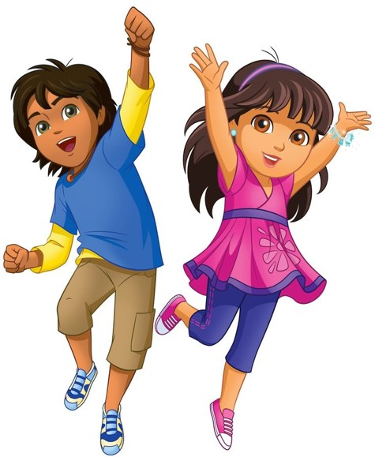
Home work
Page 7 will be well read and written.

Slide 14
That’s all for today. Goodbye. See you tomorrow.

