Slide 1
To the english class

Slide 2
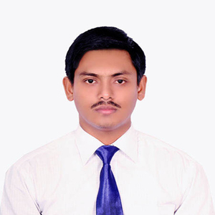
Teacher’s Identity
Md. Arafat Hossain
Assistant Teacher (English)
Haripur High School
Joypurhat Sadar, Joypurhat-5900.
E-mail: arifjoy1991@gmail.com
Contact: 01747994114

Slide 3
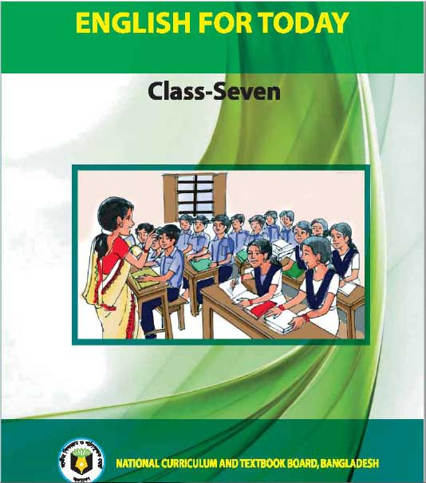
Lesson Introduction
Class: Seven
Subject: English 1st Part
Unit: Five
Lesson: 1
Time: 45 Minutes

Slide 4
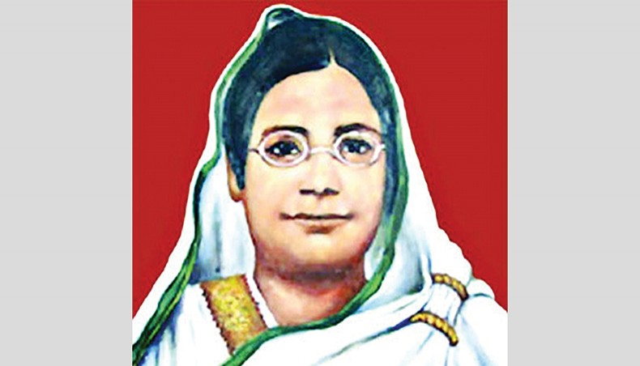
Look at the picture and ask and answer these questions.
Who is the woman?
2. What do you know about her?

Slide 5
1. This woman is Begum Rokeya.
2. She was a famous writer and social worker. She was the pioneer of Muslim women renaissance.

Slide 6
Our Today’s Lesson is-
Begum Rokeya (1)

Slide 7
Learning Outcomes
After we have studied this lesson, we will be able to-
talk about a great woman.
read and understand text.
ask and answer questions.
infer meaning from the context.

Slide 8
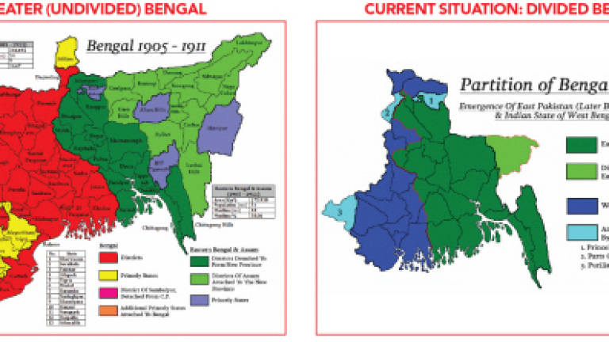
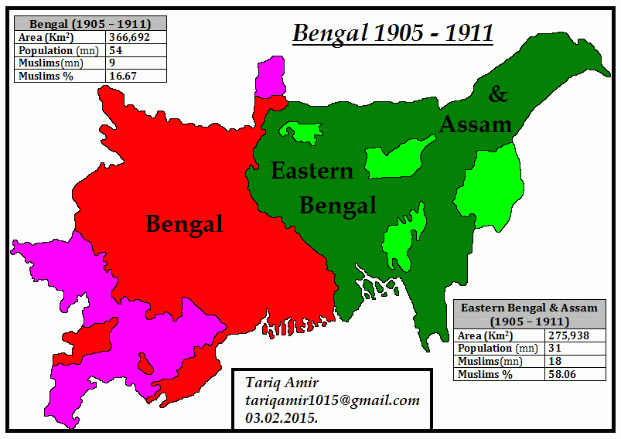
Key Words
Undivided (adj.)
not separated into parts or pieces /complete or total
We want a united and undivided land.

Slide 9
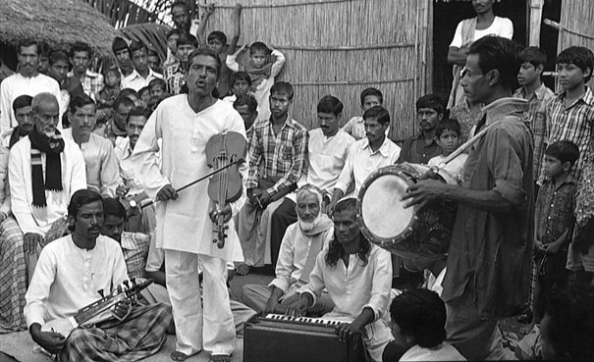
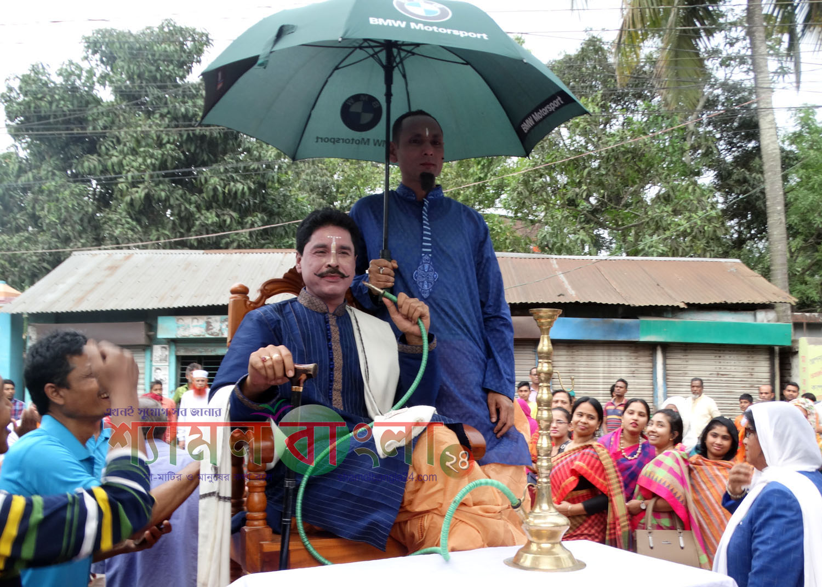
Society
Noun
Group/Community/Association
Landlord
Noun
Master/ Landowner

Slide 10
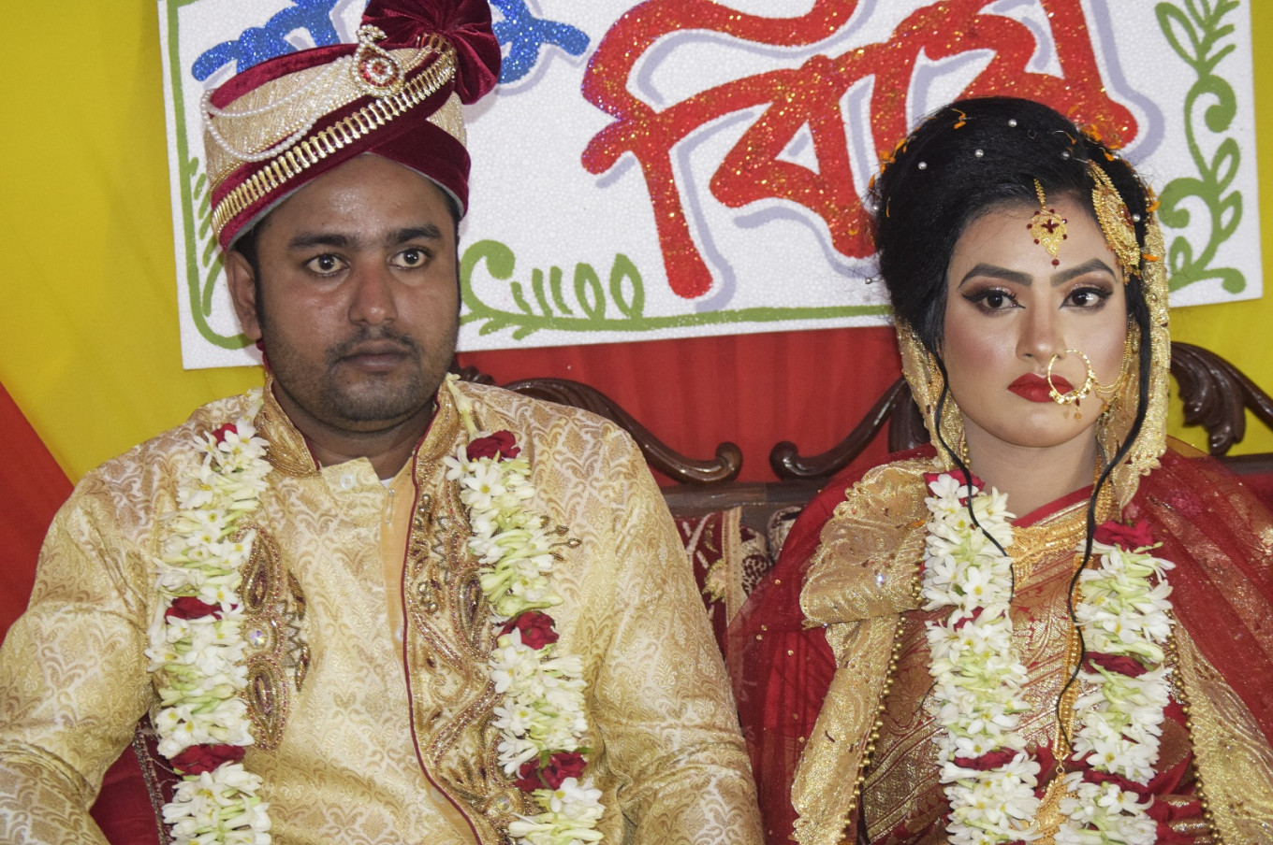
Marry
Verb
Wed/Join/Unify
Cooperative
Adjective
Collaborative/United/ Mutual assistant

Slide 11
Encourage
Verb
Give support/Inspire/Motivate
Communication
Noun
exchanging of information / Transmission

Slide 12
Read the text silently
loud reading &
pronunciation

Slide 13
Kim’s Game
Opportunity
Born
Undivided
Writer
Learn
Education

Slide 14
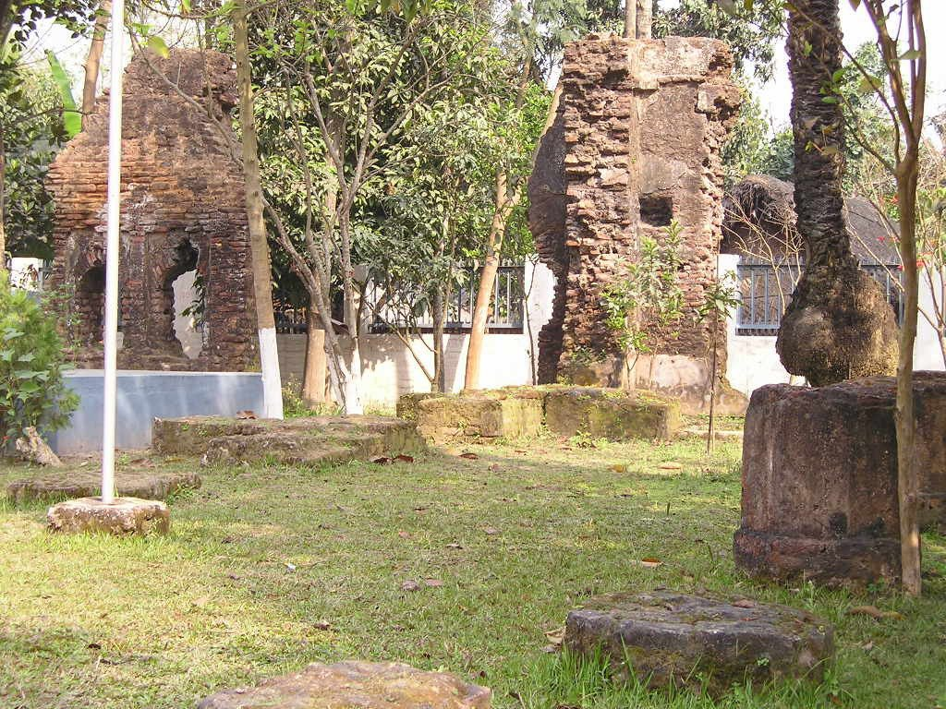
Birth place of Begum Rokeya

Slide 15
Women should have the same rights and opportunities as men have.

Slide 16
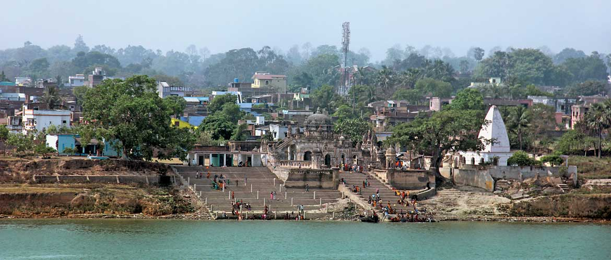
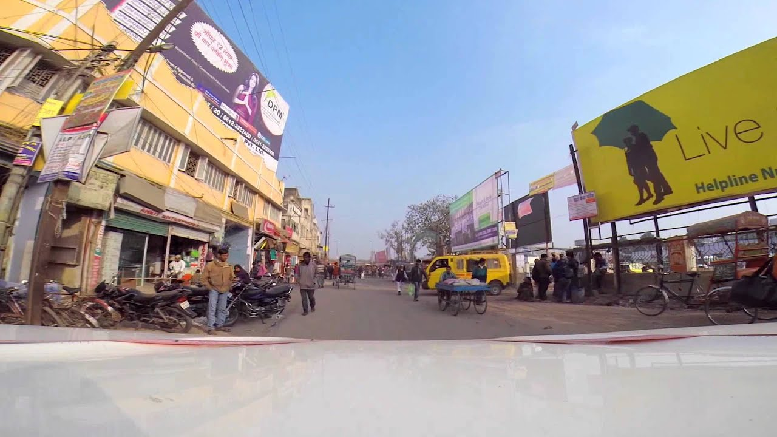
Bhagalpur District

Slide 17
Individual Work
1. Write the correct answer on the question paper. a. Begum Rokeya fought for i. Democracy ii. Independence iii. Women’s rights, iv. Communism b. Begum Rokeya was born in i. Bhagalpur ii. Rangpur iii. Bihar iv. Bangladesh c. Shakhawat Hussain worked in i. Payrabandh ii. Bhagalpur iii. Rangpur iv. Bihar d. Bhagalpur is a district in i. Bangladesh ii. West Bengal iii. Bihar iv. Rangpur e. Abu Ali Hyder was i. An honest man ii. Deputy Magistrate iii.Rich iv. Shakhawat Hussain’s father
a) iii, b) ii, c) ii, d) iii, e) iii.

Slide 18
Complete the following chart with information from the text.
Begum Rokeya
occupation | born in | married in | family | language
Writer and social worker, Pairabondh, Rangpur in 1880, 1896,
Rich Muslim, Bangla

Slide 19
Answer the following questions.
Who was Begum Rokeya?
What was Begum Rokeya’s strong believe about women?
What was Begum Rokeya’s husband profession?

Slide 20
Home Work
Write a short note about “Begum Rokeya’s life.”

Slide 21
See you again.
Thank you.

