Slide 1
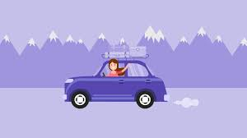
Well come all student Today lesson

Slide 2
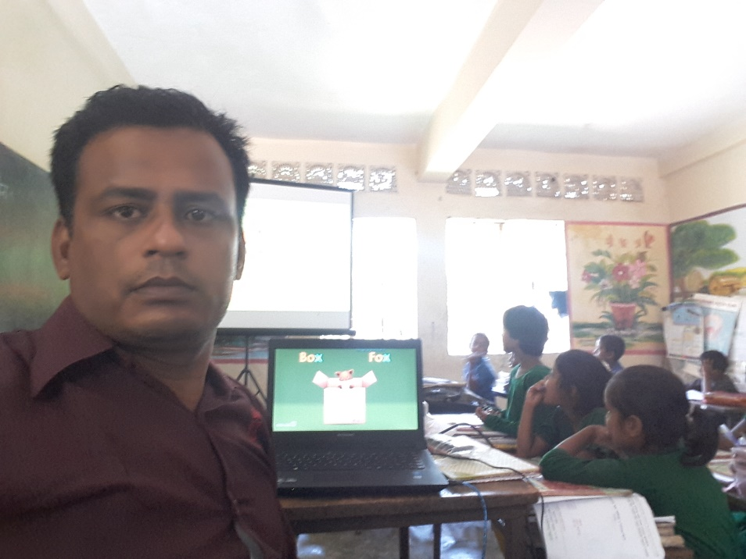
Teacher Information
Md. Sorfuddin Mridha
Assistant Teacher
41 No Laxmipur Government Primary School
Matlab South, Chandpur
Mobile- 01818-490889

Slide 3
Lesson Introduction
Class-4
Subject: English
Unit:16
Lesson: 1
Text: A

Slide 4
Learning outcomes
Listening:
1.1.1:- recognize sound differences in the context of words.
1.2.1:- recognize which syllable in a word is stressed.
1.3.1:- recognize which words in a sentence are stressed.
3.2.1:- understand questions about family and friends of students.
3.4.1:- understand statements made by the teacher and student.
Speaking:
1.1.1:- repeat after the teacher and say words, phrases and sentences with proper sounds, stress and intonation.
5.1.1:- tell the time (hours only and mention a.m /p.m.
6.2.1:- talk about people, objects, events, etc.
Reading:
1.4.1 :- read words, phrases and sentences in the text.
1.5.1 :- read words, phrases and sentences in the text with proper pronunciation, stress and intonation.
1.7.1:- read short paragraphs, dialogues and simple letters.
5.1.1:- read silently with understanding paragraphs, stories and other text materials.

Slide 5
How are you today?
Fine, Thank you.

Slide 6
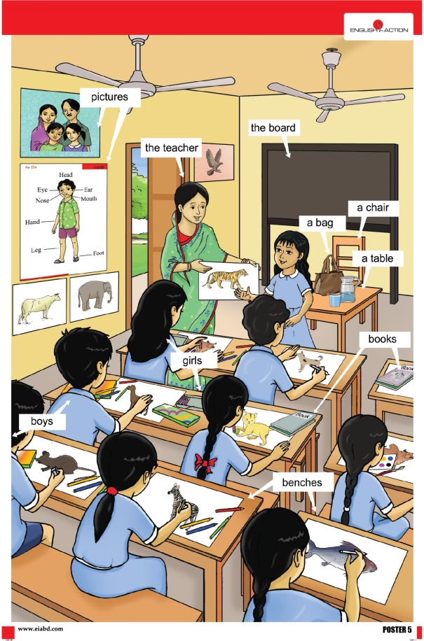
Creating a favorable environment for reading
At first we see the video, Ok.

Slide 7
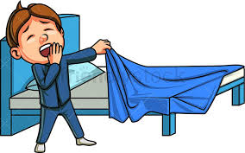
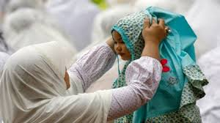
Dear Students, Now I will say few words that he can raise his hand. Ok.
Get up
Get dressed

Slide 8
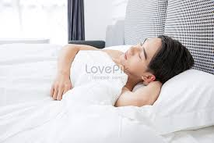
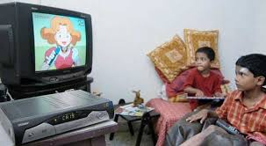
Go to bed
Red
Watch TV

Slide 9
এখন আমরা শব্দগুলোর অর্থ জেনে নেব।
Get up
ঘুম থেকে উঠা
Get dressed
পোশাক পরিধান করা
Red
লাল
Go to bed
বিছানায় যাও
Watch TV
টিভি দেখা

Slide 10
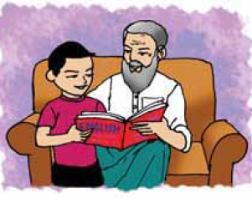
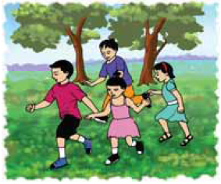
Dear Student The name of our new lesson is Sagar’s week.

Slide 11
One day one word
Teaching learning activities
Yesterday we learned a word, what is the word? Who can tell me?
Ans: Doctor
Who can tell the meaning of the word?
Doctor অর্থ :ডাক্তার চিকিৎসক।

Slide 12
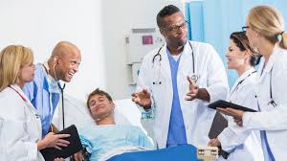
One day one word
Anyone, make a sentence with the word?
My father is a doctor.

Slide 13
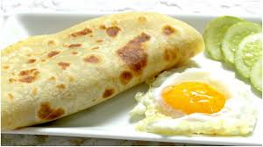
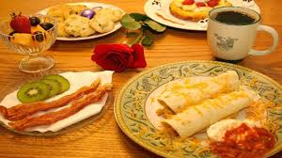
One day one word
Today our new word.
Breakfast
What means breakfast?
Breakfast: অর্থ = সকালের নাস্তা।

Slide 14
One day one word
We learn today a sentence by breakfast.
Everyone wrote the sentence in the hand write note.
He have breakfast at 8 o’clock

Slide 15
Dear student open your book, Page NO-32
Look at the picture
তোমরা ছবিগুলোতে কী কী দেখতে পারছো?

Slide 16
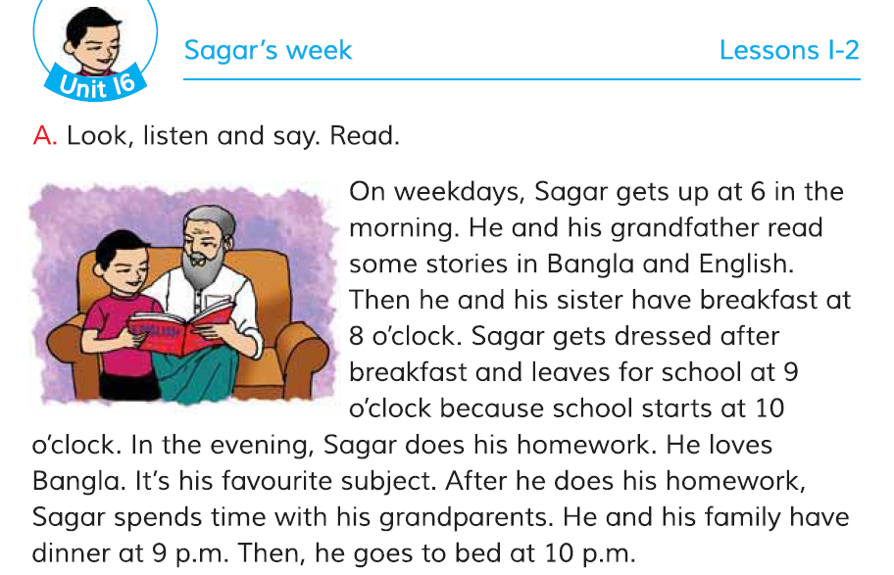
INPUT
Dear student look and read with me

Slide 17
INPUT
Dear student look and read with me, the rest of page 32

Slide 18
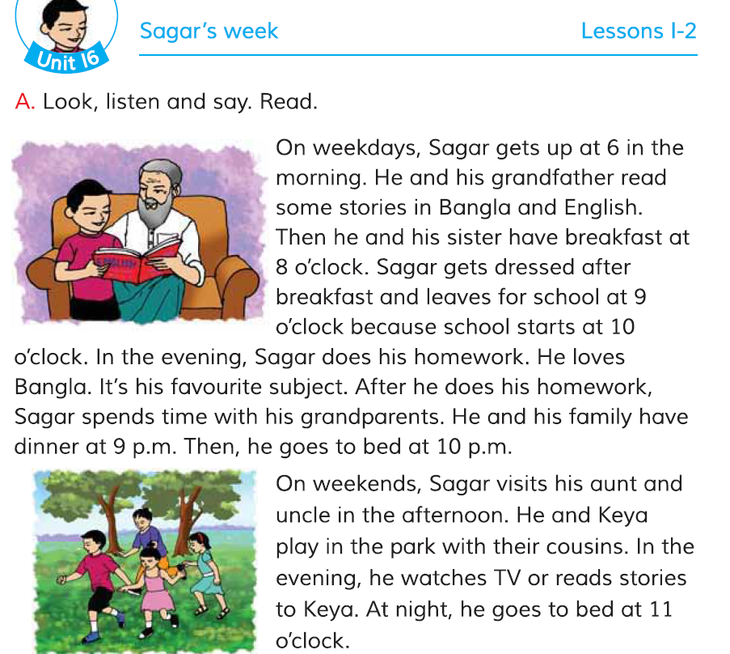
Practice
Now you read the text in silence.

Slide 19
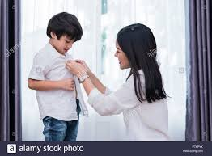
Practice
What time Sagar gets up on weekdays?
Sagar gets up at 6 in the morning.
What time Sagar gets dressed for school?
Sagar gets dressed for school after breakfast.

Slide 20
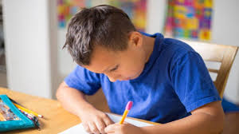
Practice
What does Sagar do in the evening?
In the evening Sagar does his homework.
What is Sagar’s favourite subject?
Sagar’s favourite subject is Bangla.

Slide 21
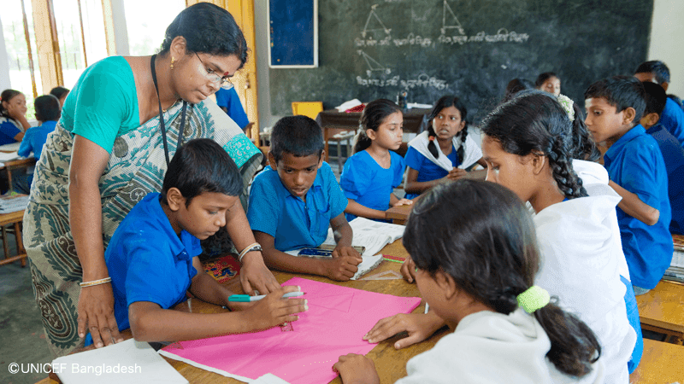
Group Work
দুটি গ্রুপে ভাগ হও। প্রথমে ১নং গ্রুপ পাঠ করবে ২নং গ্রুপ ভুল হলে সংশোধন করবে। তারপর ২নং গ্রুপ পাঠ করবে ১নং গ্রুপ ভুল হলে সংশোধন করবে।
Group-1
Group-2

Slide 22
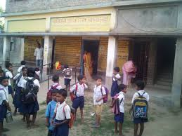
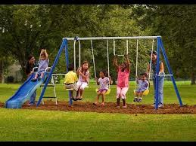
Task/Checking Learning/Assessment
What have we learned today?
Ans: We have learned today about Sagar’s weekday and weekends.

Slide 23
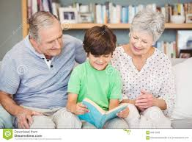
Task/Checking Learning/Assessment
Dear Students, I will ask a question to those who can raise their hands. Ok.
What do Sagar and his grandfather read?
Ans. Sagar and his grandfather read some stories in Bangla and English.

Slide 24
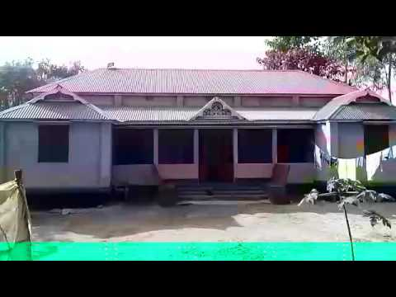
Home work
Home work
Home work
সঠিক শব্দ বসিয়ে নিচের ছকটি বাড়ি থেকে পূরণ করে আনবে।
সময়/ কাজ
সাপ্তাহিক কার্যদিবসে
সাপ্তাহিক ছুটির দিনে
সন্ধ্যা বেল কী করে?
কখন ঘুমাতে যায়?

Slide 25
Thanks To All, See You Next.
Good bye
Good bye

