Slide 1
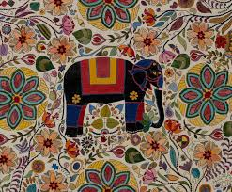
Welcome to English Class

Slide 2
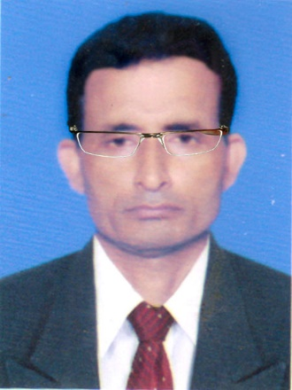
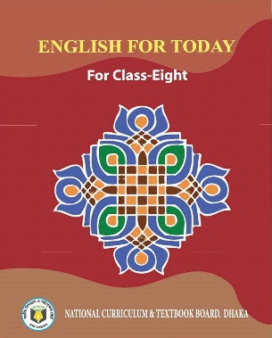
Identity
Manik Chandra Majumder
Senior Teacher
Gazirhat High School
Senbag, Noakhali
Mobile No: 01717155169
Email: manikmajumder01@gmail.com
Class : Eight
Subject : English 1st paper
Time : 50 Minutes
Date : 00/00/2019

Slide 3
Observe the video attentively and think about our lesson.
Click
Link
https://www.youtube.com/watch?v=RIDghkGgrYA&list=UUjc1rjDWUKp4A9z41Ob_zog&index=1

Slide 4
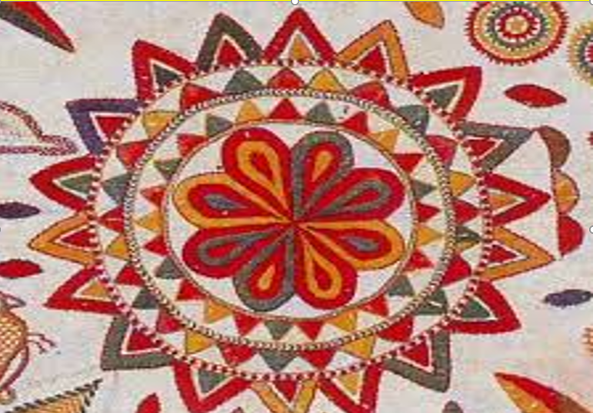
Our Today’s lesson is….
Unit – One
Lesson -Two
Nakshi Kantha

Slide 5
Learning Outcomes
After the end of the lesson, students will be able to…
ask and answer questions,
read and understand text through silent reading,
infer meaning from context,
make sentences using new words,
write a paragraph.

Slide 6
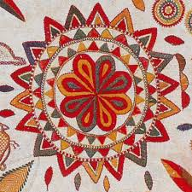
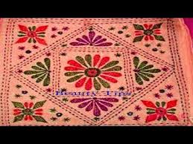
Look at the pictures.
1. What do you see in the picture?
2. What is it called?
3.Have you seen it before?
Where?
4. What do we do with it?

Slide 7
Individual work
Write 2/3 sentences about “Nakshi Kantha.”

Slide 8
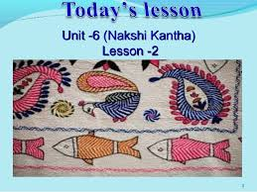
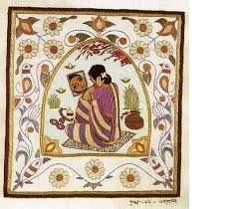
Word meaning & sentence making
Quilt
Meaning: Blanket
Sentence: Nakshi Kantha is a kind of embroidered quilt.
Artistic
Meaning: Inventive
Sentence:Nakshi kantha is made with artistic design.

Slide 9
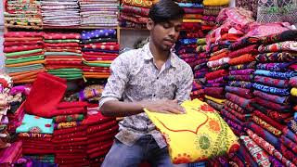
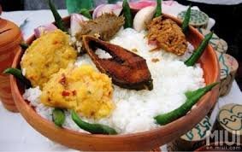
Business purpose
Commercially
Sentence: Nakshi kantha is now produced commercially.
Traditional
Old-custom
Sentence: People eat traditional food on pahela Baishakh .

Slide 10
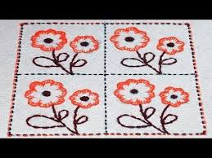
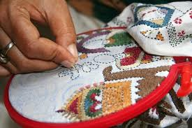
Pattern
Model/Design
Sentence: Nakshi kantha is designed with artistic pattern.
Needle-art/
Stitchcraft
Embroidery
Sentence: Nakshi kantha is embroidered with thread and needle.

Slide 11
Now read the text to know about Nakshi Kantha
Nakshi Kantha is a kind of embroidered quilt. The name was taken from the Bengali word, ‘Naksha’ which means artistic pattern. It is a kind of traditional craft and is said to be indigenous to Bangladesh and West Bengal in India. The art has been practiced in rural Bengal for centuries . The name ‘ Nakshi Kantha’ became popular after the poet Jasimuddin’s poem ‘Nakshi Kanthar Math’ was published in 1929.

Slide 12
Traditional kantha’s are made for family use. Old or new clothes an thread are used to make these quilts. Mymensingh, Jamalpur, Rajshahi , Faridpur, Bogra and Jessore are most famous for this craft. Now it is produced commercially. You can find them in many expensive handicraft shops in cities. The quilts are now in great demand because of the colourful patterns and designs embroidered on them.

Slide 13
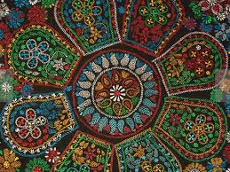
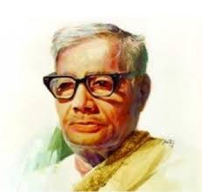
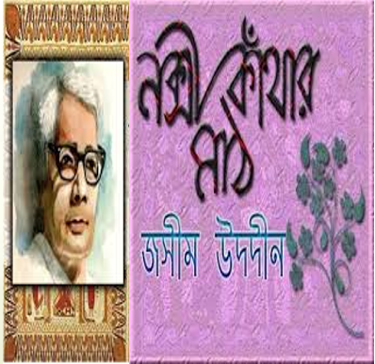
Polli Kobi Jasimuddin
Published in 1929
The name ‘Nakshi Kantha’ became popular after the poet Jasimuddin”s poem ‘Nakshi Kantaar Math’ was published in 1929.

Slide 14
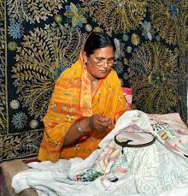
Traditional Kanthas are made for family use.

Slide 15

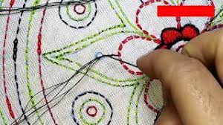
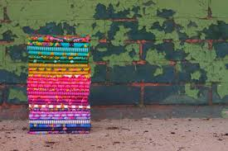
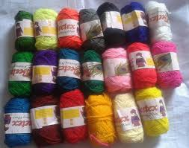
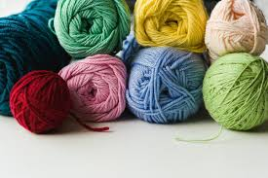
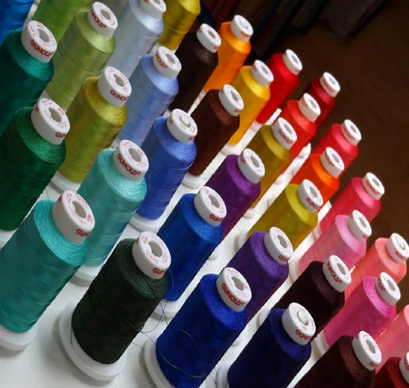
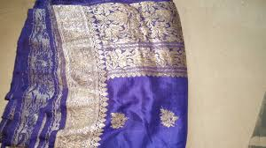
Needle
Artistic design
New cloth
Colourful thread
Old cloth
Old or new cloth and thread are used to make these quilt.

Slide 16
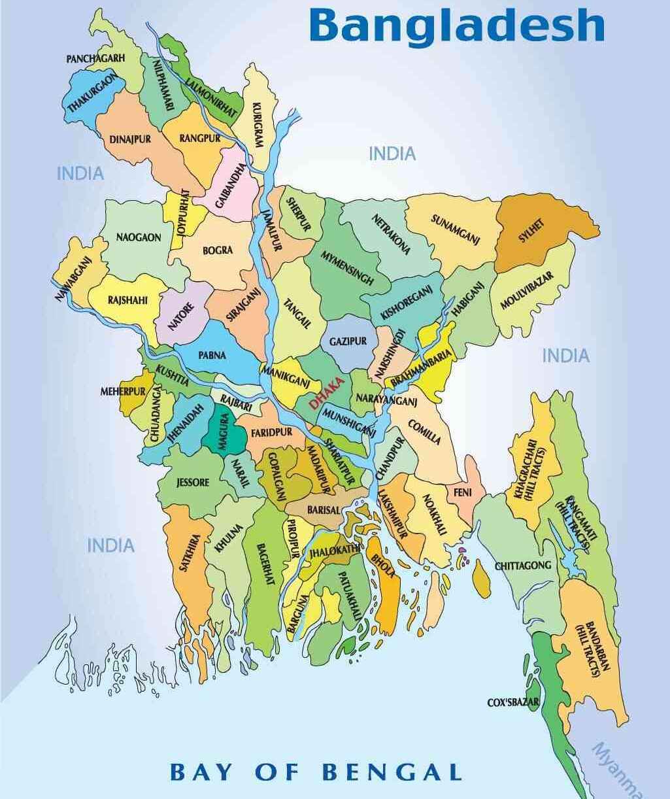
Click district’s
name
Mymensing
Jamalpur
Rajshahi
Faridpur
Bogra
Jessore

Slide 17
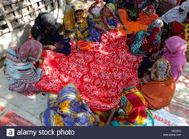
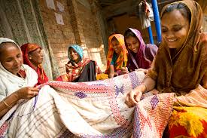
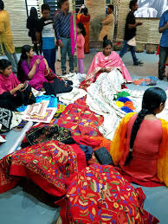
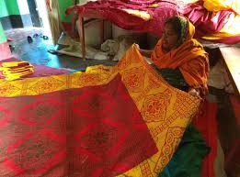
Nakshi kantha is now produced commercially. You can find them in many expensive handicraft shops in cities.

Slide 18
Pair work
What does Naksha mean?
How has “Nakshi Kantha” become popular?
What things are used to make “Nakshi Kantha?”
Do you like “Nakshi Kantha or ordinary Kantha? Why?
Why do you think “Nakshi Kanthas” are now a great demand?

Slide 19
Group work
Complete the sentences with clues given
Bengali
patterns
embroidery
years
fashion
art
rural
designs
quilt
naksha
Naksha means artistic ...............
The name was taken from a ………… ….word ………………
The art has been practiced in ………… Bengal for ….............
4. Nakshi Kanthas are now sold in …………... shops.
5. Nakshi Kanthas are in great demand because of their colourful…………. and…..........
6. Nakshi Kanthas are a kind of ………….. ………….

Slide 20
Evaluation
Ans: Indigenous means Native
Q 1: What is Nakshi Kantha?
Q 2: Who wrote the poem Nakshi Kanthar Math?
Ans: Nakshi Kantha is one kind of embroidered quilt
furnished with artistic pattern .
Ans: Nakshi Kantha is written by popular Bangalee poet
Jasimuddin.
Q 4: How long and where has the art been practised?
Q 3: What is the meaning of the word ‘indigenous?
Ans: The art has been practised in rural Bengal for
centuries.
Ans: Mymensingh,Jamalpur,Rajshahi, Faridpur, Bogra and
Jossore are most famous for this craft.
Q 5: Which districts Bangladesh are most famous for this
craft?

Slide 21

Home work
Write a paragraph about “Nakshi Kantha.”

Slide 22
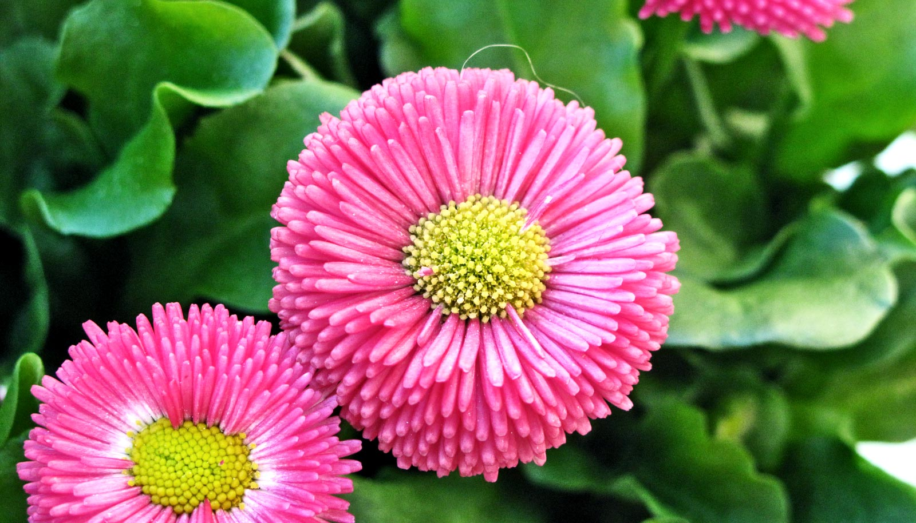
Thank you all

