Slide 1
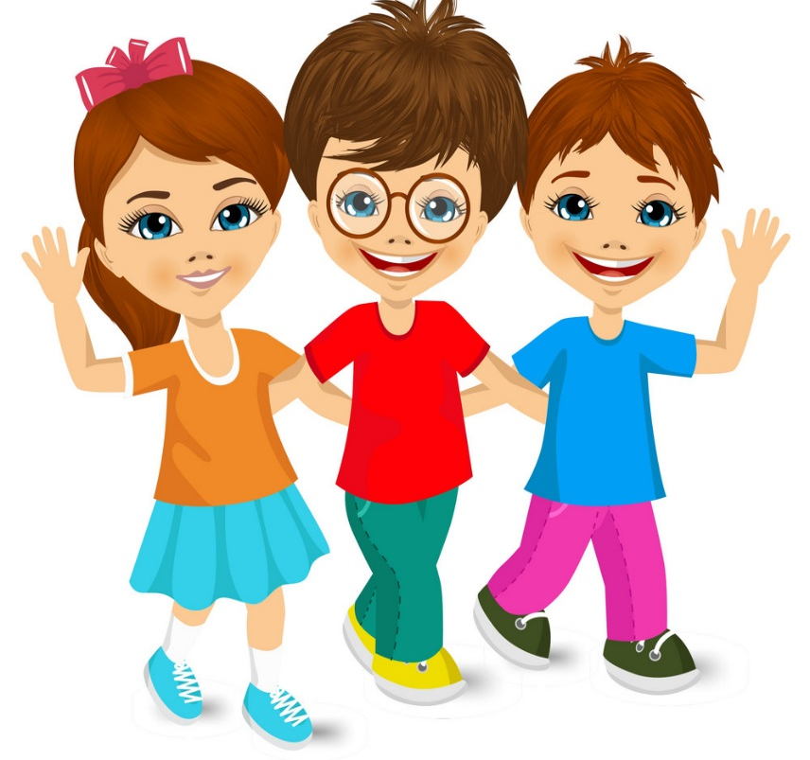
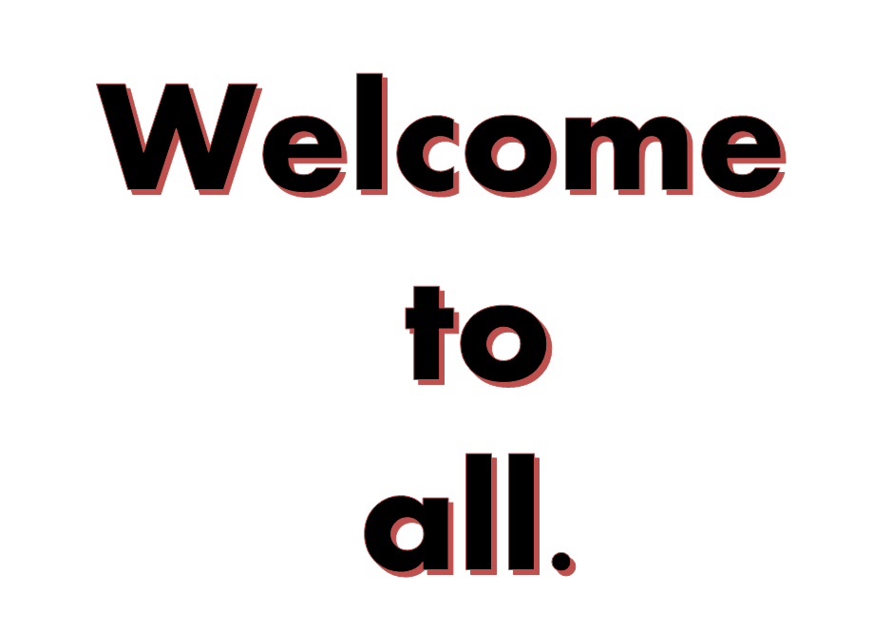

Slide 2
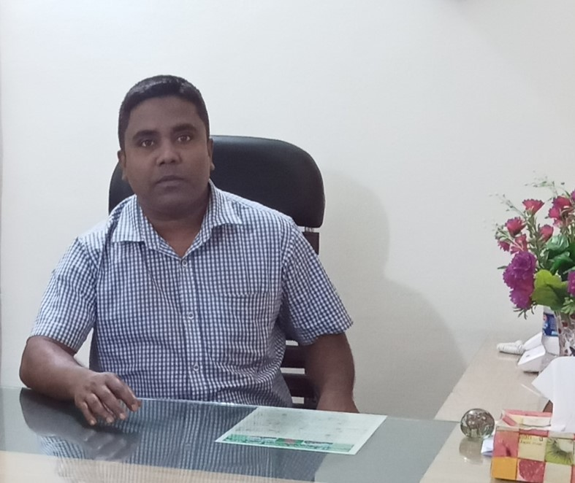
Health is wealth
Sub: English
Class: Two
Lesson : Head and shoulder
Parts of the lesson: Activity-C
Page No-22
Md. Mushfikur Rahman
ASISSTANT TEACHER
PARGOBINDOPUR GOVT. PRIMARY SCHOOL
BIRAMPUR,DINAJPUR.
mushfikurict4.2020@gmail.com

Slide 3
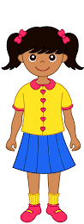
Safety environment by greetings song.
WE SHALL OVERCOME
WE SHALL OVERCOME
WE SHALL OVERCOME, SOME DAYS.
OH, DEEP IN MY HEART
I DO BELIVE THAT
WE SHALL OVERCOME, SOME DAYS.

Slide 4
Our today’s lesson is too-
Head and shoulders
Activity-C

Slide 5
LEARNING OUTCOMES
By end of the lesson students will be able to-------
Listening: 1.1.1 become familiar with English sounds by listening to common English words.
2.1.1 following simple commands and instructions.
3.1.1 understand simple questions and statements about them.
3.1.2 understand simple questions and statements about familiar objects.
4.1.1 enjoy the rhyme and music of simple rhymes.
Speaking: 1.1.1 repeat after the teacher simple words and phrases with proper sounds and stress.
1.1.2 say simple words and phrases with proper sounds and stress.
4.1.1 repeat rhymes after the teacher
4.1.2 repeat rhymes independently
Reading: 1.3.1 recognize and read the names of objects having the same initial and final sounds.
1.4.1 read words and phrases with the help of visual clues and simple sentences.

Slide 6
WCW ( The whole class is divided into two parts. One group say the rhyme, other group do the actions).
Group-1
Group-2
Say
Do
Do
Say

Slide 7
SGW
Group-1
Group-2
Say
Do
Do
Say

Slide 8
I work
One more.

Slide 9
Read and say.
Knees and toes.
Mouth and nose.
Head and shoulders,
Eyes and ears.

Slide 10
One day one word
What is this?
shoulder
কাঁধ

Slide 11
Find out the letters that are made by the word -----------.
s
h
w
o
u
a
l
d
x
e
r
k
b
Find out the correct word-------.
shoulder
solder
shalder
shouldar

Slide 12
Say the missing letter.
sh-ulder
shoulde-
shoul-er
sho-lder
Write the word to your notebook.
shoulder
সোলডার
কাঁধ

Slide 13
Home
Work
Page 15 will be well read and written.
Papaw

Slide 14
That’s all for today. Goodbye. See you tomorrow.

