Slide 1

Welcome to our English class

Slide 2
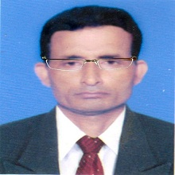
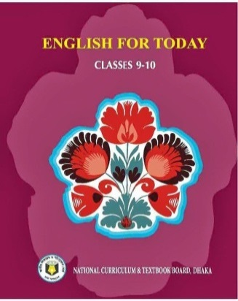
Identity
Manik Chandra Majumder
Senior Teacher
Gazirhat High School
Senbag, Noakhali.
Contact No. 01717155169
E-mail : manikmajumder01@gmail.com
Class : Nine -Ten
Sub: English 1^{st paper}
Date: 00/00/2018

Slide 3

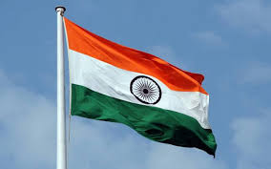

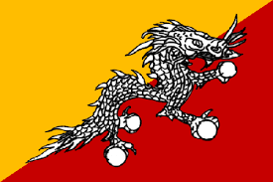
Look at the pictures and talk and about them
Sri Lanka
India
Nepal
Bhutan
Among the countries which one first recognized Bangladesh as an independent country?
Which countries belong these flags?
What do you see in the picture ? ?

Slide 4
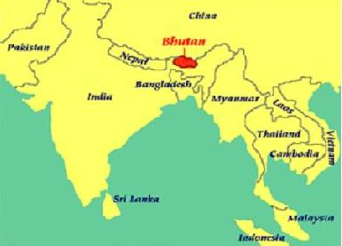
Bhutan
Our today’s lesson is:
Bhutan: The land of happiness
Unit : Six
Lesson : Five
Page : 99

Slide 5
Learning Outcomes:
After we have studied this unit, we will be able to :
a) ask and answer questions,
b) read, comprehend and summarize text,
c) write a letter to friend describing places of interest.

Slide 6
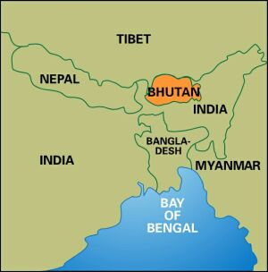
Location of Bhutan
Bhutan, a small landlocked country located in the southern slopes of Himalayan range. It is bounded by Tibet in the North and India in the South.

Slide 7
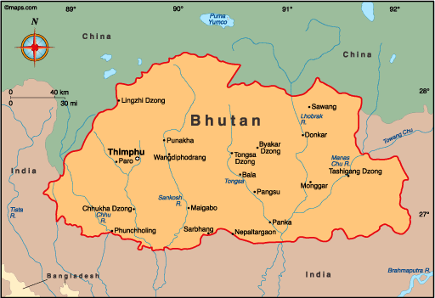
Thimphu, Capital of Bhutan

Slide 8
Individual work
Why is Bhutan called the landlocked country? Explain 2/3 sentences.

Slide 9
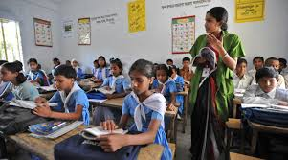
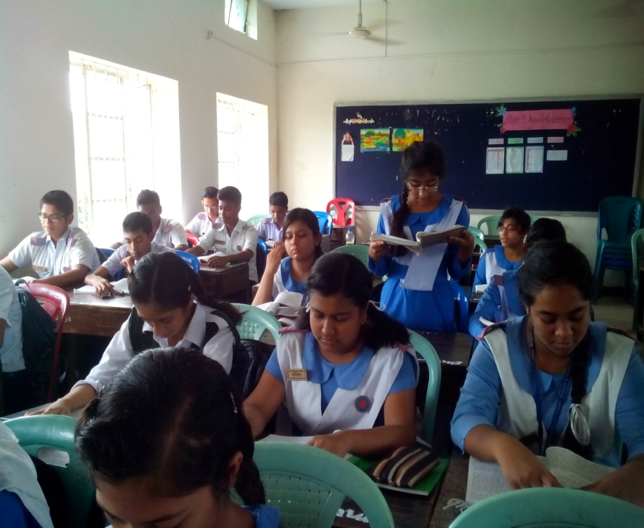
Loud Reading
Para 1-2
Silent Reading
Para 3-4
And underline the uncommon words

Slide 10
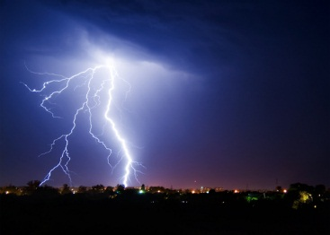
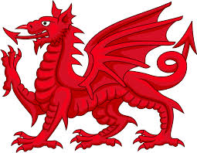
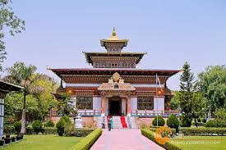
Word meaning and sentence making
A loud sound that follows a flash of lighting
Thunder
Dragon
A legendary creature
Monastery
Church, temple ,Shrine

Slide 11
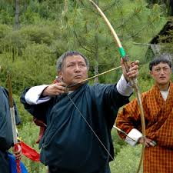
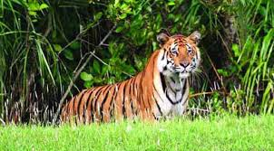
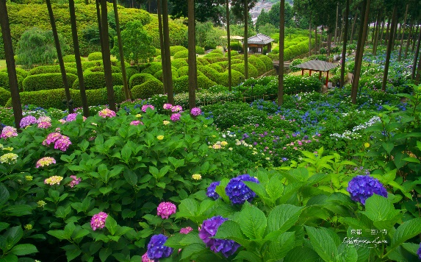
Shooting with bow and arrow
Archery
The animals of particular region
Fauna
The plants of particular region
Flora

Slide 12
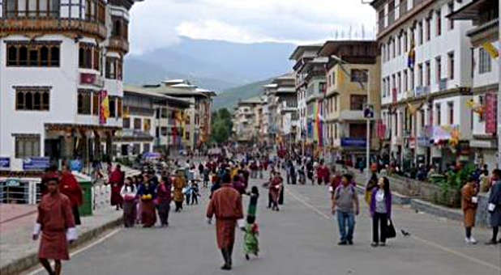
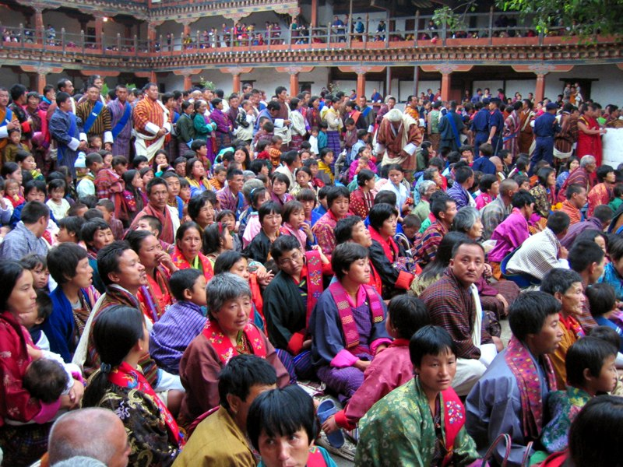
Now, match the pictures with text
Population is about 7,16,496
Thimphu, Capital city of Bhutan.

Slide 13
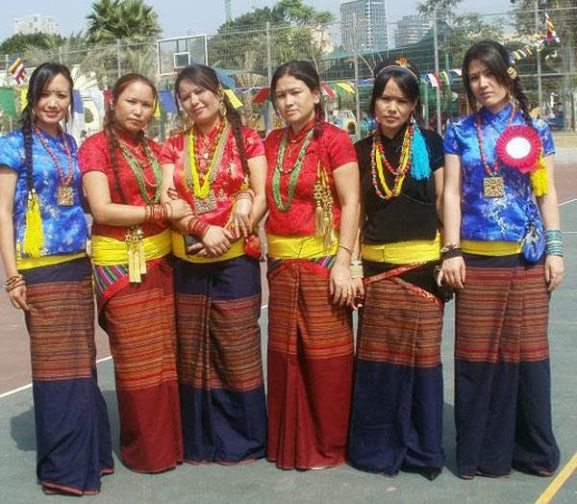
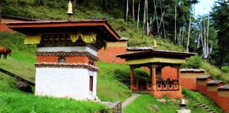
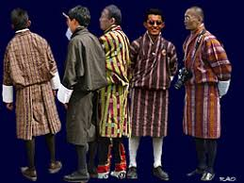
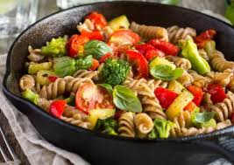
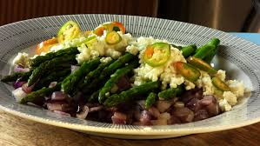
Match the pictures with your reading
Houses made of wood stone and mud
Bhutanese men wear Gho –a knee length robe.
Bhutanese food
Bhutanese Women wear Kira

Slide 14
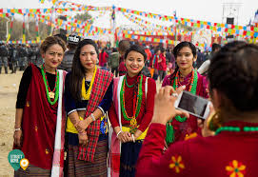
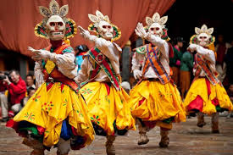
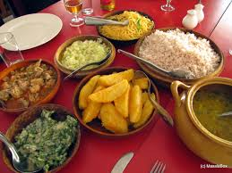
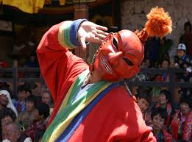
Bhutanese festival, food & cultures.

Slide 15
Let’s observe the video of mask dance which is performed to protect the valleys and ward off evil sprits

Slide 16
Pair work
Now, make a dialogue with your partner about Bhutan’s land area, population, Bhutanese food & food habit, dresses, festivals etc.

Slide 17
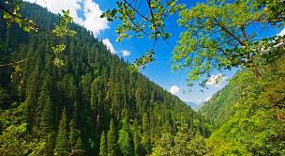
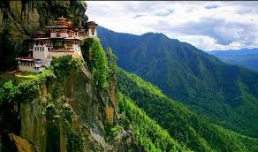
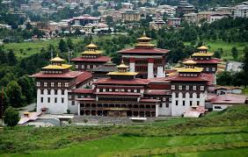
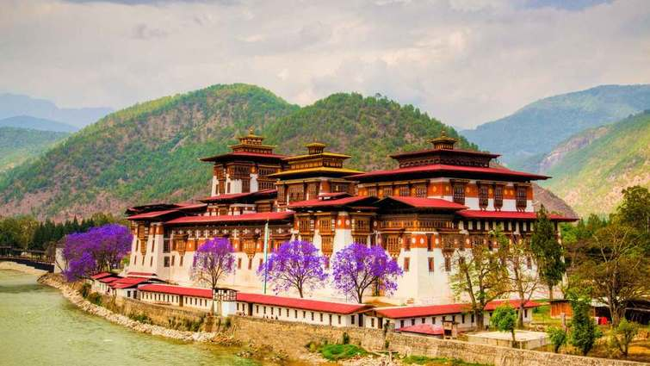
Bhutan is the only country that preserves its
environment by constitutional laws.

Slide 18


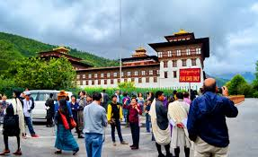
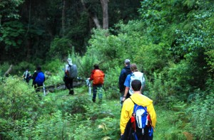
Before1999 Bhutan prohibited the use of TV& Internet and now lifted ban .
Pure mountain air, crystal blue skies and pristine vegetation allure foreigners to visit this small country.
Tourism is encouraged but is controlled and limited to 6000 visitors a year to protect intrusion of foreign cultures.

Slide 19
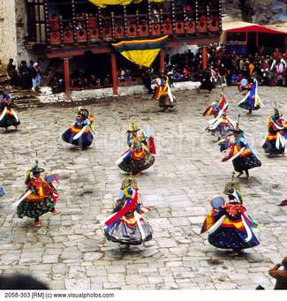
Bhutan measured as happiest country in Asia and the eighth happiest country in the world.

Slide 20
Bhutan is measured as the happiest country in Asia and the eighth happiest
Country in the world.

Slide 21
Group work
Group-1
Group-2
Bhutan is an ideal destination for environment lovers. Explain it.
Bhutan is called the land of happiness. Explain it.

Slide 22
Evaluation
Choose the best answer from the alternatives:
Q:1. A unique culture and tradition has evolved in Bhutan because------
a) fierce Himalayan storms often hit the country.
Ans:
b) it is cut off from the other parts of the world.
Ans:
b) it is cut off from the other parts of the world.
c) it has a very small area.
d) it is called the Jewel of the Eastern Himalayas.

Slide 23
Evaluation
Answer the following question in brief.
a) What is Tshechus?
b) When is the Losar celebrated ?
c) How do Bhutanese build their houses ?
d) How do Bhutan government protect their environment?

Slide 24
Home work
Write a letter to your friend describing about
Bhutan, its important places, cultures, food
and festivals of Bhutanese.

Slide 25
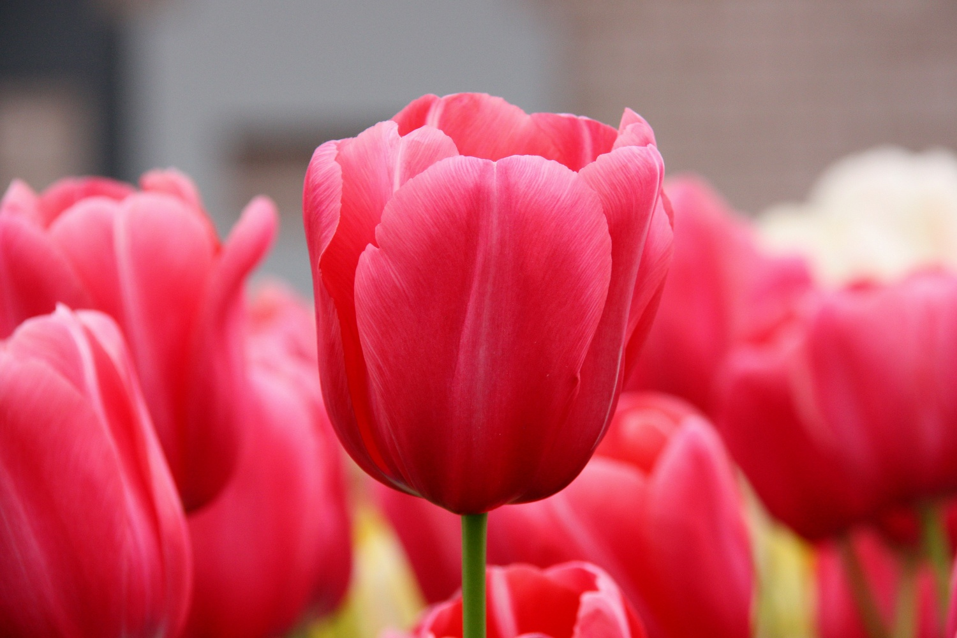
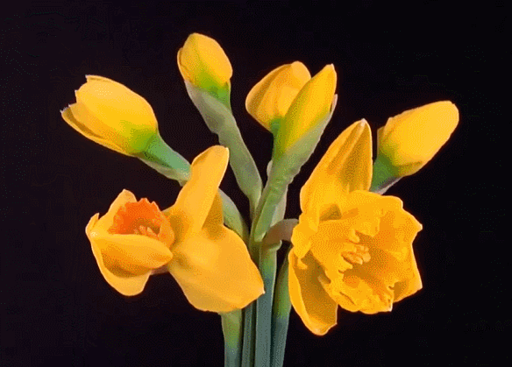
GOOD BYE
Be attentive to your studies.

