Slide 1

WELCOME

Slide 2
INTRODUCTION
Hosne Ara
Asst. Teacher( Eng)
Kumarkhali M.N. Model High School
Kumarkhali
Class: 9/10
Sub: English 2nd paper
Today’s Lesson: Paragraph writing

Slide 3
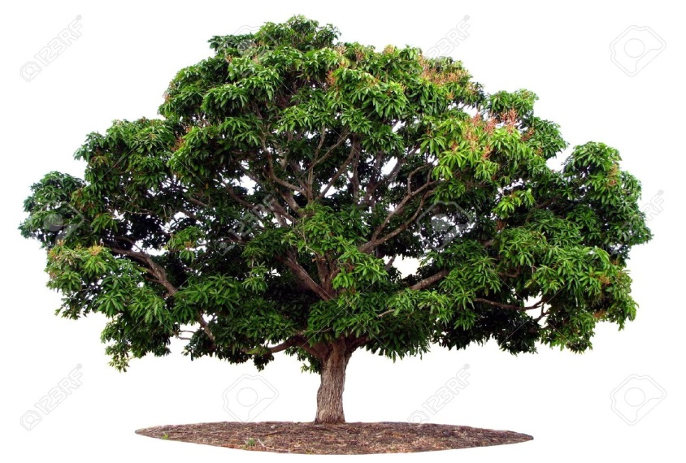
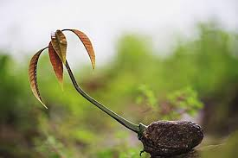


Slide 4


Slide 5
Objectives
By the end of the lesson students will be able to…
Tell about tree plantation
Describe the importance of planting trees
Write a paragraph

Slide 6
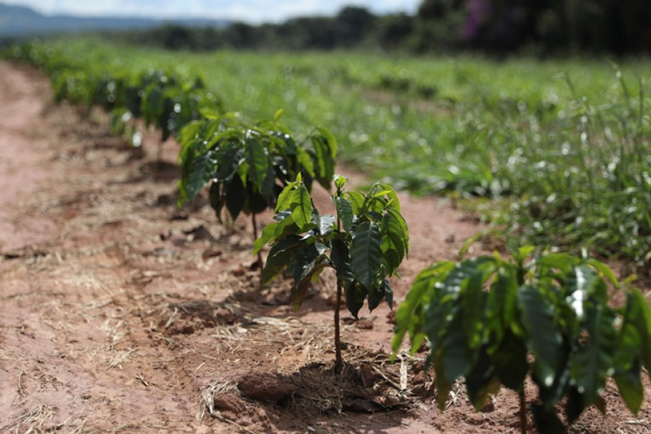
Tree plantation means
planting trees at a large scale in a planned way

Slide 7

Why is tree plantation necessary?
Trees give us Oxygen, take carbon di oxide and prevent air pollution

Slide 8
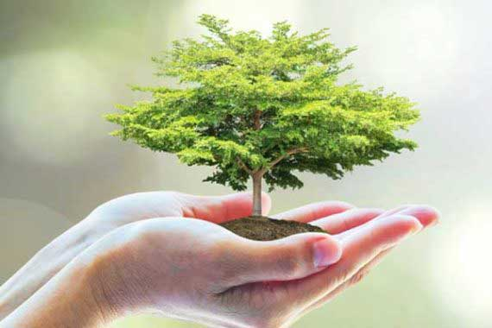
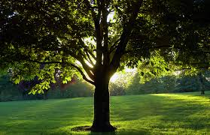
Trees are our best friends
They give us shade and soothe our eyes with green

Slide 9
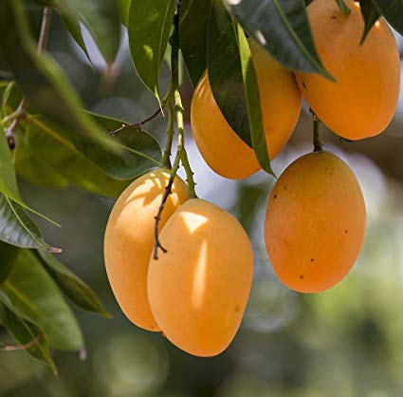
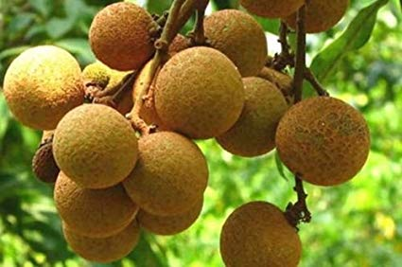
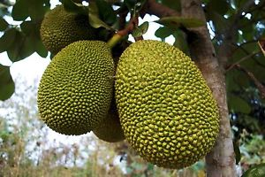
They give us various kinds of fruits

Slide 10
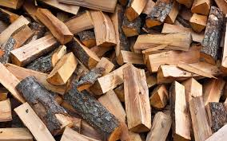


They also give
Firewood for cooking
Timber for furniture
Railway slippers

Slide 11
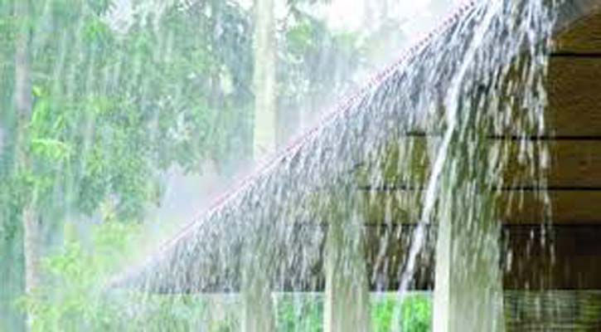
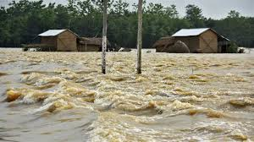
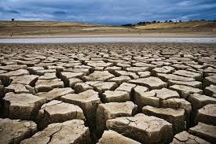
Trees cause rainfall
They save us from
Flood
Drought

Slide 12
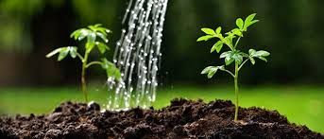
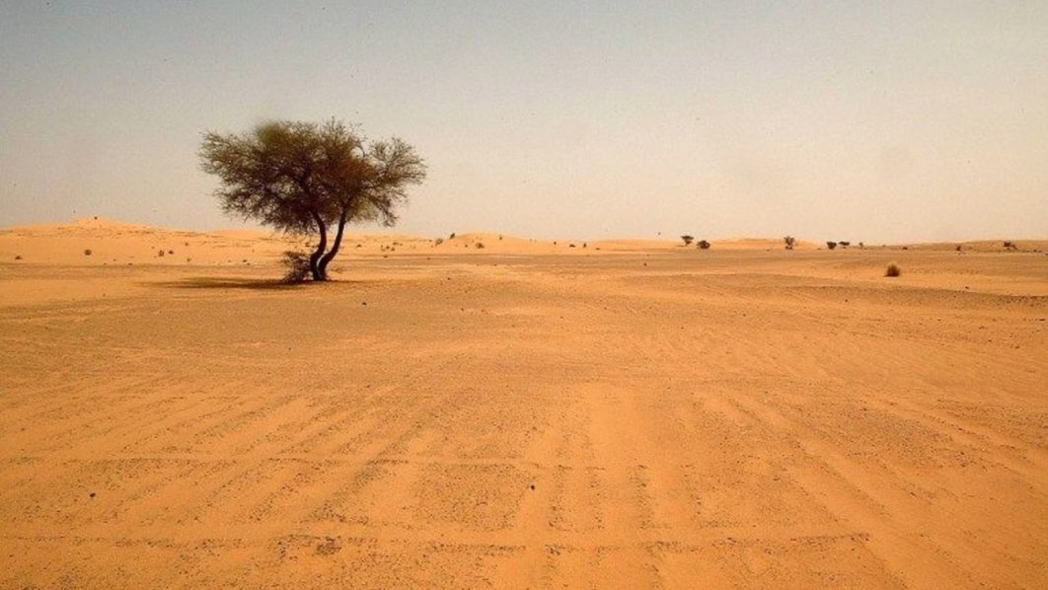
July and August are suitable month
For planting trees in Bangladesh
Without trees the country will turn into a desert

Slide 13
Group Work
What will happen if we do not plant more trees?

Slide 14
Evaluation
1.What does tree plantation mean?
2.Which months are suitable for planting trees?
3.What do trees cause?

Slide 15
Home Work
Write a paragraph on
“Tree Plantation”

Slide 16
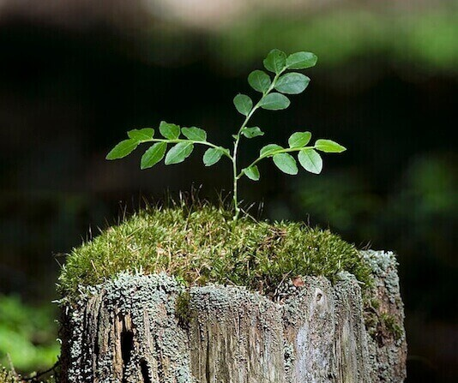
SEE YOU AGAIN

