Slide 1

Welcome to English Class

Slide 2
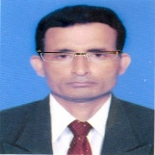

Identity
Manik Chandra Majumder
Senior Teacher (English)
Gazirhat High School
Senbag, Noakhali
Mobile No: 01717155169
Email: manikmajumder01@gmail.com
Class : Nine-Ten
Subject : English 1st paper
Time : 50 Minutes
Date : 00/00/2017

Slide 3
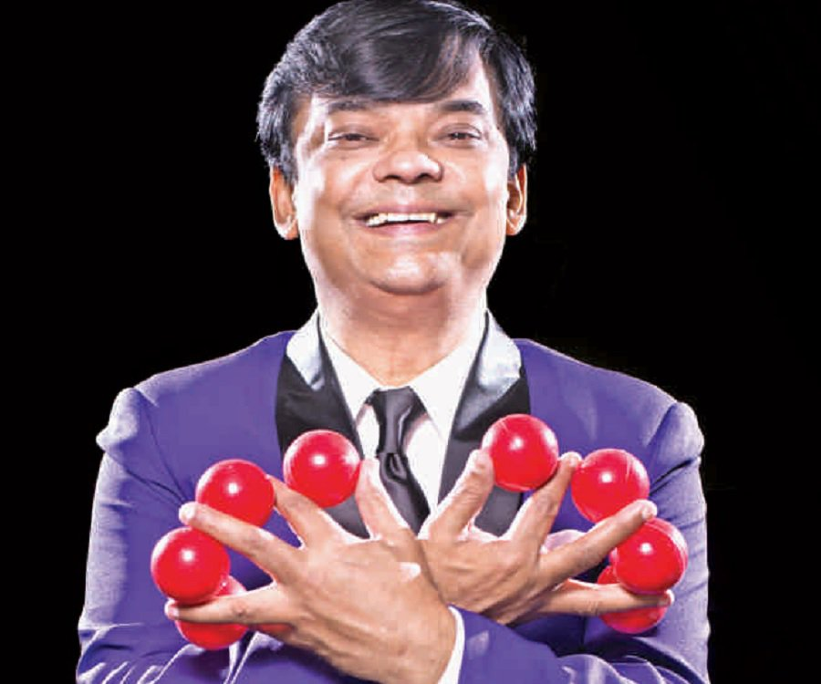
Who is he?
What does he do?

Slide 4
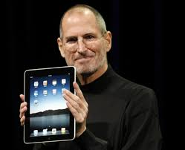
He is famous for manufacturing Apple Computer.
Why is he famous for?
He is Steven Paul Jobs.
(Steve Jobs)
Who is the man?

Slide 5
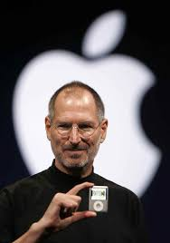
Our today’s topic is…….
The Wizard of Apple
Unit : Seven
Lesson : Seven
Page : 119

Slide 6
Learning Outcomes:
After we have studied this lessons, we will be able to:
a) listen to a text for specific Information,
b) ask and answer questions,
c) read and understand through silent reading,
d) write about the life and career of Steve Jobs.

Slide 7
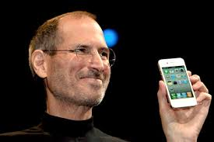
Some information about Staven Paul Jobs
Born: 24 January, 1955
Pioneer of personal computer revolution
Co-founder, chairman and Chief Executive officer of Apple Inc.
Has changed people’s outlook towards computer
Founded NexT, another
Computer platform.
A visionary leader
Co-founder & Chief
Executive of Pixar
Animation Studios.
Died-
5 October,2011

Slide 8

Look at the picture and ask and answer of the questions to your partner?
a) What do you see ?
b) Are you familiar with this logo ?
c) What does this logo stand for ?
d) Which company uses this logo
for its products?
Apple Logo

Slide 9
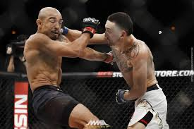
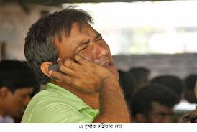
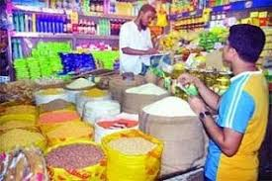

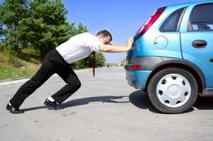
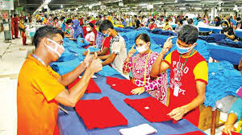
Click word
Word meaning and sentence making
Meaning :Improve , Flourish, Prosper
Meaning : Struggle ,Fight, Conflict
Meaning : Insolvency , Unable to repay loan
Meaning : Observe ,Take care ,Guide
Meaning : Buyer , Customer, Client
Meaning : Press , Shove, Knock. Collide, Clash
Develop (V)
Supervise (V)
Bankruptcy (N)
Consumer (N)
Revolution (N)
Push (N)
Sentence : He brought apple from the verge of bankruptcy.
Sentence : He was a pioneer of computer revolution.
Sentence: Jobs supervised his company’s product.
Sentence: Jobs developed his company day by day.
Sentence : He was famous for computer and consumer product.
Sentence : He pushed Apple toward profitable company.

Slide 10
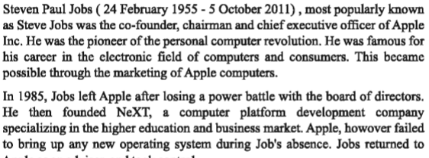
Read about Steve Jobs

Slide 11
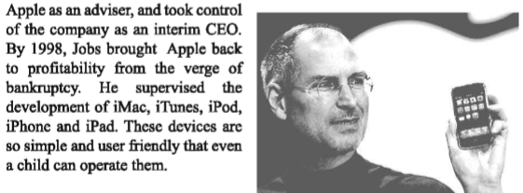

Slide 12
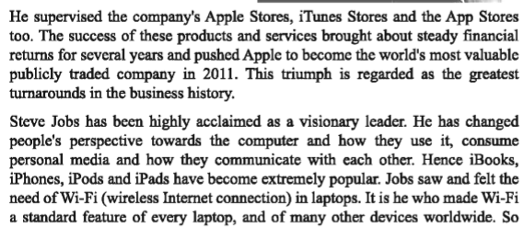

Slide 13
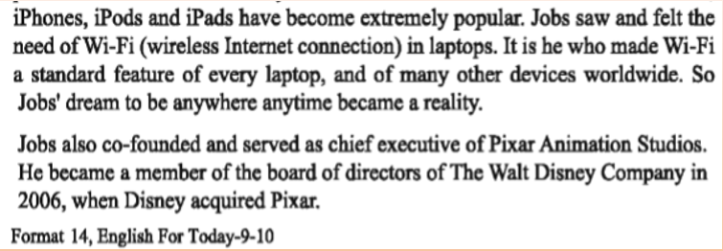

Slide 14
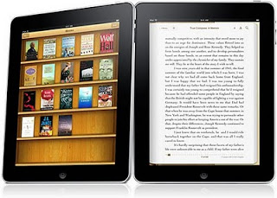
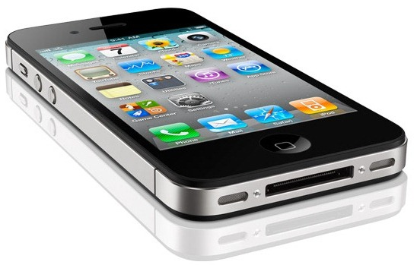
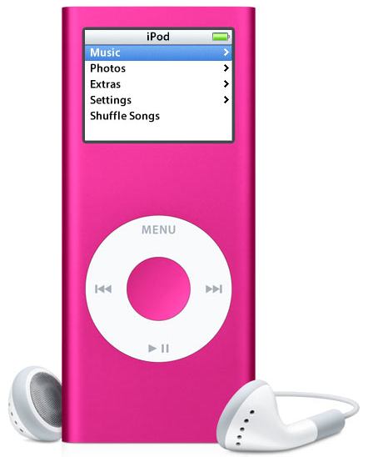
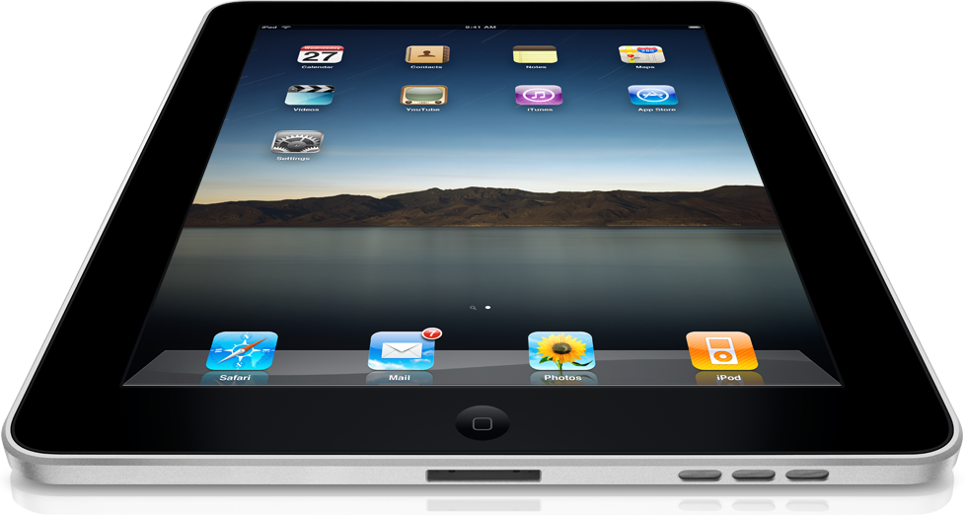
Jobs Innovation
Jobs introduced i-Books, i-Phones, i-Pads and i-Pods extremely popular
i-Books
i-Phones
i-Pods
i-Pads

Slide 15
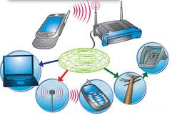
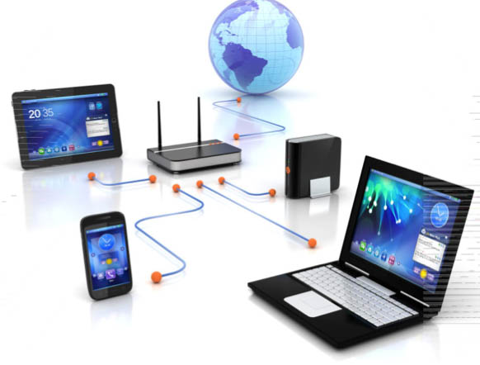
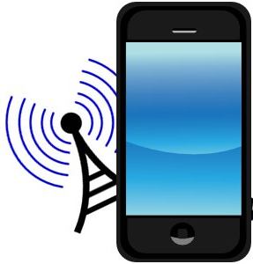
Jobs felt the need of Wi-Fi (wireless internet connection) and a standard feature of every laptop
Wi-Fi
Connection

Slide 16
Individual work
“Steve Jobs was called visionary” Explain in short.

Slide 17
Group work
Now fill up the information box
Time/Years | Happenings
24 Feb. 1955
1985
1998
2006
2011
5 Oct. 2011

Slide 18
Work in pair with your partner
What is NeXT
What is the importance of i-phone?
How did he bring about financial return of
Apple Inc?
d) Where did he serve as chief executive ?

Slide 19
Evaluation
a) Who was Steven Paul Jobs ?
b) What does “power battle” mean ?
c) How did Jobs manage to bring back apple ?
d) Why do people like the device of Apple ?
e) Why did he feel the need of Wi-Fi ?

Slide 20

Home work
Write in a short biography about Steve jobs and his contribution to establish Apple company.

Slide 21

GOOD BYE

