Slide 2
Teacher identity
Name – MD.Anowar Hossain
Assistant teacher
Pirpur Gouripur govt. primary school
Chhatak,Sunamgonj.

Slide 3
Lesson identity
Class- 5
Sub-English for today
Unit- 3
Lesson 1-2
Time-40min.
Page -10

Slide 4
Learning outcomes: student will able to........
Reading
1.5.1 –read words,phrases and sentences in the text with proper pronunciation,stress and intonation.
5.1.1—read silently with understanding paragraph.

Slide 5
Look at the video and think about this
What do we call them?

Slide 6
Look at the picture
Think about this

Slide 7
Saikat’s family

Slide 8
Teacher’s reading

Slide 9
Student’s silent reading

Slide 10
Saikat
Saikat islam lives with his parents in a flat in bogra.

Slide 11
Saikot’s father
His fatherMr.rashidul Islam is a banker.
But in his free time mr. islam writes stories and listens to music.

Slide 12
Saikots mother
Saikat’s mother is mrs. Monwara Islam. She is a housewife.In her free time she enjoys sewing. She makes dresses. She often gets orders from her friends and neighbours.

Slide 13
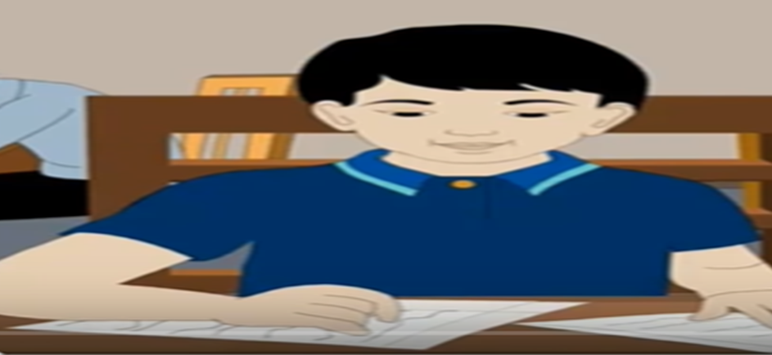
saikat
Saikot is in class five.
He is a good student.
He wants to improve his english .
So he watches cartoons on TV everyday.
He also reads English books.
He likes books about animals, especially tigers and lions.

Slide 14
PAIR WORK
Ask and answer the question
1. what is saikat’s father name ?
2.what is saikat’s mother name?
3.what does saikat do in his free time ?

Slide 15
Group work
Match with column A and column B
clothes
develop
Free time
dresses
improve
leisure

Slide 16
Evaluation
What does parents mean?
Parents means father and mother.
What does saikat’s father do ?
Saikat’s father is a banker.
What does saikat’s mother do ?
Saikat’s mother is a housewife.

Slide 17
Homework
Write five sentences about your family .

Slide 18
Thank you all

