Slide 1
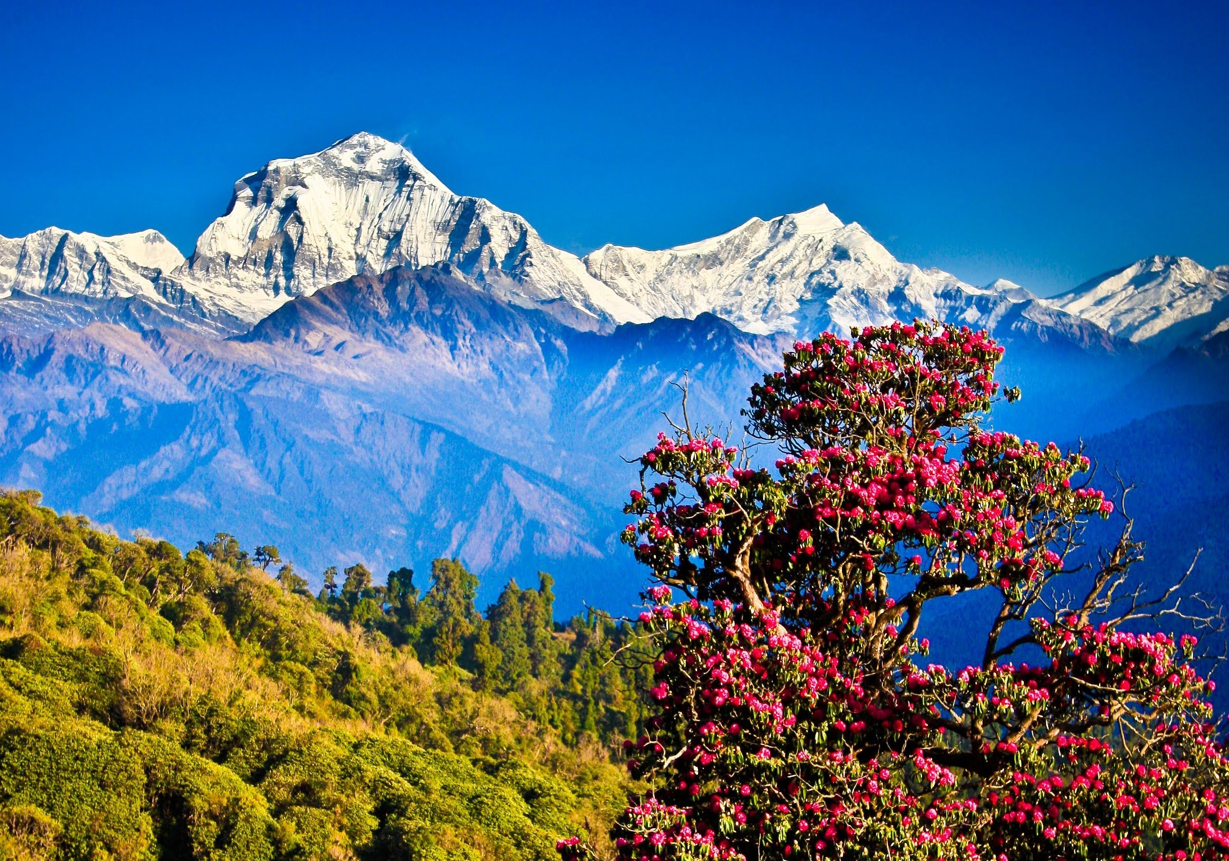
WELCOME

Slide 2
INTRODUCTION
HOSNE ARA
Asst. Teache(Eng)
Kumarkhali M.N. Pilot Model High School
Kumarkhali
Class: Ten
Sub:English
Unit: Six
Lesson:one

Slide 3
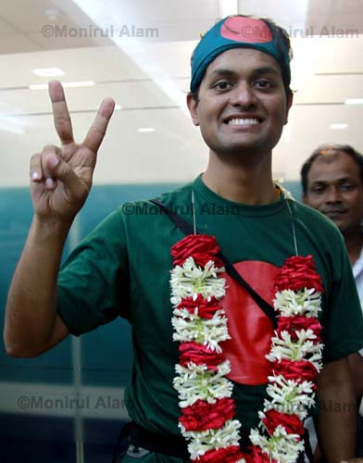
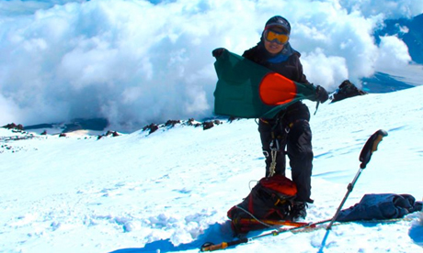
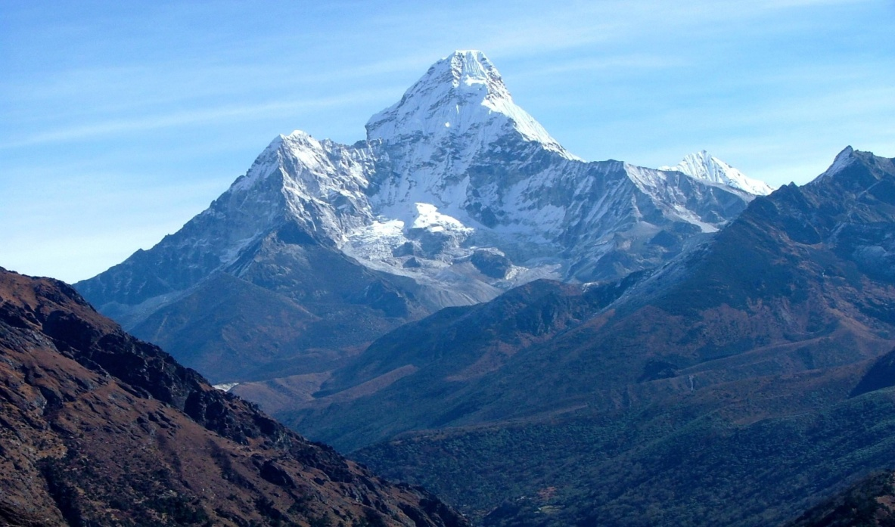

Slide 4
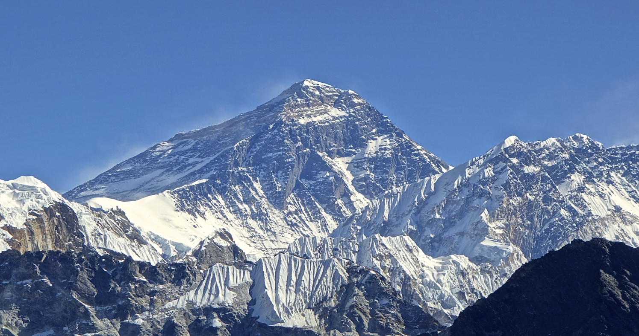
Nepal, the land of Everest

Slide 5
Learning outcomes
By the end of the lesson SS will be able to…
1. Tell the meaning of some new words
2. Read the information
3. write headings of each paragraph
3. Ask and answer questions

Slide 6
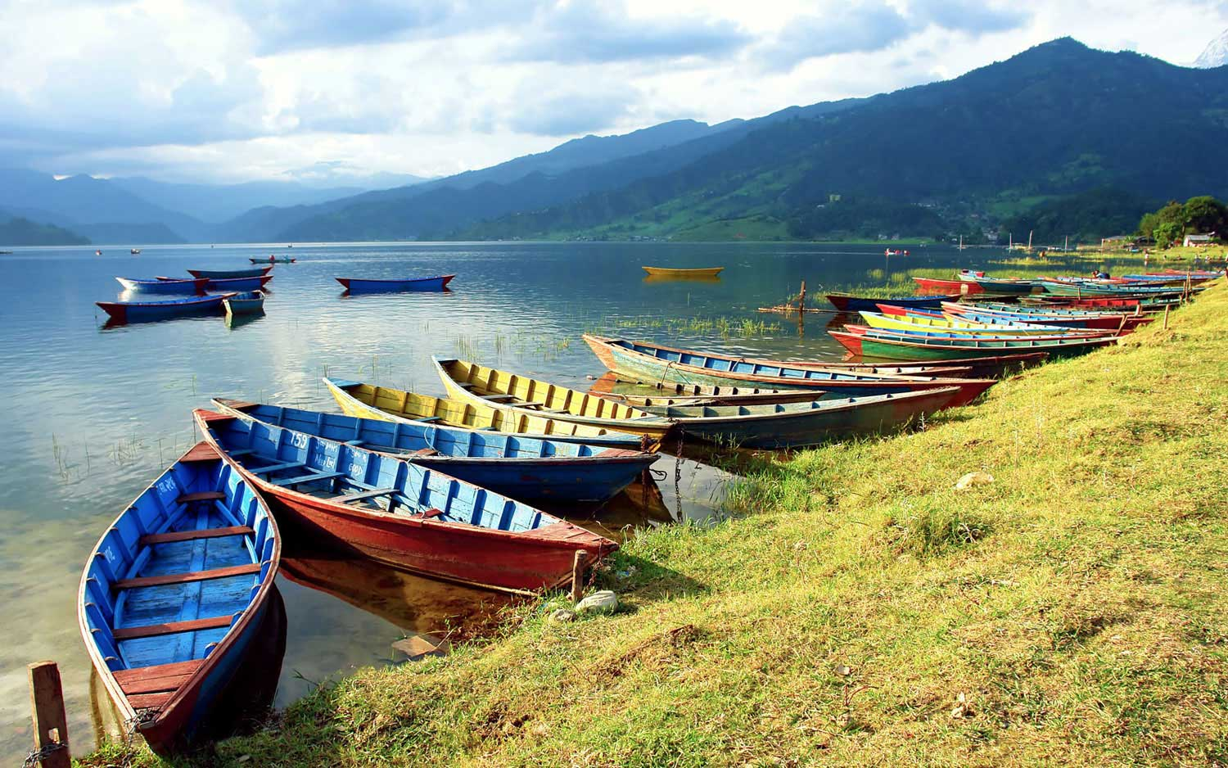
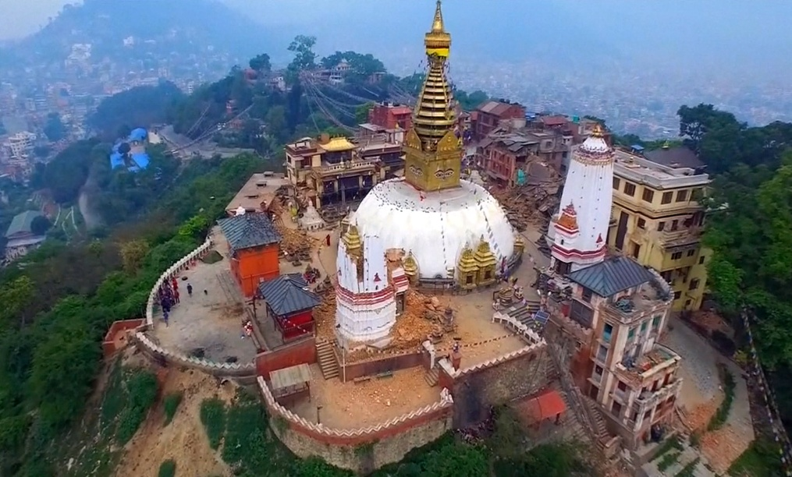
VOCABULARY
Charming
Beautiful
Kingdom
State, Country

Slide 7
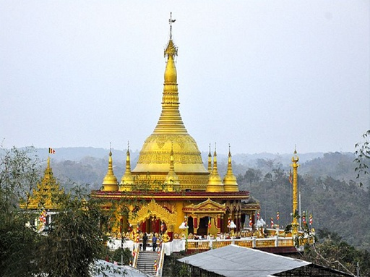
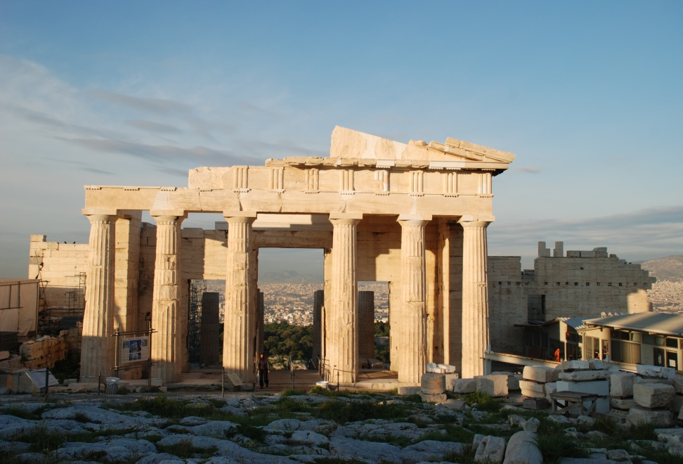
Temple
A place where Hindus pray
Heritage
Inheritance

Slide 8
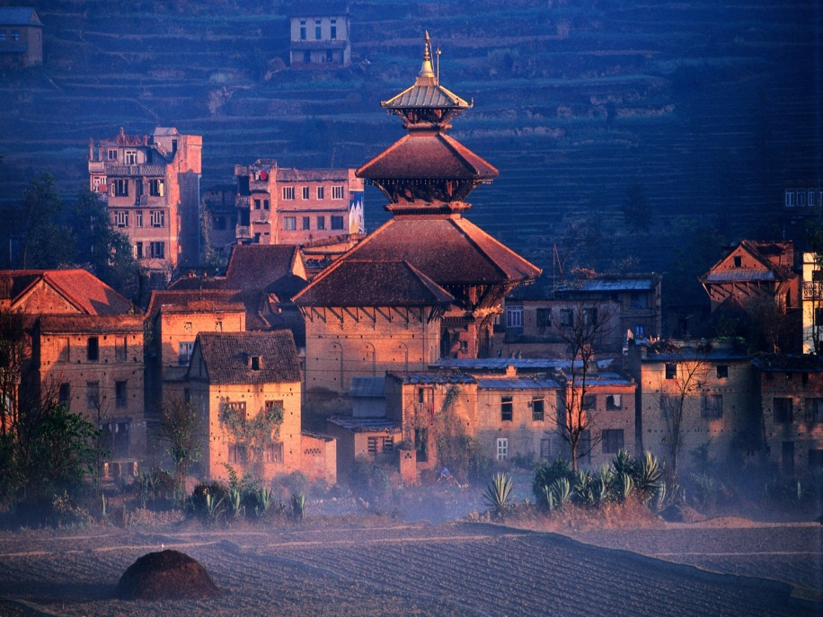
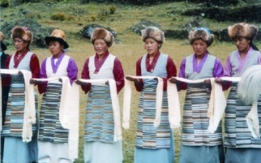
Glorious, Beautiful
Sublime
Ethnic
Groups having distinct racial and cultural features

Slide 9
Read the passage silently and choose the most suitable headings for paragraphs(a,b,c) from
(page64-65)

Slide 10
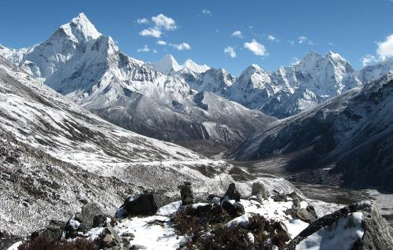
NEPAL
Known as the Land of Everest

Slide 11
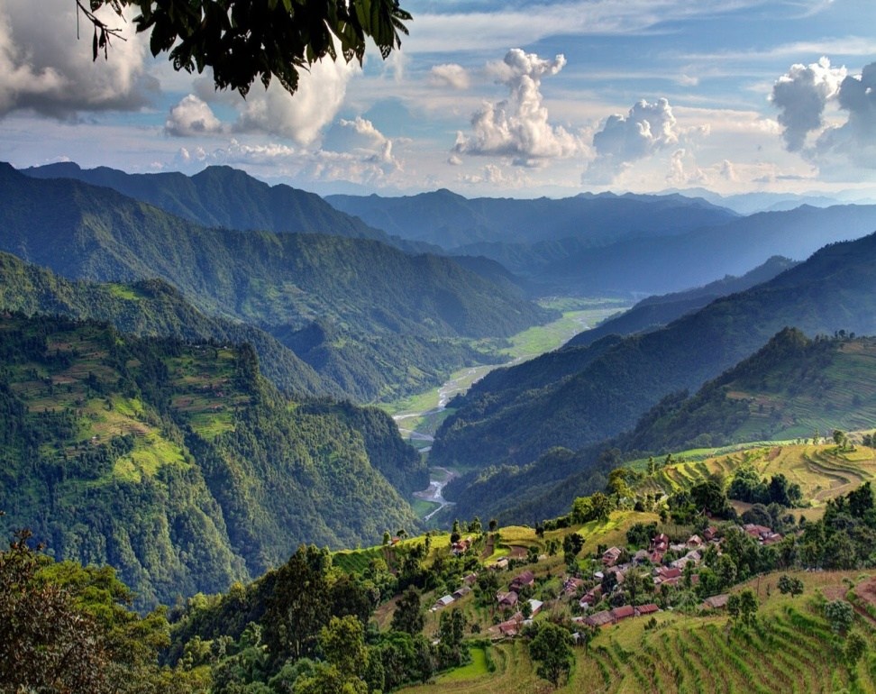
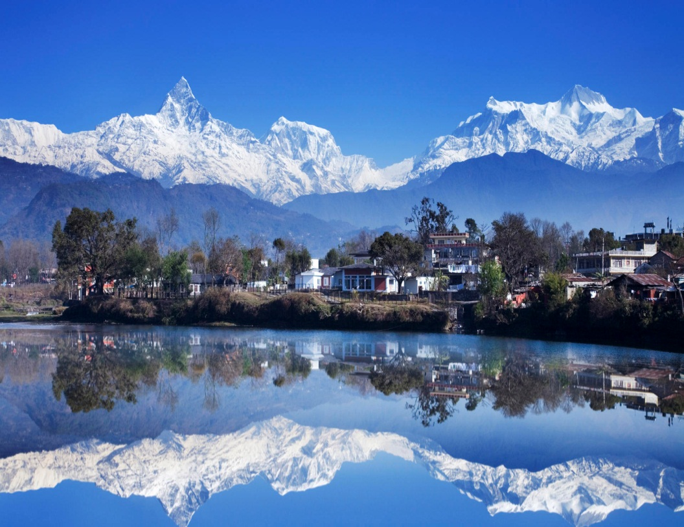
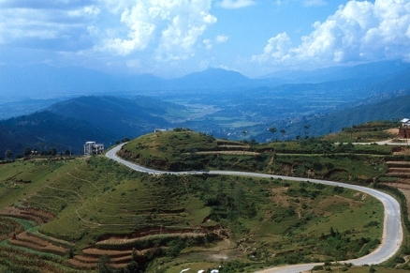
One of the most charming countries of the world

Slide 12
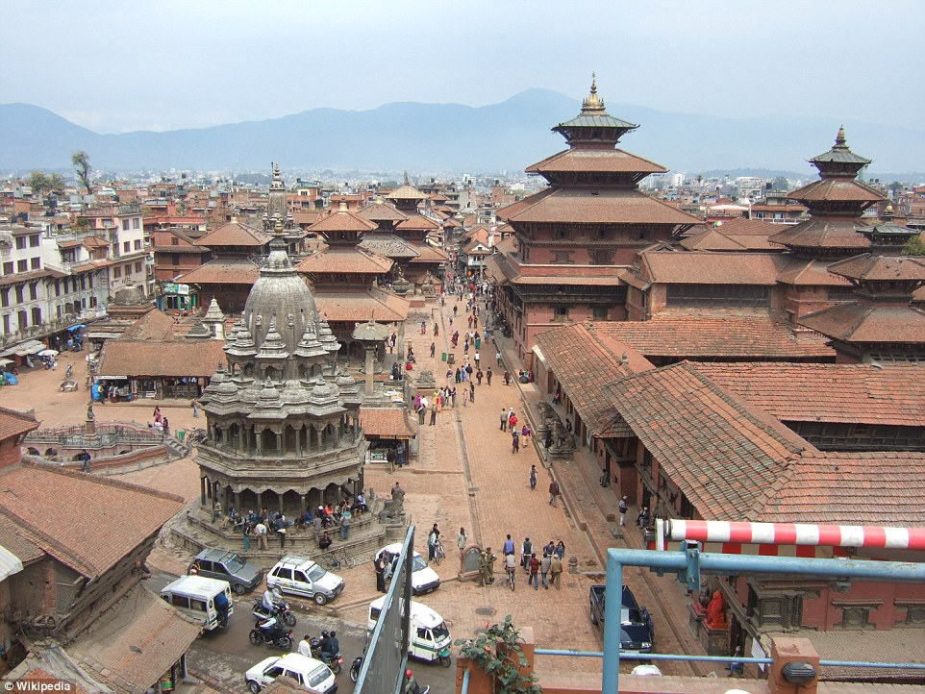
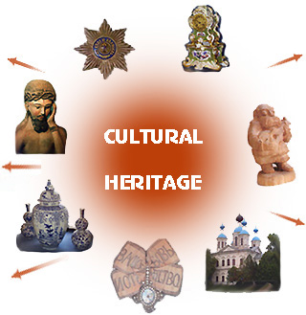
Also known as the only Hindu Kingdom in the world
Rich in scenic beauty and cultural heritage

Slide 13
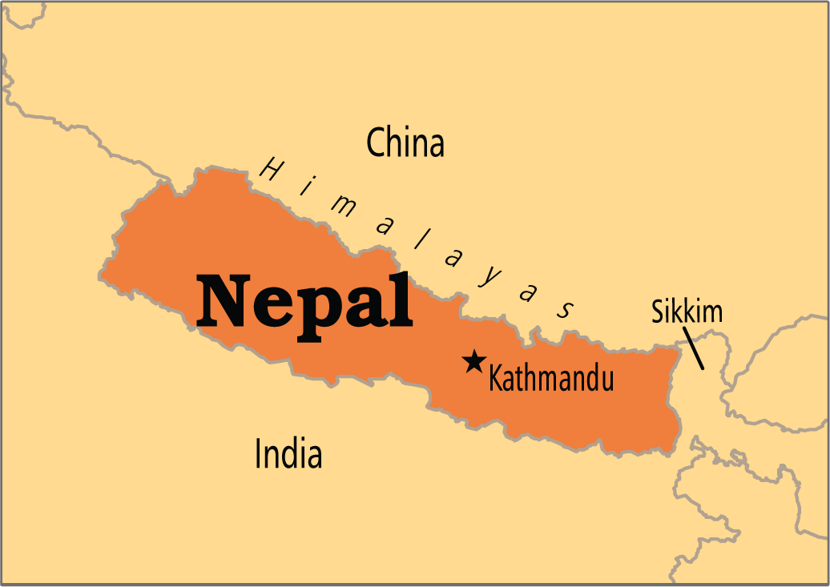
Nepal lies between India and Tibetan part of China
Having an area of 147,181 square km.

Slide 14
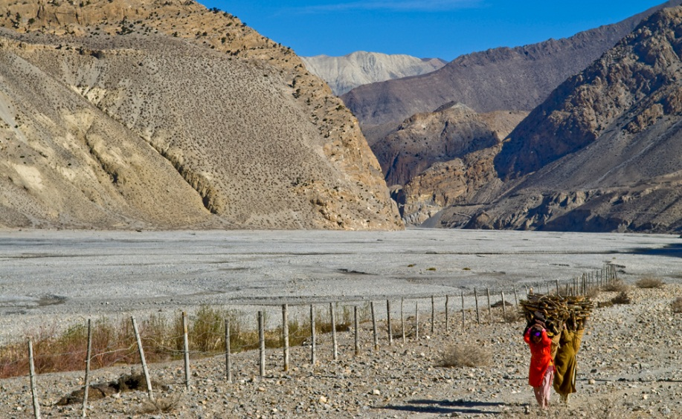
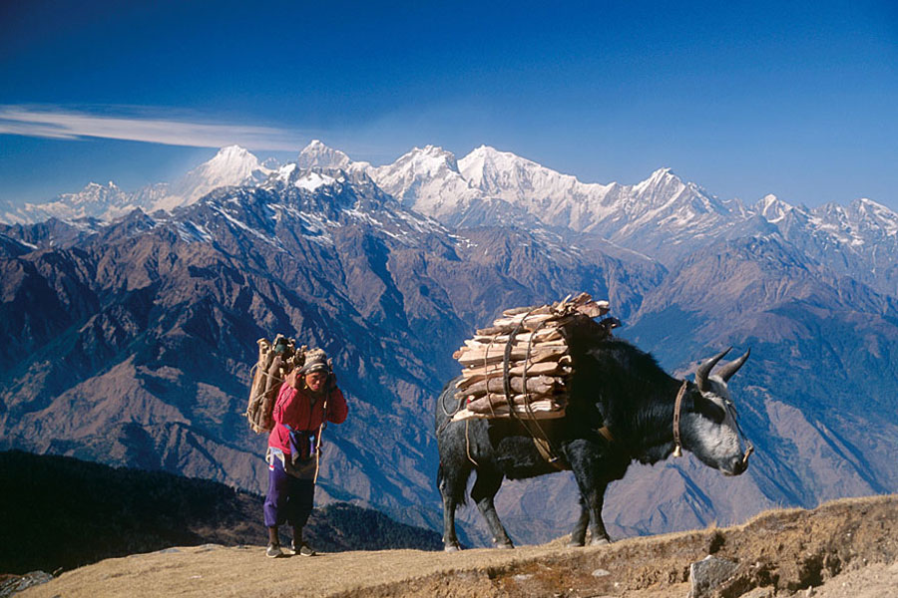
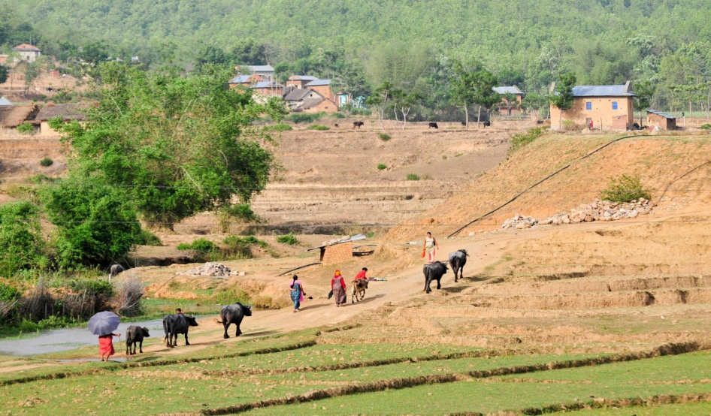
Southern Nepal is tropical low land known
asTarai Plain
This part has
Cold winter
Hot summer

Slide 15
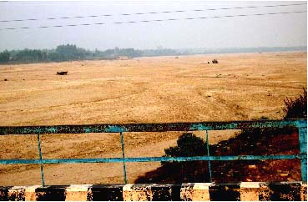
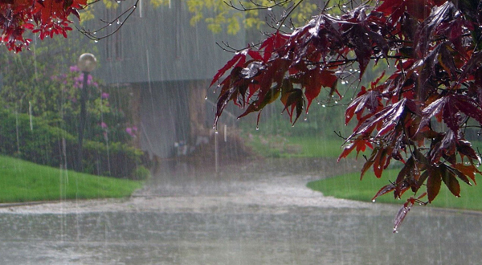
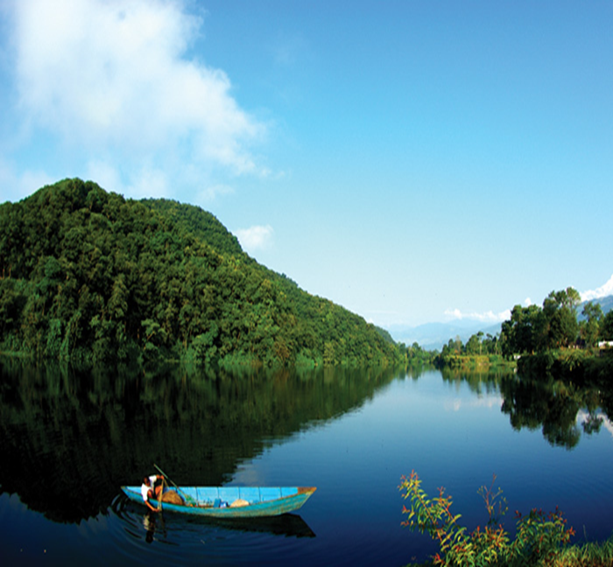
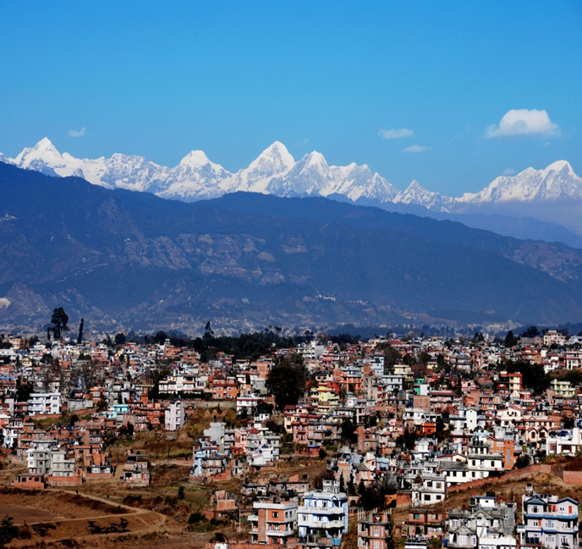
Temperatures reach up to 40° in April and May
Monsoon rains drench from June to Sept.
POKHARA VALLEY
KATHMUNDU
Have a temperate climate

Slide 16

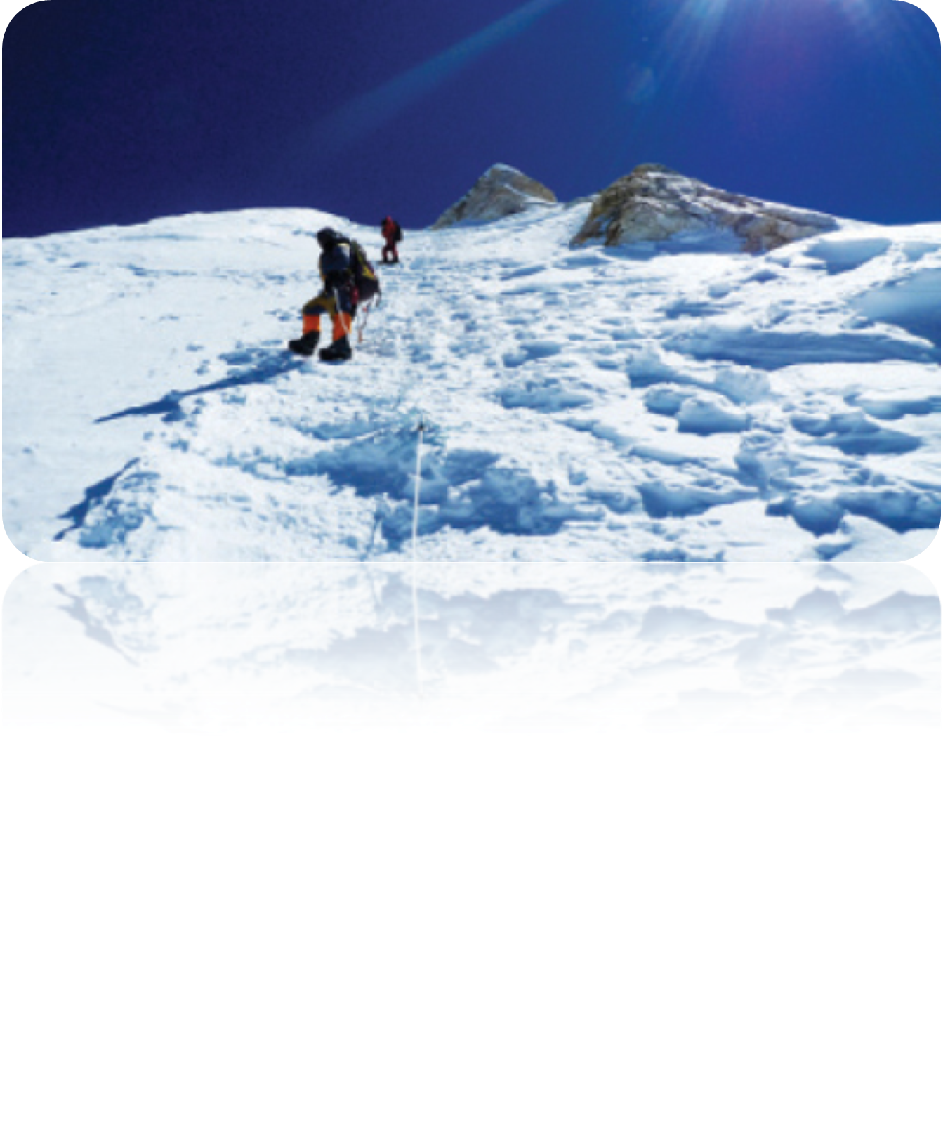
North of that is the slope of the main section of the Himalayan range
This part of Nepal has some of the highest peaks of the world including EVEREST

Slide 17
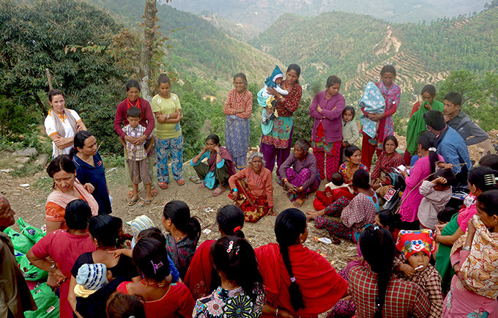
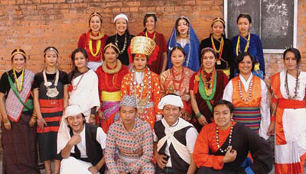
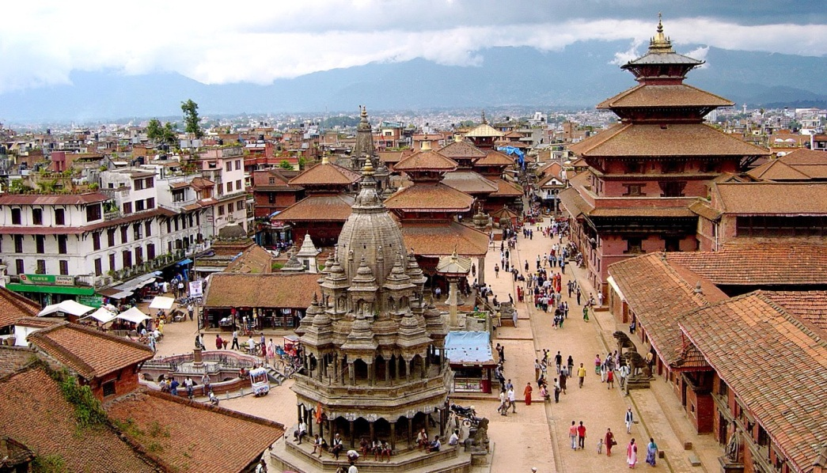
Nepal is home nearly to 29,000,000 people
The population is primarily rural
Kathmundu has less than one million inhabitants

Slide 18
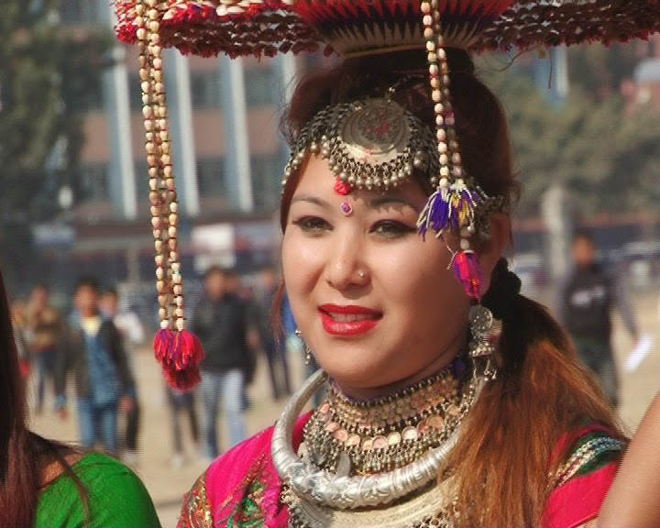
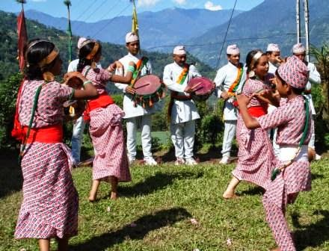
The largest ethnic group
103 castes and ethnic group live in this country
CHETRI
BAHUN
Others include MAGAR, THARU, TAMANG,NEWAR, MUSLIM, GURUNG and DAMAI

Slide 19
LANGUAGE
language
Maithali
Tharu
Bhojpuri
Tamang
Nepali
48 percent people speak in NEPALI

Slide 20
WORK IN GROUP
GROUP-A
GROUP-B
DDefine the
statement“Nepal is a blend of natural beauty and cultural heritage”
“A small population with huge diversity” give opinion about this statement.

Slide 21
EVALUATION
1.What is kingdom?
2.How many ethnic groups are there in Nepal?
3.What do you know about the weather of Nepal?
4.How many people live in Nepal?

Slide 22
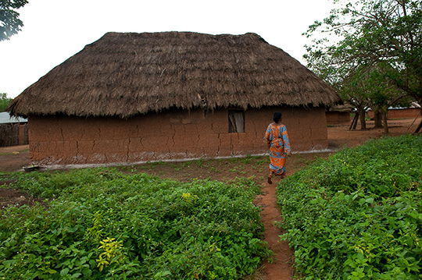
HOME WORK
Write a letter to your friend highlighting the main attraction of Nepal

Slide 23
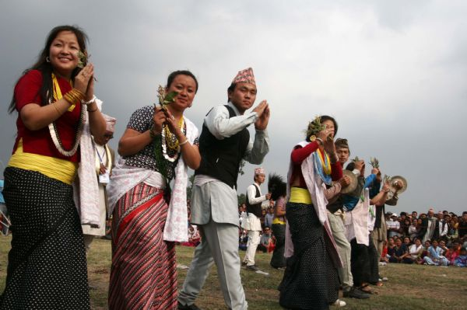
SEE YOU AGAIN

