Slide 1
welcome

Slide 2
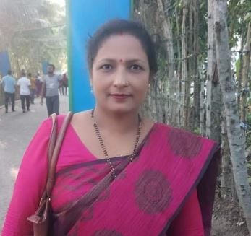
Presented by-
Lesson Detail-
Name: Topi Rani Sen
Asst:Teacher (ICT)
Bhabna Secondary School.
Fakirhat,Bagerhat.
Email- topisen795@gmail.com
Today’s lesson:
English 2nd paper
Class: Six
Topic:Noun
Time: 5o min.

Slide 3
After this session the students will be able to ----------
To define noun.
To find out noun.
To classify noun.
To find out countable and uncountable noun.

Slide 4
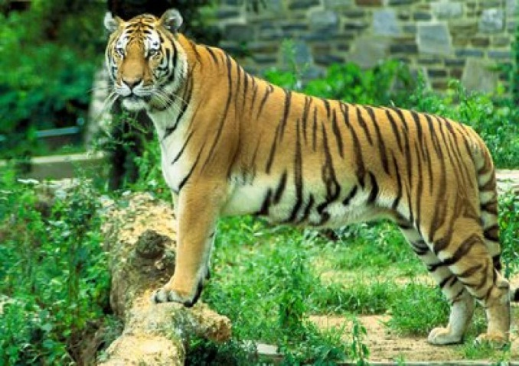
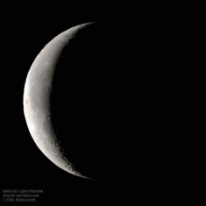
Look and say:-
What is the name of this ?
Tiger
What is the name of this ?
Moon
What is the name of this ?
Flower

Slide 5
Today we’ll learn.
Noun

Slide 6
What is Noun ?
Ans: A noun is a word that represents a person, place, thing or idea.
Example:
Man
Book
Bag

Slide 7
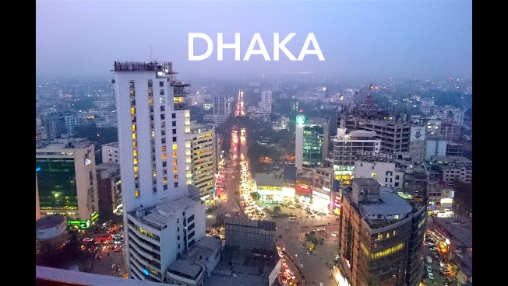
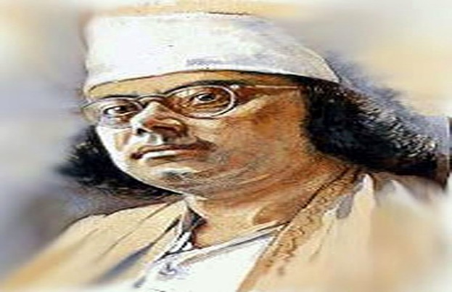
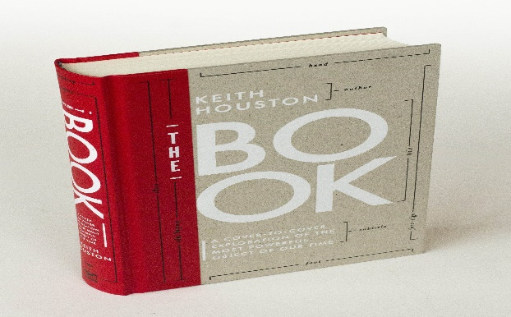
To find out noun from these following sentences:
1. The capital of Bangladesh is Dhaka.
2. Kazi Nazrul Islam is our national poet.
3.That’s his favorite book.

Slide 8
Types of Noun:
1. Proper noun.
2. Common Noun.
3. Collective noun.
4. Material noun.
5. Abstract noun.

Slide 9
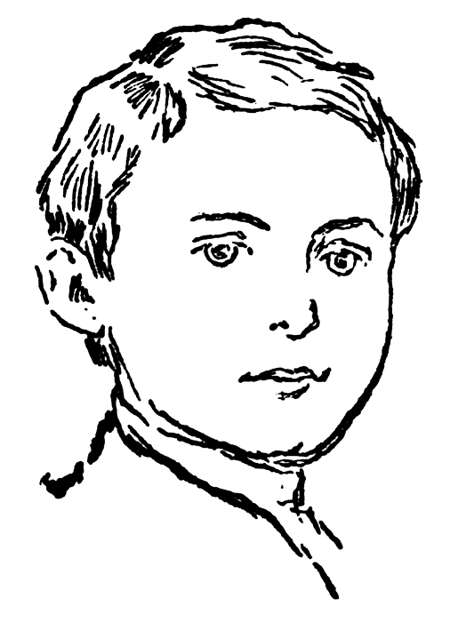
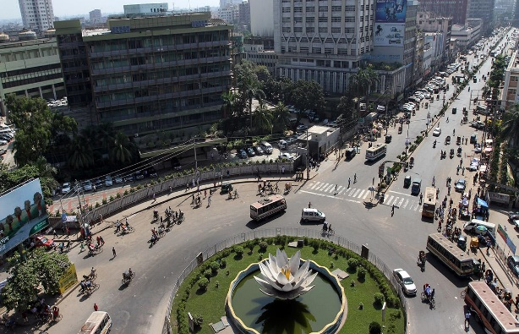
Proper noun
A proper noun is a specific person, place or thing, and is always capitalized.
Bapi is a boy.
Bapi
Rahim is a student.
Rahim
Dhaka is the capital of Bangladesh.
Dhaka

Slide 10
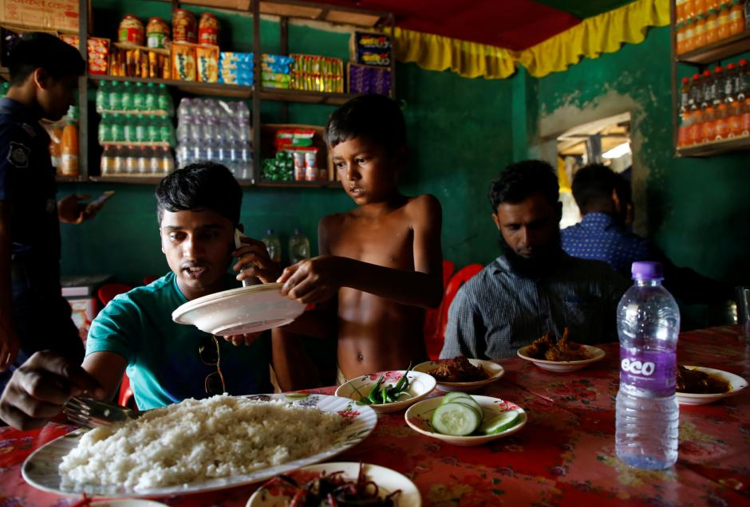
Common Noun.
A common noun names a general person, place, or thing and is not capitalized.
1. Dhaka is a big city.
city
2. He is an honest man.
man
3. He is working at hotel.
hotel

Slide 11
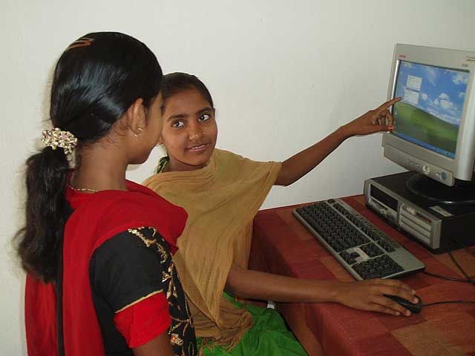
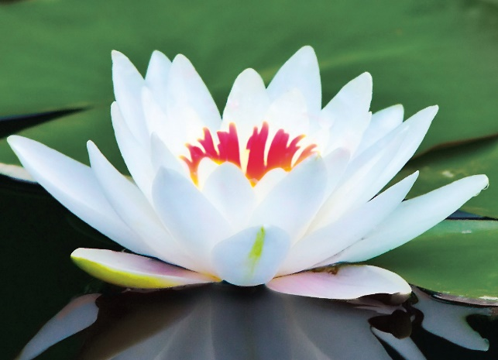
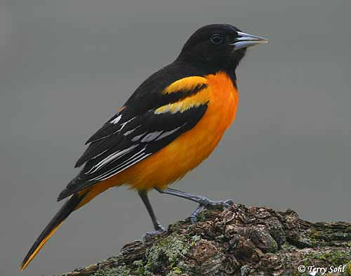
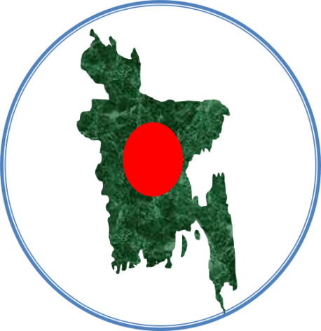
Pair work:
Make a sentence by looking at the picture

Slide 12
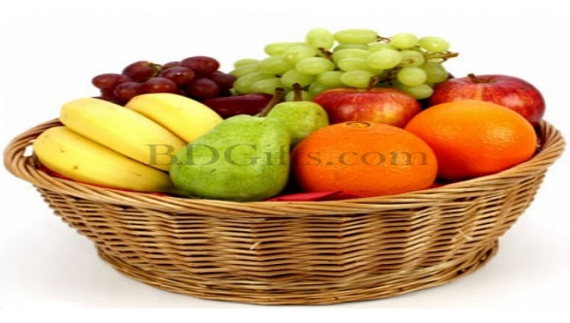
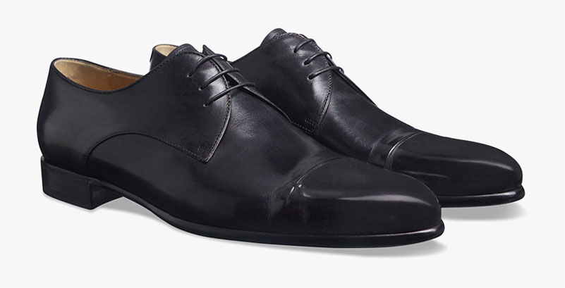
Collective noun.
Collective nouns refer to group of people or things.
1. I will join the Army.
2. I have a basket of fruits.
3. She needs a pair of shoes.

Slide 13
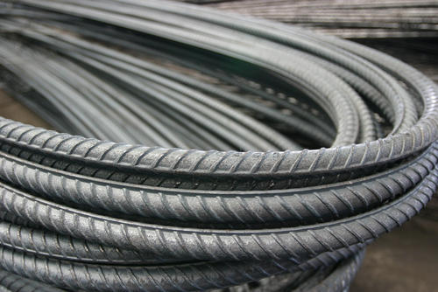
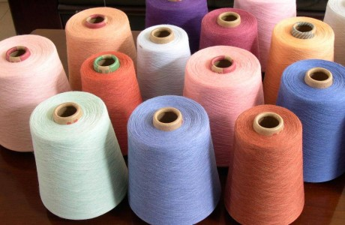
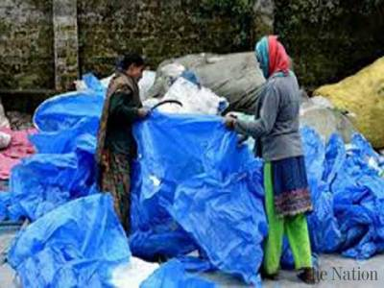
Material noun
Material noun is the name of material or substance from which things are made up of.
1. Iron is very useful metal.
2. Cotton dress is cheap.
3. Plastic is of much use.

Slide 14
Abstract noun.
An abstract noun is a name of something that we cannot see but can feel or think of.
I fell hot.
Honesty is the best policy.

Slide 15
Definition of countable and uncountable noun.
Countable noun: Anything that can be counted, whether singular or plural is a countable noun.
Uncountable noun: Anything that cannot be counted is an uncountable noun.

Slide 16
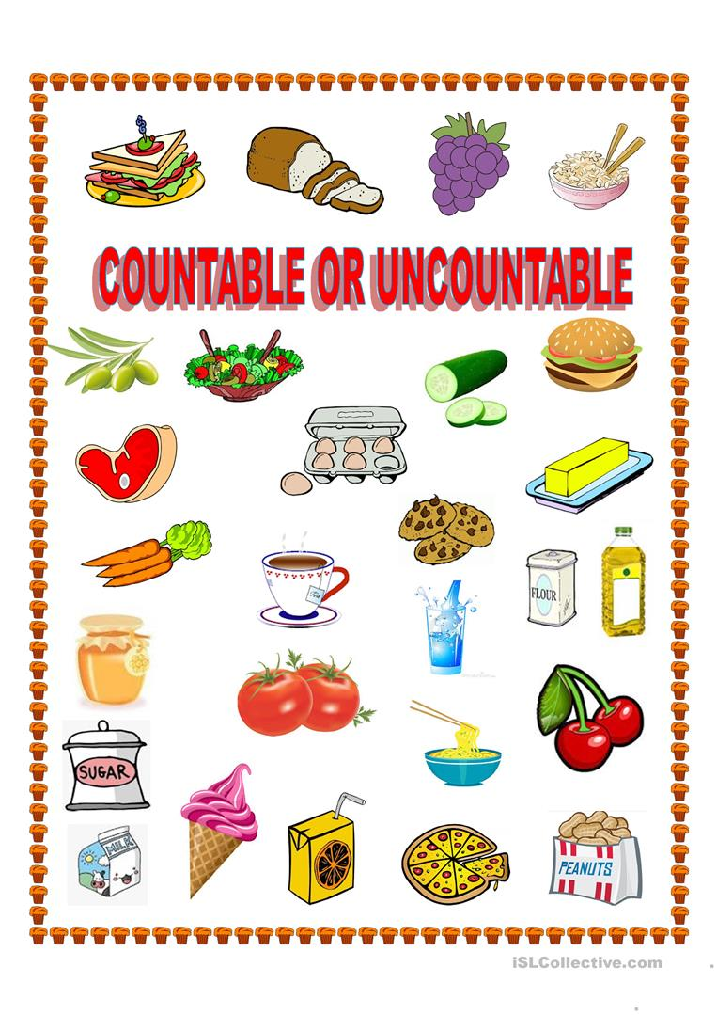
Find out the countable and uncountable
noun by look at the picture.

Slide 17
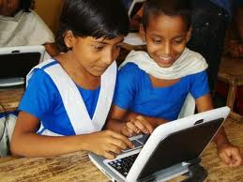
Group work:
Write the name of the following Noun and make ten Sentences.
Iron, Fruit, Gold, Khulna, Army, Honest, Water, Fire, Book, Cotton.

Slide 18
Evaluation:
Which word is noun?
1. He is a boy.
2. He lives in Dhaka.
3.Water has no colour.
Solution:
1. boy
2.Dhaka
3.Water

Slide 19
Home work:
How many kinds of noun ?Write their name. Give an example of each kinds of noun.

Slide 20
Thank you

