Slide 1
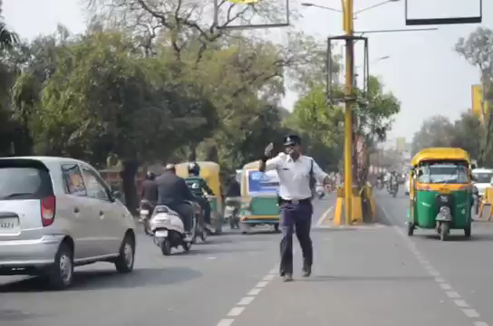
WELCOME

Slide 2
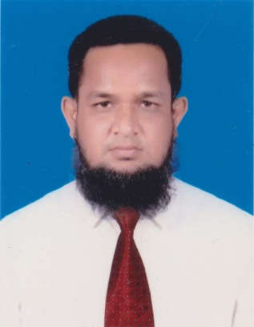
IDENTITY
Md. Abdur Rouf
Lecturer in English
Khalna Islamia Fazil(Degree) Madrasah,Patnitala,Naogaon
Cell: 01767650169
Email: rouf301285@gmailcom
Class: XI-XII
Subj: English 1st Paper
Time: 45 minutes
Date:12/09/2019

Slide 3
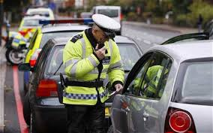
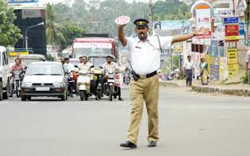
Let’s watch some pictures
Who are they in the pictures?
They are traffic police .

Slide 4
Today’s Lesson?
Unit:04
The Traffic Police
Lesson: 03

Slide 5
Learning Outcomes
By the end of the lesson, students will be able to
recite the poem;
answer the questions;
make sentences with the words.

Slide 6
.
The Traffic Police
Amidst killer speeds I stand
Facing the traffic , stretching my hand. I am seen on kids’ books and as cartoons everywhere
Educating people and asking them to beware
Of the erratic traffic and the signboards
Seen on almost all the roads.
So that you’re safe I see each one of you
But my sweat ,my plight on the road sees who?
Be it sunny or rainy ,
For your safety I must be
Vigil and agile, on the middle … … … … … …
.

Slide 7
Standing erect as fit as a fiddle.
Oh ! My ear hurts ! Oh my head aches !
Oh ! Look at the weather . . such unpredictable days !
But I cannot swerve ; I must be on duty.
I care for your safety.
Be it noisy or dusty; Be it sunny or rainy ;
I must be on duty . I care for your safety .

Slide 8
Single Work
4 ms
4
3
2
1
Find at least five new words and write down in your khata.

Slide 9
Your words are:
erratic
plight
agile
safety
dusty

Slide 10
Pair Work
5 ms
4
3
2
1
Write the meaning of the following words:
plight
erratic
agile
dusty
safety

Slide 11
Check your answers
erratic
clumsy
plight
bad condition
Words
agile
fast
Me an i ng
safety
security
dusty
stained

Slide 12
Group Work
5 ms
4
3
2
1
Make sentences with the following words:
plight
erratic
agile
dusty
safety

Slide 13
Check your answers
erratic
The road accident could not be avoided only for the driver’s erratic notion.
We should try our best to remove the plight of the flood-affected people.
plight
agile
The hare is known to be a very agile animal.
safety
You should ensure your safety during travelling.
I will not go out because the outside is dusty.
dusty

Slide 14
4 ms
Evaluation
4
3
2
1
Write the meaning of the following words:
erratic
safety
agile

Slide 15
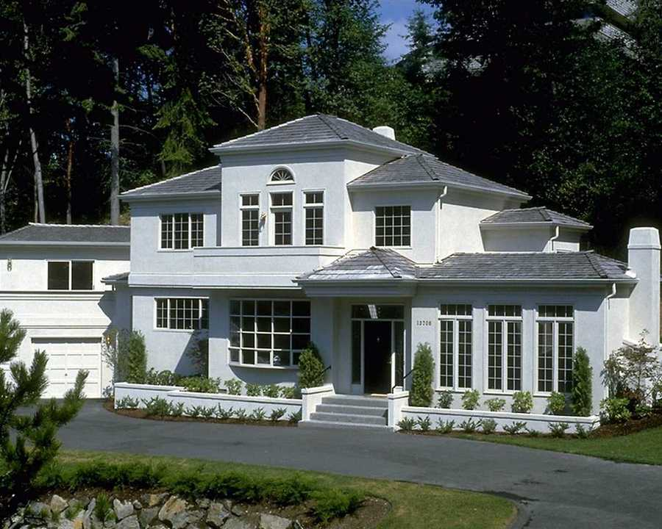
Home Work
Write a paragraph on “The Traffic Police.”

Slide 16
THANK YOU ALL

