Slide 1
Welcome

Slide 2
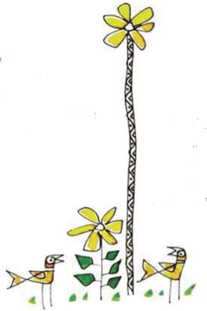
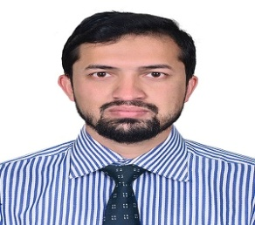
Abdur Rahim
Assistant Teacher
Rupkania Model GPS
Satkania,Chattogram
01818826957
Subject:-English
Unit:- 34
My Family
Lesson:-1-3
Page:-68

Slide 3
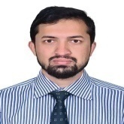
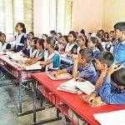
Good Morning, Students.
Good Morning, Teacher.
How are you, students ?
Fine , thank you.
Who lives in your family?.
Mother, father, sister....................

Slide 4
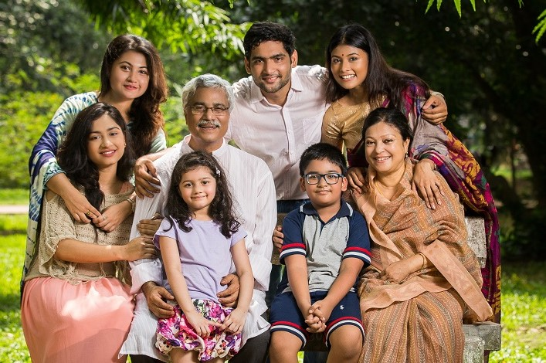
What you seeing in the picture?
A Family

Slide 5
Learning outcomes……
Students will be able to……..
Listening…..
4.3.1- Enjoy and understand simple stories.
Speaking…..
3.1.1- Ask and answer Wh-questions.
Reading…..
5.1.1- Read simple paragraph.
Writing…..
8.1.1- Write sentences from the textbook or model.
8.1.1- Write sentences from the textbook or model.

Slide 6
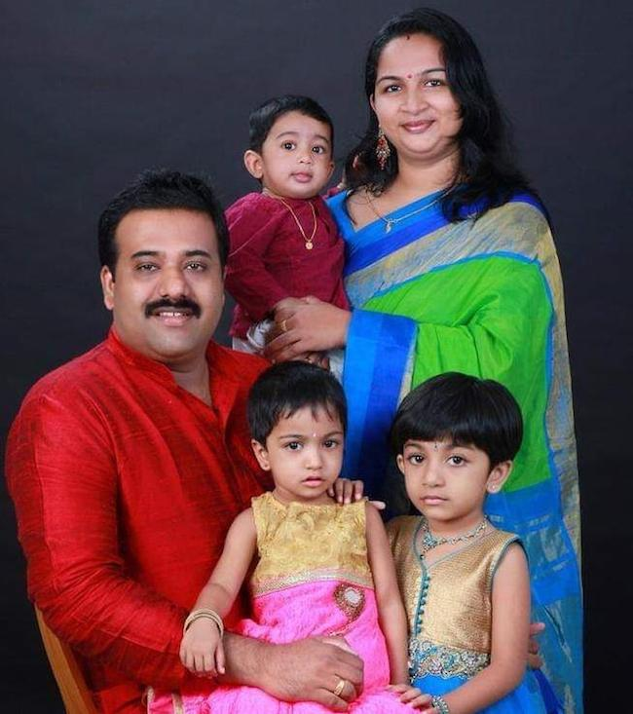
Today our lesson is
My family

Slide 7
I’m Tisha.
I’m a student.
I’m in class 3.

Slide 8
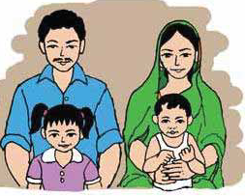
Look at the picture.
There are four people in my family.

Slide 9
Look at the picture.
My mother is a teacher.

Slide 10
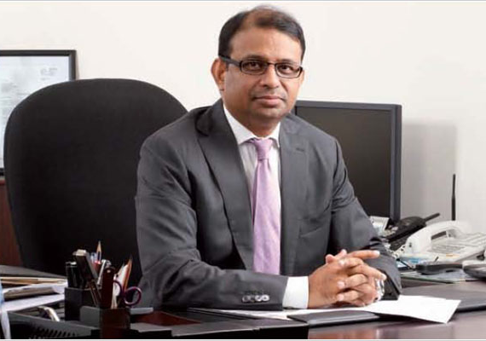
My father is a banker.

Slide 11
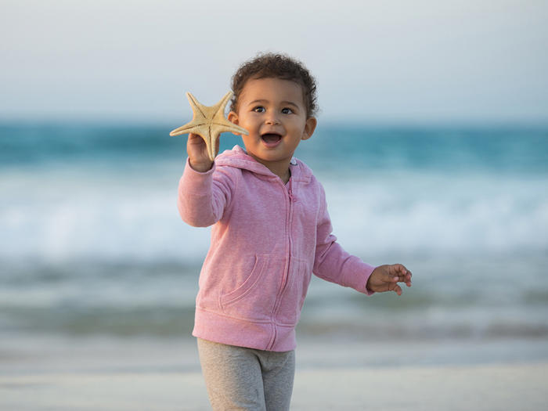
My brother is two years old.

Slide 12
Pair work
Ask questions and answer the questions.
Face to face.
1.What is your name?
2.How many people in your family?
3. What does your father do?

Slide 13
Read after teacher.
Banker
Father
Teacher
New words
Student
Mother
Family

Slide 14
Open your book at page 68
Read silently.

Slide 15
Chain drill
I’m Tisha.
I’m a student.
I’m in class 3.
There are four people in my family.
My mother is a teacher.
My father is a banker.
My brother is two years old.

Slide 16
Listen the audio and read after audio.

Slide 17
Group work
Write a paragraph About “your family” according to the questions
1. What is your name?
2. What class are you in?
3. How many people are in your family?
4. What does your parents do?
5. How many brothers or sisters do you have?

Slide 18
Make sentences.
Student
I’m a student.
Family
I live in a family.
Teacher
My mother is a teacher.
Banker
My father is a banker.
Year
My brother is 2 years old.

Slide 19
Evaluation
Answer the following questions......
1. What is the girl’s name?
2. What class is she in?
3. How many people are there in her family?
4. What does her parents do?
5. How old is her brother?

Slide 20
Make word using last letter “ake”
Make
Sake
Wake
Take
sake
Fake
Lake

Slide 21
Thank you

