Slide 1
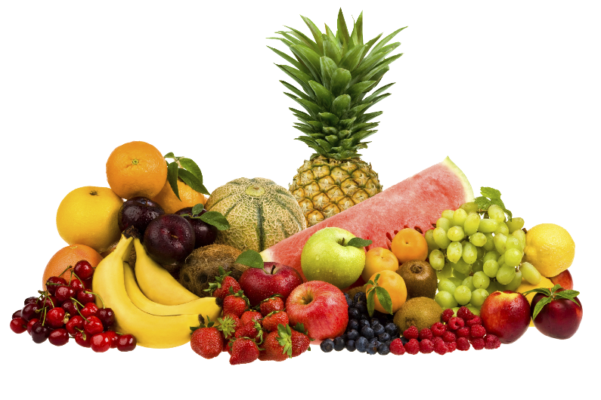
C
L
O
E
M
W
E

Slide 2
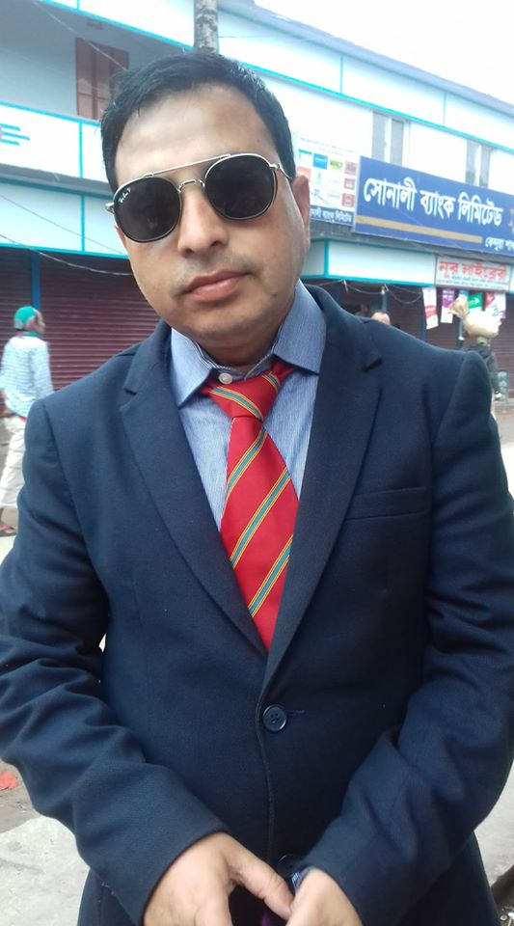
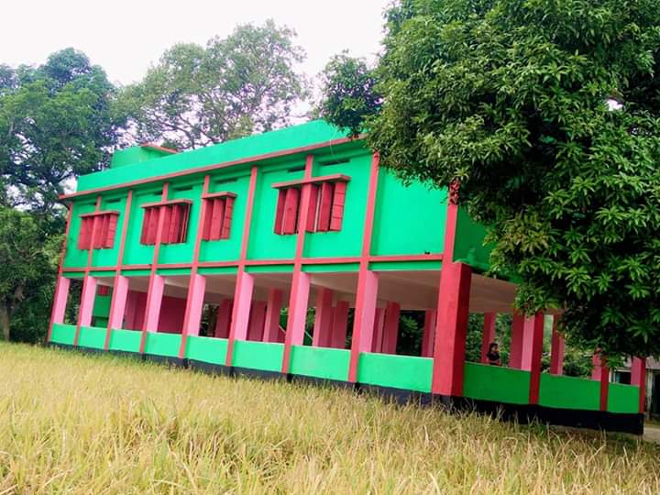
Teacher introduce
Muhammad kamruzzaman
Assistant Teacher
Harulia govt. primary School
Kendua,Netrakona.

Slide 3
Lesson Identity
Class : Five
Subject : English
Unit : 6 Eat healthy
Lesson : 4-5( What food….our health.)
Page no. 24

Slide 4
Let’s watch a video.

Slide 5
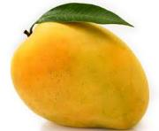
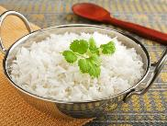
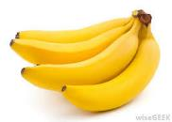
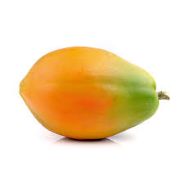
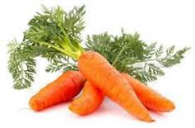
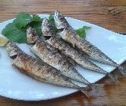
Look at the pictures
Banana
Mango
Rice
Papaya
Carrot
Fish
Why are they good food?

Slide 6
Dear students, our todays lesson is about “ Health”
Eat healthy

Slide 7
Learning outcomes:
Students will be able to -
Listening:
3.3.1 understand questions about objects around them.
Speaking:
1.1.2 say sentences with proper intonation.
Reading:
5.1.1 Read silently with understanding paragraph.
Writing:
8.1.1 make sentences using words and phrases given in the textbook.

Slide 8
Open your English book at page no. 24
Point your finger at the first line. Listen what I read out.

Slide 9
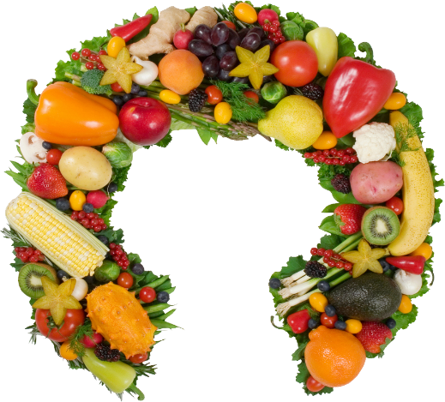
Vitamins

Slide 10
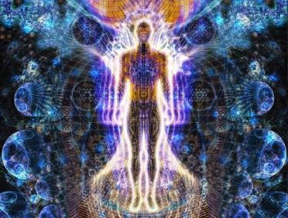
Energy

Slide 11
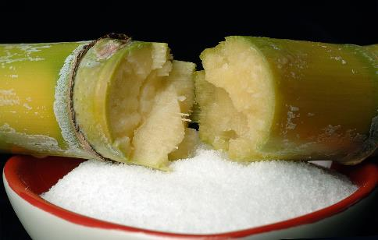
Sugar

Slide 12
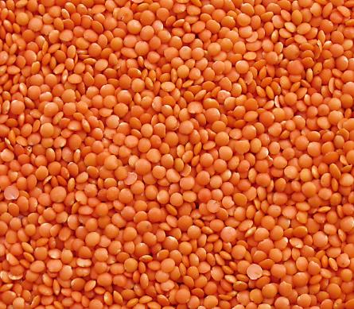
Lentils

Slide 13
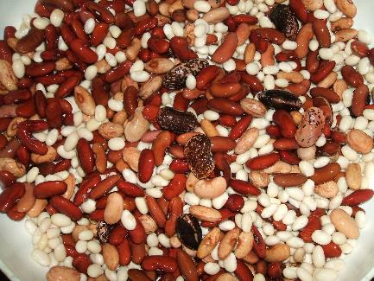
Beans

Slide 14
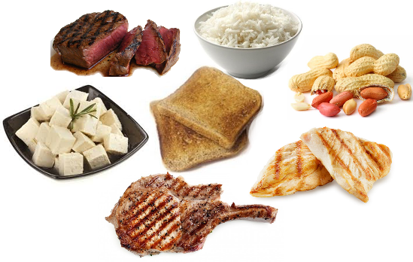
Protein

Slide 15
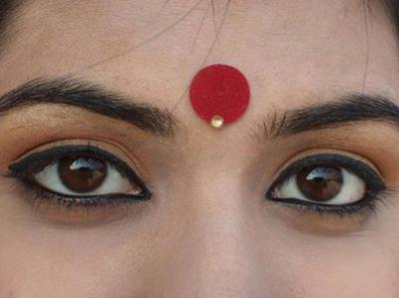
Eyes

Slide 16
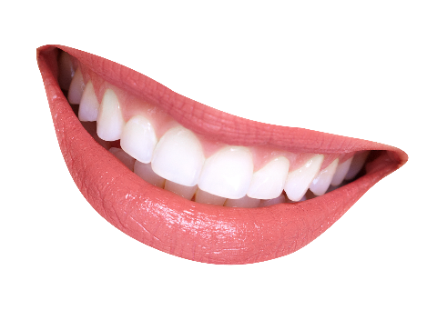
Teeth

Slide 17
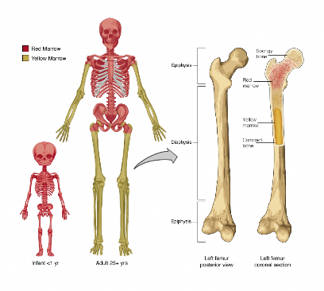
Bones

Slide 18
Group work
All of you divide into four groups.
Then read the text carefully.

Slide 19
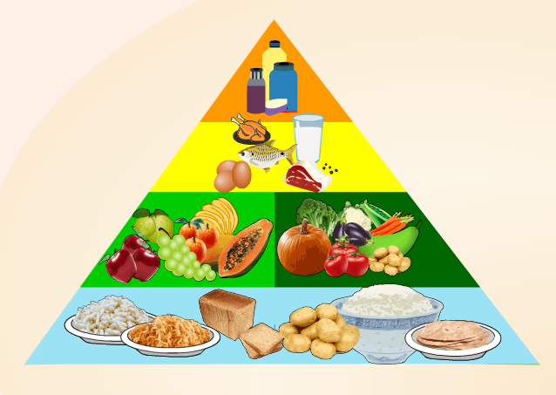
Look at the picture
From the Food Pyramid we know –
We eat more food made from grain. Because grain gives us energy.
Then we eat fruit and vegetables. Because they help our health.
What are these?
What kind of food?

Slide 20
Pair work
Write the answer of the following questions
What does the food pyramid help us to understand?
What foods are made of grain?
Why are fruit and vegetables important?

Slide 21
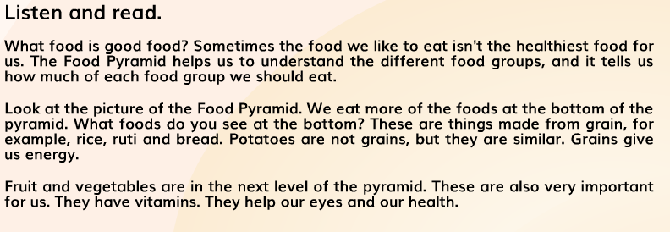
Now, everybody read the text silently

Slide 22
Evaluation
Fill in the gapes with the given words.
four
five
useful
grain
important
energy
harmful
Food Pyramid is _____ to us.
Rice, ruti give us _____.
Vegetables and fruits are _____ for us.
The bottom level of the Pyramid has food from _____.
There are _____ levels in the Food Pyramid.

Slide 23
Home Work
Draw a picture of Food Pyramid.

Slide 24
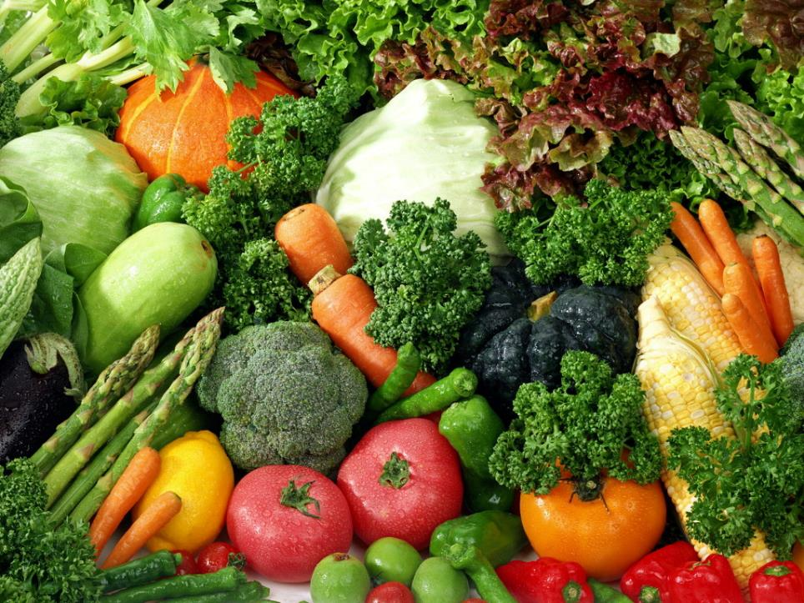
Thanks to all

