Slide 1
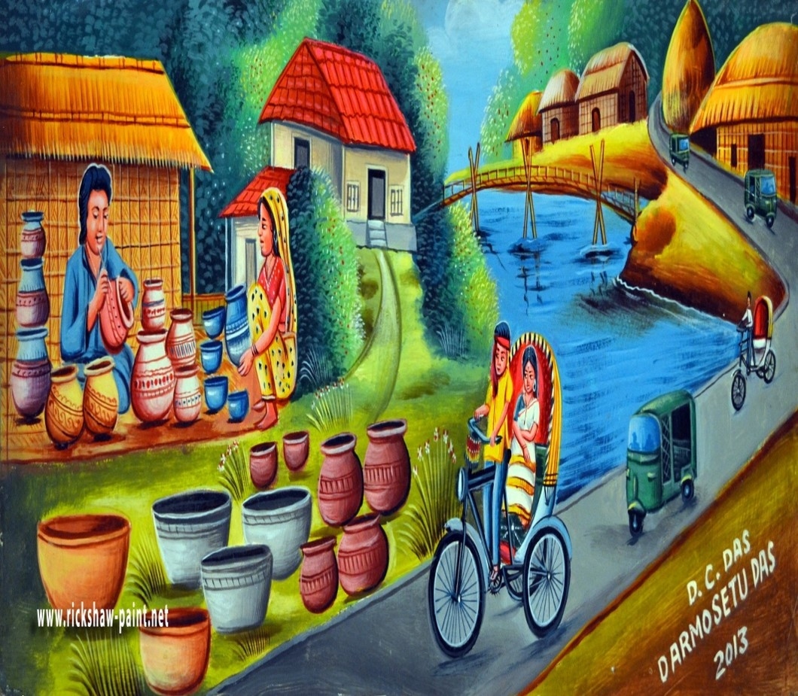
শুভেচ্ছা সকলকে

Slide 2
Presenter
E-mail: apurbodas2010@gmail.com
Call: 01931283048
Apurbo Kumar Das
Assistant teacher
Little Buds Kindergarten
Lockpur, Fakirhat, Bagerhat.

Slide 3
Lesson Introduce
Class : Five, Subject : English
Unit : 21, Lesson : 1-2
(Last january I went to ……. the train station.)

Slide 4
Learning Outcomes
Students will be able to
Understand and enjoy simple stories (4.2.1).
2. Read words, phrases and sentences in the text with
proper pronunciation, stress and intonation (1.5.1).
3. Make sentences using words and phrases
given in the textbook (8.1.1).

Slide 5
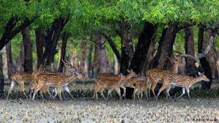
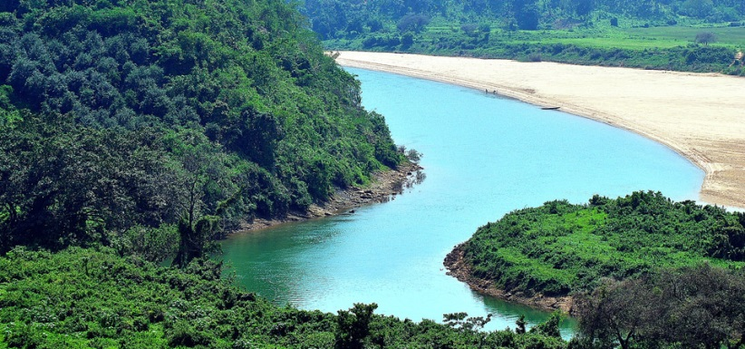
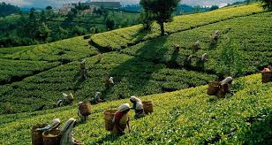
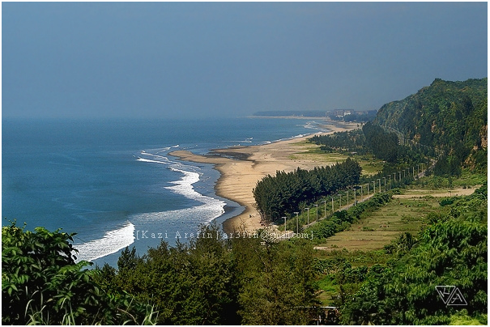
Watch the picture and think about this

Slide 6
Lesson Declaration
It was a great day !

Slide 7
Open your book at page 82
Group work
1.Find out the new word. And write down on a note book.

2. Try to say the meaning of word.
Which you find.

Slide 8
Pair work
Open your book and put your finger on that word, which I will show.

Slide 9
,
,
,
,
,
,
,
cub
Last january I went to a cub camporee. It was my
first visit to a cub camporee and it was my first
time away from home! A camporee is a gathering
of cubs from different parts of Bangladesh. Cubs
all over the world have their own camporees. The
cub camporee took place in Srimangal. To get there,
we first travelled from Dhaka to Sylhet. From Sylhet,
we took a train to Srimangal. We arrived in the
morning, so the weather was nice. We walked to our
camp from the train station.
visit
camporee
gathering
different
travelled
weather

Slide 10
Spelling practice with Syllables
Cub
Cub
→
Cub
Visit
Vi → sit
→
Visit
Camporee
Cam → po → ree
→
Camporee
Gathering
Ga → the → ring
→
Gathering
Travelled
Tra → velled
→
Travelled
Different
Di → ffe → rent
→
Different
Weather
Wea → ther
→
Weather

Slide 11
Word meaning
Cub
The early phase of scouting.
স্কাউটের একটি শাখা অর্থে ব্যবহৃত হয়েছে।
Visit
Go to certain places as for sightseeing.
দেখতে যাওয়া, ঘুরে দেখা।
Camporee
Gathering of cubs from different parts of place. বিভিন্ন স্থান থেকে আসা কাব স্কাউটদের মিলন মেলা।
Gathering
A group of persons together in one place.
সমাবেশ, জমায়েত।
Different
Distinctly separate from the frist that’s
another issue altogether.
বিভিন্ন, ভিন্ন ভিন্ন, আলাদা।
Travelled
A movement through space that changes
the location of something.
ভ্রমন ।
Weather
Sail to the windward, cause to slope.
আবহাওয়া।

Slide 12
Teacher’s reading
Last January I went to a cub camporee. It was my
first visit to a cub camporee and it was my first
time away from home! A camporee is a gathering
of cubs from different parts of Bangladesh. Cubs
all over the world have their own camporees. The
cub camporee took place in Srimangal. To get there,
we first travelled from Dhaka to Sylhet. From Sylhet,
we took a train to Srimangal. We arrived in the
morning, so the weather was nice. We walked to our
camp from the train station.

Slide 13
Now read this lesson alone
(At page-82)

Slide 14
EVALUATION
Make sentences using following words
Visit,
Different,
Weather,
Arrived,
Gathering .

Slide 15
খোদা
হাফেজ

