Slide 2
Welcome to My New Class

Slide 3
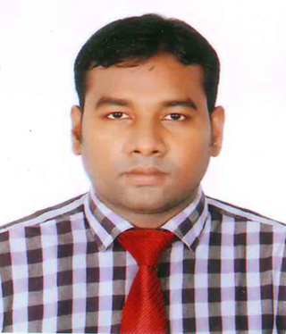
Md. Rasel Hossain BA(Hon’s)MA in English Lecturer in English Katghor Islamia Fazil Madrasha Sandwip, Chattogram, Bangladesh
ICT4E District Ambassador, Chattogram

Slide 4
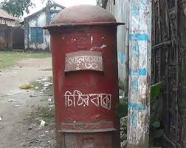
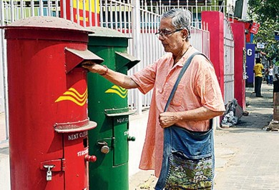
Seeing the Pictures guess the topic

Slide 5
Today’s Topic is
Letter:
Now write a letter to your friend about your Preparation for the examination.
Class: Eight/nine

Slide 6
09/04/2020
Sandwip, Chattogram
Dear X,
How are you? I hope you are well and so am I. In your last letter you wanted to know about my preparation for the upcoming examination. Now I’m writing to you about it.
My preparation for the up-coming examination is well. I’ve revised all of my subjects but I’m weak in Math and English. Now I’m giving some extra time in Math and English. Also, I’m learning them to our subjective teachers. I hope I’ll recover them soon.
No more today. Write to me soon about yours. Convey my salam to your parents and love to the youngers. Take care of your health.
Your loving friend
Y

Slide 7
Individual work:
Now write a letter to your friend about your Preparation for the examination.

Slide 8
HW
Now write a letter to your father about your progress in studies

Slide 9
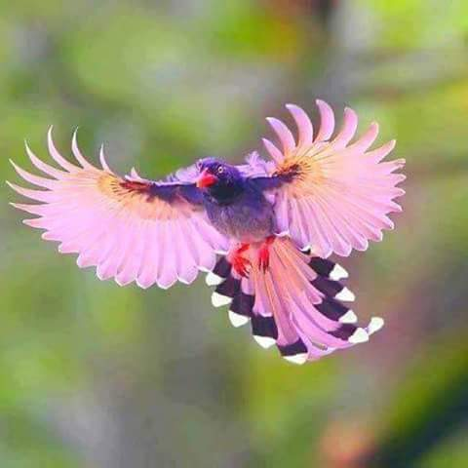
Goodbye Students

