Slide 1
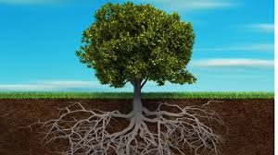
Welcome to the class

Slide 2
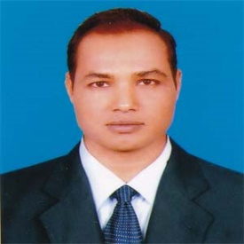
Teacher’s Identity
Md. Mizanur Rahman
B.A.(Hons.), M.A. in English, B.Ed.
Assistant Teacher
Police Lines School and College, Pabna.
E-mail: mizanplsc@gmail.com
Cell Phone :01737979719

Slide 3
Lesson’s Introduction
Lesson’s Introduction
Class: Ten
Subject: English 1st Paper
Unit: Twelve (Roots)
Lesson: One
Lesson Title: My roots
Class Duration: 40 minutes
Date: 08/04/2020

Slide 4
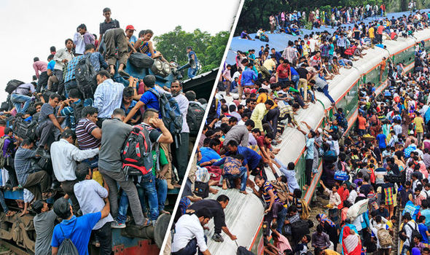
Look at the picture
A. Look at the pictures and the caption below. How do you feel looking at the photo? What do you think people take such risks to go home to celebrate Eid?

Slide 5
Today’s Lesson
My roots

Slide 6
Learning Outcomes
The students will be able to:
i. participate in conversation.
ii. exchange personal information .
iii present information in a chart.

Slide 7
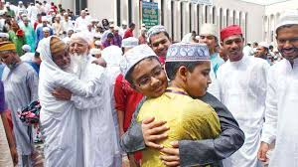
New words presentation
Meanings
Words
The part of the plant in the earth ; your relation to a place because you were born there or your family used to live there.
Roots
Syn. origin
Human being s have the roots but unlike the roots of trees
Festival
A day or period of celebration
Syn. Celebration , event
Eid is the main religious festival of Muslims.

Slide 8
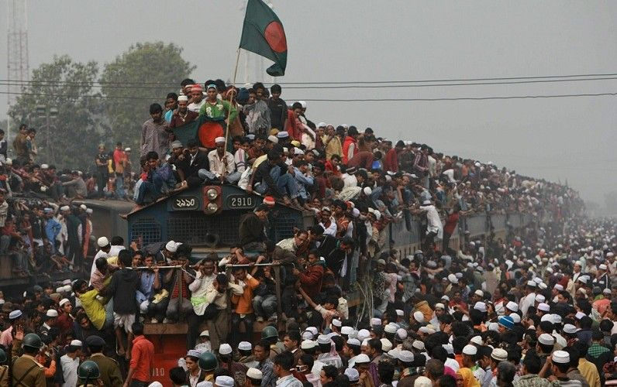
Rush
A sudden or means of conveying people or gods from place to place
Syn. Hurry, haste.
During the Eid vacation there is a mad rush to board buses, trains or launches for going home.
Hazard
A danger or risk
Syn. Danger, risk
Inspite of serious hazards, they are trying to board the trains.

Slide 9
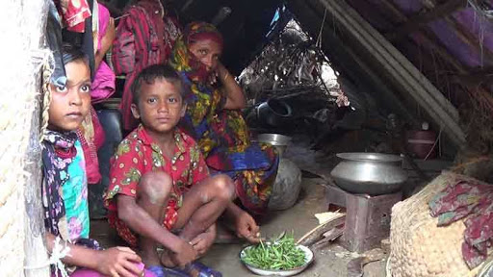
Invisible
Unable to be seen
Syn. unseen
The man’s face is invisible.
Rootless
Not having roots
Syn. nomadic
The condition of the rootless people are unbearable.

Slide 10
c. Read the text in the speech bubbles. Make questions based on the bubbles and then compare them in pairs.
Eid is the main religious festival of the Muslims in Bangladesh.
Eid means happiness.
What is the main religious festival of the Muslims in Bangladesh?
What does Eid mean?

Slide 11
In that sense our families , our land of birth, relatives , our culture, traditions or surroundings are our roots.
It’s our root that develop our identity making us what we are.
What are our roots?
What do our roots that develop our identity making us what we are.
Pair work: Now compare them with those of your classmates.

Slide 12
Individual work
D. Fill in the grid with appropriate information from the text above.
That makes our roots | The problems of a rootless person
1. | 1.
2. | 2.
3. | 3.
4. | 4.
5. | 5.
Family bondage
No entity
Love to friends
Devoid of values
Love to in-laws
Devoid of humanity
Love to neighbours
Devoid of social responsibility
Vicinity with the land where we were born and grew up
Feeling of emptiness

Slide 13
Pair Work
Works in pairs. Talk about these questions.
Do you have any root other than the place where you are living now? If yes, where is it and who live there? If not , why not?
How do you label your roots?
Do you feel any attraction for your root? Any pull in your heart?
How do you nourish your roots?
What , according to you, are the reasons why people become rootless?

Slide 14
Group Work
Make a classroom survey and present in a chart the types of roots your classmates have.
Ans. There are 42 students in our class. They are from different roots. WE have made a classroom survey and found out the roots of all the students of our class. Now, the types of roots of our classmates are presented in a chart below.
Survey Report:
Total Students | City | Small Town | Semi-urban | Village | Rural Village
42 | 15 | 10 | 5 | 7 | 5
Now draw a chart:

Slide 15
Evaluation
Read the text and fill in each gap with a suitable word based on the information of the text.
Eid means happiness and this Eid comes to us (a) a year. Every Muslim in Bangladesh has a strong (b) to share this happiness with their (c) persons. That’s why almost all Muslims (d) of rich or poor are found crazy to get their homes during this vacation. It causes a mad rush for (e) buses, trains or lunches.
twice
desire
dearest
regardless
boarding

Slide 16
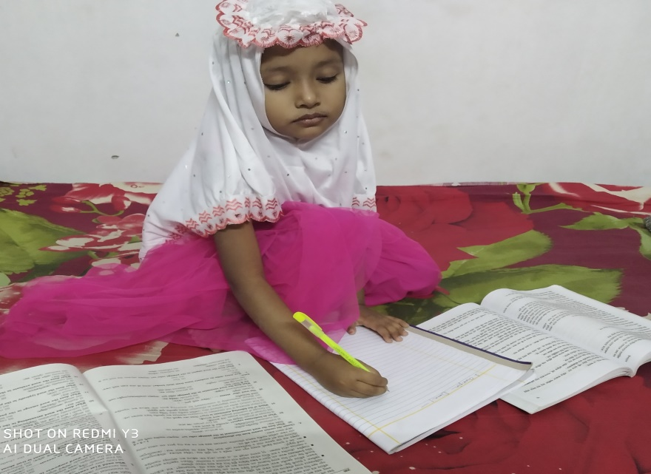
Home Work
Write a short note about rootless people

Slide 17
Thank to all.

