Slide 1
welcome

Slide 2
Teacher,s Identity
Md.Abul kalam
Assistant Teacher(English)
Dattapara girls’ high school.
Lakshmipur.

Slide 3
English 2nd paper
Class ---six
Unit—1
Lesson--1

Slide 4
Learning outcomes
by the end of the lesson students able to know-
1.say what is sentence?
2 . ,, Kind of sentences.
3.known to sentences.

Slide 5
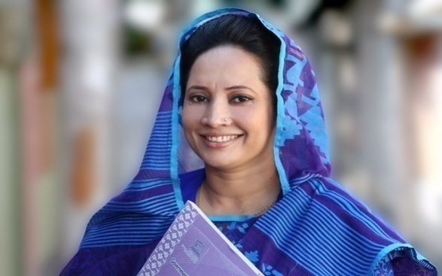
I was a student of class six in this school.
Now I am a doctor.

Slide 6
Lesson declaration
‘’Sentence’’

Slide 7
Sentence : A sentence is a combenation of words with a subject and predicate and expresses a complete thought or ideas.
Kinds of sentences.
1 . Assertive Sentence: A sentence that states something is an assertive sentence.
Rina is a girl.
2.Interrogative sentence:
A sentence that ask a question is an Interrogative sentence.
Are you well ?
3.Imperativesentence: A sentence that expresses an order,request or a prayer is an Imperative sentence.
Do this.
4.Optative sentence: A sentence that expresses wish is called an Optative Sentence.
May you be happy.
5.Exclamatory Sentence: The sentence which indicates an emotion or strong felling is called an exclamatory sentence.
Hurrah! We have won the match .

Slide 8
Make a assertive sentence in your own idea.

Slide 9
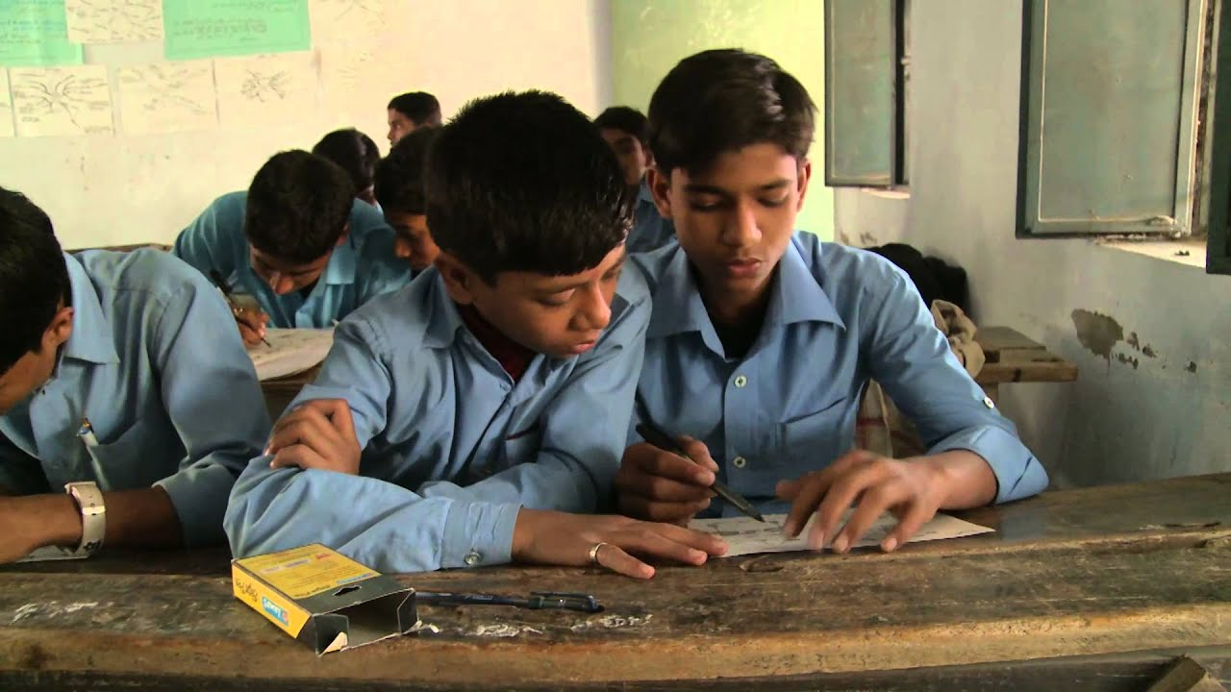
Make a meaningful sentence from these following words.
Sun, the ,rises, east, in ,the ,

Slide 10
Say what kinds of sentences are the following :-
Allah is merciful .
Alas ! I am done for.
Who are you?
May Allah help you.
Obey your teachers.

Slide 11
Home work
Five meaningful sentences make your own idea.

Slide 12
Thanks a lot all.

