Slide 1
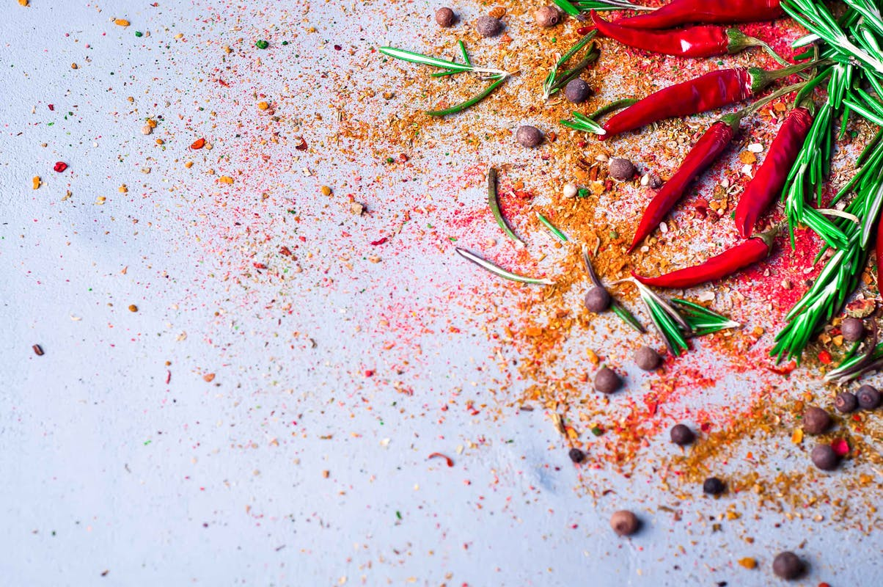
WELCOME

Slide 2
INTRODUCTION
Class: Eight
Sub: English 1st Paper
Hosne Ara
Assistant Teacher (Eng)
Kumarkhali M. N. Pilot Model High School
Kumarkhali

Slide 3
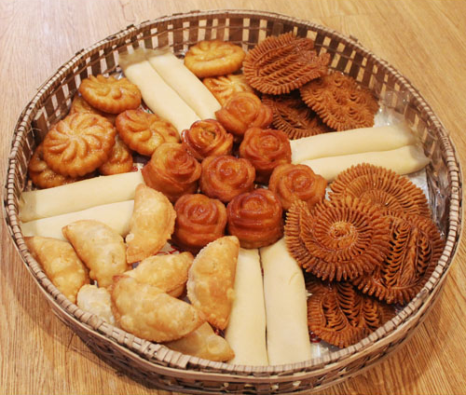
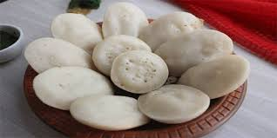
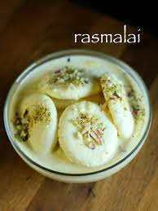

Slide 4
Bangladeshi cuisine
Unit-1, Lesson-5
The people of Bangladesh …………………… life of Bangladeshi people. (last 11 lines).

Slide 5
Objectives
By the end of the lesson SS will be able to……
Read the passage silently
Write true or false
Answer the questions
Summarise the passage

Slide 6
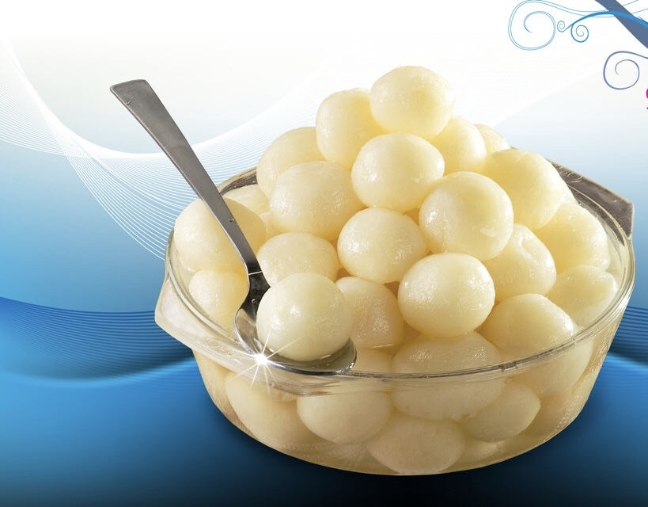
People of Bangladesh are fond of sweets

Slide 7
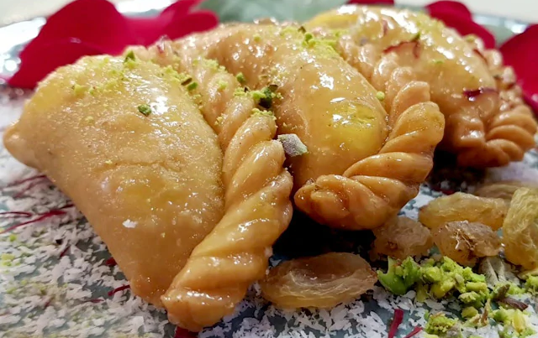
Pitha, a type of sweets is a traditional food loved by the entire population

Slide 8
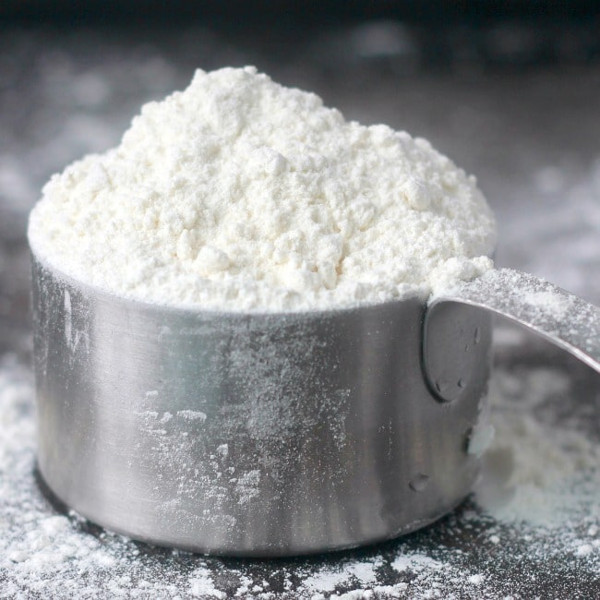
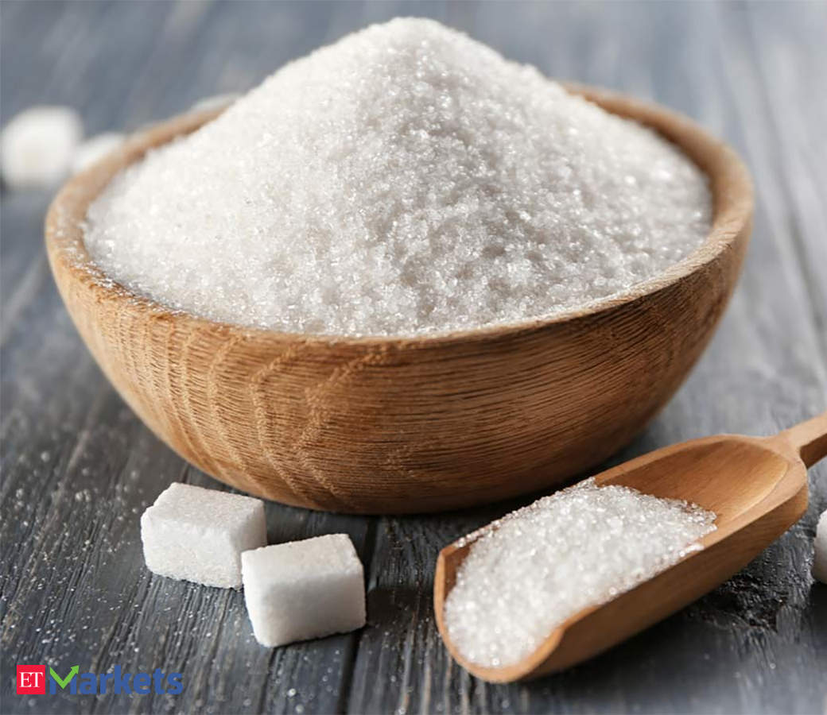
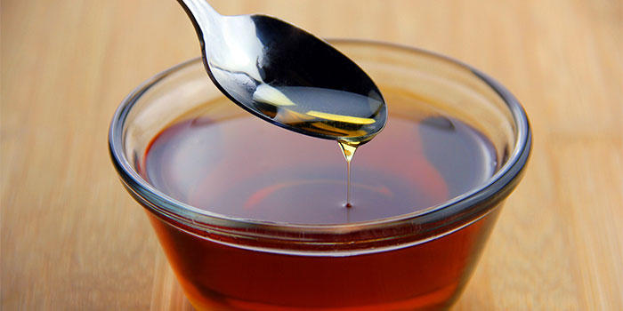
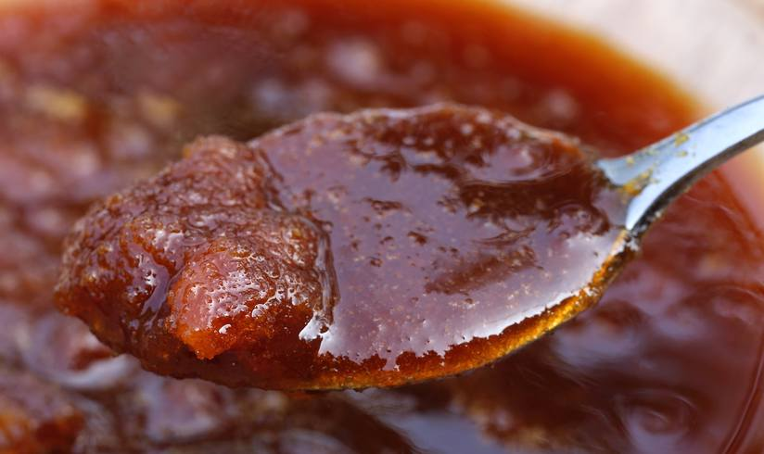
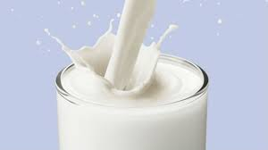
Pitha is made from

Slide 9
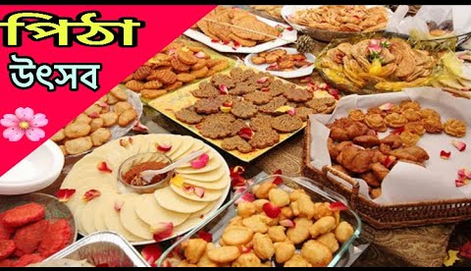
Pitha Utsab is organised by different groups of people during winter

Slide 10
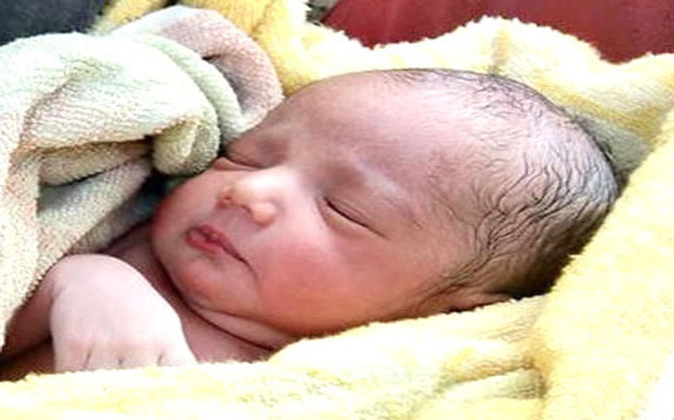
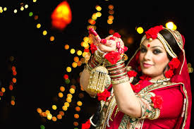
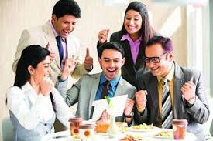
Sweets are distributed among close relatives when there is good news like
Birth
Wedding
Promotion

Slide 11
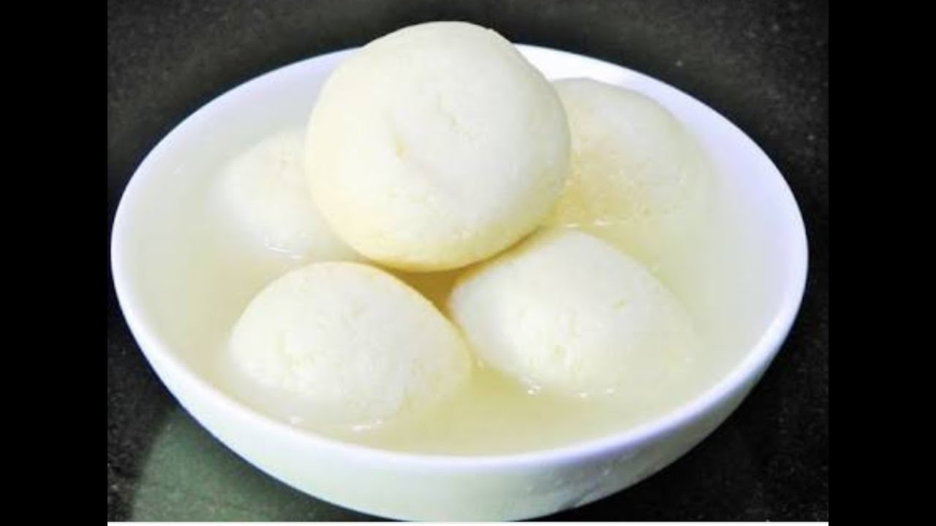
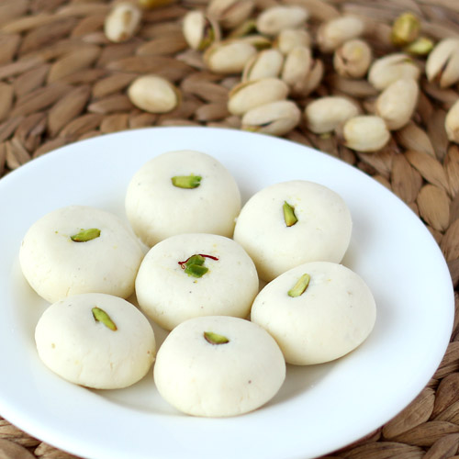
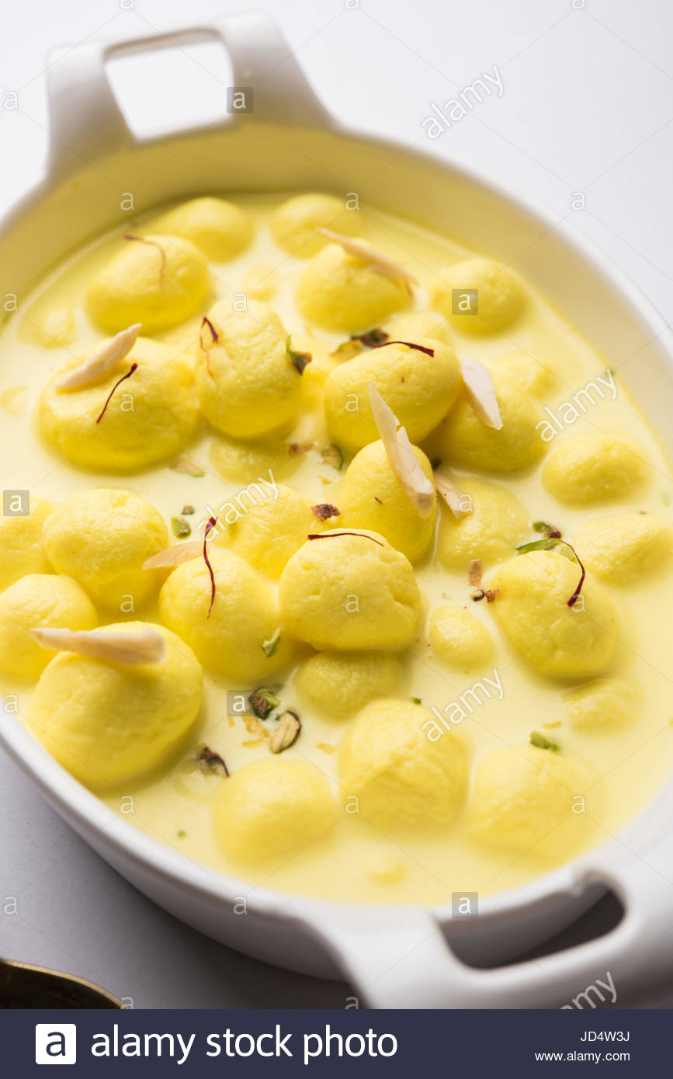
Common Sweets of Bangladesh
sandesh
roshgolla
rasamalai

Slide 12
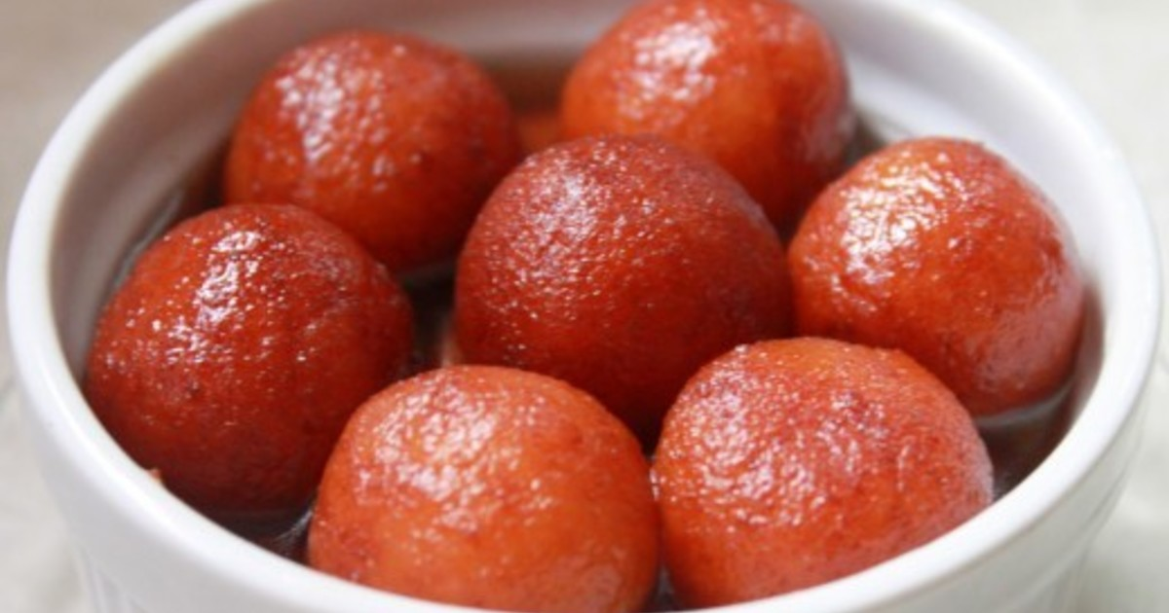
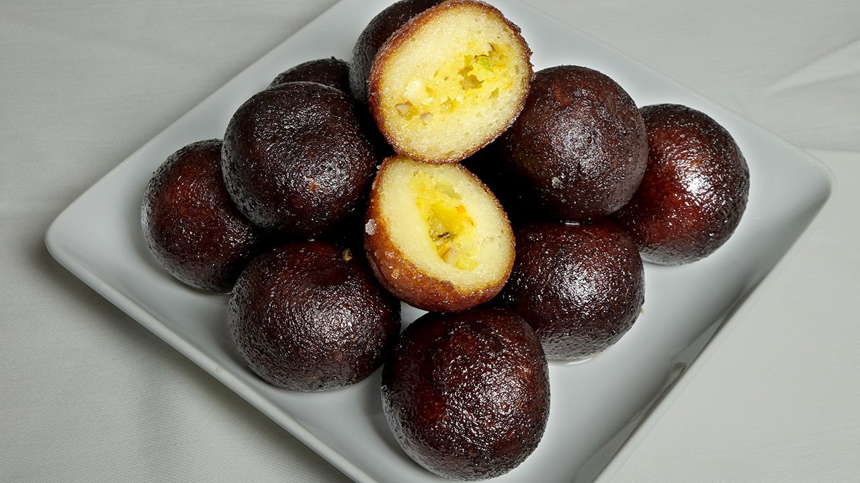
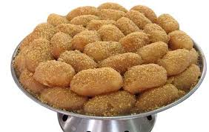
gulap jamun
Kalo jamun
chomchom

Slide 13
Read the passage again and write the statement True or False. If false, give the correct information.
Pitha Uthsab takes place almost all the year round in Bangladseh.
Sweets are not much appreciated by the people of Bangladesh.
Sweets of Bangladesh are mostly milk based.
Our foods are rich because they have a lot of oil in them.

Slide 14
Evaluation
When does Pitha Utsab take place?
When do we distribute sweets among close relatives?
Which are the common sweets of Bangladesh?
Do you like sweets?

Slide 15
HOME WORK
Write down the summary of the passage.

Slide 16
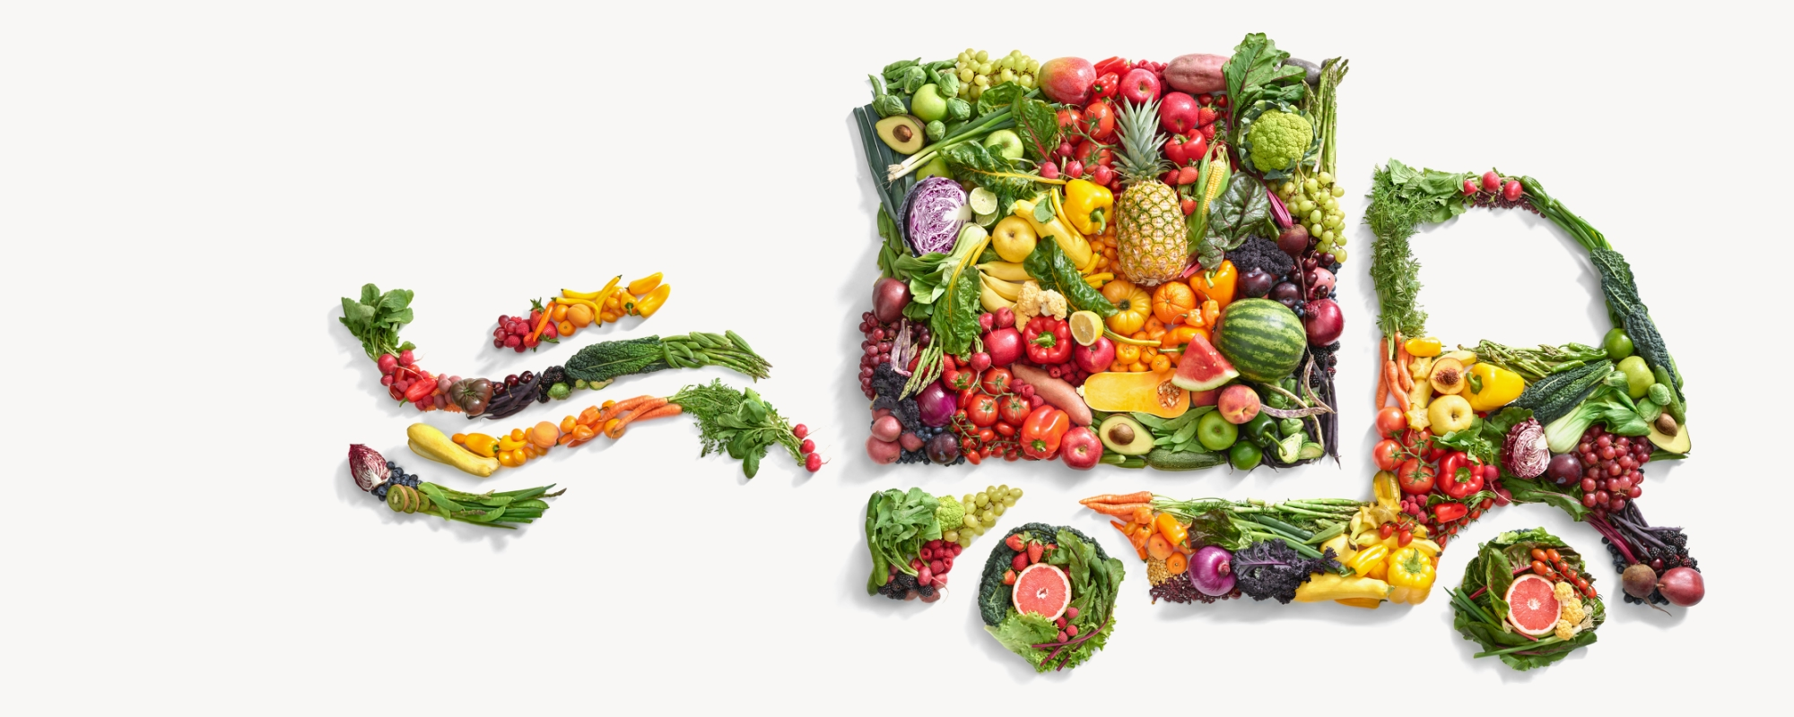
Good Bye

