Slide 1
welcome

Slide 2
Introduction of Teacher
Md. Abdul Ahad
Head Teacher
Maharajpur Govt. Primary School
Sadar, Chapainawabgonj

Slide 3
Introduction of lesson
Class:Three
Sub:English
Unit:38
Lessons: 3-4
Time:40 minute
Date: 06 May 2019

Slide 4
Learning Outcomes
Student’s will be able to :
2.3.1 Respond to request.
6.1.1: To say what the speaker doing and to others are doing..

Slide 5
Let’s watch video
What about this video

Slide 6
Todays lesson
At the shop

Slide 7
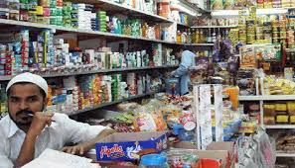
What do you see in the picture
Shop

Slide 8
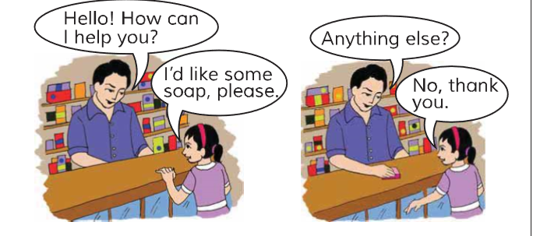
What are they doing here ?
Buy
Sell

Slide 9
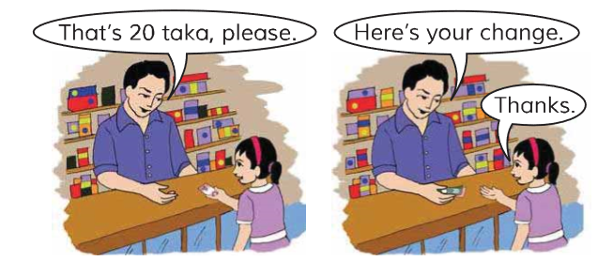

Slide 10
Dear student please open the page 77

Slide 11
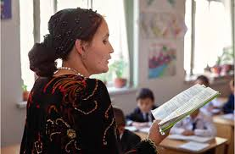
Teacher’s reading

Slide 12
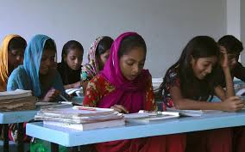
Student reading

Slide 13
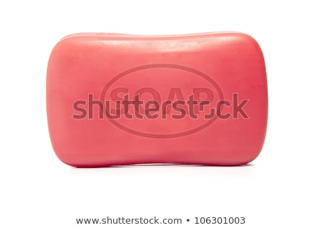
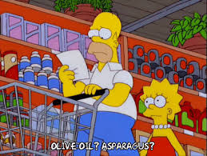
New words
Soap
সাবান
Anything
কিছু

Slide 14
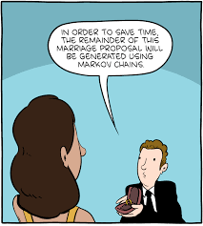
Please
অনুগ্রহ
Change
পরিবর্তন

Slide 15
Spell the words
Say with me
Shop
Anything

Slide 16
Please
Change

Slide 17
One day one word
Soap
সাবান
I’d like some soap.

Slide 18
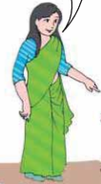
Pair work
Teacher and student

Slide 19
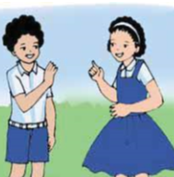
Pair work
SS

Slide 20
Task
Answer the question
Where is the girl ?
b)What thing the girl bye?
At the shop
Soap

Slide 21
Home work
Write 2 sentences about your text.

