Slide 1
Stay at home
&
save your life
form being effected
covid-19 virus..
How are you?
Dear students.

Slide 2
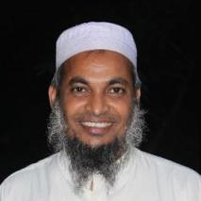
Identity
Teacher
Lesson
Dewan Rezaul Hassan
(Assistant Teacher)
Baropakhia Rothindrapara Govt. Primary School
Delduar, Tangail.
E-mail:drezaulhassan@gmail.com
Cell phone# 01731145063
Class: Two
Sub: English
Unit: 1 Lesson: 4(A)
Page # 3
Lesson title: Alphabet

Slide 3
Learning outcomes:
Students will be able to:
Listening:
Listening::1.1.1. become familiar with English sounds by
listening to common English words.
Speaking :: 1.1.1 repeat after the teacher simple words and
phrases with proper sounds and stress.
1.1.2 say simple words and phrases with proper
sounds and stress.
Reading :: 1.2.1 recognize and read the alphabet both small and
capital (non-cursive).
1.3.1 recognize and read the names of objects having
the same initial and final sounds.

Slide 4
Checking homework and justify the previous lesson.

Slide 5
Let’s watch a video…..

Slide 6
Open your English book at page-3
Lesson declaration :
Today we will learn
Unit: 1
Lesson: 4(A)
Lesson title: Alphabet

Slide 7
Open your
“English for Today” Book
page at # 3

Slide 8
Look at and say about the pictures
What is this?
A
apple
Apple
a
What is this?
ant
Ant
a
A

Slide 9
Look at and say about the pictures
What is this?
ball
Ball
c
B
What is this?
bat
Bat
b
B

Slide 10
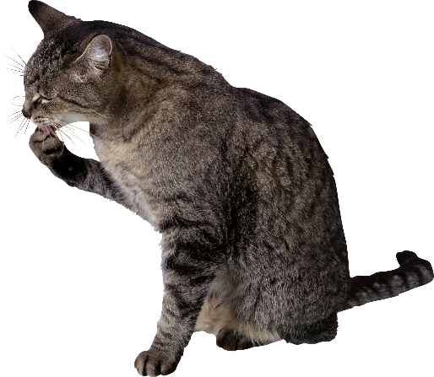
Look at and say about the pictures
What is this?
cat
Cat
c
C
What is this?
cup
Cup
c
C

Slide 11
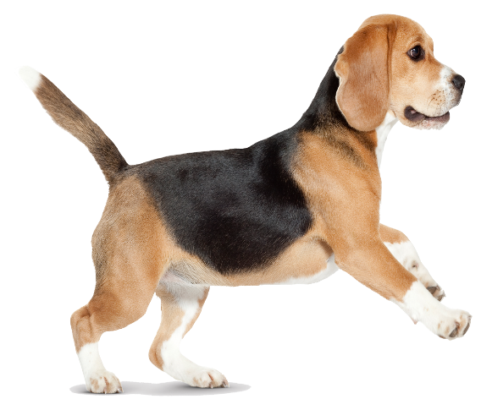
Look at and say about the pictures
What is this?
dog
D
d
Dog
What is this?
doll
Doll
d
D

Slide 12
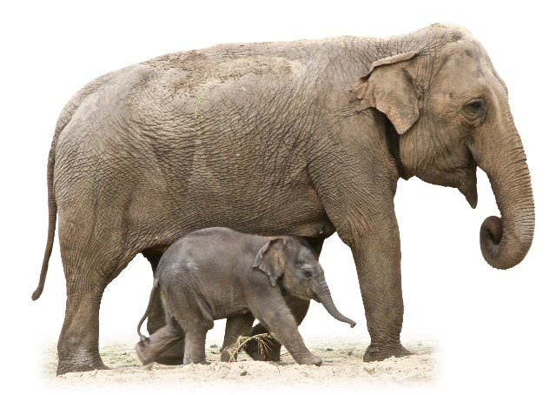
Look at and say about the pictures
What is this?
egg
E
e
Egg
What is this?
e
E
elephant
Elephant

Slide 13
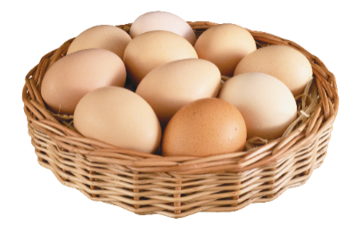
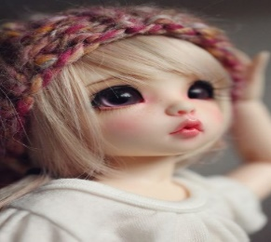
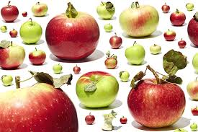
Group Work
Match letters with the pictures
Aa
Bb
Cc
Dd
Ee

Slide 14
Teacher practice with students in the classroom.
Teacher ask students
Students reply.

Slide 15
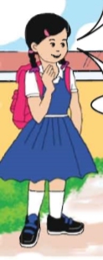
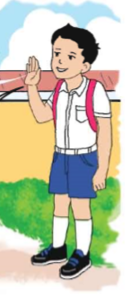
Pair work
Say the pictures, words & letters.
One more times

Slide 16
Pair work:
Practice in pair
Notes:
1st student will ask Questions 2nd student will give Answer.
Teacher will observe the class.

Slide 17
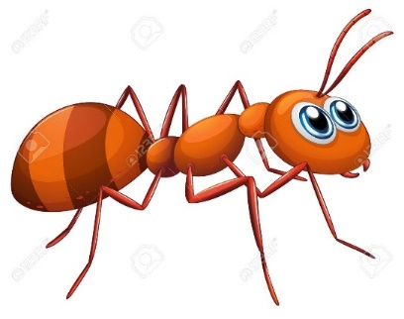
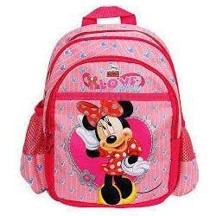
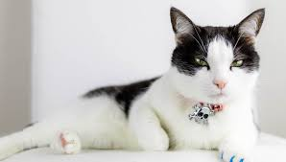
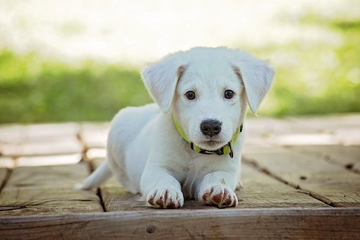
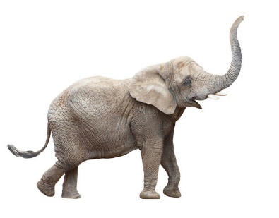
Evaluation
Match pictures with the letters
Aa
Bb
Cc
Dd
Ee

Slide 18
Say the missing letter.
_ogg _oll _egg
_nt _at _up

Slide 19
Home Task
Aa
Ee
Bb
Dd
Cc
Write the letters.

Slide 20
Date-
One day one word
Do you understand the picture?
cat
বিড়াল
Spell out the word - SGW
Write the word to your notebook.

Slide 21
That’s all for today. Goodbye. See you tomorrow.
.

