Slide 1
Welcome today’s lesson

Slide 2
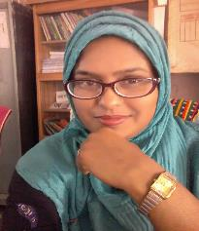
Presented by
Shahrina Bin Sweety
Assistant Teacher
Charmonai Madrasah Government Primary School
Barishal Sadar,
Barishal

Slide 3
Lesson Identity
Class: Five
Subject: English
Unit: 7 Be healthy
Lesson: 1-2
Page no: 26
Time: 40 Minutes
Date: 09/04/2020

Slide 4
Learning outcomes
By the end of the lesson the students will be able to-
Listening:
3.4.1 understand statements made by the teacher and students.
Speaking:
8.1.1 take part in conversations on appropriate topics.
Reading:
5.1.3 read silently with understanding dialogues.
Writing:
8.1.1 make sentences using words and phrases given in the textbook.

Slide 5
Dear students, Let’s enjoy a song.

Slide 6
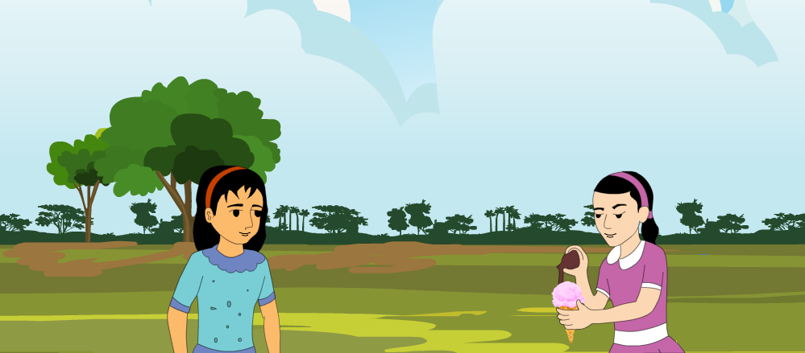
Look at the picture
You are right. Some food are good for our health. Can you tell me which food have vitamins ?
Fruits and vegetables such as mango, banana, carrots, cucumbers etc.
Is it good for us?
Ice-cream.
It is not good food.
What do you see in the picture?
What is in one girl’s hand?
Two girls are talking.

Slide 7
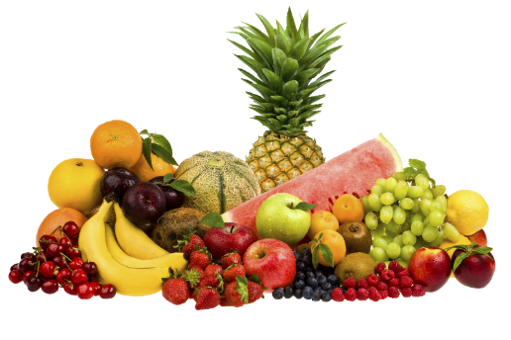
Yes, students today we’ll study about
Be healthy

Slide 8
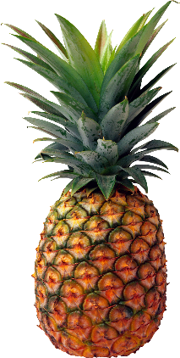
Dear students, there are some new words in this lesson.
New word
We’ll find those words.
Pineapple
One kind of fruit.

Slide 9
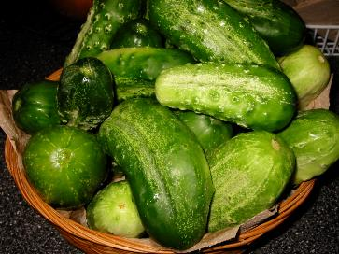
New word
Cucumber
One kind of vegetables

Slide 10
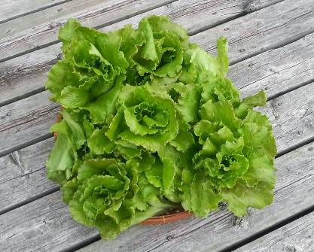
New word
Lettuce
It needs to make salad

Slide 11
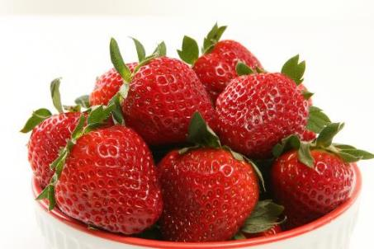
New word
Strawberries
A delicious fruit

Slide 12
New word
Delicious
Enjoyable
Something that tastes pleasant.

Slide 13
New word
Weather
Climate
The temperature of a certain place.

Slide 14
New word
Regularly
Commonly
The event what happens often.

Slide 15
New word
Favourite
Beloved
Such a thing we like most.

Slide 16
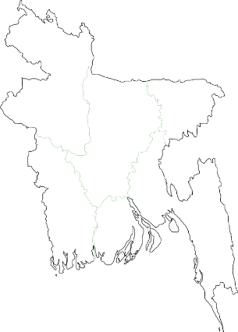
Melt
Weather
Delicious
Favourite
Regularly
Word meaning
With Bangla
আবহাওয়া
গলে যাওয়া
পছন্দ
সুস্বাদু
নিয়মিত

Slide 17
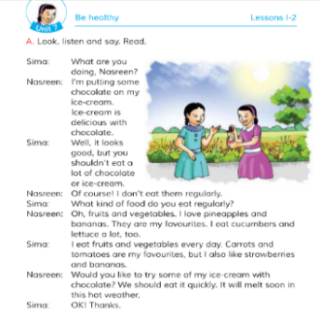
Now, open your English book at page no. 26.
Point your finger at the first line and listen what I read.

Slide 18
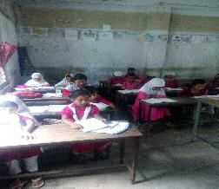
Students loud reading
Now, all of you read the text .

Slide 19
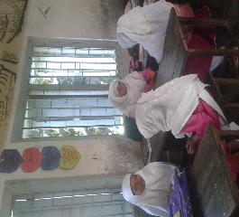
Pair work
Dear students, now think you are Sima
and your partner is Nasreen.
Practise the dialogue with your partner.

Slide 20
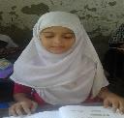
Individual work
In this lesson you have learnt some new words. Now make sentences with those words.
Delicious
Weather
Regularly
Favourite
Click the word
The weather of Bangladesh is hot now.
Ice-cream is a delicious food.
I go to school regularly.
Mango juice is my favourite.

Slide 21
Group work
All of you divide into two groups.
Group A
Group B
Write the name of ten healthy foods.
Write the name of ten unhealthy foods.

Slide 22
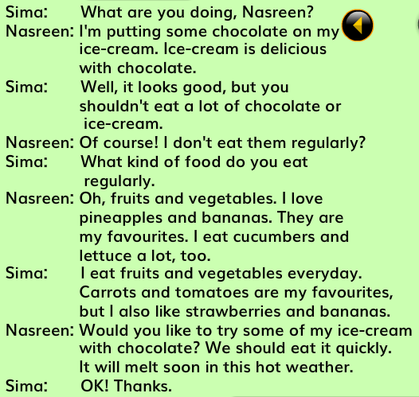
Now tell me, what have you learnt today?
We’ve learnt about different foods.
Can you tell the names?
Chocolate
Ice-cream
Strawberries
Pineapple
My dear students, read the text silently for 5 minutes.

Slide 23
Checking learning
Write True or False
Sima is putting chocolate on her ice-cream.
Fruits and vegetables are healthy.
Sima likes pineapples.
When Sima and Nasreen are talking the weather is hot.
We should eat a lot of ice-creams.
Sima likes healthy foods.
Chocolate is an unhealthy food.
Nasreen eats cucumbers.
Nasreen doesn’t share her ice-cream with Sima.
Banana is full of vitamins.
False
True
False
False
True
True
True
False
False
True
Check your answer

Slide 24
Home work
Write 3 sentences about a healthy meal you ate.

Slide 25
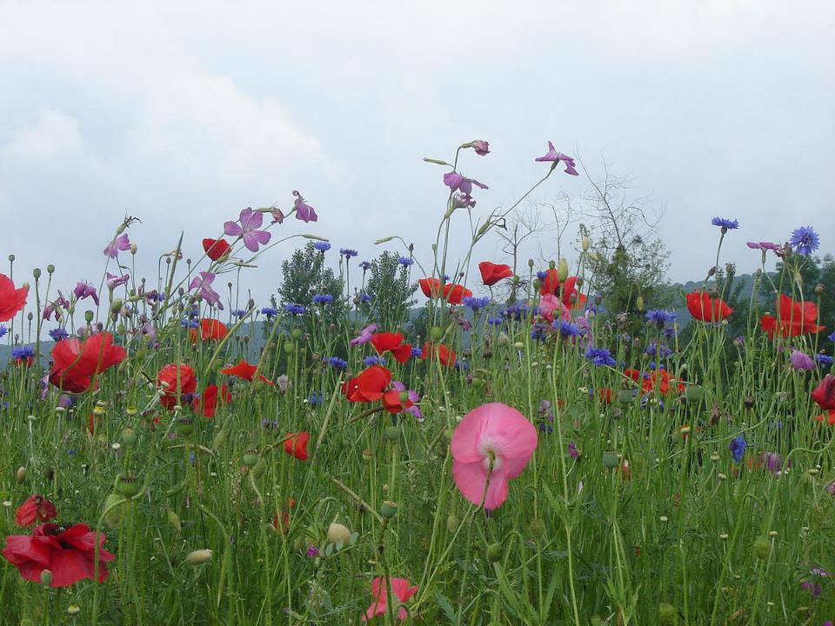
Thank You.
That’s all for today.

