Slide 1
Good Morning Students

Slide 2
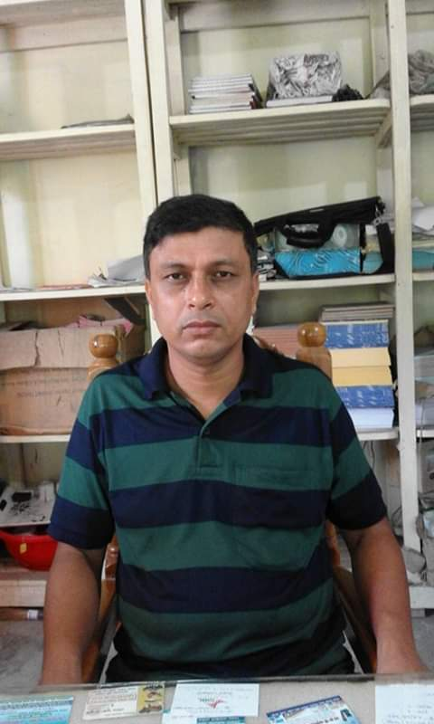
INTRODUCTION
Sultan Ahmed Miazi.
Assistant teacher,
Balia K.B.D.N. Dakhil Madrasah, Chandpur.
01817106106.
sultanshapdi@gmail.com
Subject : English
Class: Five
Time-40 minutes
Ss.p.-65
Unit-3

Slide 3
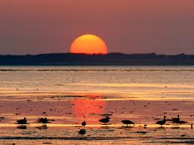
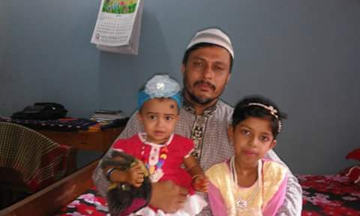
What do you see in the pictures?
An evening sun set
Saikat’s family

Slide 4
Todays lesson
Saikat’s Family

Slide 5
Learning outcomes:
The students will be able to-
1. Read the lesson correctly.
2. Make sentences by using word.
3. Give answer some questions in the text.

Slide 6
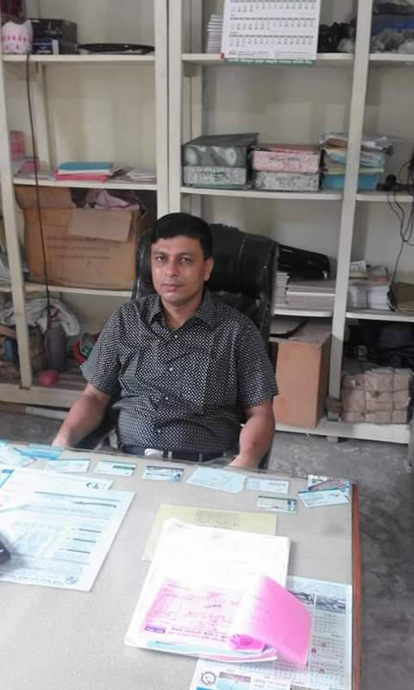
Look at the picture and say.
Presentation
Saikat lives with his parents in Bogura.
His father is a banker.

Slide 7
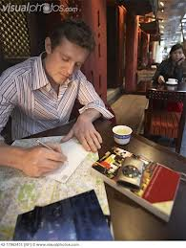
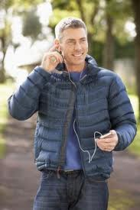
Look at the picture and say.
Saikat’s father writes
stories In his free time
He loves listening to
Music of old time

Slide 8
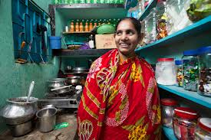
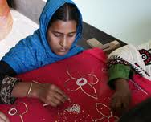
Look at the picture and say.
Saikat’s mother is a
housewife
She loves sewing in her free time

Slide 9
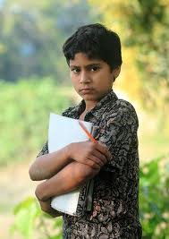
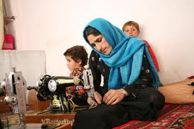
Saikat reads in class five.
She makes dresses.
He is a good student.

Slide 10
Open your book at page 10.

Slide 11
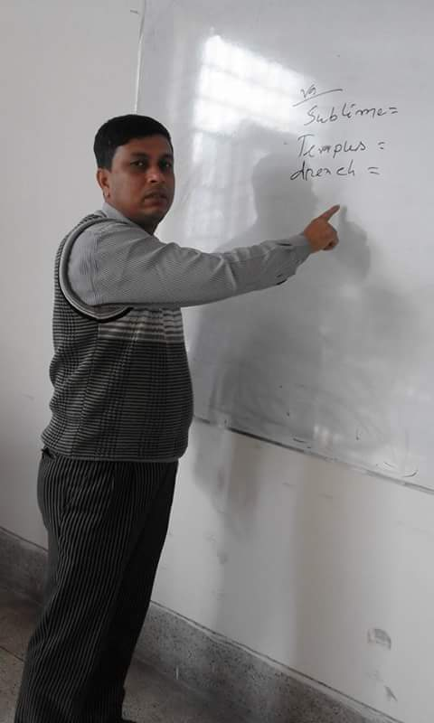
Teacher’s reading Loudly

Slide 12
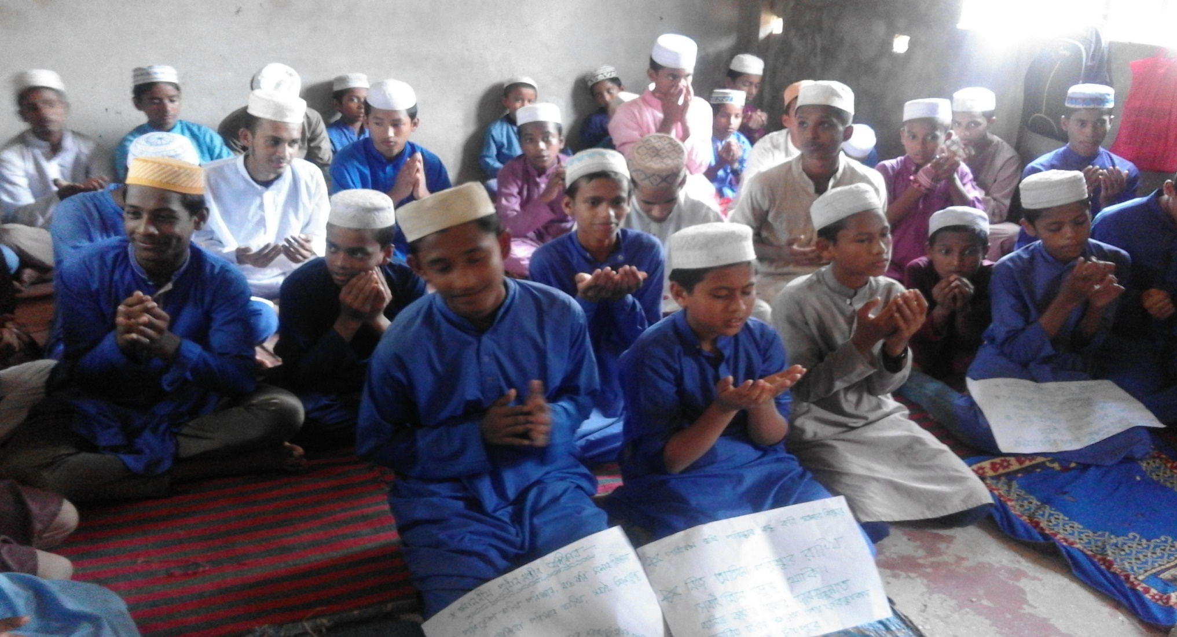
Students reading silently

Slide 13
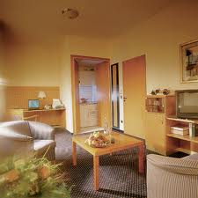
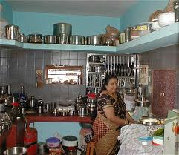
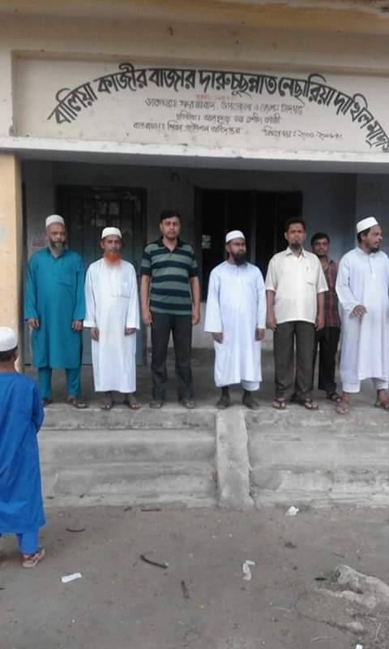
New word , similar word and make sentences
Apartment
flat
Saikat lives in an apartment.
Housewife
home maker
She is a housewife
He loves listening to song /word.
Listen
hear

Slide 14
Questions and Answers
1. Who is Saikat ?
Ans: a student.
2. Where does Saikat live?
Ans. Bogra.
3. With whom does he live?
Ans: with parents.

Slide 15
Group work
Making sentences following the words:
Love, Student, Read

Slide 16
Individual work
Write five sentences about Saikat’s family.

Slide 17
Evaluation
1. Which class does Saikat read in?
2. Write five sentences about your family.

Slide 18
Good-bye

