Slide 2
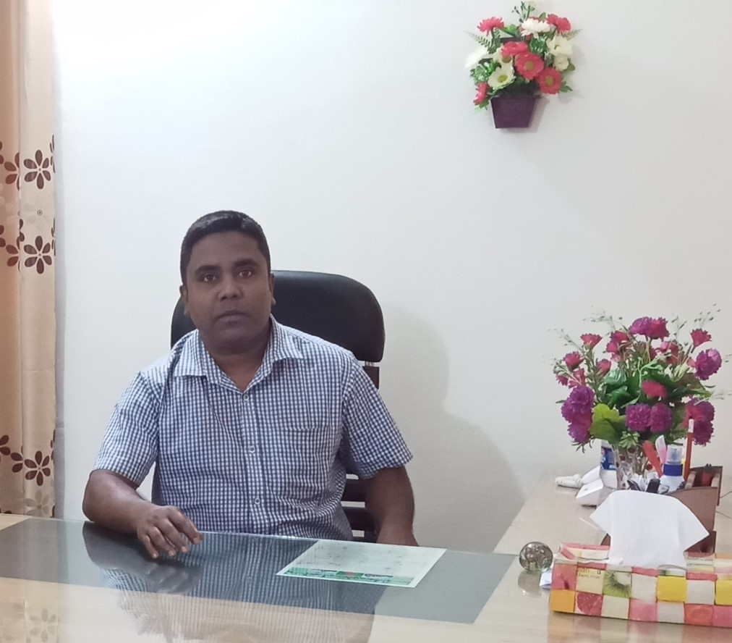
COVID-19 is one kind of virus.
COVID-19 is one kind of virus.
Sub: English
Class: Two
Lesson : Alphabet
Parts of the lesson: U-Z(Activity-A)
Page No-11
Md. Mushfikur Rahman
ASISSTANT TEACHER
PARGOBINDOPUR GOVT. PRIMARY SCHOOL
BIRAMPUR,DINAJPUR.
COVID-19 is one kind of virus.

Slide 3
Safety environment by greetings song.
We Shall Overcome
We Shall Overcome
We Shall Overcome, some day
Oh, deep in my heart
I do believe
We Shall Overcome, some day
COVID-19 is one kind of virus.
We clean our hands with regular soap.

Slide 4
What’s the name of the letter?
Kk
Hh
Cc
Ff
Oo
Dd
Gg
Bb
Jj
Ii
Aa
Ll
Nn
Mm
Ee
Pp
Qq
Rr
Ss
Tt
Now try to say-
What can be the topic of our today’s lesson?

Slide 5
Activity-A
Our today’s lesson is--
Alphabet (U-Z)

Slide 6
LEARNING OUTCOMES
By end of the lesson students will be able to-------
Listening: 1.1.1 become familiar with English sounds by listening to common
English words.
Speaking: 1.1.1 repeat after the teacher simple words and phrases with proper
sounds and stress.
1.1.2 say simple words and phrases with proper sounds and stress.
Reading: 1.2.1 recognize and read the alphabet both small and
capital (non-cursive)
1.3.1 recognize and read the names of objects having the same initial
and final sounds

Slide 7
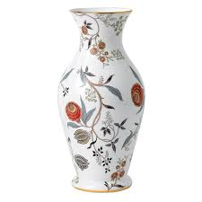
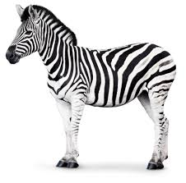
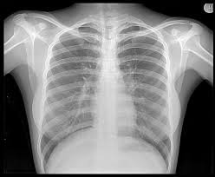
What is this?

Slide 8
Open your English book at page-11 and see the Activity -A
Uu
Vv
Ww
Xx
Y y
Z z
umbrella
vase
window
x-ray
yo-yo
zebra
Now repeat after me.

Slide 9
Capital letters
v
W
w
X
Z
U
u
V
x
Y
y
z
Small letters

Slide 10
What is this?
umbrella
What is the letter’s name?
What is the letter’s sound?

Slide 11
What is this?
vase
What is the letter’s name?
What is the letter’s sound?

Slide 12
What is this?
window
What is the letter’s name?
What is the letter’s sound?

Slide 13
What is this?
x-ray
What is the letter’s name?
What is the letter’s sound?

Slide 14
What is this?
yo-yo
What is the letter’s name?
What is the letter’s sound?

Slide 15
What is this?
zebra
What is the letter’s name?
What is the letter’s sound?

Slide 16
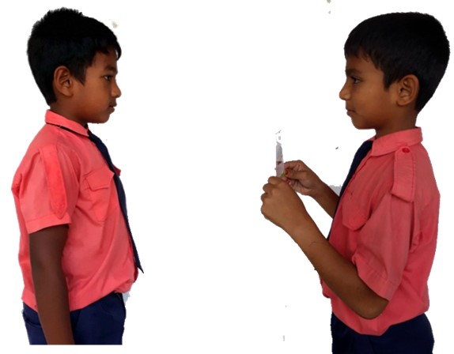
Pair work
What’s the letter’s name/sound?
W
One more

Slide 17
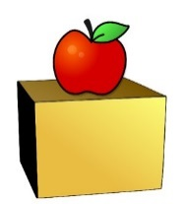
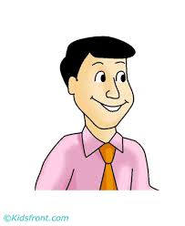
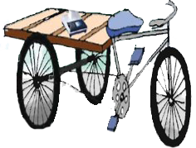
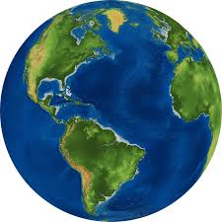
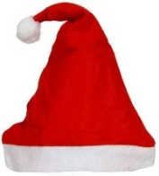
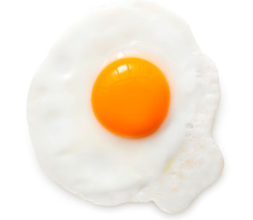
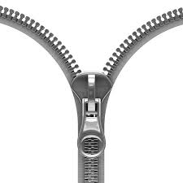
Say 2/more other words for each letter.
up
u
uncle
van
vegetables
v
world
water
w
X-max cap
x
X-max tree
yellow
y
yolk
zero
z
zipper

Slide 18
Read and say.
yo-yo
umbrella
zebra
window
vase
x-ray
vase
x-ray
yo-yo
umbrella
zebra
window
yo-yo
umbrella
zebra
window
vase
x-ray
vase
x-ray
yo-yo
umbrella
zebra
window

Slide 19
One day one word
Read and say.
vase
ফুলদানি

Slide 20
Find out the letters that are made by the word -----.
h
v
d
b
a
x
s
k
c
e
Find out the word------.
vaes
vesa
vase
vese
vise

Slide 21
Say the missing letter.
va--e
--ase
vas--
v--se
Write the word to your notebook.
vase
ভাস
ফুলদানি

Slide 22
Homework
Page 11 will be well read and written.
COVID-19 is one kind of virus.

Slide 23
That’s all for today. Goodbye. See you tomorrow.
We clean our hands with regular soap.

