Slide 1
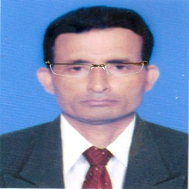
Welcome to my online class

Slide 2
Identity
Manik Chandra Majumder
Senior Teacher
Gazirhat High School
Senbag, Noakhali.
Mobile No: 01717155169
Email: manikmajumder01@gmail.com
Class : Nine-Ten
Subject : English 1st paper

Slide 3
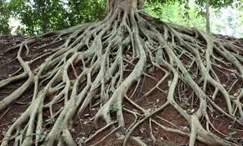
Do human beings have roots like the trees?
What is this?
Yes, But unlike the roots of trees.
They are invisible. They lie in our minds.
This is the roots of tree?

Slide 4
Human roots
Our family
Tradition
Surroundings
Birth place
Relatives
Culture
Occasion

Slide 5
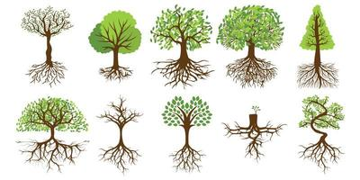
So, Our Today’s Lesson is-----
My roots -2

Slide 6
Learning outcomes
After we have studied the lesson, we will able to----
a) Read and comprehend texts,
b) participate in conversations,
c) narrate incidents and events in a logical sequence,
d) make Wh-Questions.

Slide 7
Read the following remarks and find out who is like you.
I simply just can't bear the people who don't have any respect for their roots. - Haridas Soren
We have a moderately big house in a town but we frequently go to our village home as well. I always feel so at home when I visit my village and stay with my near ones. - Bidisha Yasmin
I live in a small apartment with my mom, dad, and my little sister. Most of my relatives live in a village. I seldom go over there as I don't like village life. - Ifti Mahmud
Some people are so eager to leave their own homes, friends, and everything behind only to be a part of the city life. They arc not for me. - Antara Gomes

Slide 8
To be frank, I don't get used to visiting my relatives in the village. - Jhilik Ahsan
I live in a city but I never forget my parents are from a tiny but beautiful village. I know I have my roots there and I'm so proud of that. –Anupom Chakma
I just can't stand the people who have grown up in the village but forget it once they are out from there. -
Debashish Biswash

Slide 9
I live in city, but always feel childhood mates and my near and dear ones who are living in village. I always remember the sweet memories of the play ground and play mates.
Likings and dislikings always vary from person to person.
Those who like village | Those who dislike village
1. Haridas Soren | 1. Ifti Mahmud
2. Bidisha Yasmin | 2. Jhilik Ahsan
3. Antara Gomes
4. Anupom Chakma
5. Debashish

Slide 10
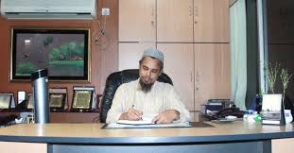
Vocabulary
Word : Qualified
Meaning: Having the necessary skill, experience or knowledge to do a particular job.

Slide 11
Word : Advanced
Meaning : Higher, developed or promoted

Slide 12
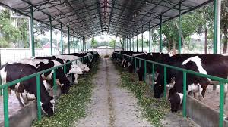
Word : farming
Meaning : The business of cultivating

Slide 13
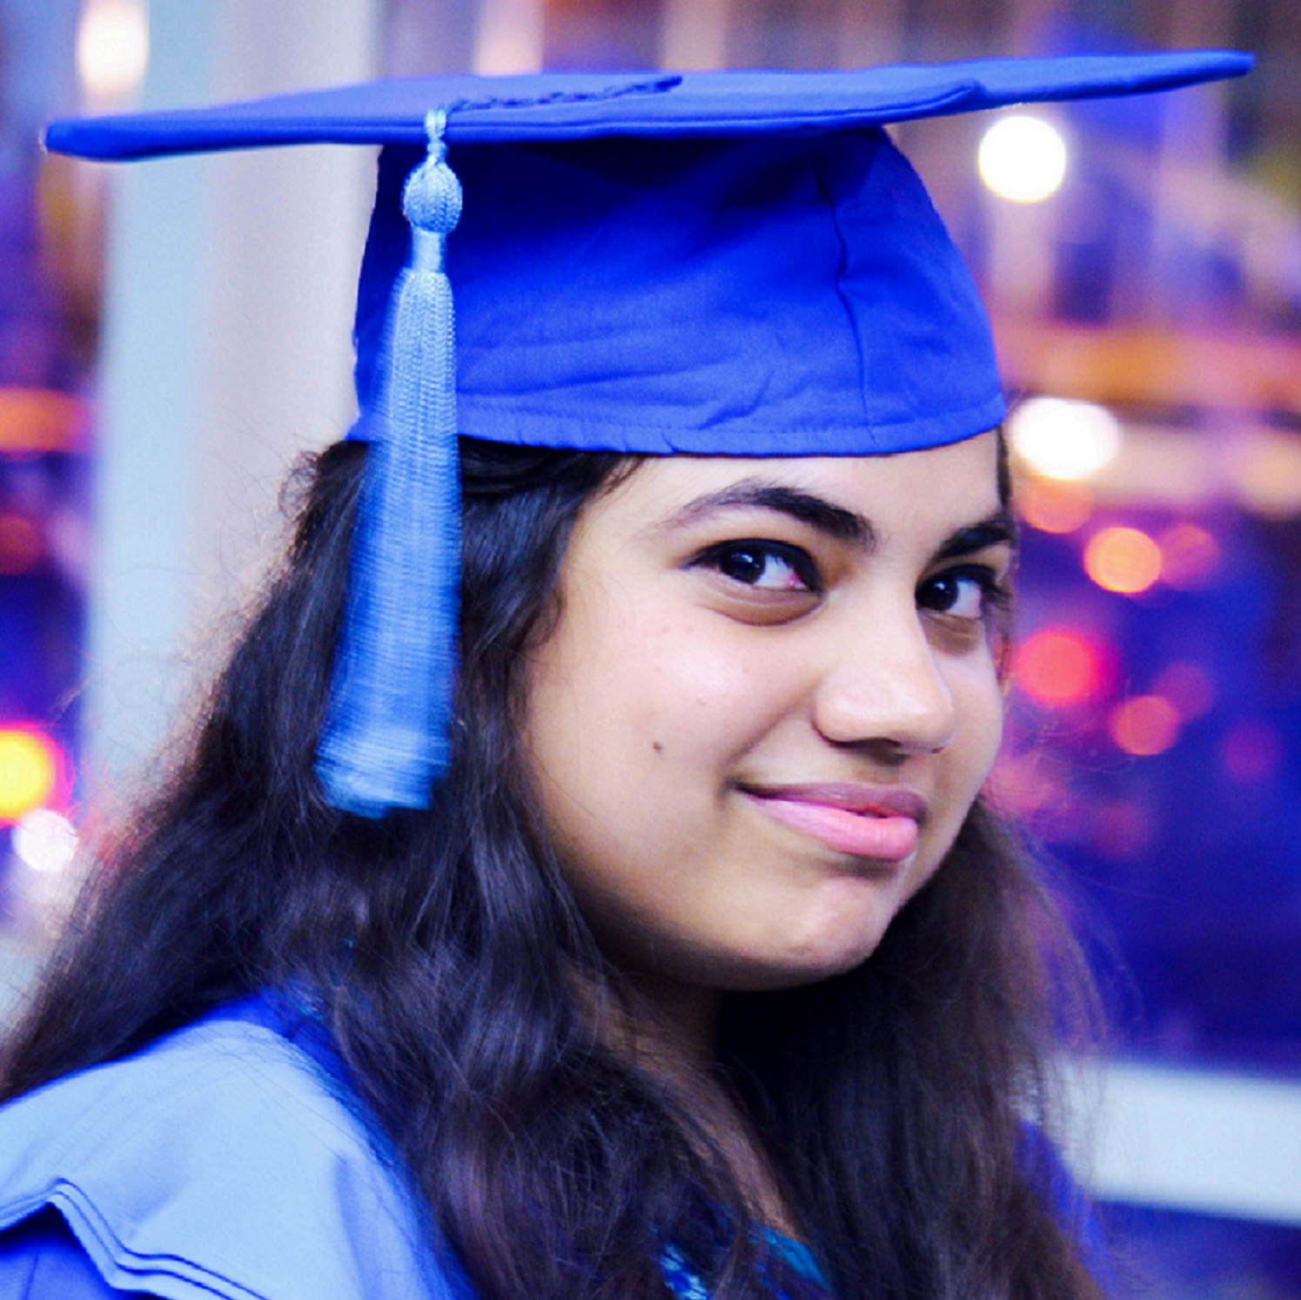
Word: Graduate
Meaning: Successfully complete Bachelor degree
.

Slide 14
Word : Obligation
Meaning : A duty or commitment or responsibility

Slide 15
Read the text.
Mainul Islam is a qualified farmer in Naogaon. Mr. Islam was very brilliant as a student. He took his higher education from Bangladesh Agricultural University in Mymensingh. He then came back home and started advanced farming. He has two brothers who graduate in different disciplines. The specialty of the Islam family is that they all are living their village and all are renowned in their own fields. Mr. Islam’s younger brother, who is a Rajshahi University graduate, is a science teacher in a local school.

Slide 16
His youngest brother is a social science graduate who takes to start a local NGO to work for this area. When asked, “What makes you decide to stay here this village?” " Mr Islam smiled and said, "Look, its true that we could leave this village for city life. I could be banker or my brothers could be bureaucrats. But it didn't attract us. We are sons of this soil. Yes, we have education but does education prepare a person only to be an officer? Don't we have any obligation to the soil that has made us what we are? " He also added that not every educated individual should be a job seeker.

Slide 17
He added that since his discipline was agriculture, after his education he took the occupation of a fanner. In response to a question whether they had any frustration living in a village, he confirmed that they were indeed very pleased with their life. He said, "I work in my own farm, stay with my family members, pass time with my old friends, and sleep at my own home. All these count a lot.“
Mr Islam is right. Many people go to cities and forget or loosen their roots knowingly or unknowingly. Mr Islam and his brothers are great—they haven't forgotten their roots. They not only stuck to their own roots, they have been torch bearers for others to be respectful of their roots.

Slide 18
Work in pairs. If you are given a chance to meet Mr Islam, what questions would you ask him? Make both Wh-questions and yes/no questions. ( Section-E )
If I’m given a chance to meet Mr. Islam, I would like to ask him---
Why have you decided to live in your village instead of trying a
good job ?
What is your advice to them who leave village for city?
What is your advice to the unemployed graduates of our country?
How can our agricultural production be increased?
What crops do you grow?
How can the use of chemical fertilizers be re reduced ?

Slide 19
If I’m given a chance to meet Mr. Islam, I would like to ask him---
Do you ever think that you’ve mistaken?
Do you think that your brothers have also done the right thing?
Do you think join farming more productive?
Do you think city life has some facilities which are absent from village life?

Slide 20
Read the statements in columns A and B then match them to make complete sentences.
Column A | Column B
1. Mr. Islam | a. if anyone has education she/he must have job.
2. The specialty of Islam's brother is | b. has multi- faceted opportunities.
3. Mr Islam never believes that | c. graduated from Bangladesh Agricultural University.
4. Mr. Islam also believes | d. in the duty toward roots.
5. Staying with the roots | e. that city life couldn't attract them.

Slide 21
Match your Answer.
Column A | Column B
1. Mr. Islam | if anyone has education she/he must have job.
2. The specialty of Islam's brother is | has multi- faceted opportunities.
3. Mr Islam never believes that | graduated from Bangladesh Agricultural University.
4. Mr Islam also believes | in the duty toward roots.
5. Staying with the roots | that city life couldn't attract them.
(2+e) The speciality of Islam’s brother is that city life couldn’t attract them.
(3+a) Mr. Islam never believes that if anyone has education she/he must have job.
(1+c) Mr. Islam graduated from Bangladesh
Agricultural University.
(5+b) Staying with the roots has multi- faceted opportunities.
(4+d) Mr. Islam also believes in the duty toward roots.

Slide 22
Evaluation
Choose the correct answer from the alternatives.
Q: a) According to Mr. Islam,----------should not be the only motto of education
Cor. Ans:
Cor. Ans:
i. acquisition of knowledge
ii. fellow feeling
iv. Job seeking
iii. To be aware of responsibility
iv. Job seeking
Q: b) Mainul along with his brother--------- in a village.
ii. lives
i. live
ii. lives
Cor. Ans:
Cor. Ans:
iii. studies
iv. work

Slide 23
Q: c) Mainul and his brothers are ----------with their present life.
Cor. Ans:
i. frustrated
ii. dissatisfied
Cor. Ans:
iii. satisfied
iii. satisfied
iv. annoyed
Q: d) Mainul started ---------farming in his village.
Cor. Ans:
i. modern
ii. traditional
Cor. Ans:
i. modern
iii. Out dated
iv. conventional
Q: e) Which quality of Mainul describes him best in the passage?
Cor. Ans:
i. He is a graduate
Cor. Ans:
ii. He is an educated farmer
iii. He showed his responsibilities to his root
iii. He showed his responsibilities to his root
iv. He does not like conventional job

Slide 24
Home work
Who is Mr. Islam ?
What made Mainul Islam to come back to his village ?
What is the specialty of Islam family ?
Why couldn’t city life attract them ?
What did he say with determination ?

