Slide 1
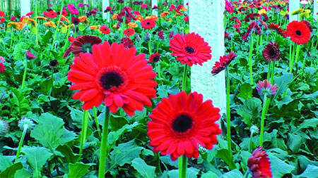
Welcome

Slide 2
IDENTITY
Class - ix
Unit – One
Lesson – 1
Good citizen
50 mins
Azizul Fakir
Assistant teacher
Dighirjan Secondary School
Nazirpur, Pirojpur.
Email: azizul.nk@gmail.com
Mobile: 01710745128

Slide 3
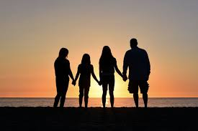
Where do you live?
I live in Barishal
Is it a village or a town?
It is a village.
With whom do you live?
I live with my family.
Why do you live with your family?
Because I can’t live alone.
So, can you tell me what is our topic today?

Slide 4
So our today’s topic is
“Can you live alone?”
Unit – 1
Lesson - 1

Slide 5
Learning outcomes
After completing the lesson students will be able to
1
infer meaning from the context
2
talk about the pictures
write answers to the questions.
3
4
tick the best answers from the alternative
listen for information to the CD
5

Slide 6
Keyword
Part of speech
Meaning
Synonym
Quarrel -
noun
Discord
an angry argument between people.
Jealousy -
noun
Envy
the state of being jealous

Slide 7
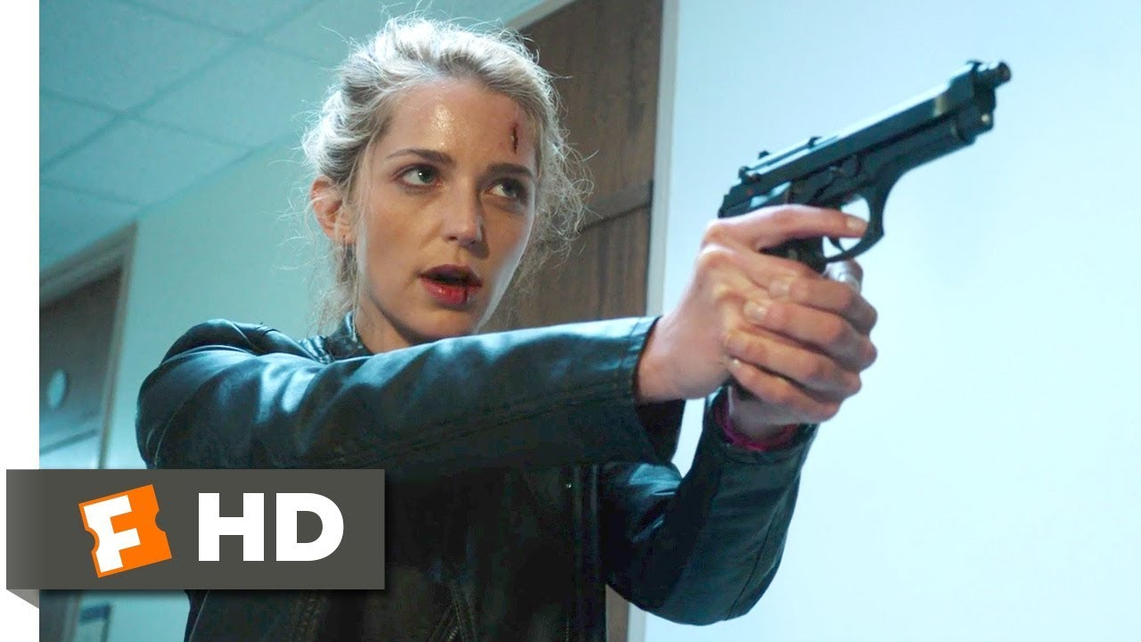
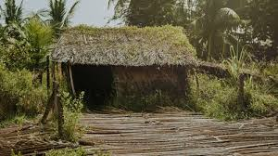
Keyword
Part of speech
Meaning
Synonym
Enmity -
feelings of hatred towards somebody.
Hostility
noun
Hut -
noun
a small, simply built house.
Shack

Slide 8
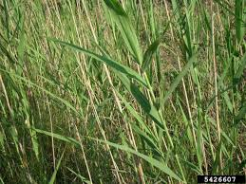
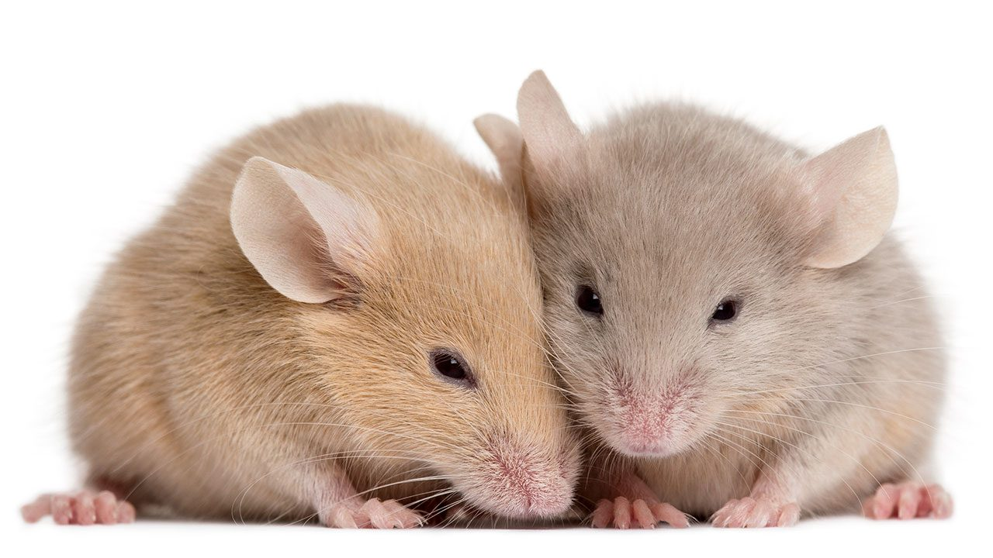
Keyword
Part of speech
Meaning
Synonym
Reed -
noun
Twig
a tall plant like grass with a hollow stem.
Creature -
noun
any large or small living being that can move.
Animal

Slide 9
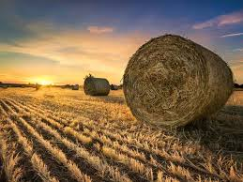
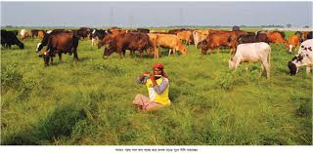
Keyword
Part of speech
Meaning
Synonym
Hay -
noun
Dried grass
grass that has been cut and dried and is used as good for animals.
Cowhand -
noun
Cattleman
a man who takes care of cattle.

Slide 10
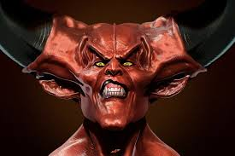
Keyword
Part of speech
Meaning
Synonym
Devil -
noun
Demon
the supreme spirit of evil.
Angel -
noun
Hostility
symbol of purity and innocence.

Slide 11
Open at page 02 in your text book and read the passage carefully.
Long ago, a young man who lived in a village, found his life full of problems and sufferings. Quarrels, ill-feelings, jealousy, enmity – all were part of everyday life there. So, he left his house and went to a jungle to live by himself. There he made a nice little hut with wood, bamboo and reeds. ‘Ah, how happy I am here!” said the man to himself.
But one day he found some mice in his hut. The little creatures soon made holes in his blanket. So he brought a cat to kill the mice. The cat needed milk. So he brought a cow. The cow needed grass and hay. So he brought a cowhand.

Slide 12
The cowhand needed food. So he took a wife to cook meals. Then children were born to them, and the man found himself again a family.
So nobody can live alone, unless that person is either an angel or a devil. People need food, shelter, companions and help. They need to look after each other. And if they live in a family or community, their needs can be fulfilled. Hence living in society can make people good and happy citizens.

Slide 13
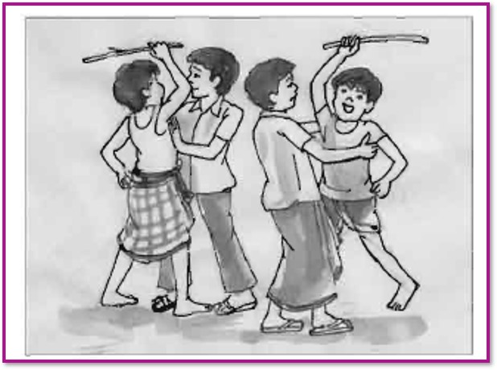
Look the picture carefully
Now read the text bellow.
What happened here?
A young man who lived in a village, found his life full of problems and sufferings. Quarrels, ill-feelings, jealousy, enmity – all were part of everyday life there. So, he decided to left his house.
Here some people are doing unexpected task.

Slide 14
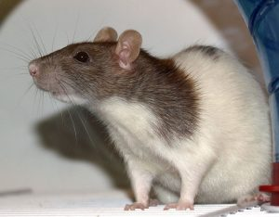
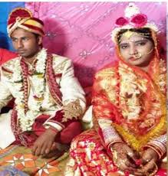
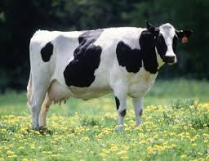
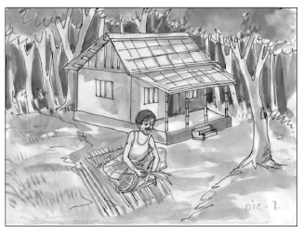
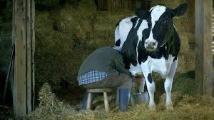
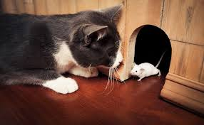
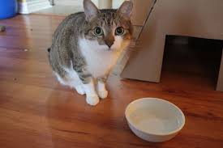
See this picture also
Now read the text bellow.
Can you tell me about this man?
Living in a jungle, the man saw that once a little creature soon made holes in his blanket.
So he brought a cat to kill the mice.
The cat needed milk.
So he brought a cow. The cow needed grass and hay.
So he brought a cowhand, The cowhand needed food.
So he took a wife to cook meals.
Then children were born to them, and the man found himself again a family. At last he realized that human beings can’t live alone.
This man wanted to live alone in a jungle.

Slide 15
Time 3mins
12
1
11
10
2
9
3
Individual works
8
4
7
5
6
Answer the following questions
Q1: Explain the reasons behind the young man’s decision to leave the village.
Q2: The young man realized that human beings can’t live alone. Do you think
so? Justify your answer.

Slide 16
You may check your answers
Ans1: The young man decided to leave the village because he thought that human society
was full of problems and sufferings. He also found that quarrels, ill-feelings,
jealousy, enmity, etc. were the part of everyday life in society.
Ans2: Yes, I think the young man realized that human beings can’t live alone. For
instance, when some mice made holes in his blanket, he brought a cat to kill the
mice and cow to feed the cat. Subsequently, brought a cowhand, and later, took a
wife. Thus, he found that he is no more living alone.

Slide 17
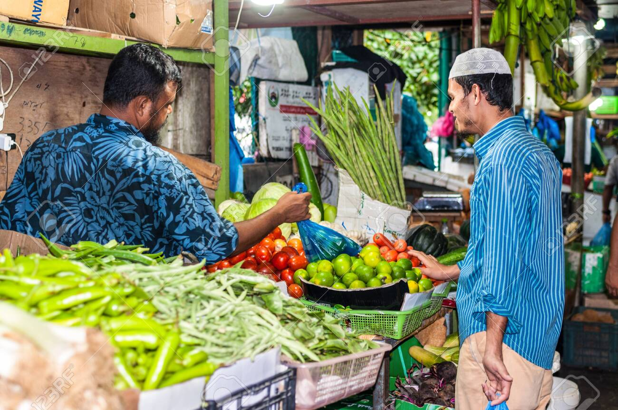
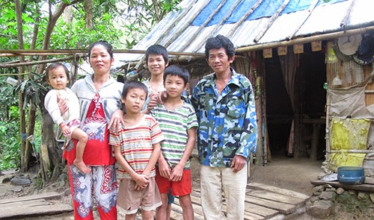
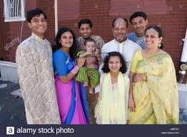
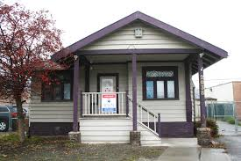
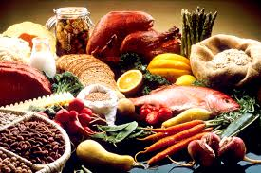
Read the text
A human cannot live alone by any means. It is because a man needs to take the help of others to fulfill his necessities.
After leaving the society to stay in the jungle, the young man eventually learnt the importance of living together in society.
Society fulfills our needs by ensuring food, shelter companions and help. Thus, society makes people good and happy citizens.

Slide 18
Pair works
Q1. Can a human being live alone? Why/Why not?
Q2. What did the young man learn after leaving the society to stay in the jungle?
Q3. “Society can make people good and happy citizens”. How? Explain in 2/3sentences.
12
1
11
10
2
5mins
9
3
8
4
7
5
6

Slide 19
Check your answers
Ans1: No, a human cannot live alone by any means. It is because a man needs to take the
help of others to fulfill his necessities.
Ans2: After leaving the society to stay in the jungle, the young man eventually learnt the
importance of living together in society.
Ans3: Society fulfills our needs by ensuring food, shelter companions and help. Thus,
society makes people good and happy citizens.

Slide 20
Time 6mins
Group works
12
1
11
10
2
9
3
8
4
7
5
6
Close your book and answer the question.
What five things did the young man do in the jungle?
Now divide into groups of five. Tell the story to the groups sequentially.

Slide 21
Check your answers
Ans: Five things that the young man did in the jungle are follow.
The young man made a nice little hut.
He brought a cat to kill the mice.
He brought a cow to have milk.
He brought a cowhand to tend the cow.
He took wife to cook food.

Slide 22
Tick the best answer.
The young man found his life full of ---
i. joy ii. difficulties iii. poverty iv. Delight
(b) The phrase ‘look after’ in the text implies ---
i. guide ii. relieve . alleviate iv. assist
(c) The meaning of the word ‘community’ is ---
i. tribe ii. society iii. group iv. clan
(d) ‘The little creature’ in passage refers to in the passage?
i. mouse ii. cat iii. cow iv. cowhand
(e) The man brought the cow to ---
i. hire an cowhand iii. kill the mice iv. feed cat iv. drink milk
(f) The young man made a --- in the jungle.
i. farm ii. hut iii. protection iv. plantation
(g) A --- kills a mouse.
i. cow ii. cat iii dog iv. maid
$$$$
$$$$
$$$$
$$$$
$$$$
$$$$
$$$$

Slide 23
Listen to the CD
Evaluation
Now fill the passage from your listening.
A young man used to live in a village. Once, he found his life problematic in the (a) ---. So, decided to abandon the social life and live in a (b) ---. But to his utter dismay, he somehow found himself in a (c) --- again even in the jungle. Actually, a human being cannot live without a (d) ---, because he needs help and support from others in society. Only an (e) --- or a devil can live alone.

Slide 24
Check your answers
A young man used to live in a village. Once, he found his life problematic in the (a) society. So, he decided to abandon the social life and live in a (b) jungle. But to his utter dismay, he somehow found himself in a (c) family again even in the jungle. Actually, a human being cannot live without a (d) companion, because he needs help and support from others in society. Only an (e) angel or a devil can live alone.

Slide 25
Homework
Stay home
Stay safe
Write the summery of the text.

Slide 26
Thanks

