Slide 1
Good Morning

Slide 2
GREETINGS
Good morning, students
Teacher
Good morning, teacher
Student’s
Teacher
How are you today ?
Fine
Student’s

Slide 3
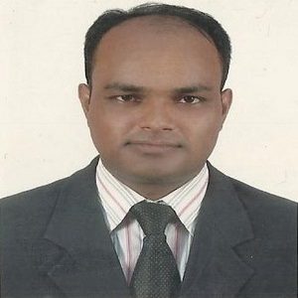
Teacher’s Identity
Lesson Identity
Class: One
Subject : English
Unit : Unit-2
Lesson 4-6
MD. ABDUL KADER
Assistant Teacher
Borni Govt. Primary School,
Companigonj, Sylhet.

Slide 4
Ok, my dear students lets start with a song.

Slide 5
Ok, students our today’s lesson is
Letter (A a)

Slide 6
Learning Outcomes
Listening :
1.1.1 become familiar with English sounds by listening to
common English words.
Speaking:
1.1.1 repeat after the teacher simple words and phrases.
1.2.1 say simple words and phrases.
Reading:
1.2.1 recognize and read the alphabet both small and capital.
Writing:
1.1.1 to practice letter shapes/simple writing patterns, etc.

Slide 7
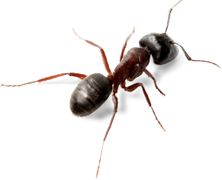
Look at the picture and say loudly with teacher
a
A
Ant
ant

Slide 8
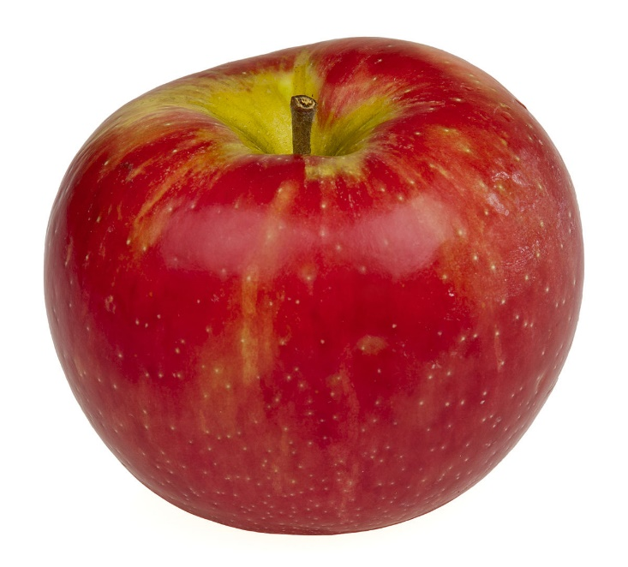
Look at the picture and say loudly with teacher
a
A
Apple
apple

Slide 9
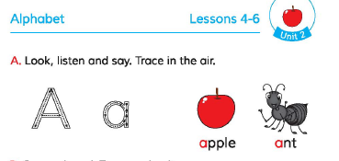
Open at page 5 of your EFT book and look and do activity A
Everybody, listen to carefully
And repeat with me.

Slide 10
Look and Say with me again loudly
Capital =A
Small= a

Slide 11
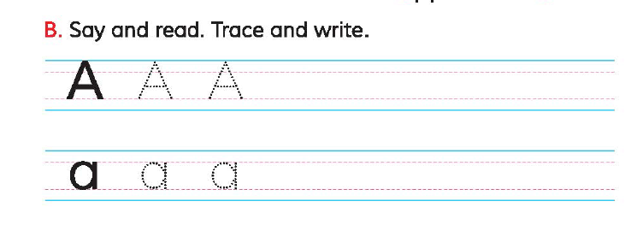
WCW
Open at page 5 of your EFT book and look and complete activity B.

Slide 12
Open at page 5 of your EFT book and look and complete activity C
Evaluation

