Slide 1
Dear Students, Welcome
To
My Presentation

Slide 2
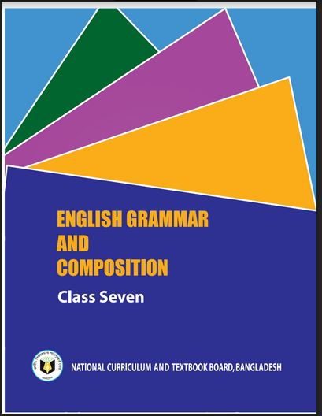
Identity
Habibur Rahman
Asst. Teacher
Barohit High School
Ishwargonj, Mymensingh
Contact No: 01724102270
Email: habibur.dcd6@ gmail.com
Class : Six / Seven / Eight
Topic: Right Forms of Verbs
English Grammar & Composition
Date:11/08/2020

Slide 3
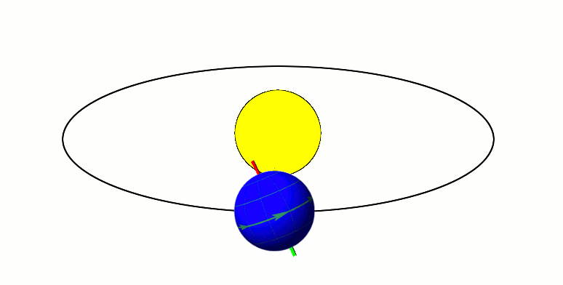
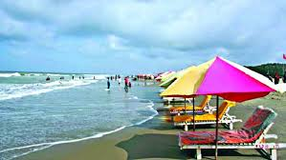
Look at the pictures and the sentences.
The Sun
The earth moves round the sun.
They went to Cox’s Bazar sea-beach yesterday.
What is the parts of speech of the words in the boxes?
Verbs

Slide 4
Can you tell what may be our today’s lesson?
Our Today’s lesson is-
Right forms of verbs

Slide 5
Learning outcomes
After completing the lesson the students will be able to –
write the sentences using right forms of verbs.
fill the gaps with right forms of verbs (with clues).

Slide 6
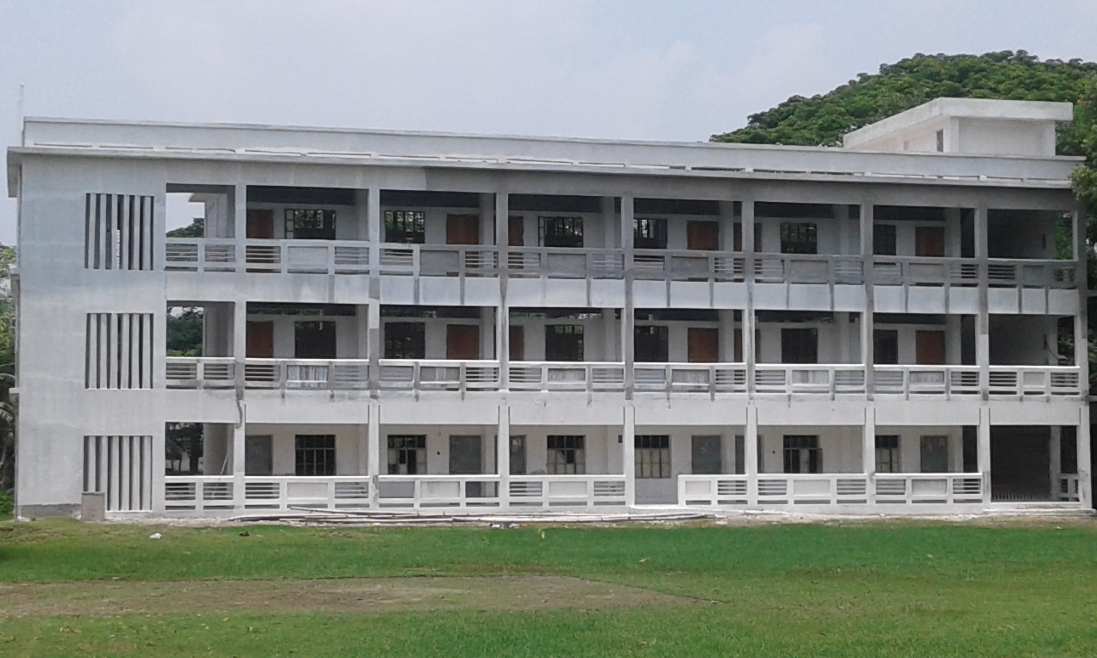
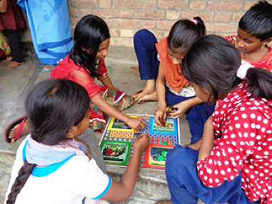
Look at the pictures and the sentences.
Barohit High School
Ishwarganj, Mymensingh.
The boy went to school yesterday.
They did not go to school yesterday.
We use the past simple to talk about an action or happening at a definite time in the past.
Can you tell why the sentences are Past Indefinite?
Do the sentences express past event?
Past Indefinite Tense
Which tense is expressed by the sentences?

Slide 7
Structure of the Past Indefinite Tense:
Subject + মূল Verb এর past form + Object + other words.
Example:
My friend gave me a nice story book last week.
Subject
Verb2
1st Obj
2nd Obj
Past indicating word
If in the sentence there is yesterday, ago, before, long since, last week, in 1952, when I was in school, once upon a time, the sentence will be Past Indefinite Tense .
More Example:
1. I mailed the letter yesterday.
2. I met her two years ago.
3. He left home last night.

Slide 8
Look at the sentences.
Aff: He came home yesterday.
[Here used main verb without auxiliary.]
Sub.
Other words
V2
Neg: He did not come home yesterday.
Aux Verb+not
V1
Other words
Sub
Int: Did he come home yesterday?
Aux V
Sub
V1
Other words
Neg.Int: Didn’t he come home yesterday?

Slide 9
Single Work
Give answers using right forms of verbs.
Last Friday I (a) ---- (go) to the zoo with some of my friends. We (b) ------(reach) there before the gate was (c) ------(open). Then we (d) -----(buy) some tickets and (e) -----(enter) the zoo.
went
reached
opened
bought
entered

Slide 10
Look at the sentences.
Q: No sooner had he (see) the police than he (run) away.
Neg: No sooner had he seen the police than he ran away.
Note: No sooner had---- than, scarcely had---- when, hardly had ---- before থাকলে প্রথম ব্রাকেটের Verbকে past participle এবং ২য় ব্রাকেটের Verbকে past form করতে হয়।
Example:
Q: No sooner had the teacher (enter) the class room than the students (stand) up.
A: No sooner had the teacher entered the class room than the students stood up.

Slide 11
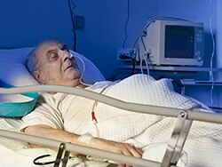
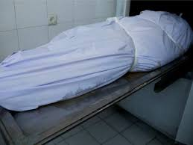
Look at the pictures and the sentences.
The patient had died before the doctor came.
(ডাক্তার আসার আগে রোগীটি মারা গেল )
The patient died after the doctor had come.
(ডাক্তার আসার পরে রোগীটি মারা গেল)
Note: Before মানে হল "আগে" । এর আগে verb এর past perfect tense(had+verbএর past participle) বসে। আবার after মানে হল "পরে" । এরপরে past perfect tense (had + verb এর past participle) বসে ।অর্থাৎ Past Perfect tense “before” এর পূর্বে অথবা “after” এর পরে বসে।

Slide 12
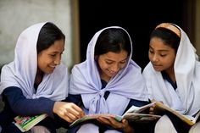
Look at the pictures and the sentences.
Q:It (to rain) since morning.
A: It has been raining since morning.
Q: They (read) the book for two hours.
A: They have been reading the book for two hours.
Rule: কোন Sentence -এ সময়ের পূর্বে since বা for থাকলে Sentence টি Present Perfect Continuous Tense- এর হয়ে থাকে। Structure: Subject +have been/has been+ V1 + ing + for/since + time

Slide 13
Look at the picture and the sentences.
Q: It (be) five years since I (loss) my father.
A: It has been five years since I lost my father.
Or, It is five years since I lost my father.
Q:Three years (passed) since I (leave) the village.
A: Three years have passed since he left the village.
Note: Since যদি Sentence -এ Conjunction হিসেবে ব্যবহৃত হয় , তবে Sentence- এর প্রথম অংশ Present Perfect Tense বা Present Indefinite Tense হয় এবং since-এর পরের অংশটি Past Indefinite Tense-এর হয়।

Slide 14
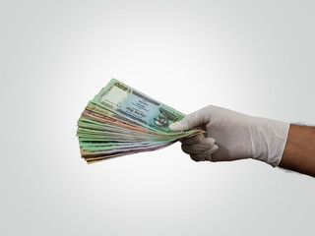
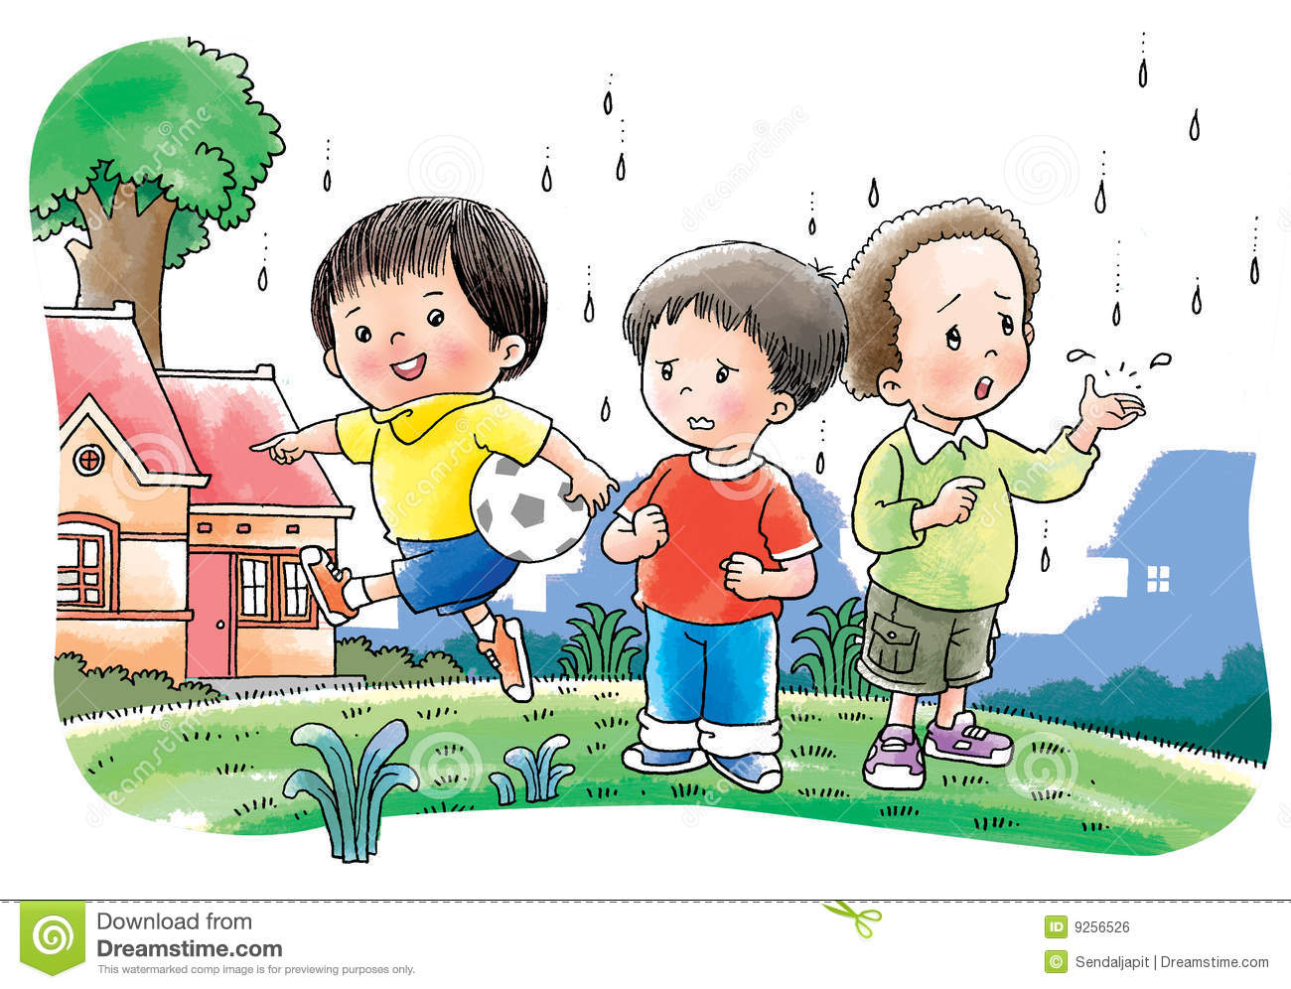
Look at the pictures & the sentences.
(a) If he wants , I shall help him.
Present Indefinite
Future Indefinite
(b) You will catch cold , if you play in the rain .
Future Indefinite
Present Indefinite
Note: Sentence-এ If যুক্ত Conditional clause টি Present Indefinite Tense হলে, পরের clause টি Future Tense-এ হবে।
Example: If you work hard, you will shine in life.

Slide 15
Look at the pictures & the sentences.
(a) If he came to me , I would help him.
Past Indefinite
Future In the Past
(b) I would fly in the sky , if I were a bird.
Future In the Past
Past Indefinite
Note: Sentence-এ If যুক্ত Conditional clause টি Past Indefinite Tense হলে, পরের clause টিতে Subject এর পরে would/should/could/might বসে এবং পরের verb এর Predent form হয়।
Example: If I saw him, I would talk to him.

Slide 16
Look at the sentences.
(a) If she had tried , she would have succeeded.
Past Perfect
Perfect Conditional
(b) I could have met him if he had been here .
Perfect Conditional
Past Perfect
Note: If যুক্ত clause টি Past Perfect Tense হলে, পরের clause টি Perfect Conditional অর্থাৎ Sub + would have /could have/ should have/might have + V3 হবে।
Example: If I had seen him, I might have told him the news.

Slide 17
Look at the picture & the sentences.
You may come tomorrow.
Modal Auxiliary
Verb1
We should respect our teachers.
Note: Modal Auxiliaries যেমন- Shall, will, should, would, can, could, may, might, must, need, dare, used to, ought to, have to, has to, had to ইত্যাদির পরে মূল verb এর Present form হয়।

Slide 18
Pair Work
Complete the following text using right forms of verbs.
compare | have | be | remove
enlighten | prosper | call | do
is
Education (a) ----- the backbone of a nation. No nation can (b) ------------ without it. It (c) ---------------------- to light that (d) ------------- the darkness of mind. It (e) ---------------- the power that (f) ------------------ our souls. But in our country most of the people do not (g) ------------ education. They (h) ------ not have access to education because of poverty.
prosper
is compared
removes
is called
enlightens
have
do

Slide 19
Evaluation (Orally)
1. The man ---------- (die) last night.
died
did not go
2. They ------ (not go) to school yestreday.
prosper
3. If he works hard, he will -----------(prosper) in life.
rain
4. It may ------(rain) today.
5. If I --- (be) an MP of Ishwarganj I would help the poor.
were
had left
6.He reached the station after the train---(leave).

Slide 20
Recall these rules and practice more and more.

Slide 21
Thank you everybody.
Stay Home; Stay Safe.
Good wishes for all of you.
Allah Hafez.

