Slide 1
electrical engineering fundamentals
Sub. Code: 66712
Presented by-
Mir Shafiul Islam
Instructor (Tech.)
Dept. of Electronics
Chattogram Mohila Polytechnic Institute
Mob: 01312-114266;
Email: shafi.cmpi@gmail.com
Web: msishafi.blogspot.com

Slide 2
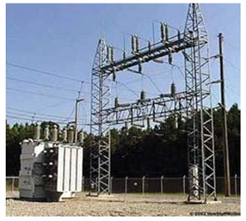
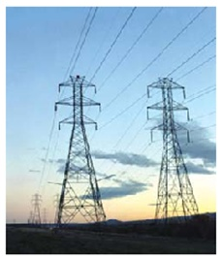
Electrical Engineering FUNDAMENTALS
Sub. Code: 66712
Department for:
1st Semester: Electronics, Computer, Civil, Architecture, Mechanical…….
2nd Semester: AIDT, Refrigeration and AC, Food, Surveying Automobile……..

Slide 3
About the Course
Subject Code
66712
T – P - C
T ( Theory) = 3 , P ( Practical ) = 3
C (Credit) = 4
Pre requisite
NO NEED

Slide 4
Assessment
Total
Marks
Theory
Continuous 40%
Final 60%
Practical
Continuous 50%
Final 50%
Attendance 5%
Mid 20%
QT+CT15%
Experiment 25%
Home Task 5%
Job Report 5%
Oral Test 5%
Behavior 2%
Attendance 8%
Experiment 30%
Report 10%
Oral Test 10%
Subject Code : 66712
T-P-C : 3-3-4

Slide 5
Assessment - detail
Total Marks
(200)
Theory (150)
Continuous (60)
Final (90)
Practical (50)
Continuous (25)
Final (25)
Attendance (8)
Mid Term (30)
QT+CT Test (22)
Experiment (10)
Home Task (3)
Job Report (5)
Oral Test (3)
Behavior (1)
Attendance (3)
Experiment (15)
Report (5)
Oral Test (5)
Subject Code : 66712
T-P-C : 3-3-4

Slide 6
Tests Cycle Diagram
2
3
1
CT-1
Mid Term
QT -1
QT -2
4
Theory
Final
CT-2
Practical
Final
5
7
6

Slide 7
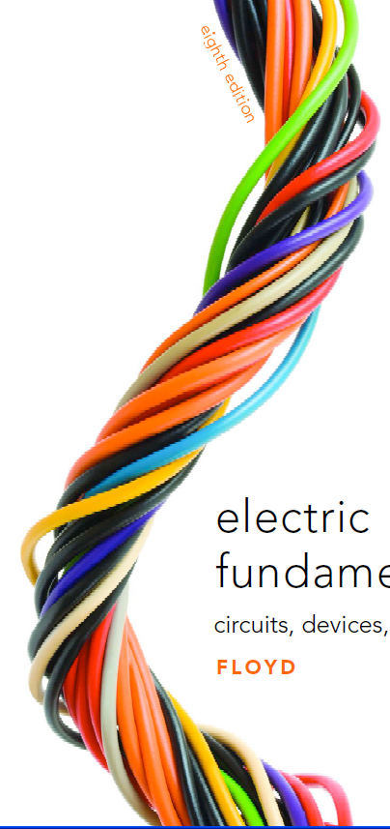
Electrical Engineering Fundamentals
Chapter-01
Electricity & its Nature

Slide 8
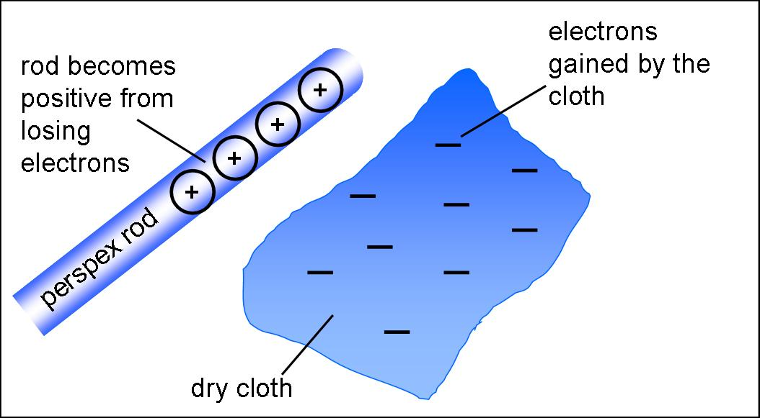
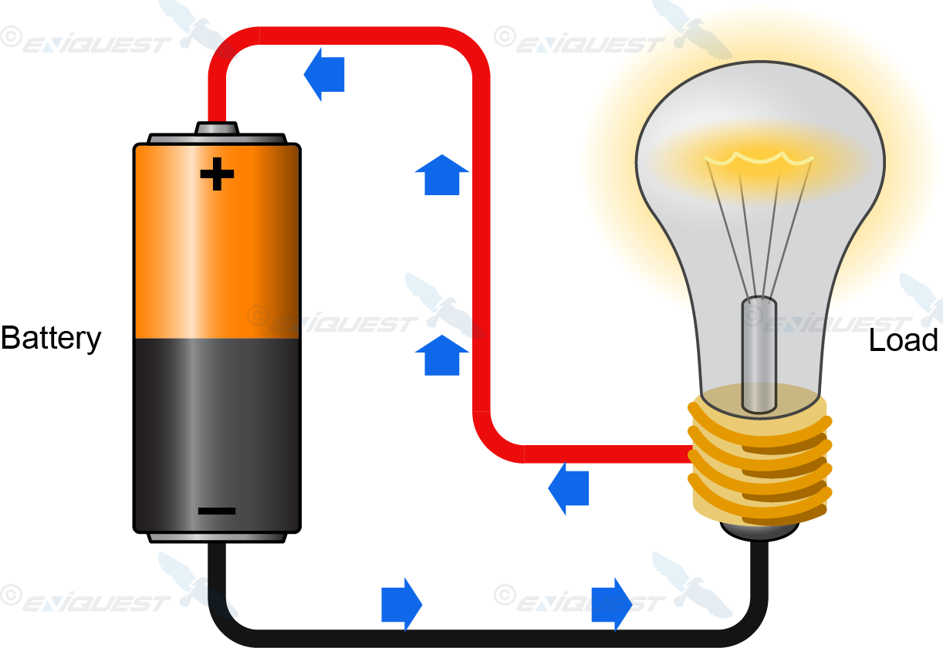
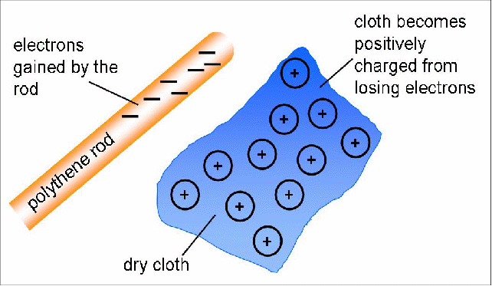
1.1 Meaning of Electricity
Electricity is a type of energy that can build up in one place or flow from one place to another.
When electricity gathers in one place it is known as static electricity (the word static means something that does not move).
Electricity that moves from one place to another is called current electricity.

Slide 9
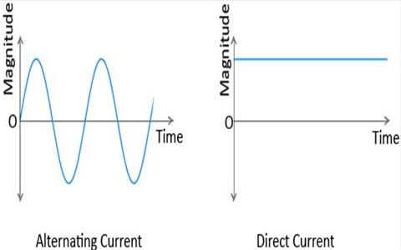
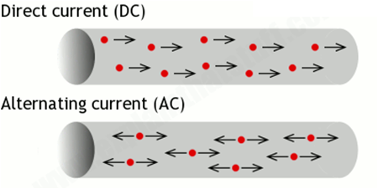
Current Electricity
When electrons move, they carry electrical energy from one place to another. This is called current electricity or an electric current. Electricity can move around a circuit in two different ways.
Direct Current (DC)
Alternating Current (AC)

Slide 10
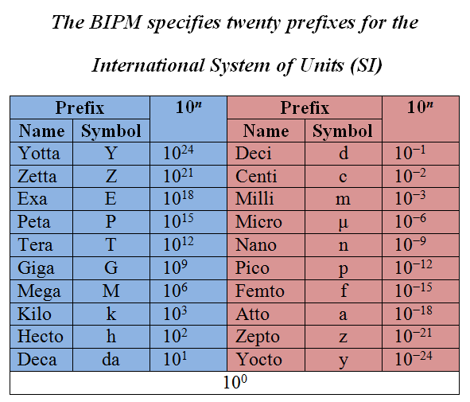
Power of 10

Slide 11
Effect of Electric Current
Heating Effect
Magnetic Effect
Chemical Effect
Effect on Human Body

Slide 12
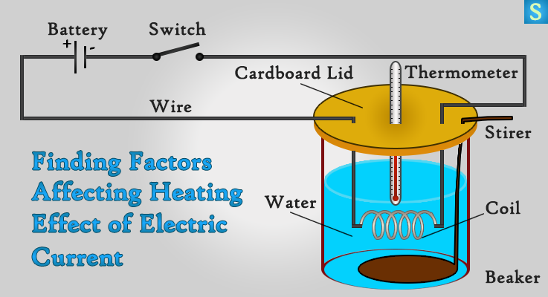
Heating Effect

Slide 13
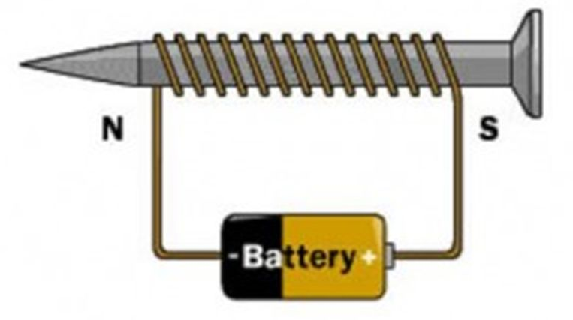
Magnetic Effect

Slide 14
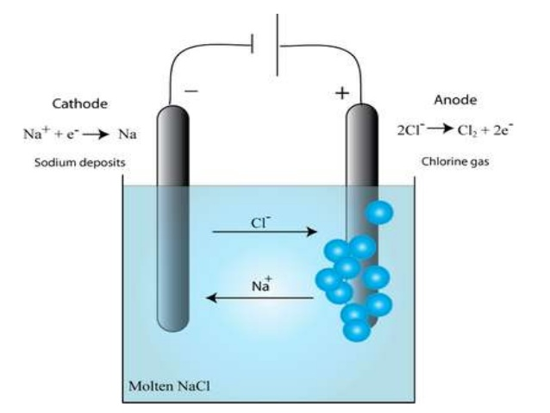
Chemical Effect

Slide 15
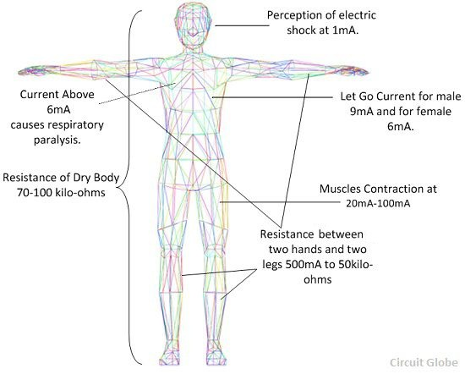
Effect on Human Body

Slide 16
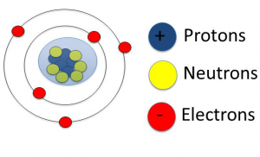
1.2 Structure of Atoms
Acceding to the modern electron theory, every matter in the universe is made up of very small divisible particles known as molecules.
Every molecule is further composed of very minute particles called atoms.
Every matter differs from the other in atomic structure. The electrical behaviour of the matter can study from its atomic structure.
Atom

Slide 17
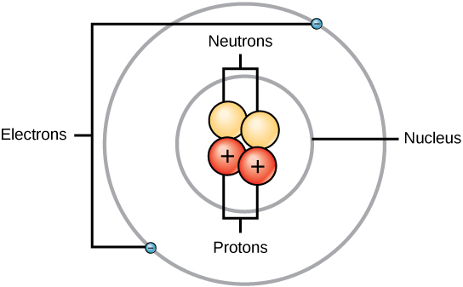
The Parts of Atom
Nucleus
Extra-nucleus
Nucleus: The central core of the atom is known as the nucleus. Properties of nucleus :
Nucleus contains two types of particles.
Protons
Neutrons
Protons: Protons are positively charged particles. each proton has a positive charge of 1.602×10⁻¹⁹ coulombs. Neutrons: Neutrons have no charge at all. The mass of neutrons is equal to the mass of the proton. The nucleus has a net positive charge due to its protons.

Slide 18
The Parts of Atom (Cont….)
Extra-nucleus
Extra-nucleus: The outer part surrounding the nucleus is known as the extra-nucleus.
Properties of the extra-nucleus
It consists of tiny particles known as electrons each electron has a negative charge of 1.602×10⁻¹⁹ coulomb.
Thus the total net charge of the atom is assumed to be zero in polarity.
The electrons are approximately 1/1840 times that of the protons and hence it is neglected.
Thus the total mass of the atom is assumed to be concentrated at the nucleus

Slide 19
Comparative Analysis

Slide 20
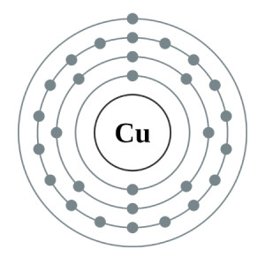
Atomic Structure of Copper
Copper is a chemical element and it is a member of group 11 and period 4 in the periodic table. The atomic number of copper is 29 and it is indicated by the symbol Cu. Cu is a soft, malleable and ductile metal with very high thermal and electrical conductivity. It is one of a few metallic elements with natural Color other than gray or silver. ⁶³Cu and ⁶⁵Cu are the stable isotopes of copper.
Electron configuration:
1s² 2s² 2p⁶ 3s² 3p⁶ 3d¹⁰ 4s¹

Slide 21
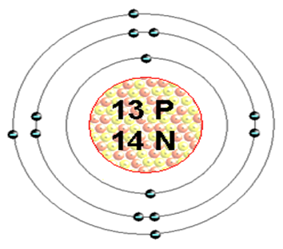
Atomic Structure of Aluminum
Aluminum is an element in the 13th group and third period of periodic table. Its atomic Number is 13 and symbol is Al. Aluminum is a silvery-white, ductile metallic element. Though Aluminum is the third most abundant element after oxygen and silicon and the most abundant metal in the crust, it is never found free in nature. Al can found only in combination, chiefly in bauxite. Natural Aluminum has 22 isotopes among which one is stable, ²⁷Al.
Electron configuration:
1s² 2s² 2p⁶ 3s² 3p¹

Slide 22
1.3 Current, Voltage and Resistance

Slide 23
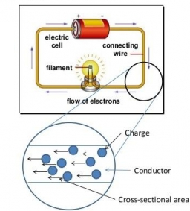
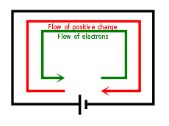
Electric Current (Cont…..)

Slide 24
1.3 Voltage and Resistance
Voltage is the pressure from an electrical circuit's power source that pushes charged electrons (current) through a conducting loop, enabling them to do work such as illuminating a light.
In brief, voltage = pressure, and it is measured in volts (V).
In electricity's early days, voltage was known as electromotive force (emf). This is why in equations such as Ohm's Law, voltage is represented by the symbol E.

Slide 25
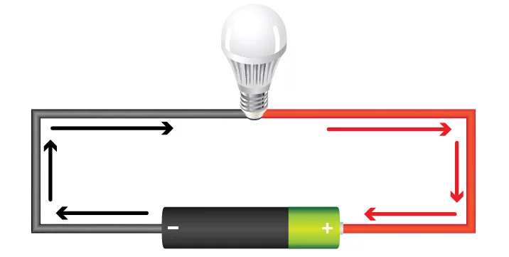
Voltage (Cont…..)
Example of voltage in a simple direct current (dc) circuit:
In this dc circuit, the switch is closed (turned ON).
Voltage in the power source—the "potential difference" between the battery's two poles—is activated, creating pressure that forces electrons to flow as current out the battery's negative terminal.
Current reaches the light, causing it to glow.
Current returns to the power source.
Voltage is either :
Alternating current (ac) voltage
Direct current (dc) voltage.

Slide 26
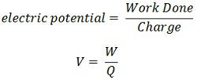
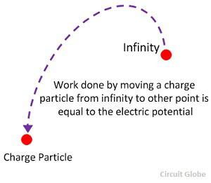
Electric Potential
The electrical potential is defined as the capability of the charged body to do work. When the body is charged, either electric electrons are supplied to it, or they are removed from it.
In both the cases, the work is done. This work is stored in the body in the form of electric potential. Thus, the body can do the work by exerting a force of attraction or repulsion on the other charged particles.
Units: joules/coulomb or volts.

Slide 27
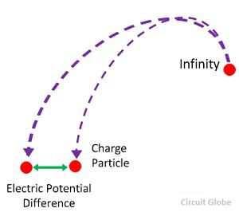
Potential Difference
The electrical potential difference is defined as the amount of work done to carrying a unit charge from one point to another in an electric field.
In other words, the potential difference is defined as the difference in the electric potential of the two charged bodies.
Units: The unit of potential difference is volt.

Slide 28
1.3 Resistance
Resistance: The property of any material that slows down the flow of electrons and converts electrical energy into other forms of energy. The symbol of resistance is “R”
Electrical Resistance: The ratio of the voltage to the current.
Ohm(Ω): The SI unit for electrical resistance.
International Ohm: The international ohm was defined as the resistance of a column of mercury of constant cross section at the temperature of melting ice, 106.3 centimeters long and with a mass of 14.4521 grams.

Slide 29
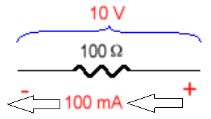
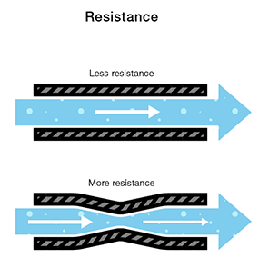
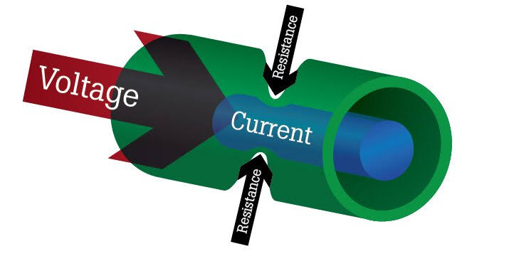
Resistance (Cont…..)

Slide 30
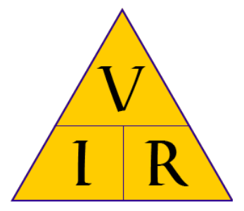
1.3 Summary (I, V & R)
The V I R Triangle:

Slide 31
The Coulomb

Slide 32
The Coulomb (Cont….)

Slide 33
The Coulomb (Cont….)

Slide 34
The Coulomb (Cont….)

Slide 35
The Coulomb (Cont….)

Slide 36
The Coulomb (Cont….)

Slide 37
The Coulomb (Cont….)

Slide 38
? ?
?

Slide 39
THANK YOU ALL

