Slide 1
electrical engineering fundamentals
Sub. Code: 66712
Presented by-
Mir Shafiul Islam
Instructor (Tech.)
Dept. of Electronics
Chattogram Mohila Polytechnic Institute
Mob: 01312-114266;
Email: shafi.cmpi@gmail.com
Web: msishafi.blogspot.com

Slide 2
Chapter-03
Ohm’s Law

Slide 3
Chapter outline
Chapter-03
3.1 State Ohm's law.
3.2 Deduce the relation between energy current, voltage and resistance.
3.3 Solve problems relating to Ohm's law.

Slide 4
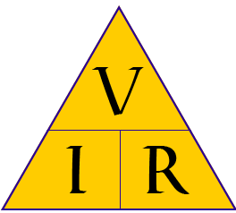
Ohm's Law
Ohms law
Ohm’s law is a Basic Electrical and Electronics Engineering law which relates current, voltage and resistance in a circuit.
Statement: The current in a resistive circuit is directly proportional to the applied voltage and inversely proportional to its resistance.
Mathematical Formula,
I = V/R
Where
I = Current in amps
V = Voltage in volts
R = Resistance in ohms

Slide 5
Ohm's Law
Voltage measured in volts, symbolized by the letters "E" or "V".
Current measured in amps, symbolized by the letter "I".
Resistance measured in ohms, symbolized by the letter "R".

Slide 6
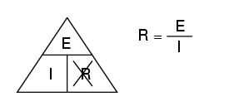
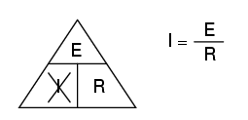
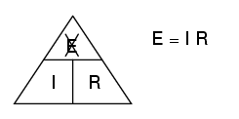
Ohm's Law Magic Triangle

Slide 7
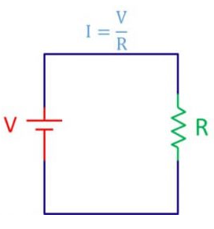
Ohm's Law-Example
Example 1: Let’s assume V = 10 V and R = 15 ohms, then current I is:
I = V/R = 10 V /15 ohms = 0.66 amps

Slide 8
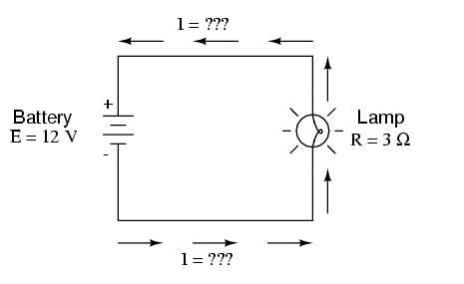
Ohm's Law-Example
Example 2: Calculate the amount of current (I) in a circuit, given values of voltage (E) and resistance (R).

Slide 9
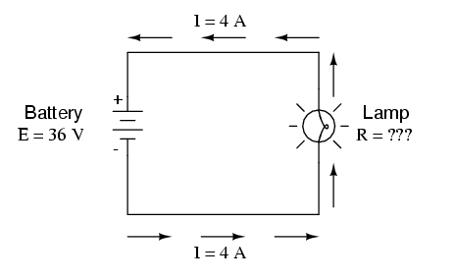
Ohm's Law-Example
Example 3: Calculate the amount of resistance (R) in a circuit, given values of voltage (E) and current (I):

Slide 10
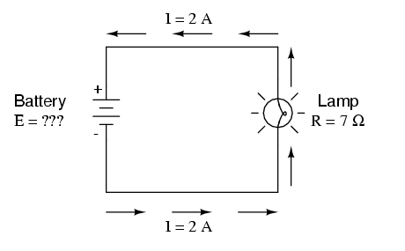
Ohm's Law-Example
Example 4: Calculate the amount of voltage supplied by a battery, given values of current (I) and resistance (R).

Slide 11
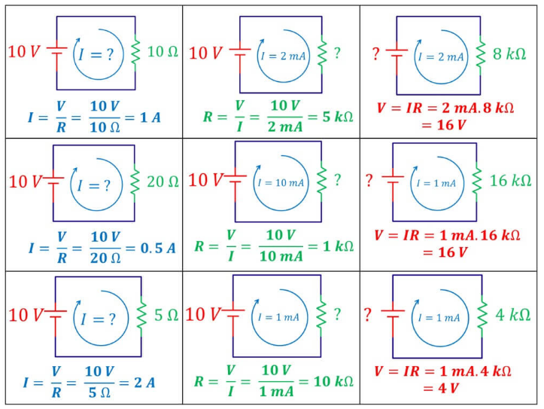

Slide 12
? ?
?

Slide 13
THANK YOU ALL

