Slide 1
WELCOME

Slide 2
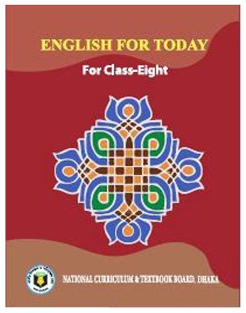
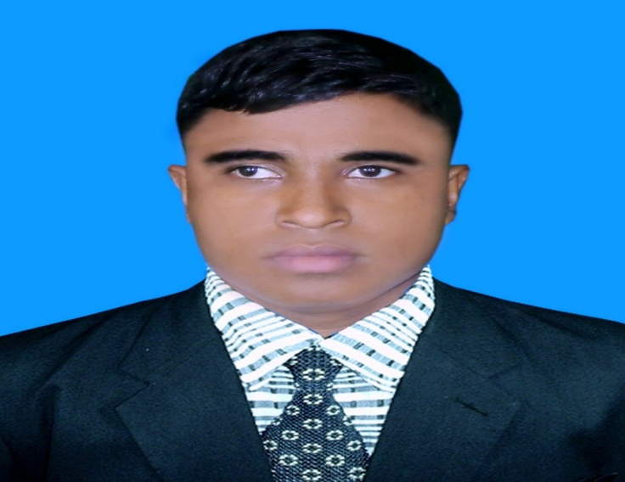
Teacher’s Identity A. Sukur Ali Khan B.A hons.M.A In English Assistant Teacher(English)
Naldha Secondary School
Naldha,Fakirhat,Bagerhat.
Email : sukur360720@gmail.com Mobile no-01922-360720
Class Introducing
Class : Eight
Unit : 01
Lesson :

Slide 3
Let us watch a video……

Slide 4
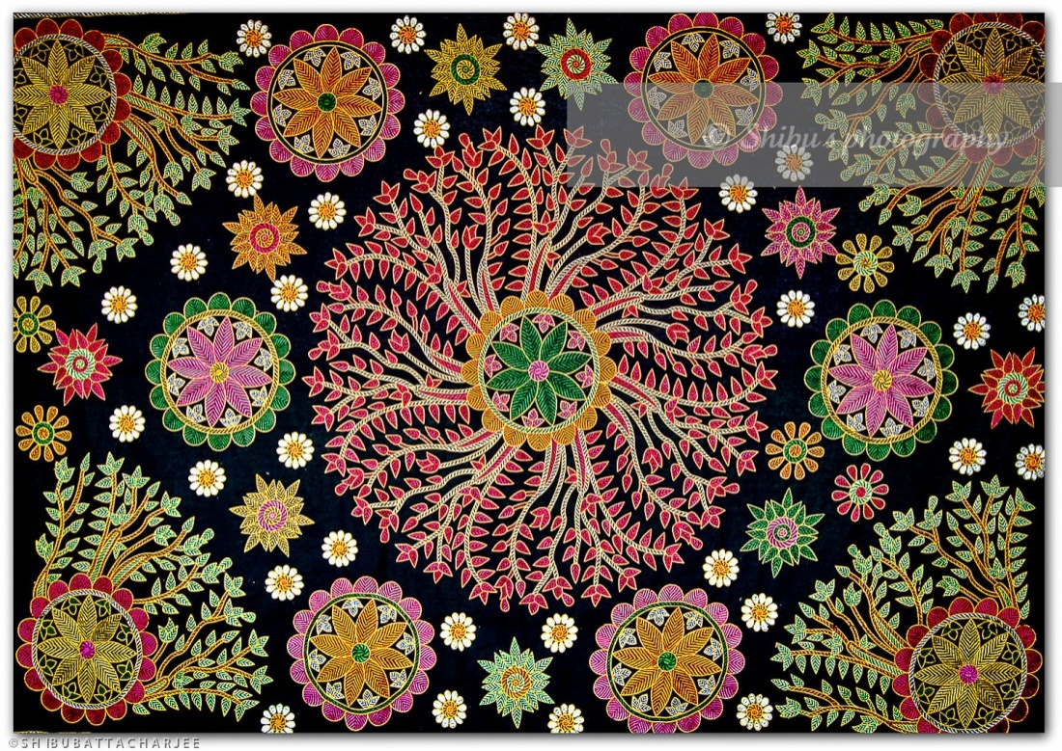
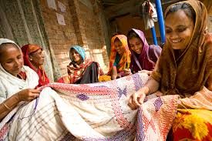
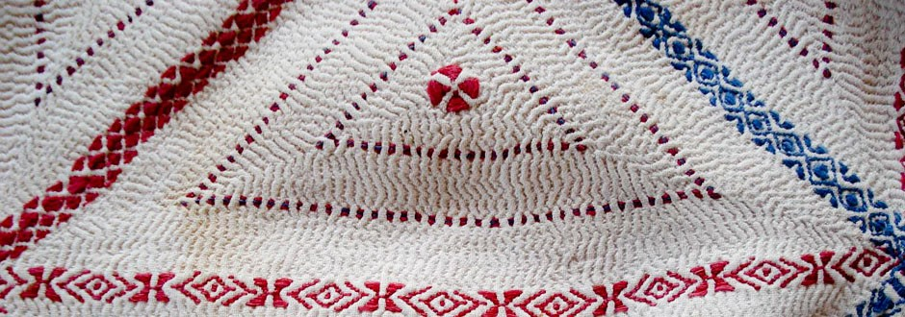
Look at the pictures and answer the following questions...
What do you see in the pictures ?
Have you seen it before?
3.Can you guess what are they called?

Slide 5
NAKSHI
KANTHA
So our today’s topic is...?
Dear students write
down the lesson’s headline.

Slide 6
LEARNING OUTCOMES
By the end of the lesson the learners will be able to…
tell about Nakshi Kantha.
read the text.
understand the new words.
ask and answer questions.
fill in the blanks.
write a short paragraph.

Slide 7
Key Words
Quilt
A thick cover for a bed, made from pieces of fabric that are stitched together

Slide 8
Artistic
Having or revealing natural creative skill

Slide 9
Pattern
A decorative design

Slide 10
Nakshi
Artistic pattern

Slide 11
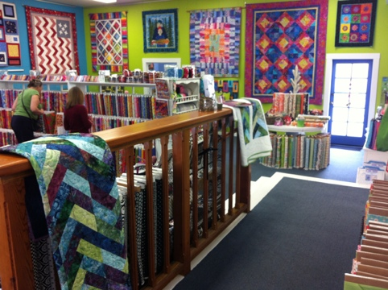
Commercially
Business

Slide 12
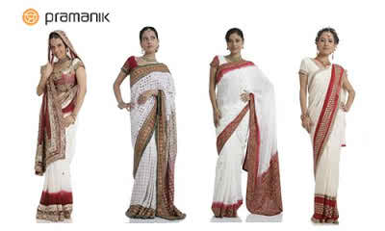
Traditional
Manners

Slide 13
Expensive
Costing a lot of money

Slide 14
Read the text.
Nakshi kantha is a kind of embroidered quilt. Nakshi means artistic pattern which was taken from the Bengali word ‘naksha’.
The name Nakshi kantha became famous after the poet Jasimuddin’s poem “Nakshi kanthar Math” was published in 1929. Traditional Kanthas are made for family use. Old or new cloth and thread are used to make this quilt. Mymensingh, Jamalpur, Rajshahi, Faridpuir Bogra and Jessore are most famous for this craft. Now it is produced commercially. We find them in many expensive handicraft shops in cities. The quilts are now in great demand.

Slide 15
Individual Work
Choose the best answer from the alternatives Choose the best answer from the alternatives.
The word ;Nakshi Kantha’ comes from a/an……word.
English ii. French
iii. Hindi iv. Bengali
2. This art has been continuing for………..
days ii. years
iii. centuries iv. ages.

Slide 16
3. The word ‘indigenous’ refers to…….
foreign ii. native
iii. hand-made iv. all the above.
4. ‘Nakshi Kantha’ becomes popular for its……..
beauty ii. high price
iii. Advertisement iv. low price

Slide 17
Pair Work
Give short answer to the following questions.
Why do you like Nakshi Kantha?
Answer - We like nakshi kantha as it is artistic and comfortable.
2. Who was the poet of “NAKSHI KANTHAR MATH”?
Answer-Jasim Uddin

Slide 18
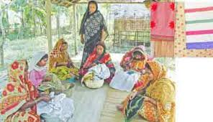
Practiced rural Bengal for centuries.

Slide 19
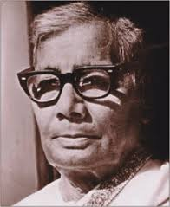
Rural poet Jasim Uddin. His famous work “Field of the Embrodried Quilt”

Slide 20
Group Work
Fill in the blanks with suitable words .
Naksha means artistic …………The name was taken from a ……… word Naksha.The art has been practised in ……… Bengal for years.Nakshi kanthas are now sold in………. Shops.Nakshi kanthas are in great demand because of their colourful embroidery and ……
patterns
Bengali
West
fashion
designs

Slide 21
HOME WORK
Write a short paragraph describing how to make a Nakshi kantha.

Slide 22
THANK YOU ALL

