Slide 1
Welcome
Multi-media classroom

Slide 2
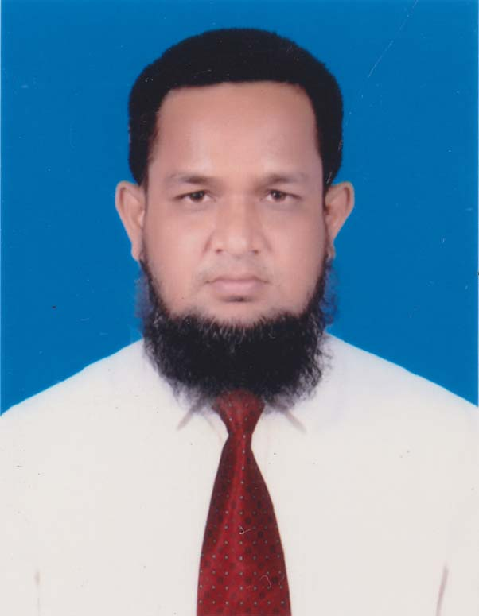
Identification
MD.ABDUR ROUF Lecturer in English Khalna Islamia Fazil Madrasah,
Patnitala,Naogaon.
Email No:rouf301285@gmail.com

Slide 3
Learning outcomes
We will be able to----
a)Know about the father of our nation
b) Know about the historical speech of Bangabandhu Sheikh Mujibur Rahman
c)Comprehend and understand the text
d)Ask and answer the questions

Slide 4
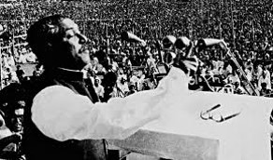
English 1st Paper Class –xi Unit -1 Lesson-1 The Unforgettable History
Look at the picture:

Slide 5
Dear learners,now open your text book’s Unit-1, Lesson-1 & read silently.

Slide 6
Some important events of this glorious speech:
Ayub Khan Decleared Martial Law to enslave the people of the then East Pakistan
1958
1966
With the leadership of Bangabandhu Sheikh Majibur Rahman, the Six Point ‘Bangabandu Demand arose
23 February 1969
Sheikh Mujibur Rahman was accorded a splendid reciption,where he was given the title ‘Bangabandhu’
7 December 1970
The all Pakistan General Election was held.
25 March 1971
Operation Searchlight started at the midnight of March 25,1971 particularly targeting Bangalee nationalists, students, intellectuals and religious minorities.

Slide 7
Bangabandhu Sheikh Mujibur Rahman’s direction of 7th March speech
Directives for common people | Directives for office employees | Directives for Pakistani army
Confront the enemy with whatever you have. | Bangladeshi courts, magistracies, government offices and educational institution will be shut down indefinitely. | Stay in your barracks.
No one will pay taxes. | Take orders only from Bangabandhu. | Don’t try again to aim your bullets at our chests.
Shut down all shops and make sure that traffic on all roads and ports are brought to a stand still. | On 28th employees will go and collect their salaries. | Withdraw martial law.

Slide 8
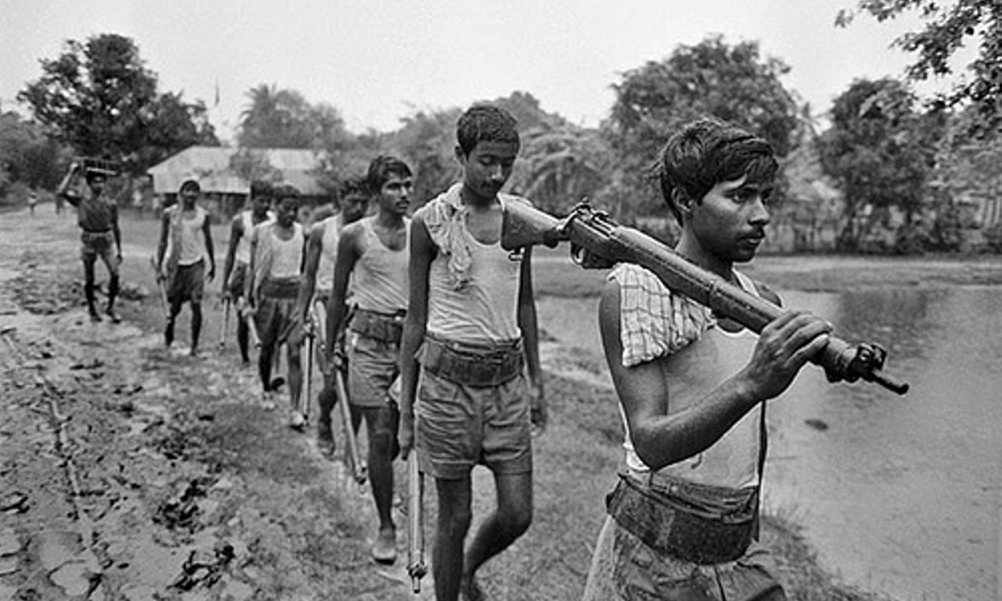
The most famous speech which inspired our people highly: “The struggle this time is a struggle for freedom-the struggle this time is a struggle for emancipation.’’ Hearing this motivating speech, the Bangalees fell upon the Pakistanies to defeat their own beloved country:

Slide 9
That you see in the picture ,everything is happened by the leadership of Sheikh Mujibur Rahman
.

Slide 10
Pairwork
Whom do you see in the picture?
What do know about him?
Where is he giving the speech?
What was the time?
What was the significance of it?
Have you ever heard the speech?Where?

Slide 11
Homework
Write a paragraph on 7th March Speech

Slide 12
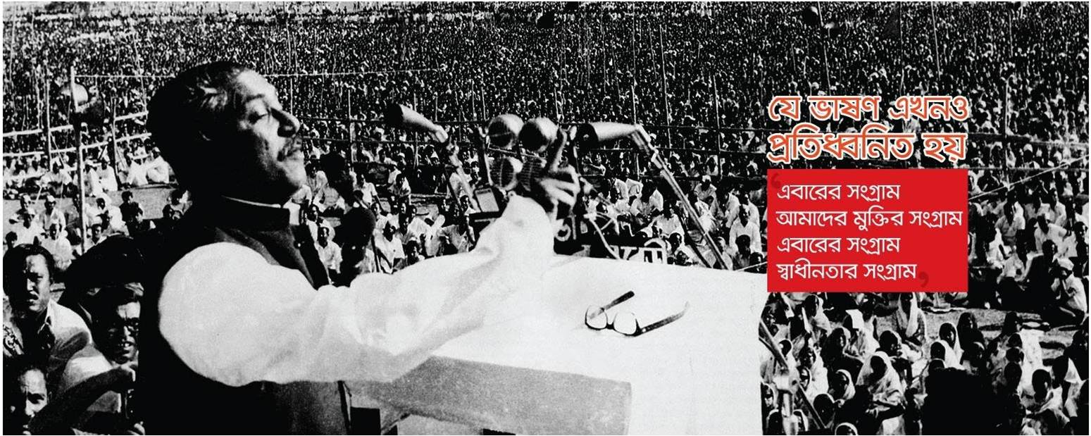
Thank you

