Slide 1
Welcome to multimedia class

Slide 2
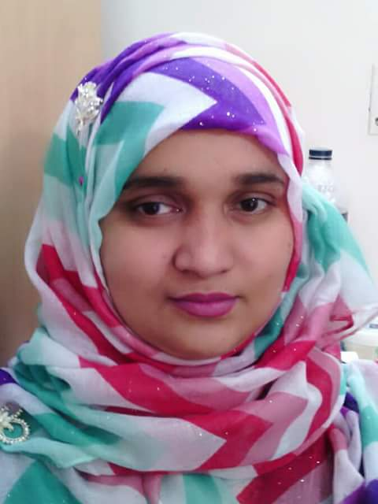
Teacher
Mosammat Nelufa Afrose (Bithi)
Lecturer in English
Khilbaisa Rahmania Fazil(Degree) Madrasah
Sadar, Lakshmipur
E-mail:nelufa.afrose@gmail.com

Slide 3
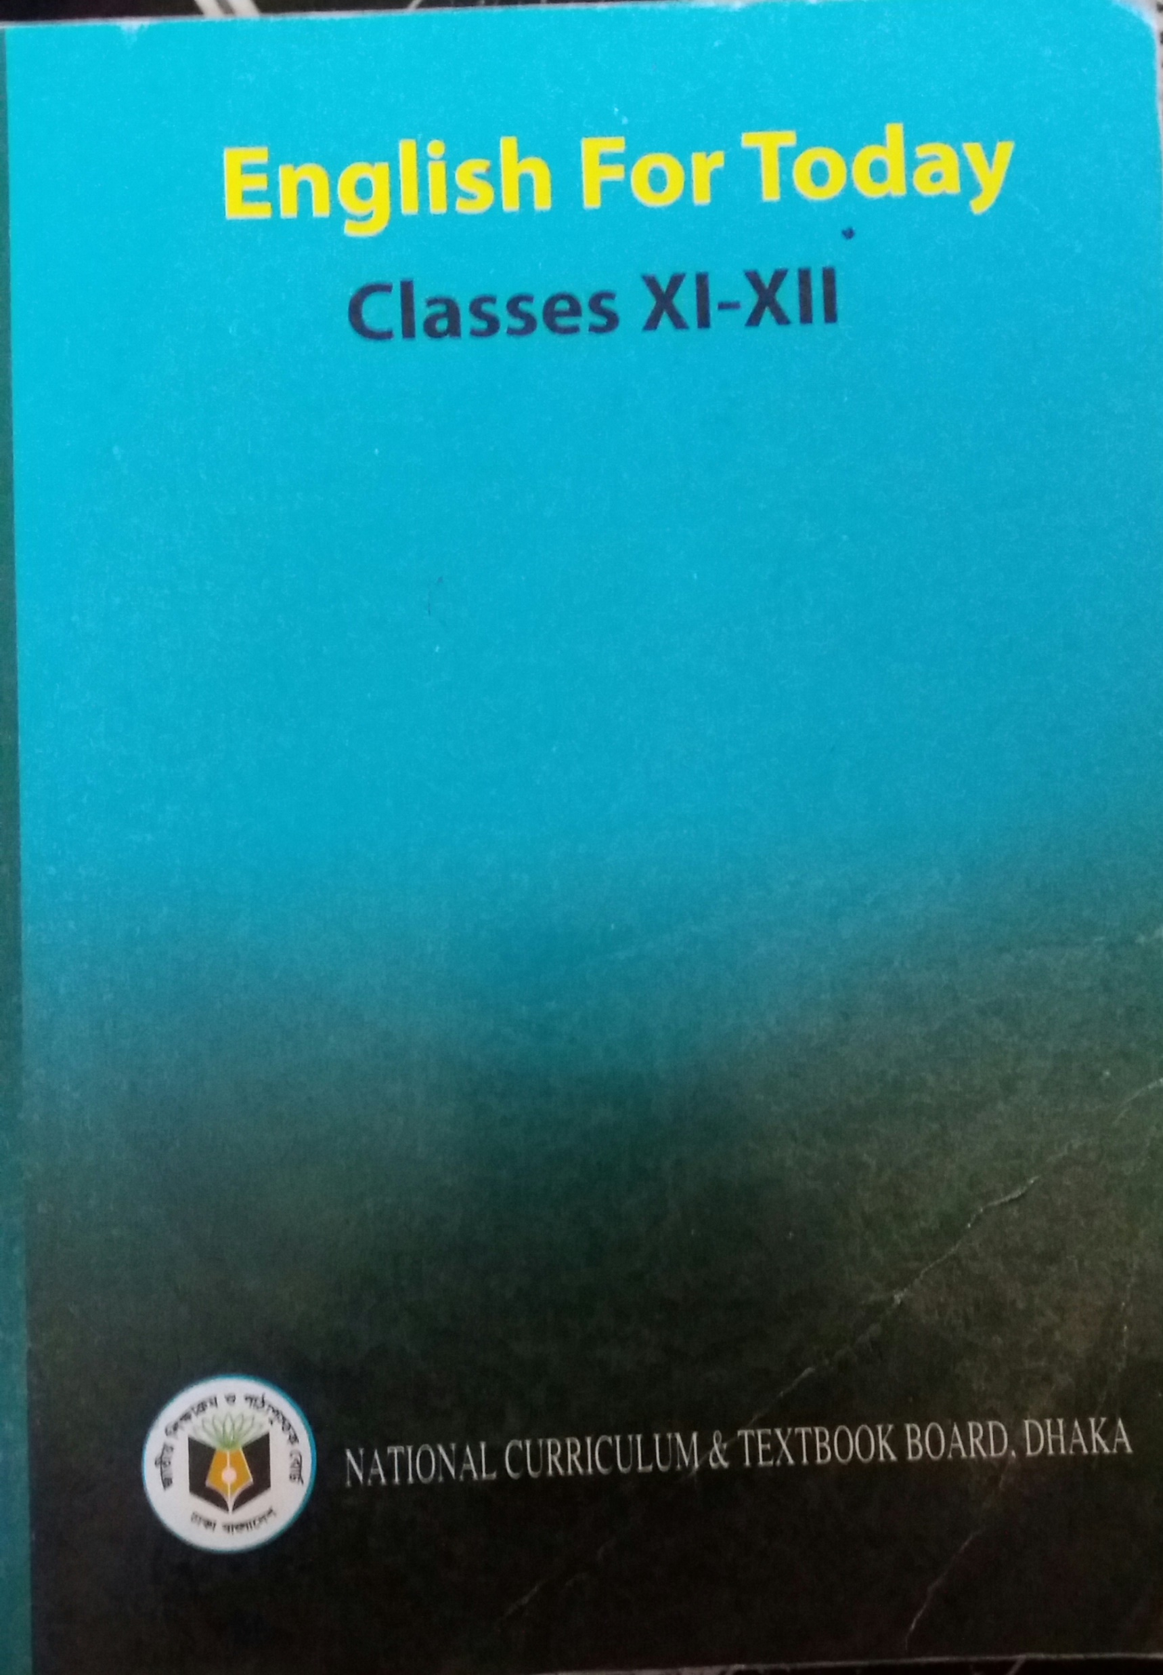
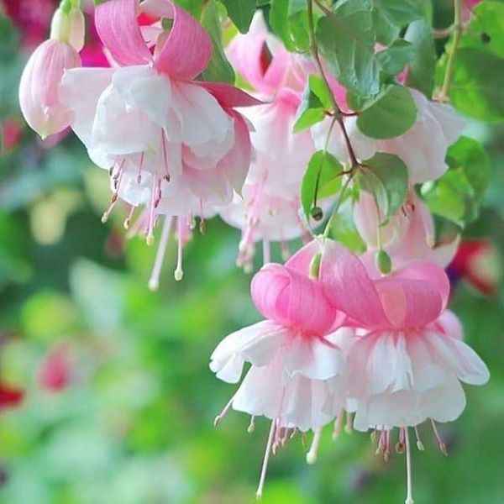
English First Paper
Unit-1, Lesson-2

Slide 4
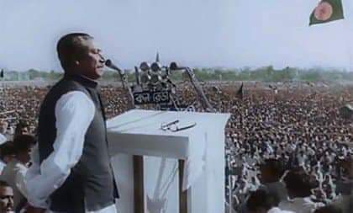
Look at the picture

Slide 5
Answer the questions
Who is the speaker here? Where is he giving the speech?
Have you ever heard the speech? Where?
Which features of the speech do you appreciate most? Why?

Slide 6
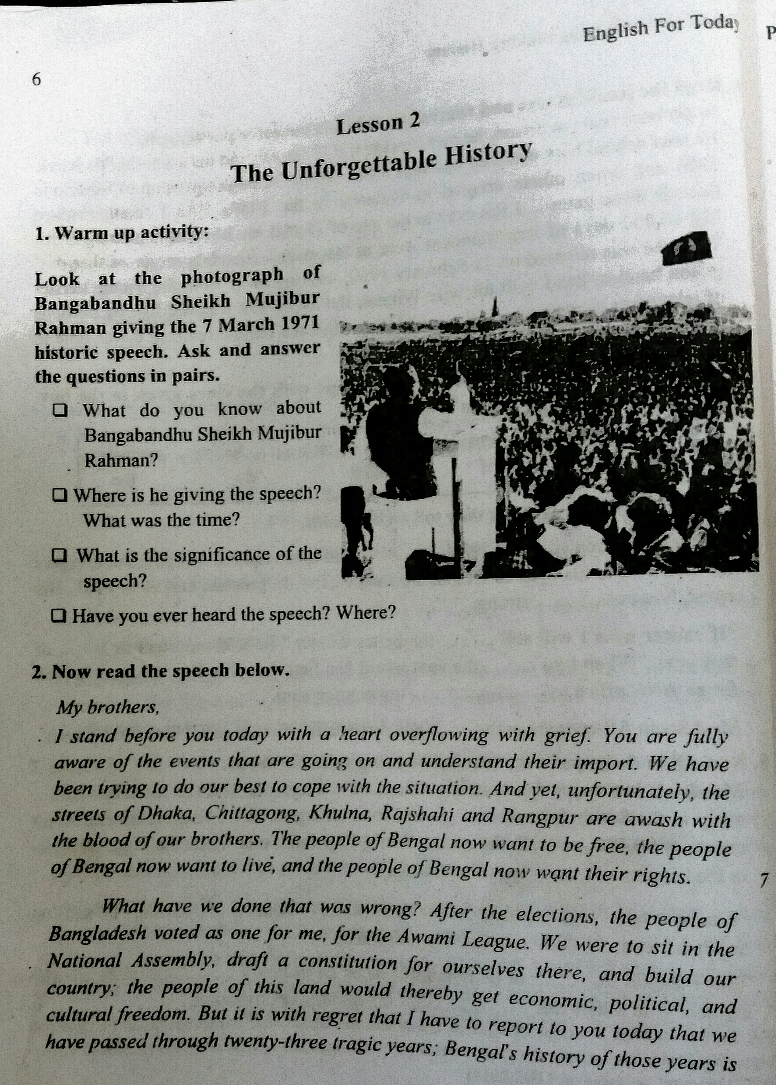
The topic of our today class is
“The Unforgettable History”

Slide 7
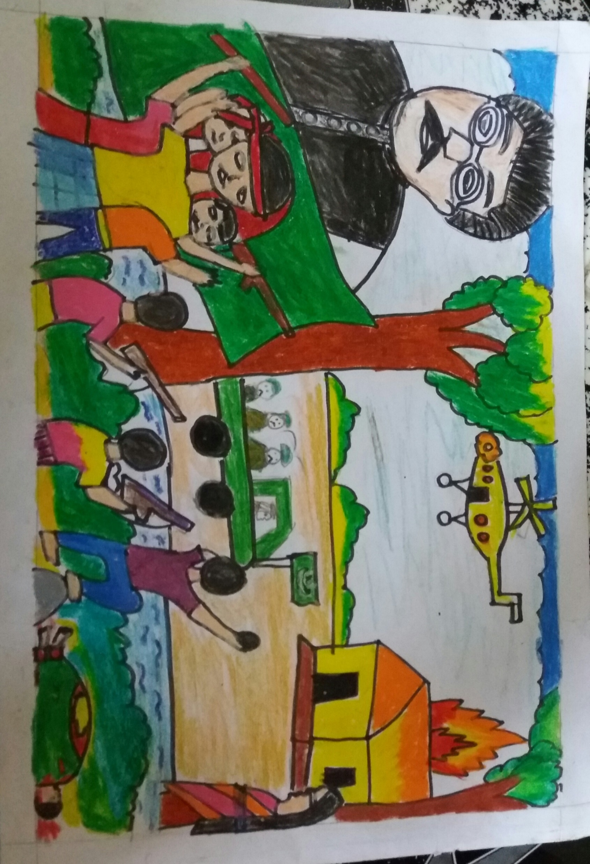
At the end of the lesson , students will able to know-
1.About the unforgettable history of 7 March,1971
2.About the father of nation in Bangladesh.
3. The oppression of Pakistan and history of freedom war.
4. Get some important lines from the speech by heart.

Slide 8
At a glance 7 March speech
The 7th March historical speech is delivered by Bangabandhu Sheik Mujibur Rahman
Year: 1971
Date: 7 march
Day: Sunday
Time: 3:20
Place : Ramna Race Coure maidan.
( Now, Suhrawardy Udyan)
Lasting :Approximately 19 minutes
Words: 1108
UNESCO recognizes as a part of world documentary heritage: 30 October, 2017

Slide 9
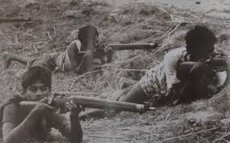
The landmark fiery speech is important for us because-
**It motives the whole nation to fight to the last drop of blood for independence.
** It clears the reasons for demanding separation from the then Pakistan.
** The ultimate consequence is 16th December victory of our mother land

Slide 10
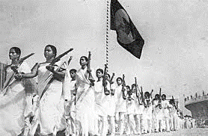
The main two parts of the speech-
# The discussion about the oppression and injustice of the West Pakistan Rulers.
# The way forward for the emancipation of Bengali people.

Slide 11
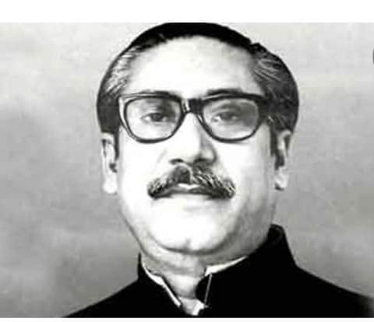
A fact file on Bangabandhu’s life.
Born on 17 march, 1920 in Tungipara.
Became the first President of Independent Bangladesh in 1971
Showed sign of future leader by distributing rice among poor .
Launched the historical Six Point Movement in1966.
Played a leading role in the student movement in 1952.
Entered a second coalition government as a minister in1956.
Joined the Awami Muslim League and was elected GS in 1953.
Became the undisputed leader of AL in 1957.

Slide 12
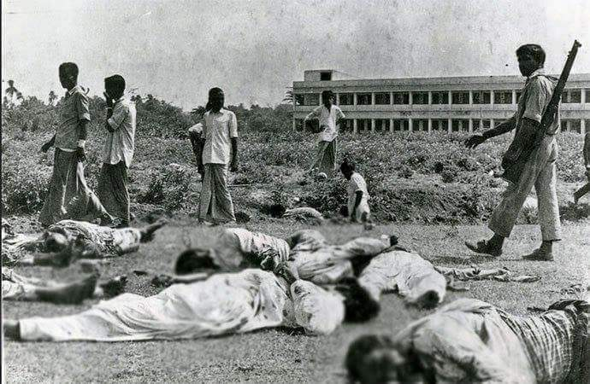
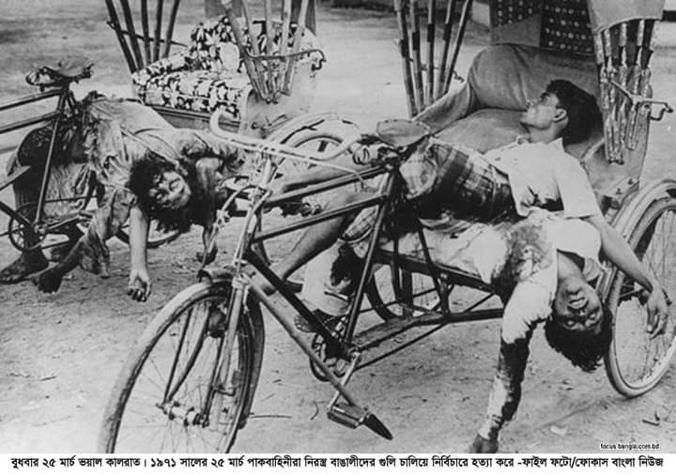
The 23 years of our history with Pakistan is a history of repression and bloodshed.

Slide 13
Some important quotations from the speech :
# “We have been trying to do our best to cope with the situation. And yet, unfortunately, the street of Dhaka, Khulna, Rajshahi, and Rangpur are awash with the blood of our brothers.”
# “Twenty three years of a history of men and women in agony.”
# I request all of you: converted every house into a fort; confront enemy with whatever you have.
# “Be prepared to act with whatever you in your possession.”
# “Remember: since we have already had to shed blood, we’ll have to shed a lot more of it: by the grace of God, however, we’ll be able to liberate the people of this land.”
# “The struggle this time is a struggle for freedom- the struggle this time is a struggle for emancipation.”

Slide 14
Silent Reading

Slide 15
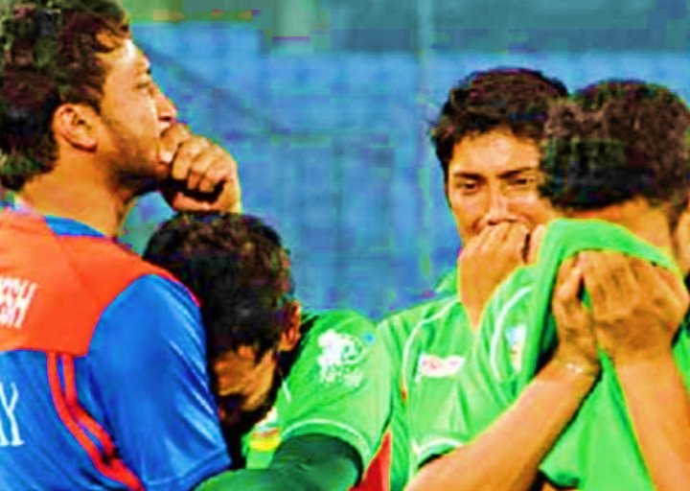
Let’s know some new words from the text-
Agony (verb):
Intensive physical or mental suffering.

Slide 16
Crimson (adjective):
A rich deep red colour inclining to purple.

Slide 17
Negotiation: (Noun):
The process of trying to make or change an agreement by discussion.

Slide 18
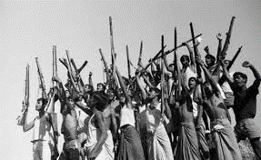
Spontaneously (Adverb):
Coming or resulting from a natural impulse without being asked.

Slide 19
Pair Work
Read the speech again.
The speech has reference to some years and dates in our history. Find out their historical importance and complete the flow chart, ending with 25 March’1971.
1958
1966
23 February 1969
7 December
1970
25 March 1971

Slide 20
Evaluation
a)Who is the speaker here? When did he make this speech?
b)What was unfortunate as Bangabandhu mentioned in his speech?
c) Why does Bangabandhu say that “23 years of our history with Pakistan is a history of repression and bloodshed?
d) How do you differentiate between the ‘struggle for freedom’ and the ‘struggle for emancipation’?
e) Why did Ayub Khan declare Martial Law? Explain in brief.

Slide 21
HOME WORK
Write a paragraph on the major events leading to March 7.

Slide 22
Thanks to all

