Slide 1
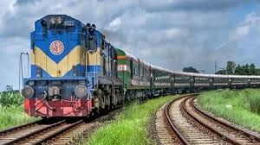
Welcome to our virtual class
1. Have you ever travel by train?
2. Do you like train journey?

Slide 2
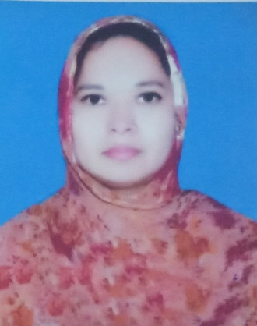
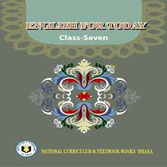
introduction
Musa. Rahima Akther
Asst. teacher
Khulna Engineering University School
Class 7
English 1st paper

Slide 3
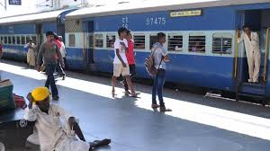
Today’s lesson is--
“Travelling by Train (2) ”
Unit-6 lesson-5

Slide 4
Learning outcomes -
At end of the lesson, students will be able to –
Discuss about pictures;
Introduce with some new words;
Ask and answer questions;
Write the summary of the text.

Slide 5
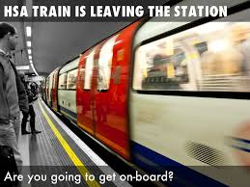
Kew words
departure
exit
The act of departing

Slide 6
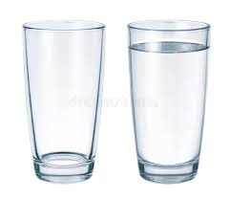
Kew words
empty
vacant
void
Empty glass
Glass full of water

Slide 7
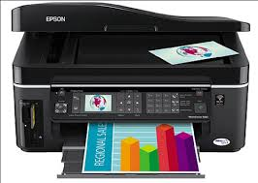
Kew words
Print out
publish
reproduce from type

Slide 8
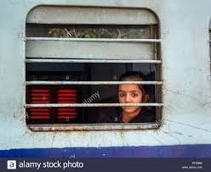
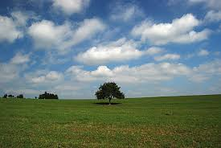
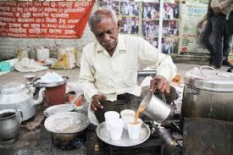
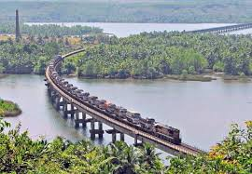
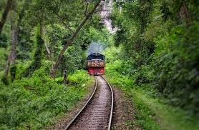
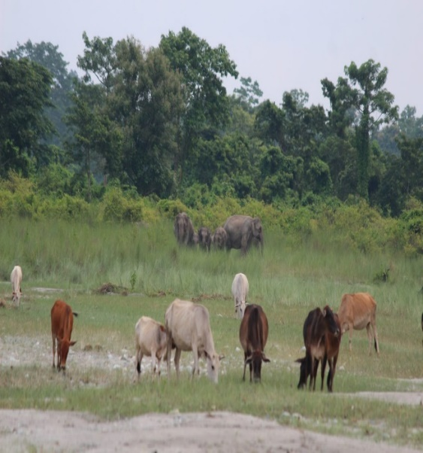
Have you ever looked through the window from a running train?
If you have, what did you see?

Slide 9
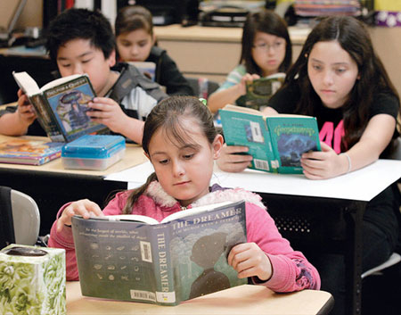
Read the text
Zishan, Julie and their parents Mr and Mrs Arif Khan got into a 1st class compartment at Kamalapur Railway Station. It was Dewanganj-bound Tista Express. The train left at 8 o’clock. Zishan saw that the departure time on the big time table at the station was 7:30. However the train was running quite fast. The children sat by the window beside their parents. The compartment was half empty. Yesterday Julie downloaded a beautiful poem on a train journey by Robert Louis Stevenson. She took a printout of the poem. She was looking out and saw the passing things. Then she took out the poem and began to read. Questions 1 Were all the seats in the compartment taken? 2 Where did Zishan sit? 3 Where was the train going? 4 Did the train leave Kamalapur Station late or on time? 5 Where did Julie get the poem from? 6 What was Julie doing from her seat?

Slide 10
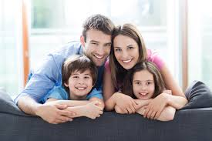
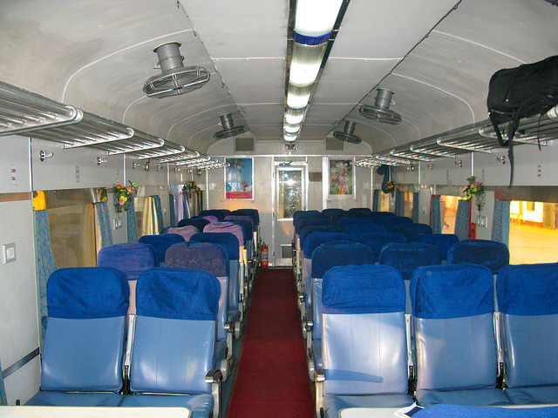
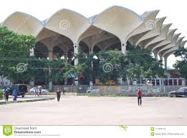
Zishan, Julie and their parents Mr and Mrs Arif Khan
got into a 1st class compartment
at Kamalapur Railway Station.

Slide 11
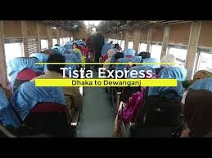
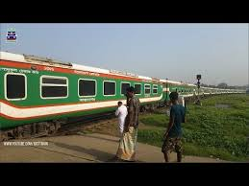
It was Dewanganj-bound Tista Express.

Slide 12
The train left at 8 o’clock.

Slide 13
Zishan saw that the departure time on the big time table at the station was 7:30.

Slide 14
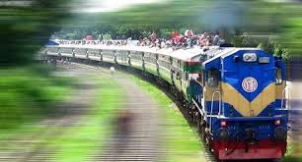
However the train was running quite fast.

Slide 15
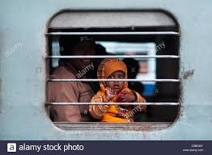
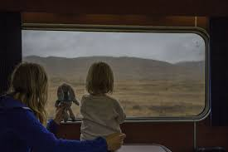
The children sat by the window beside their parents.

Slide 16
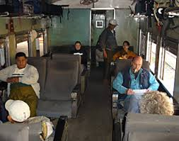
The compartment was half empty.

Slide 17
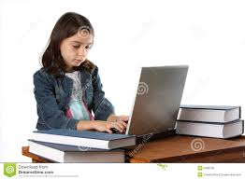
From a Railway Carriage
Faster than fairies, faster than witches,
Bridges and houses, hedges and ditches;
And charging along like troops in a battle
All through the meadows the horses and cattle:
All of the sights of the hill and the plain
Fly as thick as driving rain;
And ever again, in the wink of an eye,
Painted stations whistle by.
Here is child who clambers and scrambles,
All by himself and gathering brambles;
Here is a tramp who stands and gazes;
And here is the green for stringing daisies!
Here is a cart runaway in the road
Lumping along with man and load;
And here is a mill, and there is a river:
Each a glimpse and gone forever!
[Robert Louis Stevenson]
Yesterday Julie downloaded a beautiful poem on a train journey by Robert Louis Stevenson.

Slide 18
She took a printout of the poem.

Slide 19
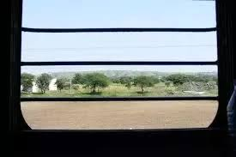
She was looking out and saw the passing things.

Slide 20
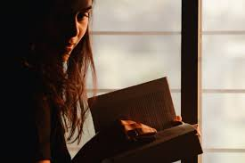
From a Railway Carriage
Faster than fairies, faster than witches,
Bridges and houses, hedges and ditches;
And charging along like troops in a battle
All through the meadows the horses and cattle:
All of the sights of the hill and the plain
Fly as thick as driving rain;
And ever again, in the wink of an eye,
Painted stations whistle by.
Here is child who clambers and scrambles,
All by himself and gathering brambles;
Here is a tramp who stands and gazes;
And here is the green for stringing daisies!
Here is a cart runaway in the road
Lumping along with man and load;
And here is a mill, and there is a river:
Each a glimpse and gone forever!
[Robert Louis Stevenson]
Then she took out the poem and began to read.

Slide 21
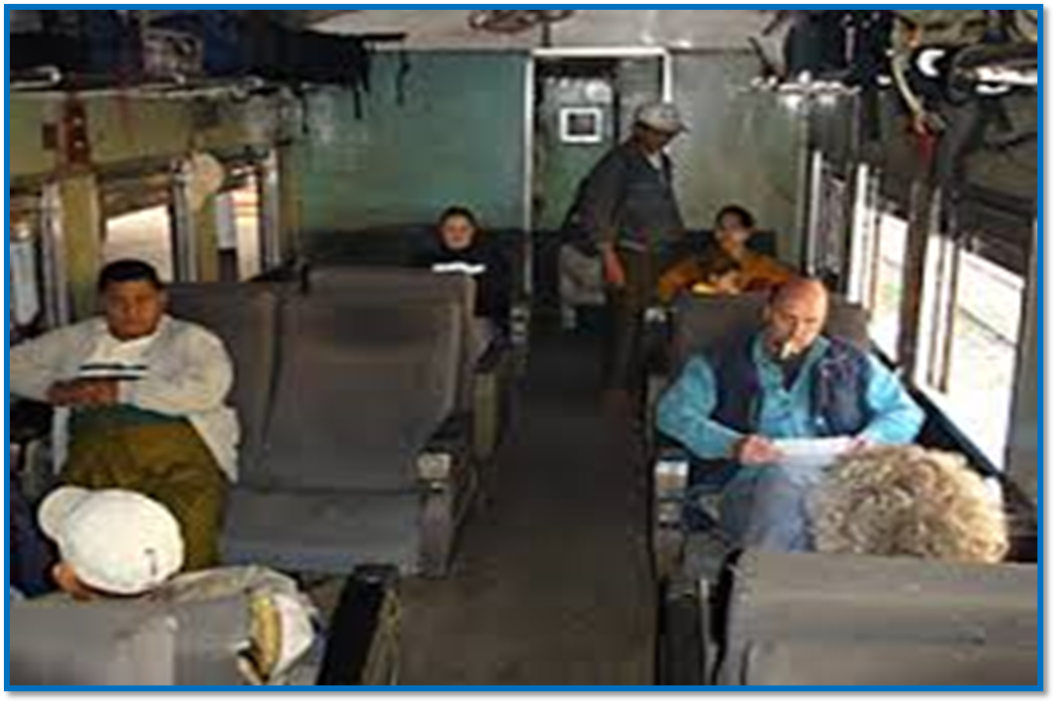
Ask and answer questions
1. Were all the seats in the compartment taken?

Slide 22
2. Where did Zishan sit?

Slide 23
3. Where was the train going?

Slide 24
4. Did the train leave Kamalapur Station late or on time?

Slide 25
5. Where did Julie get the poem from?

Slide 26
6. What was Julie doing from her seat?
From a Railway Carriage
Faster than fairies, faster than witches,
Bridges and houses, hedges and ditches;
And charging along like troops in a battle
All through the meadows the horses and cattle:
All of the sights of the hill and the plain
Fly as thick as driving rain;
And ever again, in the wink of an eye,
Painted stations whistle by.
Here is child who clambers and scrambles,
All by himself and gathering brambles;
Here is a tramp who stands and gazes;
And here is the green for stringing daisies!
Here is a cart runaway in the road
Lumping along with man and load;
And here is a mill, and there is a river:
Each a glimpse and gone forever!
[Robert Louis Stevenson

Slide 27
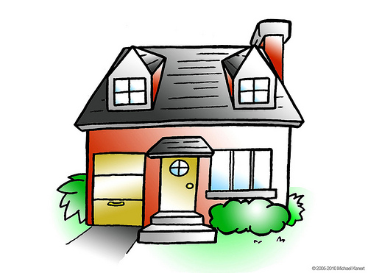
Home work
Summarise the text in your own words.

Slide 28
Thank you

