Slide 1
“Please stay at home. Stay safe.”

Slide 2
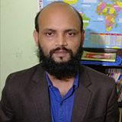
Nurul Aziz
Assistant Teacher (English)
Krishnakumari City Corp. Girls’ High School,
Nandankanan,Chittagong
E-mail : naziz13.na@gmail.com
Mobile : 01843773924
English For Today
Class : 7
Time : 20 Minutes
Date : 07/08/2020

Slide 3
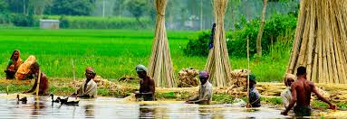
Our Today’s lesson is on……
Paul visits Sundarpur
Unit 8 , Lesson 3

Slide 4
Learning outcomes
After the end of the lessons students will be able to…
tell the meanings of new words
write dialogue about likes and dislikes
ask and answer questions

Slide 5
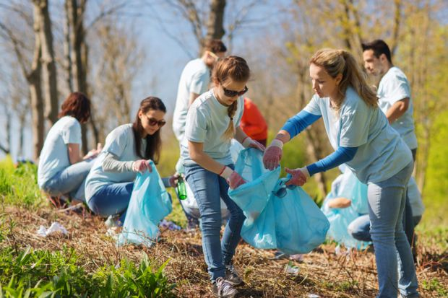
Vocabulary
Volunteer
unpaid worker
meaning: when someone works unpaid for the greater benefit.
Syn. helper
Volunteers work selflessly for the society.

Slide 6
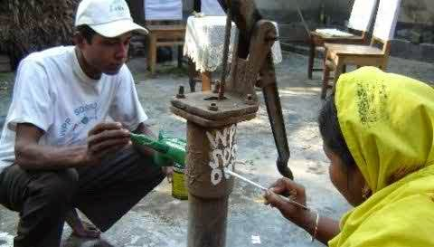
Vocabulary
arsenic poisoning
Meaning: poisoning caused by arsenic
Syn. arsenicosis
Arsenic poisoning is a dangerous problem in Bangladesh.

Slide 7
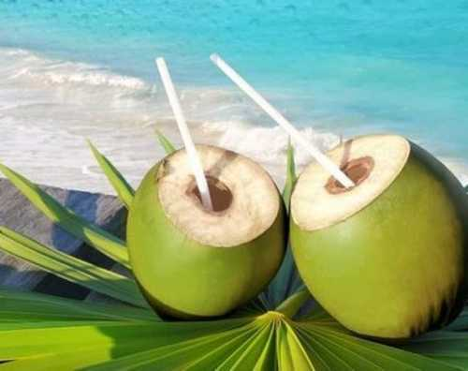
Vocabulary
green coconut
Meaning: tender coconut having a healthy drink
Syn. : tender coconut
Green coconut drink is a healthy drink.

Slide 10
C In pairs, discuss the following questions
1. Why did Paul go to Sundarpur High School?
Ans. Paul went to Sundarpur High School to meet the teachers and the students.
2. Did Paul like the students and teachers of the school?
Ans. Yes, Paul liked the students and teachers of the school very much.
3. How was Paul entertained at the school on his arrival?
Ans. Paul was entertained with green coconut drink at the school on his arrival.

Slide 11
4. What did Paul talk about to the students of the school?
Ans. Paul talked about the ways of fighting against arsenic poisoning to the students of the school.
5. Why doesn’t Paul like riding rickshaws?
Ans. Paul doesn’t like riding rickshaws because he hates the idea of sitting idle while another person is pulling the rickshaw.

Slide 12
Evaluation

Slide 13
Evaluation
D Read the statements about Paul’s likes/dislikes and replace the underlined parts of each sentence with a phrase given in the box.
1 Paul the green coconut drink.
quite likes
2 He walking along the village roads.
didn’t mind
3 He taking pictures.
loves
hates
3 He sitting idly in a rickshaw.
really dislikes
b) did not dislike
c) enjoys
d) really likes

Slide 14
Homework

Slide 15
Please stay at home. Protect yourself, protect family.”

