Slide 1
Welcome

Slide 2
Teacher’s Identity
Md. Shahidul Alom
Assistant Teacher of English
Rajar Gaon High School
Shiber Bazar, Sadar, Sylhet
Mobile -01715 720 745
Email: msagainer@gmail.com
Fb: msamartyr

Slide 3
Introduction of the lesson
Class: ix-x
Subject: English 1st paper
Total Students: 45
Date-17.08.2020

Slide 4
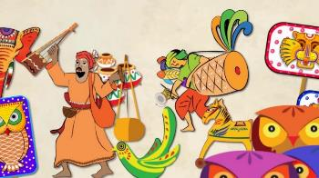
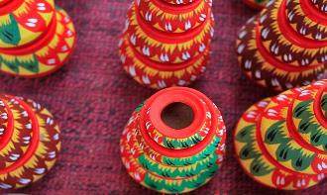
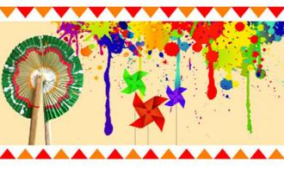
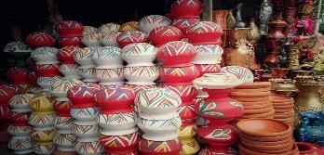
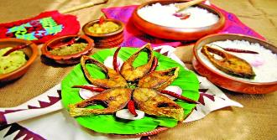
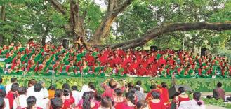
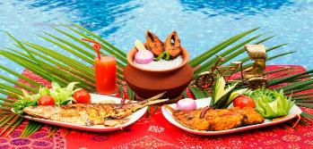
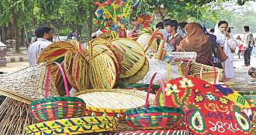
What do you see in the pictures?
What can be our topic of the class?

Slide 5
Our Topic is on
Pahela Boishakh
Unit-3, lesson-6

Slide 6
Learning Outcomes
By the end of the lesson the students will be able to
a. Read and understand text.
b. Tell the meaning of the words: significant, unity, mask, celebrate.
c. List of Boishakhi foods.
d. Answer the questions from the text.
e. Fill the gaps with the new words.

Slide 7
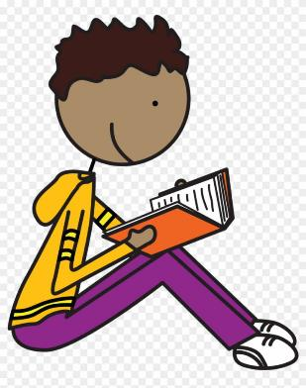
Silent Reading
open your text book at page no 39 to read text. The text is also available in the next slide.

Slide 8
‘Pahela Boishakh’ is the first day of Bangla new year. The day is a public holiday. This day has a special significance for us as it is a part of Bangalee culture and tradition. People from all walks of life, irrespective of their ethnic identity or religious beliefs, celebrate the day with traditional festivities. On this day, the whole of Bangladesh is in a festive mood. The day inspires people to start life with renewed hopes and inspirations.
Every year the day is celebrated traditionally. People wake up early in the morning, have a bath and wear their traditional clothes. Women wear white sarees with red borders and adorn themselves with colourful flowers while men dress themselves in pajamas and punjabis. It is a day when people love eating traditional food.
One of the most colourful events of the day is held in Dhaka. Early in the morning, people in hundreds and thousands pour in from all directions to attend the cultural function at Ramna Batamul organised by Chhyanata. The cultural programme begins just at sunrise and the renowned artists of the country take part in the programme that starts with the famous Tagore-song Esho-he-Boishakh, Esho Esho…… Artists also sing traditional folk songs, and display classical dances with the rhythm of musical instruments.
People also come to join the colourful processions, the biggest carnival of the country, organised by the Fine Arts students of Dhaka University. The procession usually displays the traditional practices of Bangalee culture. The masks and wreaths worn by the people are so fascinating! Often they symbolise contemporary worries or happiness in the national life. It attracts an increasing number of foreign tourists every year.
The day is also observed all over the country. Different social and cultural organizations and educational institutions celebrate the day with their own cultural programmes.
On this day, newspapers bring out special supplements. There are also special programmes on the radio and television.
The celebration of Pahela Boishakh marks a day of cultural unity for the whole nation irrespective of caste and creed.

Slide 9
See the vocabulary first
below

Slide 10
Vocabulary
Related picture
Significance
Meaning in English
the quality of being worthy of attention; importance.
synonym
content, denotation, drift, import, intent,

Slide 11
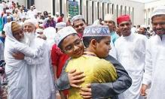
Related picture
to take part in special enjoyable activities in order to show that a particular occasion is important:
celebrate
Meaning in English
synonym
rejoice, revel, party, chant, cheer,

Slide 12
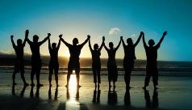
Related picture
Unity
Meaning in English
the state of being joined together or in agreement:
synonym
Unison, agreement, balance, coherence, concinnity

Slide 13
Related picture
a covering for all or part of the face that protects, hides, or decorates the person wearing it:
Mask
Meaning in English
synonym
False face, disguise
hood, veil, visor

Slide 14
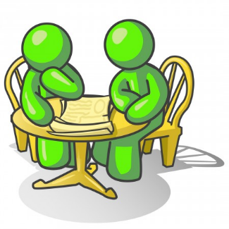
Pair work
Make a list of foods we prepare and eat in the pahela Baishakh.

Slide 15
Probable Answer
Pantabhat
Ilish mach
Pitha
Sondesh
shutki

Slide 16
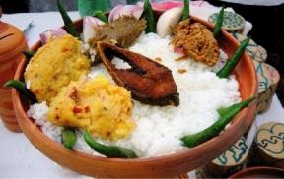
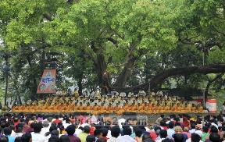
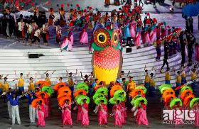
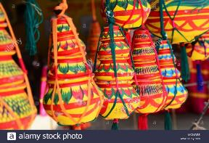
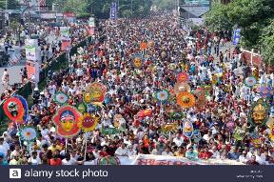
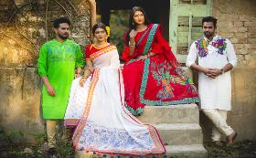
Panta bhat
Ramna Batmul
Cultural display
traditional
Long possession
Men women dress code
A short lecture on the topic will be given depending on the pictures. Scroll down to see.
Students can ask any question on the topic.
Special supplement

Slide 17
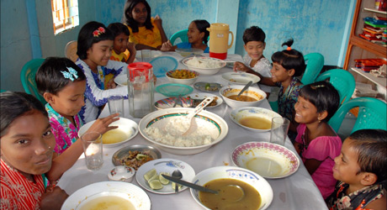
Group Work
Fill in the gaps with appropriate word.

Slide 18
The Bengali New Year is (a) _____ as a public holiday in Bangladesh. It is celebrated across religious boundaries by its Muslim majority and Hindu minority. According to Willem van Schendel and Henk Schulte Nordholt, the festival (b) ___ a popular means of expressing cultural pride and heritage among the Bangladeshi as they resisted Pakistani rule in the 1950s and 1960s.
The day is marked with singing, processions, and fairs. (c) ____, businesses start this day with a new ledger, clearing out the old. Singers perform (d)___ songs welcoming the new year. People enjoy classical jatra plays. People wear festive dress with women desking their hair with flowers. White-red color combinations are particularly popular.
People of Bangladesh prepare and enjoy varieties of traditional festive (e) ___ on Pahela Boishakh. These include panta bhat (watered rice), ilish bhaji (fried hilsa fish) and lots of special bhartas (pastes).
Match your answer
a. observed
b. became
c. Traditionally
d. traditional
e. foods

Slide 19
Evaluation
What is Pahela Boishakh?
How do we celebrate Pahela Boishakh?
What is the significance of Pahela Boishakh?

Slide 20
Home Work
Read and write a paragraph on
‘Pahela Boishakh’
Using the below words
Colourful, special, traditional, religious, dance, cultural , flowers, food , songs, festive

Slide 21
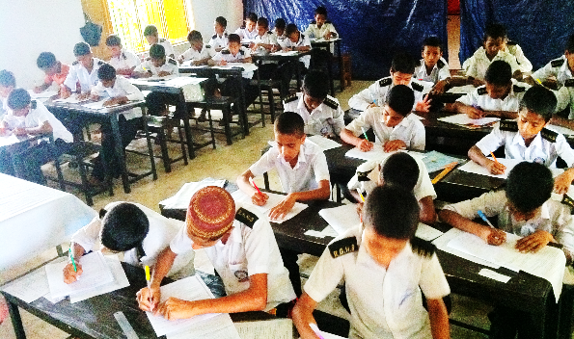
Thank you

