Slide 1
Welcome to my online class

Slide 2
Identity
Manik Chandra Majumder
Senior Teacher
Gazirhat High School
Senbag, Noakhali
Mobile No: 01717155169
E-mail- manikmajumder01@gmail.com
Class : Nine-Ten
Subject : English 1st paper

Slide 3
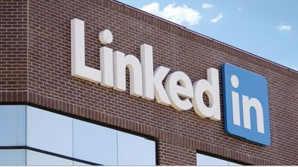
Are you familiar with them?
Look at the logos.

Slide 4
What are they ?
How are they related to the field of e- communication?
They are related to e-communication because they are social networking website and people communicate with one another with the help of them .
They are the logos of Facebook, Twitter, Google+, LinkedIn .

Slide 5
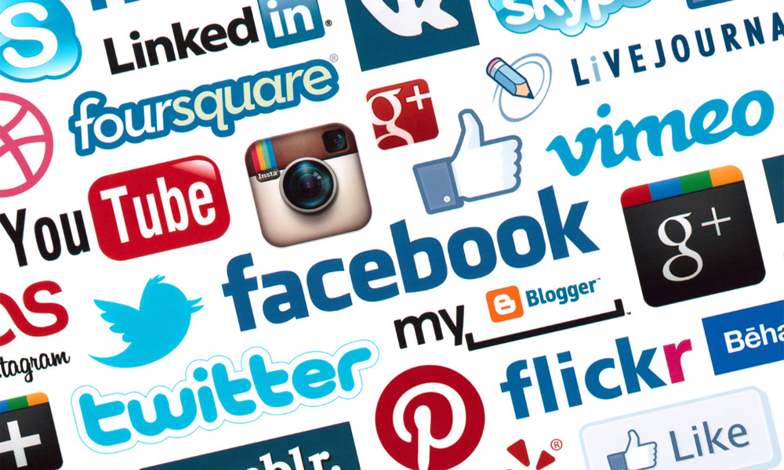
So dear, Our today’s topic is-----------
Unit - 13
Lesson -2
Page -168
Social network services

Slide 6
Learning Outcomes
By the end of this lesson, students will be able to--
a) tell the names of social network services,
b) use social network services,
c) describe the advantages of social network
services.

Slide 7
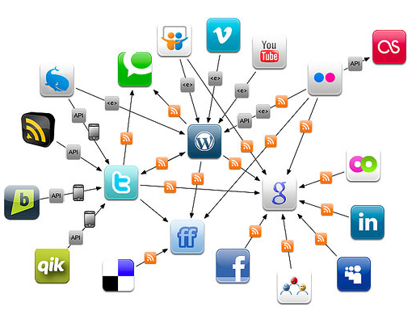
But
What is social network service?
A social networking service is a platform to build social networks or social relations among people who share interests, activities, ideas , views of real-life connections.

Slide 8
Names of some popular social network services.
Facebook is the most popular social media site. The founder of Facebook is Mark Zuckerberg. It is founded on February 4, 2004. Today, this social networking site has more than 60 million active members.

Slide 9
Twitter is founded on March 21, 2006. Its founders are Evan Williams, Jack Dorsey, Noah Glass. Twitter has more than 500 million users, out of which more than 302 million are active users.

Slide 10
Google+ launched in June 2011 as a social network. It is owned and operated by Google Inc.
LinkedIn is a business-oriented social networking service founded in December 2002 and launched on May 5, 2003. On March 2015, LinkedIn reports more than 364 million acquired users in more than 200 countries.

Slide 11
YouTube launched in May 2005. It allows billions of people to discover, watch and share originally-created videos.
With Skype, you can hold meeting , share a story, celebrate party, learn a language, work with colleagues – just about anything you need to do together every day. It is founded in 2003. Skype is a division of Microsoft Corp.

Slide 12
Read the text and answer the following questions
The internet technology has helped design a large number of web sites to facilitate social relations among people around the world. These arc known as social networking services or social networks or social media. At present, Face-book is the most popular social media site. Google+, Twitter, LinkedIn, etc. are other frequently used social services. Social network services are web-based and hence, provide ways for the users to interact through the Internet. These services make it possible to connect people sharing interests and activities across the borders and thus have made the users feel that they really live in a global village.

Slide 13
These services make it possible to connect people sharing interests and activities across the borders and thus have made the users feel that they really live in a global village.
Why are social networks expanding so fast? The answer is simple. Most of the social services are cost-free. You can make use of them free, paying a very little to your Internet service provider. Secondly, you can make your personal profile public before the entire online community. It is like presenting yourself before the entire world. You can also look into other people's profile if you are interested. It is simple and easy.

Slide 14
Thirdly, social networks allow users to upload pictures, multimedia contents and modify the profile. Some services like Facebook allow users to update their profiles. Fourthly, networks allow users to post blog entries. User profiles have a section dedicated to comments from friends and other users. Finally, there are privacy protection measures too. A user himself or herself decides over the number of visitors/viewers, and what information should be shared with others.

Slide 15
Advantages of social network services
To connect people sharing interests and activities over the world.
Most of the social service are cost free or low cost.
Users can make their profile public.
Social networks allow users to upload pictures, multimedia contents.
Users can maintain privacy and update their profile.

Slide 16
Answer the following questions
What do you understand by social networks?
What are some uses of social networks?
These services ...have made the users feel that they really live in a global village'. Do you agree with this view? Why/ Why not?
Make a list of the arguments as to why social networks are expanding so fast. Why do you think this is happening?

Slide 17
Match your answer
Q : 4. Make a list of the arguments as to why social networks are expanding so fast. Why do you think this is happening?
Q: 1. What do you understand by social networks?
Q : 3.These services ...have made the users feel that they really live in a global village'. Do you agree with this view? Why/ Why not?
Q :2. What are some uses of social networks?
Ans: Social networks are expanding so fast because-
They are cost free or low cost,
Users can make profile public and update profile,
Users can share interests and activities over the world,
Social networks allow users to upload pictures, multimedia contents and viewers can comment on profile,
There are also privacy protection measures.
My view: If more facilities are added in future, their demand will be increased.
Ans: Yes, I agree with the view as social networks help people to connect sharing interests and activities across the borders and to feel that they are really living in a global village or they are global citizen.
Ans: Social networks help people to interact through internet to share interests and activities over the world.
Ans: Social networks refer to a system that help people to establish communication among the people around the world.

Slide 18
Look at the following table adapted from Wikipedia. It shows some data on worldwide use of social networks.
Social Networks | Individual users | Percentage (%) of popularity | Regions covered
Facebook | 792,999,000 | 55.1 % | worldwide
Google+ | 250,000,000 | 17.7 % | worldwide
Twitter | 167,903,000 | 11.7 % | worldwide
Linkedln | 94,823,000 | 6.6 % | Asia and Europe
MySpacc | 61,037,000 | 4.2 % | USA and Canada
Others | 255,539,000 | 17.8 %
Total | 1,438,877,000 | 100%

Slide 19
Now complete the following dialogues about Faccbook and MySpace, and provide your own questions and answers on the rest of the social networks in the table. Act them out in pairs.
Social Networks | Individual users | (%) of popularity | Regions covered
Facebook | 792,999,000 | 55.1 % | worldwide
Google+ | 250,000,000 | 17.7 % | worldwide
Twitter | 167,903,000 | 11.7 % | worldwide
Linkedln | 94,823,000 | 6.6 % | Asia and Europe
MySpacc | 61,037,000 | 4.2 % | USA and Canada
Others | 255,539,000 | 17.8 %
Total | 1,438,877,000 | 100%
S1
S2
Q: Which social network is the most popular ?
Q: How many individual users use MySpace
Q: Which is the least popular ?
Q: Which part of the world is Faccbook mostly used in?
Q: How many individual users use Faccbook?
A: MySpacc is the least popular.
A : About 793 million.
A: 61 million individual users use Myspace.
A: It is popular worldwide among individual users.
A : Facebook is the most popular social network.

Slide 20
Evaluation
What do you mean by social networks?
Where can you make personal profile?
What do social networking services offer for the users
Why do you think social networks are expanding so fast?

Slide 21
Home Work
"Social networking has not only positive impact but also has negative impact on the society." Do you agree about it ? Why or why not ?

Slide 22
Thank you all

