Slide 1
Welcome

Slide 2
Starter
Md. Shahidul Alom
Assistant Teacher in English
Rajar Gaon High School
Sylhet Sadar, Sylhet 3100
Mob: 01715 720 745
Email: msagainer@gmail.com
Fb: msamartyr

Slide 3
Information of the class
Class: IX-X
Subject: English II
Time: 45 Minutes
Date: 01.08.2020

Slide 4
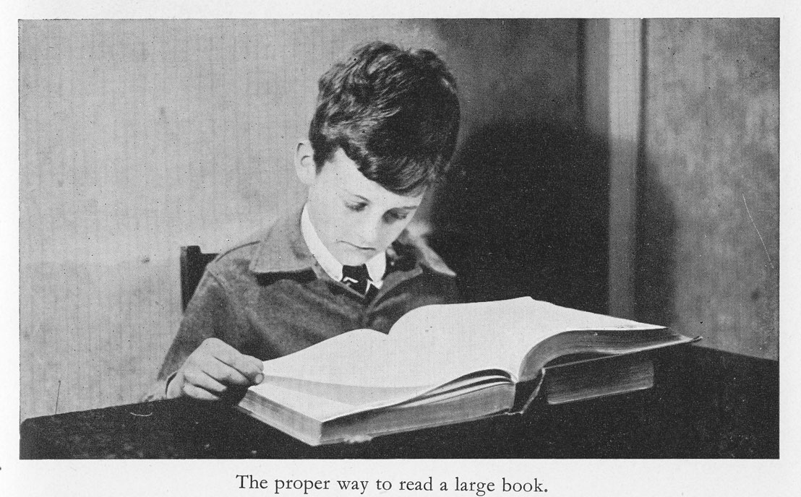
Look at the picture
Action
Action
Can you guess our lesson title

Slide 5
Our Topic is on
Right Form of The Verb
Part: I

Slide 6
Lesson Plan
SL NO | STEPS | ACTIVITIES | TIME | AIDS
1 | Preparation | Exchange greetings ,seating arrangement & drawing attention | 5 mnts | MB/Mm
2 | Outcomes -1 | Taking to the lesson by ask and answering | 05 mnts | MB/Mm
3 | Outcomes -2 | Discussion on Rules 1 | 10 mnts | MB/Mm
4 | Individual Task | Answering gap filling | 05 mnts | Note/Mm
5 | Outcomes 4 | Discussion on Rules II | 10 mnts | MB/Mm
6 | Group Task | Answering gap filling | 05 | MB/Mm
5 | Evaluation |  | 03 mnts | MB/Mm
6 | Homework | Meet a freedom fighter in your locality, interview him/her .Then write a paragraph | 01 | MB/Mm
7 | Ending | Giving thanks | 1 mnts | Mm
MB= Marker and Board, Mm= multimedia

Slide 7
Learning outcome
use the correct form of the verbs
write and say correct sentences using correct verbs.

Slide 8
Rule: 01: Present verb ৬ টি স্থানে বসে।
i. To এর পরে present verb হয়।
a. Mother advised me to go to school.
ii. Do , does, did এর পরে present verb হয়।
a. They don’t play football.

Slide 9
iii. Modal Auxiliary এর পরে present verb হয়।
a. Everybody should love his country.
iv. imperative sentence এর পরে present verb হয়।
a. Let’s go for a walk.

Slide 10
v. Present indefinite tese এ present verb হয়।
a. He reads regularly.
vi. Would rather, had better এর পরে present verb হয়।
a. I would rather die than beg.
b. You have rather leave the place.

Slide 11
Individual Work
Write the right form of the verb in the gaps.
Father asked me to___________ to school.
We should ____________our native.
c. She ______________Quran daily
Answer
a. go b. Love c. reads

Slide 12
Rule: 02: Past participle verb 4 টি স্থানে বসে।
i. Have , has, had এর পর past participle হয়।
a. I have bought a mobile phone.
ii. To + Be এর পর past participle হয়।
a. the examination system has to be changed.

Slide 13
iii. Modal auxiliary+be এর পর past participle হয়। (Without Shall/will)
a. our duty should be performed timely.
iv. Ing+verb এর পর past participle হয়।
a. They were being paid their honour.

Slide 14
Rule: 03: Present participle verb 3 টি স্থানে বসে।
i. Be verb (am, is are, was , were, be) এর পর present participle হয়।
a. we will be talking to our glory.
ii. একই বাক্যে দুটি মূল verb থাকলে যেকোন একটির সাথে present participle হয়।
I saw a bird flying in the sky.
b. Teacher advised him studying regularly.
iii. prepostion এর পর present participle হয়।
a. i shall go to college after eating.
b. He is fond of playing cricket.

Slide 15
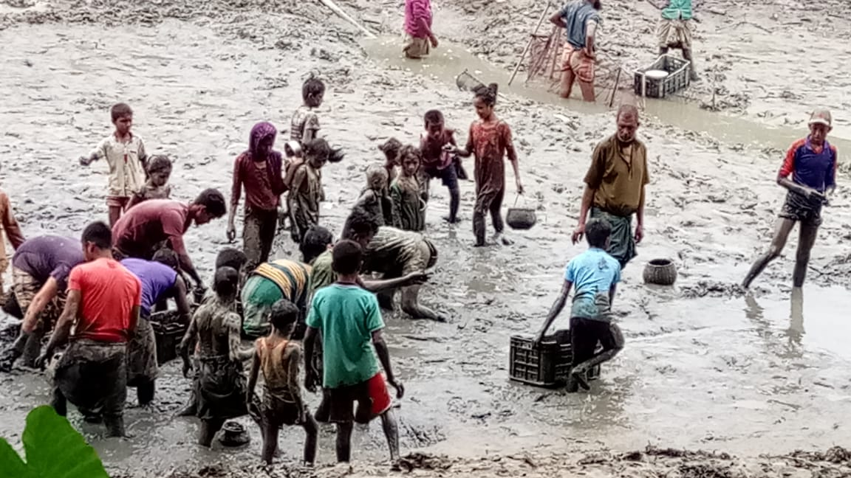
Group Work
Write the right form of the verb in the gaps.
I saw a bird ________in the sky.
I have ________a mobile phone.
They were being___________ their honour.
Answer
a. Flying b. bought c. paid

Slide 16
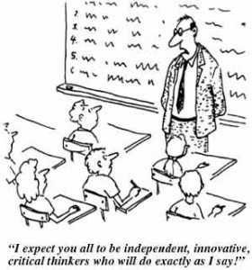
Evaluation
Match your answer
the examination system has to be_________.
They don’t _________football.
You have rather __________ the place.
changed
play
leave

Slide 17
Home Work
Practice a lot at home

Slide 18
Thank You

