Slide 1
Welcome

Slide 2
Introduction
Md. Babar ali
B.Com.M.Com(Accounting),B.Ed(1st)
Assistant Teacher
(Business Studies)
Dighulia Shahid Mizanur Rahman High School,Tangail.
E-mail: mdbabarali16061982@gmail.com
Mobile: 01719993636
Class : Eight
Subject : English 1st Paper
Unit : Nine
Lesson : 06

Slide 3
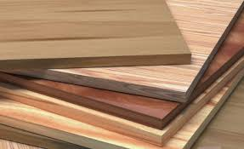
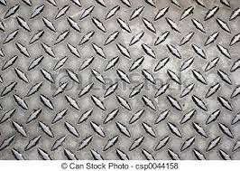
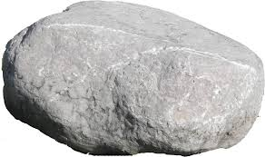
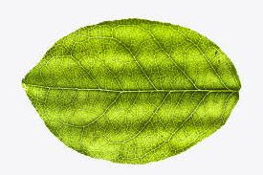
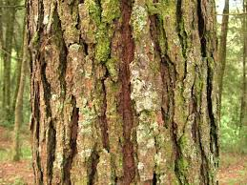
Look at the pictures and say about them
Wood
Metal
Stone
Bark
Leaf

Slide 4
Announcing the class
Today our class is……….
Paper has advanced our Life

Slide 5
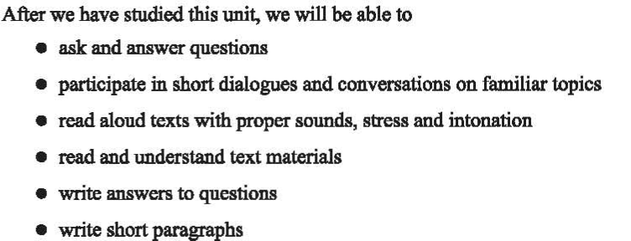
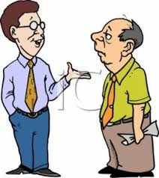
Learning outcomes

Slide 6
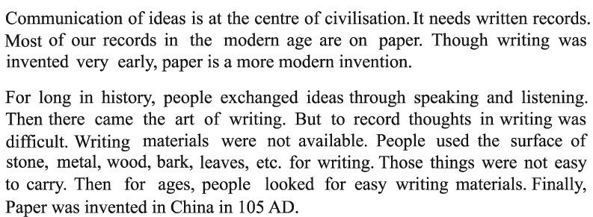
Presentation
Read the following passage and answer the questions
China City

Slide 7
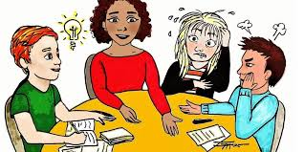
Group Work
Read the text again then fill up the following gape

Slide 8
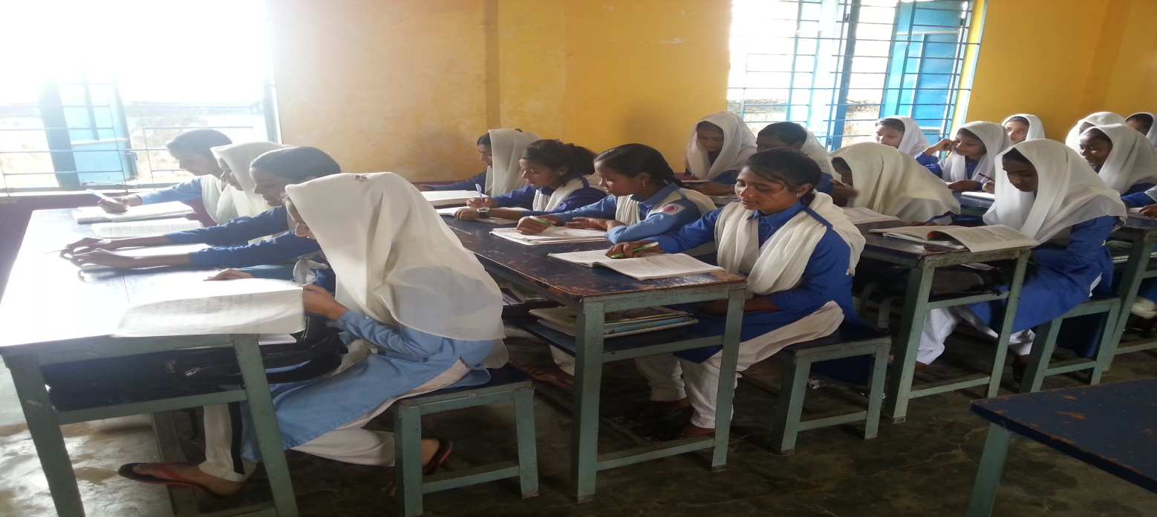
Individual Work
Read the passage again then write a paragraph

Slide 9
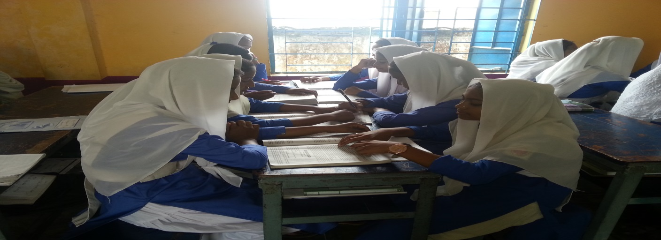
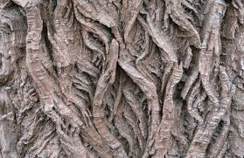
Pair Work
Look at the pictures then answer the questions

Slide 10
Evaluation
Who did invent paper first?
How did people transfer their ideas?
Why was knowledge restricted before paper age?

Slide 11
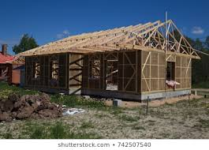
Home Work
Write a short paragraph about communication

Slide 12
Thank You
Thank You For all
To day is the End

