Slide 2
WELCOME

Slide 3
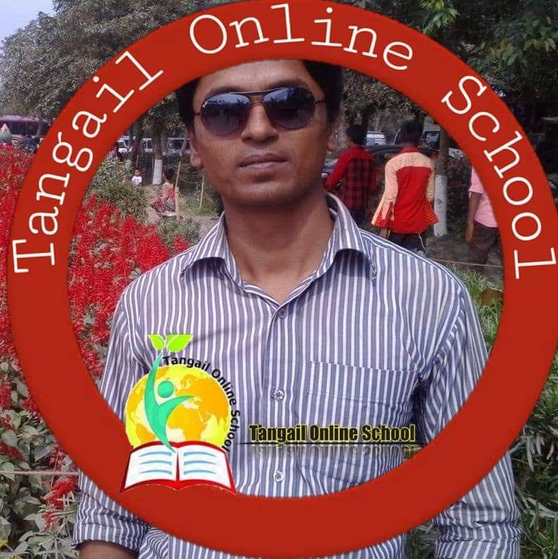
INTRODUCTION
Md. Babar Ali
Assistant Teacher
Dighulia Shahid Mizanur Rahman High School,Tangail.

Slide 4
Which one is the most important thing in our life?
1. Money
2.Education
3.Health
4.Good job

Slide 5
So our Today’s Lesson is
Health

Slide 6
Class Introduction
Class:Eight
Subject: English For Today
Unit:Three
Lesson:One
Time:40 minutes

Slide 7
Learning outcome
By the end of the lesson -
The students will be able to-
talk about the picture.
read the passage.
answer the questions.
choose the right answer from the the alternative objectives.

Slide 8
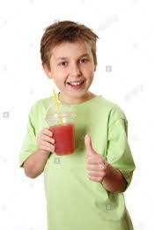
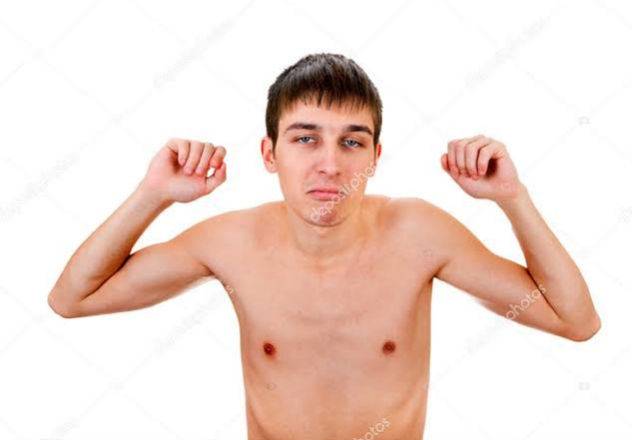
A.Look at and talk about the pictures .Then ask and answer the following questions.
1. Which boy looks healthy?
2. Which boy is unhealthy?
3. Can you guess why they are so?

Slide 9
B. Read the question first then read the text and answer the following questions.
1. Why is good health essential for us?
Ans: Good health is essential for us to lead a happy life.
2. Why is physical exercise necessary?
Ans: physical exercise is necessary for us for sound health.

Slide 10
C. Read the text in B silently and then choose the best answer.
1. Health means the condition of
a.our body
b.our mind
c.our body and mind
d.our environment

Slide 11
2. Healthy person is one who
a. He is physically and mentally sound
b. eats good food.
c.has a lot of wealth
d.is overweight.

Slide 12
3.We need to eat
a. rich food
b. balanced food
c. little food
d. lot of food

Slide 13
4. The phrase'to keep late hours' means-
a. go to bed late.
b. to wake up late in the morning.
c. to do things late always.
d. to be late for the class.

Slide 14
D. Write a short paragraph about how we can maintain good health. Your paragraph should not be more than 50 words.

Slide 15
h
HOME WORK
Write five things that you do everyday to keep yourself healthy and happy.

Slide 16
Wishing
the best luck for everybody.
See you again.

