Slide 1
Dear Students
Notes:
Greeting the students.

Slide 2
Identity
Md. Jakirul Islam
BA (Hons’), MA in English, B.Ed, LL.B
Assistant Teacher of English
Shaitshala Adarsha High School & College
Brahmanpara, Cumilla.
Contact- jakir.oy@gmail.com (01811285175)
Notes:
Introducing the teacher & Subject-Lesson.

Slide 3
Class Identity
Class- IX
Subject- Grammar
English 2nd Paper
Unit- 2
Time- 45 min
Notes:
Introducing the teacher & Subject-Lesson.

Slide 4
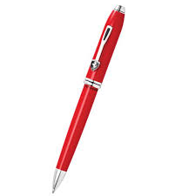
What is the name of the thing?
Noun
pen
Article
A pen
Possessive
My pen
Demonstrative
This pen
Quantifier
One pen
Article, Possessive, Demonstrative & Quantifier
are the Determiners of Noun.
Notes:
Preparation for the lesson.

Slide 5
Today’s lesson is on
Can you tell today’s lesson?
Determiners
Notes:
Declaration of the lesson.

Slide 6
Learning Outcomes
By the end of the lesson, students will be able
To define determiner.
To use determiners in noun phrase.
To classify determiners.
Notes:
Proclamation of learning outcomes.

Slide 7
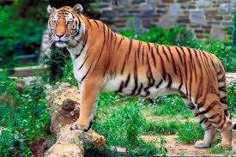
A tiger is an animal.
Noun Phrase
Noun Phrase
The tiger is the king of jungle.
Noun Phrase
Noun Phrase
Article- a, an, the sit before noun to modify the noun.
Articles are the Determiner of Noun.
Determiners are words which are used before nouns
to clarify the noun.
Notes:
Demonstration of Articles as determiner and the definition of determiner.

Slide 8
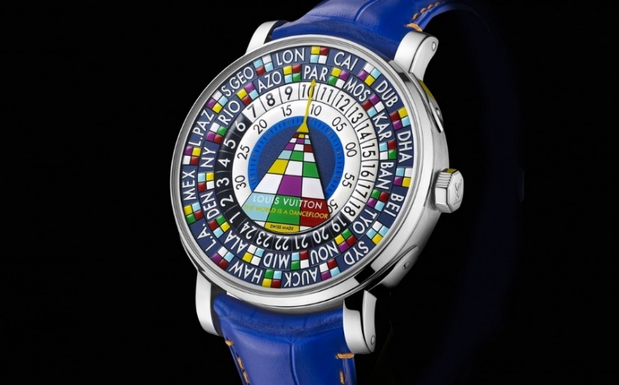
My pen is your choice.
Noun Phrase
Noun Phrase
Our house is bigger than their house.
Noun Phrase
Noun Phrase
Possessives- my, our, your, his, her, their, its, ones
sit before noun to modify the noun.
9 Possessives are the Determiner of Noun.
Notes:
Demonstration of Possessives as determiner.

Slide 9
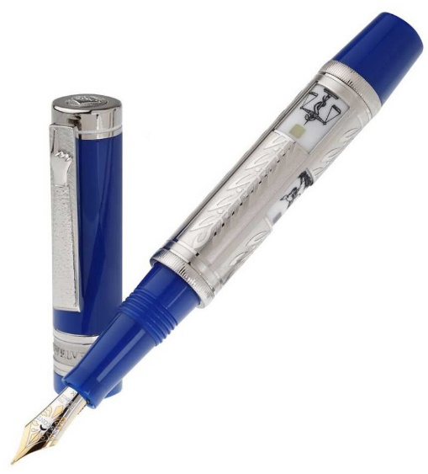
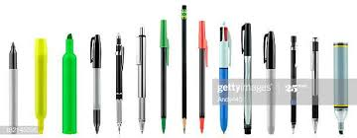
This pen is very costly.
Noun Phrase
These pens are not costly.
Noun Phrase
Demonstratives- this, these, that, those
sit before noun to modify the noun.
Demonstratives are the Determiner of Noun.
Notes:
Demonstration of Demonstratives as determiner.

Slide 10
That book is a novel.
Noun Phrase
Those books have been bought.
Noun Phrase
This- near thing (singular), these- near things (plural)
That- near thing (singular), those- near things (plural)
Four Demonstratives
Notes:
Demonstration of Demonstratives as determiner.

Slide 11
This pen is very costly.
Noun Phrase
The word ‘This’- sits before noun. Here ‘This’- Determiner.
This is a very costly pen.
Preposition
The word ‘This’- sits alone as a Subject. Here ‘This’- Pronoun.
Notes:
The difference Between Demonstrative Determiner & Demonstrative Pronoun.

Slide 12
Pair Work
5 minutes
Make a list of (1) Possessives
(2) Determiners
Notes:
Arrangement for Pair Work. Monitoring the given work.

Slide 13
Determiners
Possessives
My, our, your, his, her, its, ones, their
Determiners
This, these, that, those
Notes:
Solution of Pair Work.

Slide 14
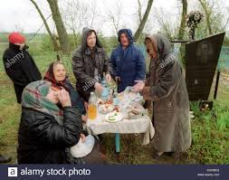
Many houses remain in one village.
Noun Phrase
Noun Phrase
Few people live in some villages.
Noun Phrase
Noun Phrase
Quantifiers- many, one, few, some
sit before noun to modify the noun.
Quantifiers are the Determiner of Noun.
Notes:
Demonstration of Quantifiers as determiner.

Slide 15
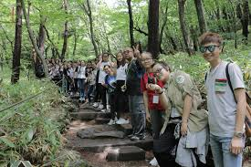
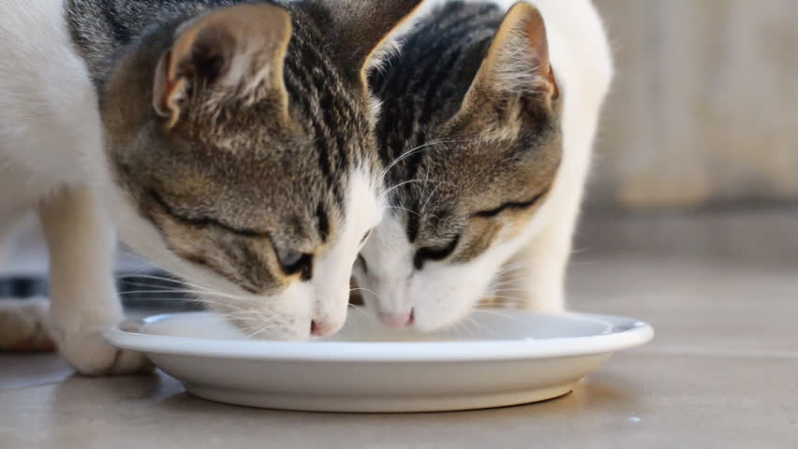
A lot of students enjoyed much time.
Noun Phrase
Noun Phrase
Two cats are drinking little water.
Noun Phrase
Noun Phrase
Quantifiers- a lot of, much, two, little
sit before noun to modify the noun.
Quantifiers are the Determiner of Noun.
Notes:
Demonstration of Quantifiers as determiner.

Slide 16
Determiners
All, both, half, some, either, neither,
every, each, any, no, much, more, most,
one, two, three etc.
Quantifiers
Notes:
The list of quantifiers.

Slide 17
Determiners are of four kinds.
Articles
Possessives
Demonstratives
Quantifiers
Notes:
Classification of Determiners.

Slide 18
Determiners
Articles
A, an, the
Possessives
My, our, your, his, her, its, ones, their
Determiners
This, these, that, those
All, both, half, some, either, neither,
every, each, any, no, much, more, most,
one, two, three etc.
Quantifiers
Notes:
The full list of Determiners.

Slide 19
Group Work
8 minutes
Write down the full list of Determiners.
Notes:
Arrangement for Pair Work. Monitoring the given work.

Slide 20
Evaluation
3 minutes
How many kinds of determiners are there?
1. Four kinds
2. How many demonstratives are there?
2. Four
3. How many possessives are there?
3. Nine
4. What kind of noun is ‘all’?
4. Quantifier
5. What kind of noun is ‘my’?
5. Possessive
Notes:
Evaluation about today’s learning.

Slide 21
Write down 15 sentences
using with Quantifiers.
Notes:
Giving Home Work.

Slide 22
Thank you all
for enjoying
the class.
Notes:
Ending the class.

