Slide 1

Welcome

Slide 2

Introduction
                Md. Jakirul Islam
                BA (Hons’), MA in English, B.Ed, LL.B
                Assistant Teacher of English
                Shaitshala Adardha High School & College
                Brahmanpara, Comilla
                Subject: English 2nd Paper
                Grammar

Slide 3
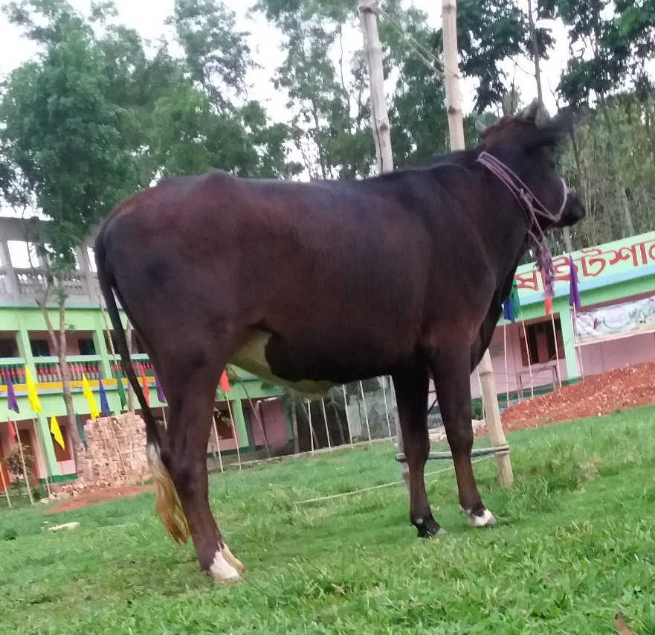
Let us make some sentences with cow.
The cow is a domestic animal.
It has four legs and a long tail.
It gives us milk.
We like it very much.
Verb
What are these words inside the waving boxes?

Slide 4
So, today’s topic is
‘Verb’ in Tense

Slide 5
By the end of the lesson, students will be able…
To know few forms of verb.
To use different forms of verb in tense.
To differentiate tense.

Slide 6


He works in the office.
Present Form
of Verb
We read books everyday.
The above sentences mean our daily activities.
So, The sentences express:
Present Indefinite Tense

Slide 7


The sun rises in the east.
Present Indefinite Tense
= Present Form of Verb
The moon shines at night.
The above sentences mean universal truth.
So, The sentences express:
Present Indefinite Tense

Slide 8
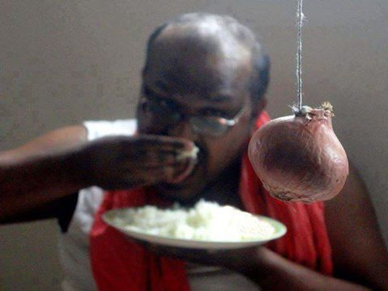
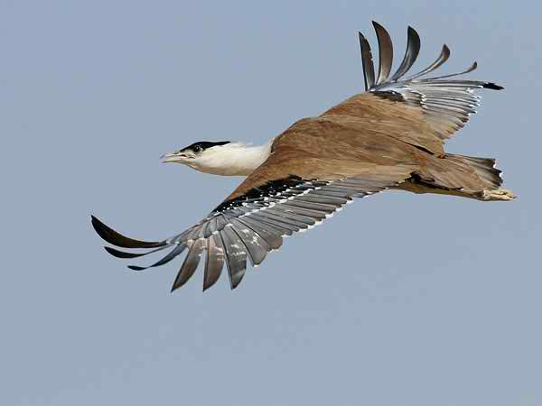
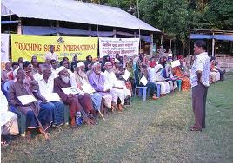
He eats rice.
Subject 3rd Person Singular Number.
So, Verb takes ‘s’ at the end of it.
The bird flies in the sky.
Subject 3rd Person Singular Number.
So, Verb takes ‘es’ at the end of it.
The people listen to the man.
Subject 3rd Person Plural Number.
So, No ‘s/es’ at the end of the verb.

Slide 9
He eats rice.
What is the difference Between the verbs in the box and those in the oval?
He ate rice.
The bird flies in the sky.
The bird flew in the sky.
The people listen to the man.
The people listened to the man.

Slide 10
He eats rice.
eats
ate
He ate rice.
Past Form of Verb
Present Form of Verb
The bird flies in the sky.
The bird flew in the sky.
flies
flew
Present Form of Verb
Past Form of Verb
The people listen to the man.
listen
listened
The people listened to the man.
Every First Verb is Present Form & Every Last Verb is Past Form

Slide 11
He ate rice.
The bird flew in the sky.
The people listened to the man.
These Verbs are in Past Form expressing actions
done in the past.
Past Indefinite Tense = Past Form of Verb

Slide 12

Pair Work: Make Past Form from the Base Form of the Verbs.
5
min
Base/Present | Past Form
Break
Choose
Drive
Steal
Take
Write
Wear
am/is/are
Do
Base/Present | Past Form
Eat
Go
See
Hide
Fall
Give
Come
Drink
Begin
broke
ate
chose
went
drove
saw
stole
hid
took
fell
wrote
gave
wore
came
was/were
drank
did
began

Slide 13
I listen to my teachers.
listen
Present Form
I listened to my teachers.
listened
Past Form
I shall listen to my teachers.
shall listen
shall+Base Form
He eats rice.
eats
Present Form
He ate rice.
ate
Past Form
He will eat rice.
will eat
will+Base Form

Slide 14
I shall listen to my teachers.
He will eat rice.
These Verbs are expressing actions to be done in future.
Future Indefinite Tense = Past Form of Verb

Slide 15
Present Indefinite Tense = Subject + Present Form of Verb + Extension.
Past Indefinite Tense = Subject + Past Form of Verb + Extension.
Future Indefinite Tense = Subject + shall/will + Base Form of Verb + Extension.
So, we can learn these structures in brief:
Present Indefinite = Present Form
Past Indefinite = Past Form
Future Indefinite = shall/will + Base Form

Slide 16

Group Work
10 minutes
Make the following sentences in Past Indefinite Tense &
Future Indefinite Tense
1. We eat food everyday.
2. They play cricket in the afternoon.
3. The fisherman catches fish in the river.
4. Mother cooks food for us.
5. Father takes care of me.
5. Two and two makes four.
6. We learn English for communicating with the world.
7. The baby drinks milk everyday.
8. They read books attentively.
9. I want to see the zoo.
10. Everybody likes flowers.

Slide 17
Evaluation
3 minutes
Fill in the gaps of the following sentences with the right form of the verb from the options.
1. We …(eat/eats) food everyday.
1. eat
2. He …(eats/ate) a pine-apple yestersy.
2. ate
3. They wil … (goes/go) home now.
3. go
4. Moni usually… (came/comes) here.
4. comes
5. The earth … (move/moves) the sun.
5. moves
6. I shall … (meet/met) you soon.
6. meet

Slide 18

Write down Base Form/Present Form and Past Form ( 50 strong Verbs )

Slide 19

Thanks
To All

