Slide 1
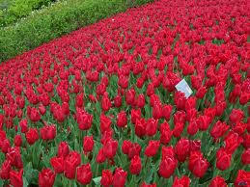
WELCOME TO ALL STUDENTS

Slide 2
Teacher Identification
MD. Aowalul Islam
Assistant Teacher
Panchurchak High School
Joypurhat Sadar.
Email: aowalulislam@gmail.com
English for today
Class – Eight

Slide 3
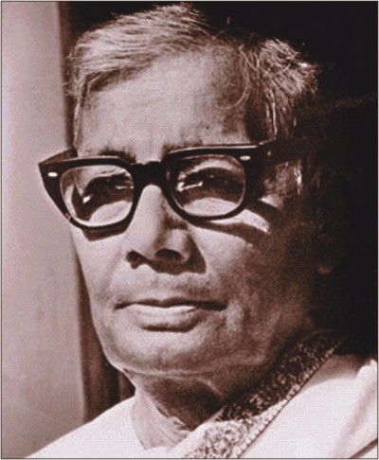
Do you know him?
Jasimuddin (1903-1976)

Slide 4
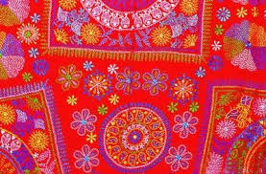
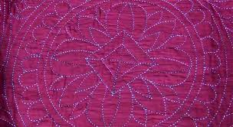
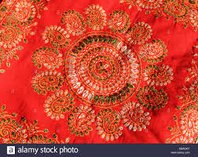
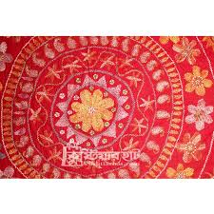
Look at the pictures
Can you tell about the pictures ?
Nakshi kantha

Slide 5
Our Today’s lesson is--
Nakshi katha
Unit-1, Lesson-2

Slide 6
Learning Outcomes
By the end of the lesson, learners will be able to…
►tell new word meaning and read and understand text .
ask and answer questions
fill in the gaps
write a paragraph

Slide 7
We learned the meaning of some new word
English word | Bangla meaning
embroidered | নকশা
quilt | কাঁথা
artistic | শৈল্পিক
pattern | কারুকাজ
traditional | ঐতিহ্যবাহী
craft | লোকশিল্প
indigenous | দেশীয়
art | শিল্প

Slide 8
We learned the meaning of some new word
word | Bangla meaning
handcraft | হস্তশিল্প
practiced | অনুশীলন
rural | গ্রাম বাংলা -পল্লী
Popular | জনপ্রিয়
famous | বিখ্যাত
produced | উৎপাদন
commercially | বাণ্যিজকভাবে
expensive | ব্যায়বহুল

Slide 9
Open the page at 3 of your text book and silent reading
Read the text
Nakshi kantha is a kind of embroidered quilt. The name was taken from the Bengali word, “naksha” which means artistic pattern. It is a kind of traditional craft and is said to be indigenous to Bangladesh and west Bengal in India.The art has been practiced in rural Bengal for centuries. The name “Nakshi kantha” become popular after the poet Jasimuddin`s poem Nakshi kathar math was published in 1929.
Traditional kantha s are made for family use.Old or new cloth and thread are used to make these quilts.Mymensingh, Jamalpur, Rajshahi, Faridpur, Bogra, and Jashore, are most famous for this craft. Now it is produced commercially. You can find them in many expensive handicraft shops in cities. The quilts are now great demand because of the colorful patterns and designs embroidered on them.

Slide 10
Choose the correct answer
(a) Nakshi kanthas are a kind of---
√ iii. embroidered quilt
i. quilt
ii. song
iii. embroidered quilt
iv. crop
b.The word `quilt means`--
√ iv. covering
i. coverlet
ii. covered
iii. cover
iv. covering
c The word `embroidered ` means –
√ iii. stitched
i. inflated
ii. inflation
iii. stitched
iv. understated

Slide 11
(d) The word `traditional` means—
√ iii. conventional
i. rule
ii. Custom
iii. conventional
iv. convention
(e) The word `Nakshi kantha` comes from a/an --- word.
i. Burmese
ii. Bengali
iii. Hindi
iv. English
√ ii. Bengali
(f) The term `indigenous`means –
i. indigestible
ii. Native
iii. famous
iv. wild
√ ii. Native
(g) The word `craft` means –
i. knack
ii. Property
iv. liability
√ i. knack
iii. asset

Slide 12
2. Answer the following questions from your reading of the above text.
a. What do you mean by Nakshi kantha?
Ans: Nakshi kantha means a kind of embroidered quilt.
b. Why is Nakshi kantha our tradition?
Ans: Nakshi kantha is our tradition because it is a kind of traditional craft and is said

Slide 13
c. Which districts are most popular for Nakshi kantha?
Ans: The districts of Mymensingh, Jamalpur, Rajshahi, Faridpur, Bogra, and Jashore are most popular for Nakshi kantha.
d. Why are the quilt now in great demand?
Ans: The quilts are now in great demand because of the colorful patterns and designs embroidered on them.

Slide 14
c. Which districts are most popular for Nakshi kantha?
Ans: The districts of Mymensingh, Jamalpur, Rajshahi, Faridpur, Bogr, and Jashore are most popular for Nakshi kantha.
d. Why are the quilt now in great demand?
Ans: The quilts are now in great demand because of the colorful patterns and designs embroidered on them.

Slide 15
3. Fill in the gaps with appropriate word from your reading of the above text.
Nakshi kantha is a kind of
(a)
embroidered
quilt. The name was
from the Bengli word, “Nakshi” which means
(b)
artistic
(d)
indigenous
It is a kind of
(c)
traditional
craft and is said to be
to Bangladesh and west Bengal in India. The art has been practiced in
rural
(e)
Bengal for centuries. The name “Nakshi kantha”
become popular after the poet Jasimuddin`s poem “Nakshi kathar math” was published in 1929.

Slide 16
Home work
Write a paragraph about Nakshi kantha

Slide 17
THANKS TO ALL

