Slide 1
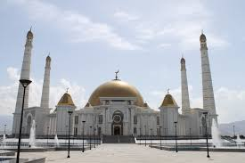
Name – Joyesree Chakrobortty
Asst. Teacher (English)
Charadi Union High School
Ranirhat, Bakergonj
ID - 1169
Subject – English 1^{s} paper
Class - Nine

Slide 2
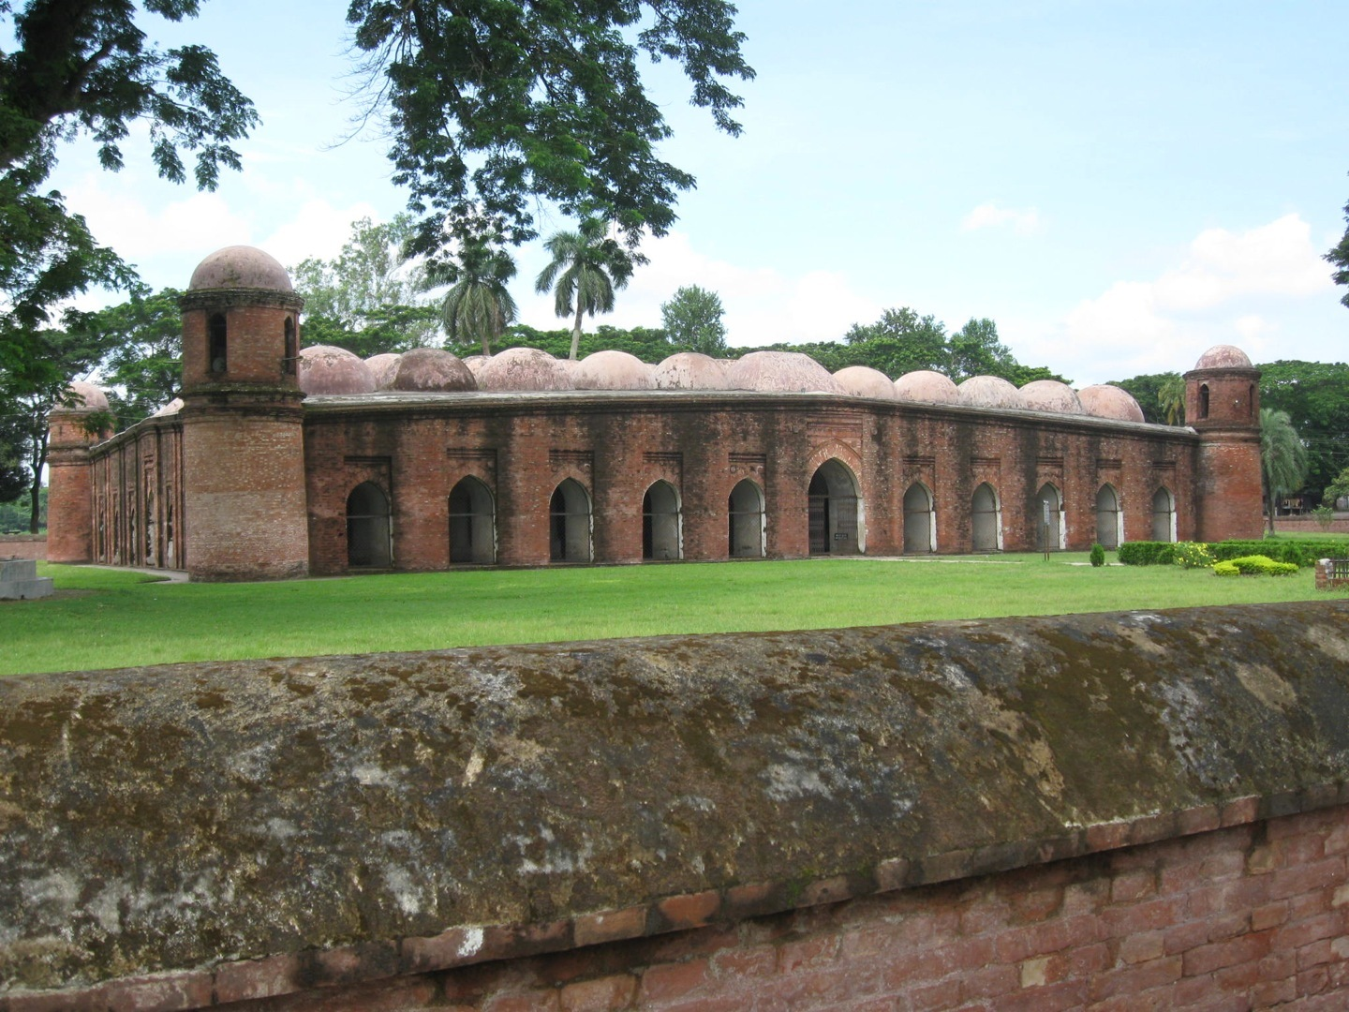
What do you see in the picture? Describe it.
This is the Shat Gombuj Mosque. It is one of the historical places of Bangladesh. It is also one of the world heritages.

Slide 3
Today our topic is
The Shat Gambuj Mosque
Unit- 8
Lesson- 1

Slide 4
Learning outcomes
After this lesson the students will be able to-
1. talk about a picture.
2. listen for specific information.
3. read and understand the text through silent reading.
4. write about a place.
5. infer the meaning from the text.

Slide 5
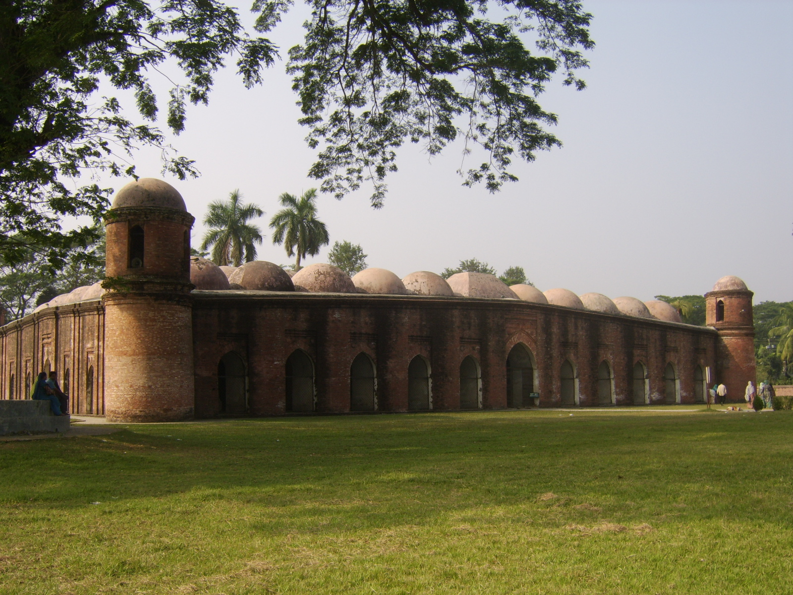
Have a look outside the mosque.
Four corners have 4 smaller domes
11 Arched doorways on east.

Slide 6
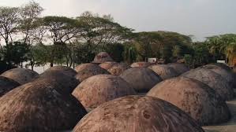
77 low hight dooms

Slide 7
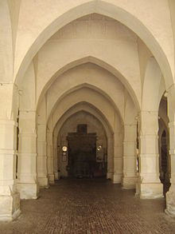
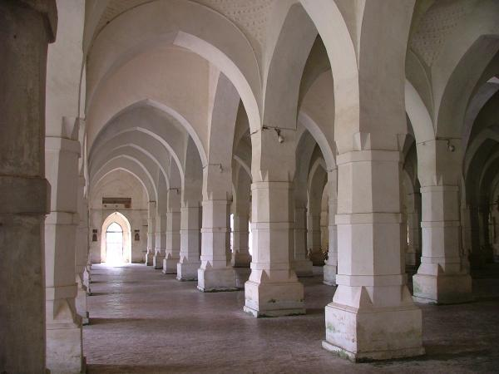
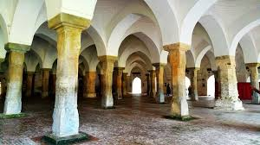
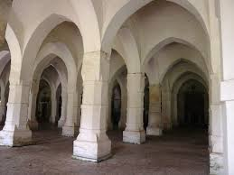
Let’s see inside of the mosque.

Slide 8
Let’s see a video about the topic
https://www.youtube.com/watch?v=YEm1wG5mQFo

Slide 9
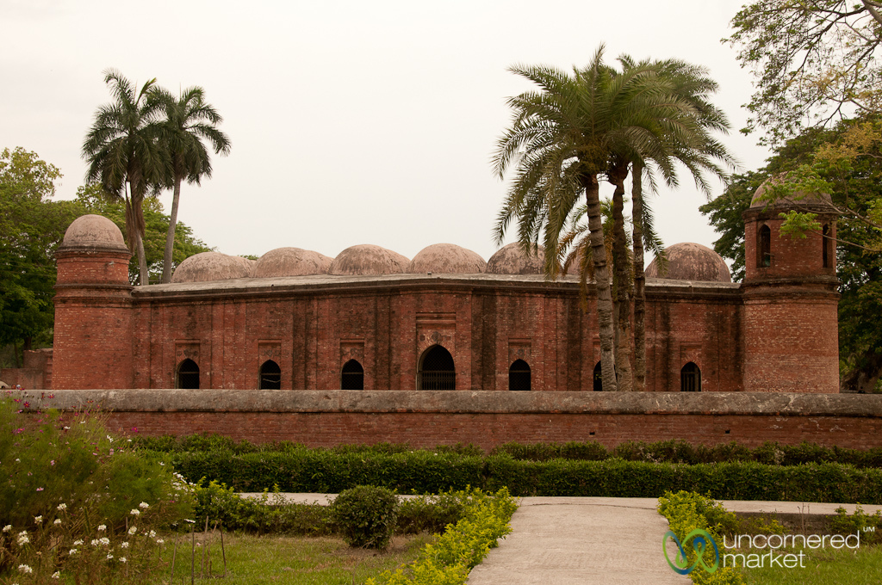
SILENT READING
Read the text silently at the page 38

Slide 10
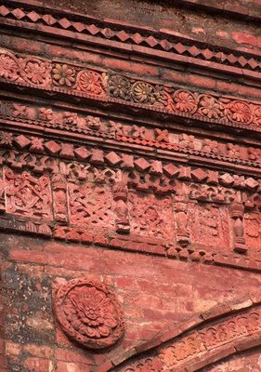
The interior western wall of the mosque is beautifully decorated with terracotta.

Slide 11
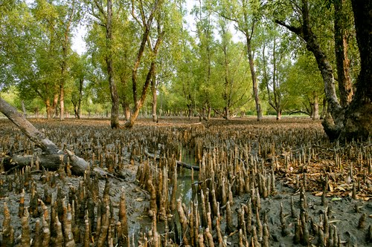
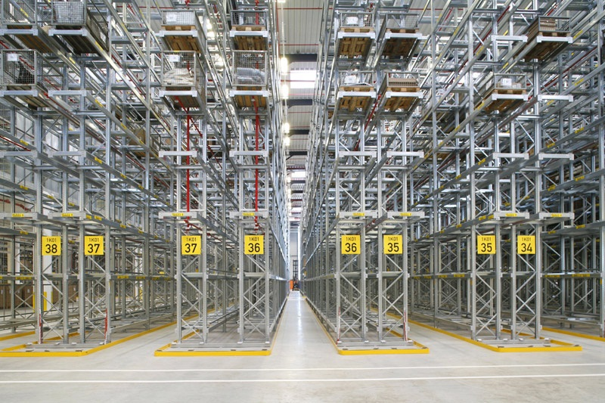
Key words
A tree or shrubs in wet mud at the edge of river.
Mangrove
Aisle
Path / corridor
We can see five aisles in the picture.

Slide 12
Read the text again and fill the table.( Pair work)
Who/What | Events/Activities | When/ Why
The Shat Gombuj Mosque | a)……………… | in 1985
It | was founded | b) ……………….
Khan Jahan Ali | c) ………………… | to fit the city to live in
The mosque | is unique | d) ……………
It | e) ………………… | for its architectural beauties.
a) became a UNESCO World Heritage site
b) in the 15th century
c) Built a networks of roads, bridges, public buildings and reservoirs
d) For its 60 pillars that support the roof with 77 low height domes.
e) Attracts the tourists

Slide 13
Read the text in the book and write the answers of the following questions.( Group work)
Why were there many doorways in the mosque?
B. For what purpose was the mosque used?

Slide 14
Evaluation

Slide 15
Home work
Do your area has such building like the Shat Gombuj Mosque or the Star Mosque? Write about that building. (Not more than 15 lines)

