Slide 1
welcome

Slide 2
Introduction
Amal Kanti Biswas
Instructor(English)
Kushtia Technical School & College, Kushtia
Class : X
English-2
Unit : 3 Lesson : 2

Slide 3
May Day

Slide 4
Learning outcomes
After you have studied this lesson, you will be able to-
talk about events and festivals.
ask and answer questions and give options in a logical sequence
infer meanings from the context.

Slide 5
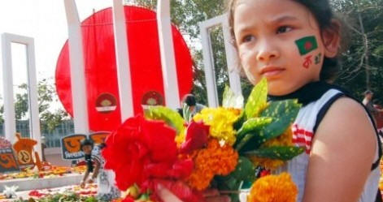
New words
Commemorate=
remember something ceremonially
A plaque commemorates the battle.

Slide 6
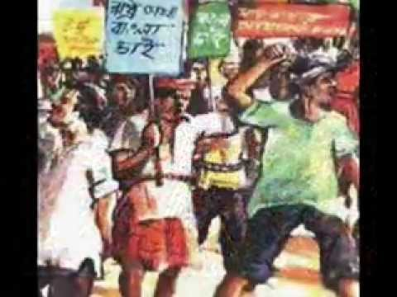
Sacrifice =
giving somebody or something valued
Her parents made sacrifice so that she could have a good education.

Slide 7
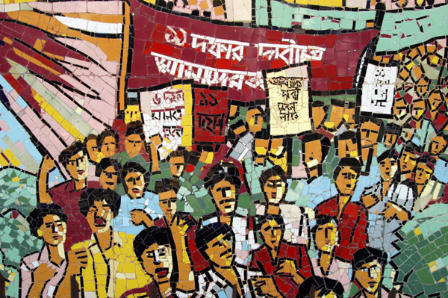
Rally =
a large public meeting
The students brought out a rally.

Slide 8
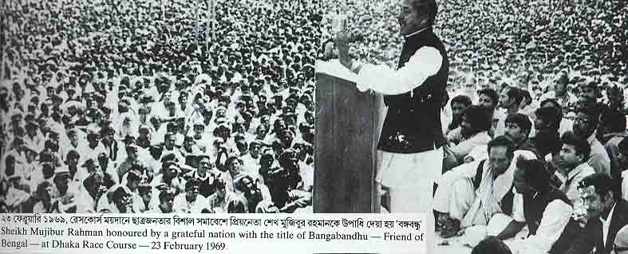
Address =
talk to
Sheikh Mujib addressed to the people as brothers and sisters.

Slide 9
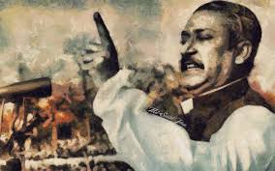
Talk about the picture.
What do you see in the picture?
Can you relate any historical event to this picture?
What happened on this day?

Slide 10
Read the text in your book and complete the following chart.
Time | What happened
1/5/1886
3/5/1886
18th and 19th century

Slide 11
Group work
Match the following words with their meaning
Words | Meaning
Relate | gathering
Observe | connect
Revolution | monitor
Striker | revolt
Rally | defender

Slide 12
Evaluation
What does May Day refer to?
How long did the workers have to work a day before the May 1 strike?
Why did the workers in Chicago go on a strike?

Slide 13
Home work
Write a paragraph on how you observed the May Day in your school this year.

Slide 14
Thanks

