Slide 1
Welcome

Slide 2
Amal Kanti Biswas
Instructor (English)
Kushtia Technical School & College
Class-IX Unit-1
Subject-English Lesson-1

Slide 3
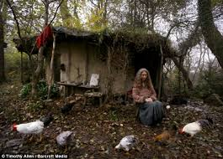
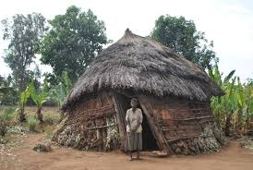
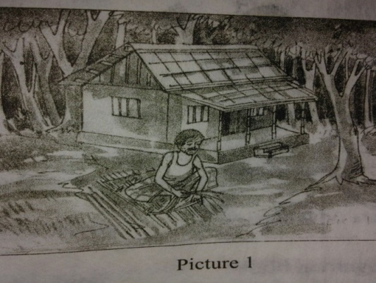
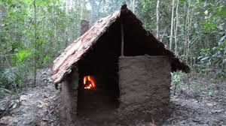

Slide 4
Good Citizens
Can anyone live alone?

Slide 5
Learning Outcomes
By the end of the lesson the students will able---
To narrate incidents
To participate in discussion
To listen and understand others
To describe something in writing

Slide 6
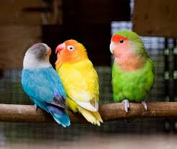
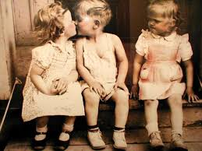
New Vocabs
Envy, rivalry
Jealousy=
Jealousy
is a part of everyday life.

Slide 7
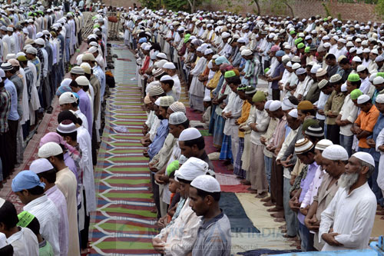
New Vocabs
Community =
a group of people living together, society, fellow people
Eid-ul-fitor is celebrated in a community

Slide 8
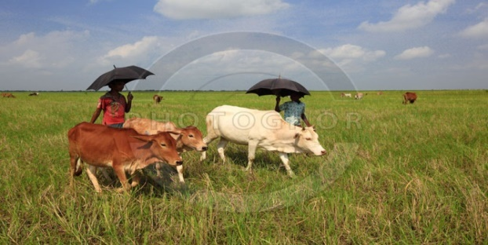
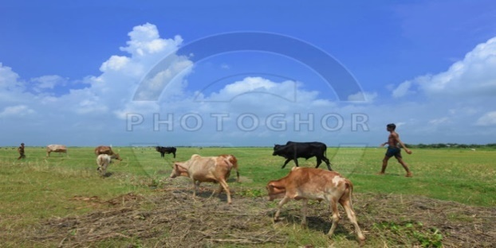
Cowboy =
a boy who tends cows
Cowboys
are tending their cows.

Slide 9
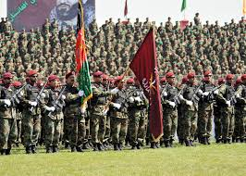
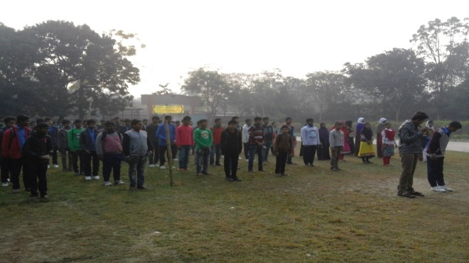
Orderly, in regular order
Sequentially =
Sequentially
the boys and girls are in lines.

Slide 10
Silent Reading
Five Minutes

Slide 11
The young man found life in the family full of -----
A. reach
Try again
B. happiness
Try again
C. problems
Correct
D. co-operation
Try again

Slide 12
He took a wife to -----
A. cut grass & hay
Try again
B. cook meals
Correct
C. cook rice
Try again
D. cook milk
Try again

Slide 13
Pair work
Complete the passage with suitable words.
man
Long ago a young____found life in the ______full of problems and_______.Quarrels, ill-feelings, ________, enmity - all were______of everyday life there. wwwwwo
village
sufferings
jealousy
part
9/28/2019

Slide 14
Evaluation
a) Where did the young man go?
Ans: The young man went to the jungle.
b) What did he make in the jungle?
Ans: He made a nice little hut in the jungle.
c) Where and how did he make a hut?
Ans: He made a nice little hut with wood, bamboo reeds in the jungle.

Slide 15
What problems did the young man find in his family
Ans : The young man found life in his family full of problems and sufferings as quarrels, ill-feelings, jealousy and enmity.
What is the moral of the story?
Ans: I learn that nobody can live without a society.

Slide 16
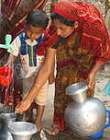
Home work
Write a paragraph about “Good Citizen”.

Slide 17
THANK YOU

